Slide 1
The game of TV-Tennis
Maxim Chernyshov, Timofey Khrapovitskiy, Artyom Solovyov

Slide 2
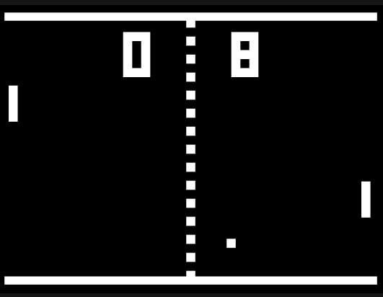
Game rules
The game consists of two bats and a ball which bounces off them. If a ball touches a wall, the player, whose bat is the opposite of that wall receives a point. The bats move only vertically, while the ball also can move left or right.

Slide 3
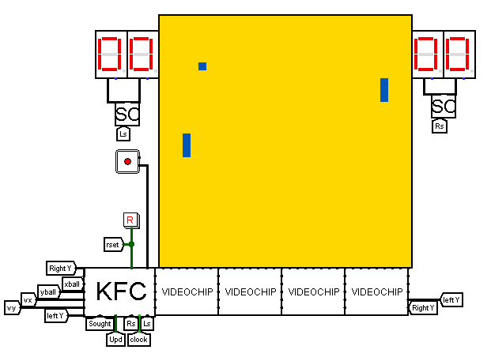
The display panel
The display panel consists of 1024 pixels (32x32). A ball is a pixel, and a racket is 3 pixels long and 1 pixel wide. Below the screen there are 32 videochips connected into 4 video sections, 8 videochips each. This video subsystem displays the bats, the ball and the background.

Slide 4

Controls
The player controls the left bat by moving the red part of the joystick. Only the Y axis of the joystick affects the bat. Speed of the bat is changed by how much the red “button” is deviated from the center. Speed changes from -3 to +3 in 10 ticks.

Slide 5
The video subsystem
Each videochip has an ID. The first ID is 0, then it increases with each videochip. Each videochip drives one column of the display panel. It checks if the ball is on it’s column and lights up if that is the case. Videochips 3 and 28 also display the bats. They light up pixels with the Y coordinates LeftbatY, LeftbatY+1, LeftbatY-1 in the column 3 and RightbatY, RightbatY+1, RightbatY-1 in the column 28. To check the the objects’ positions the videochip needs coordinates of the ball and Y coordinates of bats. They are represented as 5bit values from 0 to 31.

Slide 6
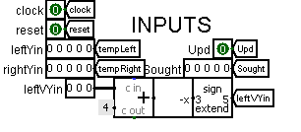
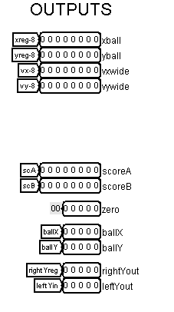
Kinematic controller
Kinematic controller has contacts for resetting the screen and clock generator.
It gets the Y coordinates of both bats – left from the joystick and right from the processor.
Kinematic controller returns coordinates and velocity of the ball to the processor. It also returns scores to the scores schemes and ball’s coordinates and Y coordinates of bats to the video subsystem. The first videochip in the video subsystem needs to have Chip ID of zero, so it receives an input from the kinematic controller that equals zero.

Slide 7
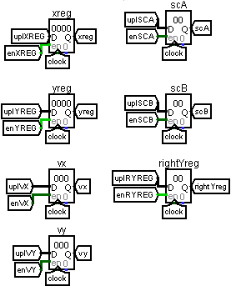
Kinematic controller
The kinematic controller updates coordinates of bats and ball. It also updates velocity. The velocity of a ball is reversed when it hits something.
These are registers: two for the ball’s coordinates (16-bit), two for the ball’s velocity (12-bit), two for the scores(8-bit) and one for the right bat Y coordinate(5 bit).

Slide 8
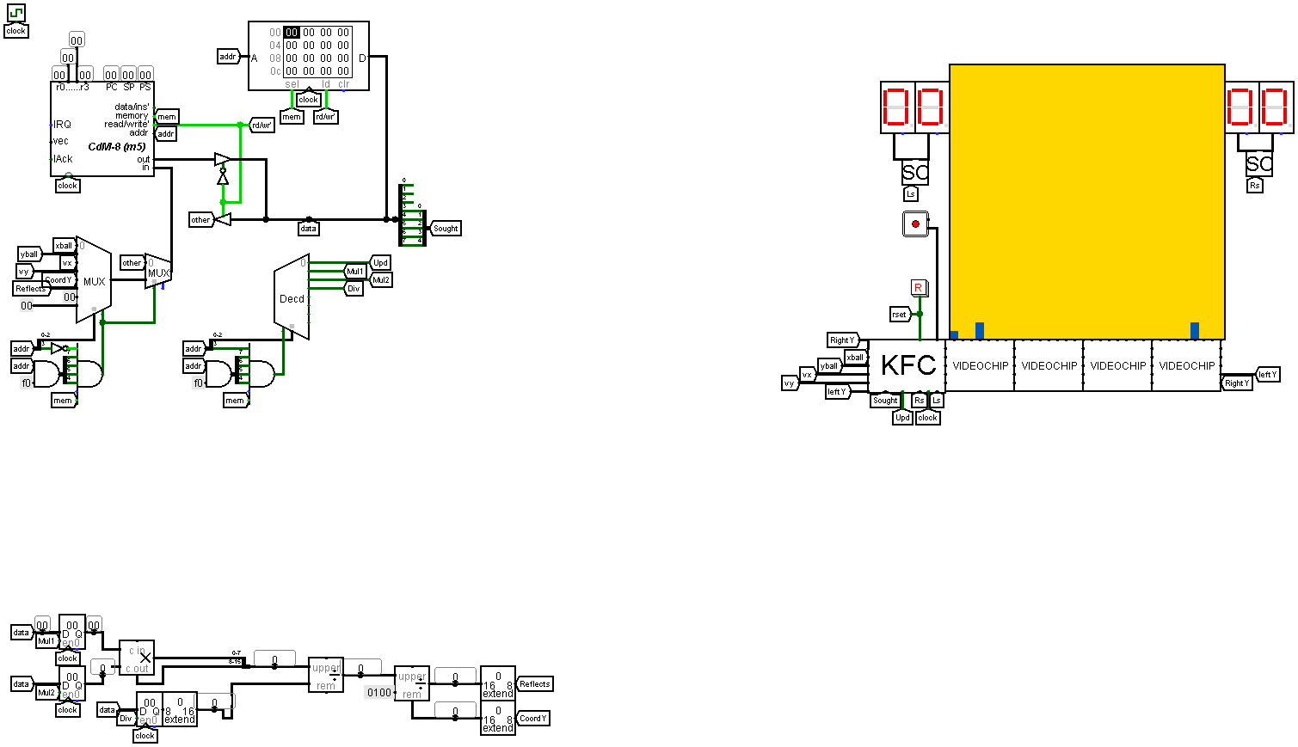
Artificial intelligence
Our opponent is controlled with AI. The processor receives coordinates and velocity of the ball and adjusts the position of the right bat to hit the ball when it returns back.

Slide 9
Artificial intelligence
We have a program for the processor which calculates what Y coordinate for the bat is optimal in order to deflect the ball. It checks if the X velocity of the ball is positive. If it is, then it calculates what Y is optimal for the bat.
It computes (227 – X coordinate of the ball) / (velocityX) , multiplies it by velocity by using the external calculator. If the velocityY is negative it subtracts the ball’s Y coordinate. Otherwise it adds the ball’s coordinate. Then it changes the sign of the number we have depended on parity of a number of times ball will reflect off a wall. We compute this number by counting carry bits.

Slide 11
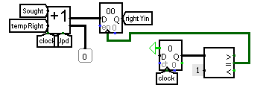
Moving the right bat
After getting the optimal Y coordinate for the right bat the kinematic controller moves it with a velocity of 2.5 display pixels per 10 ticks. The right bat can only move when the ball is in the left half of the display panel.

