Slide 1
The game of TV-Tennis
Maxim Chernyshov, Timofey Khrapovitskiy, Artyom Solovyov

Slide 2
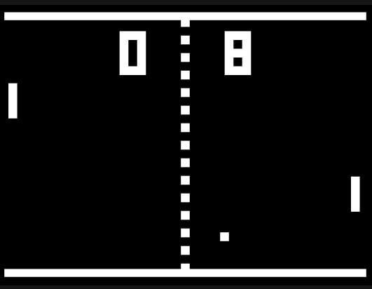
Game rules
The game consists of two bats and a ball which bounces off them. If a ball touches a wall, the player, whose bat is the opposite of that wall receives a point. The bats move only vertically, while the ball also can move left or right.
Notes:
Artem

Slide 3
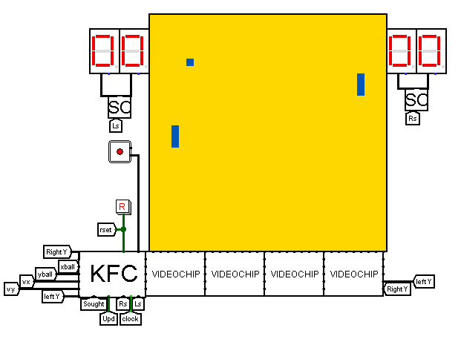
The display panel
The display panel consists of 1024 pixels (32x32). A ball is a pixel, and a racket is 3 pixels long and 1 pixel wide. Below the screen there are 32 videochips connected into 4 video sections, 8 videochips each. This video subsystem displays the bats, the ball and the background.
Notes:
Artem

Slide 4

Controls
The player controls the left bat by moving the red part of the joystick. Only the Y axis of the joystick affects the bat. Speed of the bat is changed by how much the red “button” is deviated from the center. Speed changes from -3 to +3 in 10 ticks.
Notes:
Artem

Slide 5
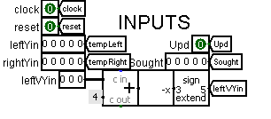
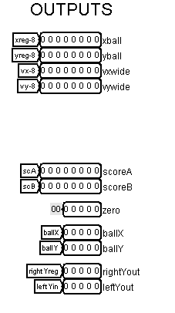
Kinematic controller
Kinematic controller has contacts for resetting the screen and clock generator.
It gets the Y coordinates of both bats – left from the joystick and right from the processor.
Kinematic controller returns coordinates and velocity of the ball to the processor. It also returns scores to the scores schemes and ball’s coordinates and Y coordinates of bats to the video subsystem. The first videochip in the video subsystem needs to have Chip ID of zero, so it receives an input from the kinematic controller that equals zero.
Notes:
Maxim

Slide 6

Kinematic controller
Bat coordinates
0
0
0
Fractional part
Ball coordinates
Integer part
-0.5 - 0.5 points/tick
Ball velocities
±
±
±
±
XV, YV for CDM-8
Notes:
Timofey

Slide 7
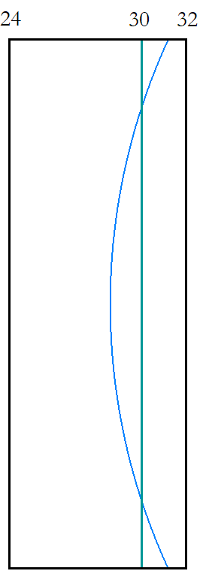
The bat
The bat is a circular arc. Its height is 24, its central angle is 60 degrees.
The left bat seems to have x coordinate between 24 and 32, but the collision is calculated as it is a vertical line segment on x = 30. The right bat is the same, x = 226
Notes:
timofey

Slide 8
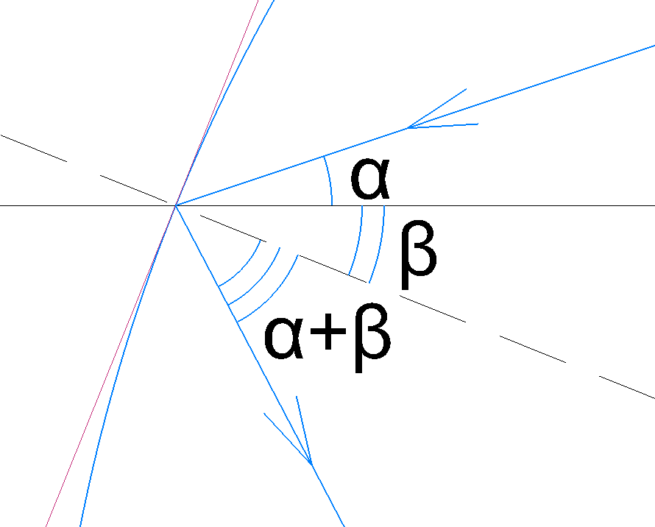
Calculating angle of reflection
The angle between the normal to the bat surface and the x+ axis is (-β), the angle of the ball trajectory is α and the ball velocity is v.
vx = -v * cos α
vy = -v * sin α
vx' = v * cos (-2β - α) =
= cos (-2β) * (-vx) + sin (-2β) * (-vy)
vy' = v * sin (-2β - α) =
= sin (-2β) * (-vx) - cos (-2β) * (-vy)
Notes:
Timofey

Slide 9
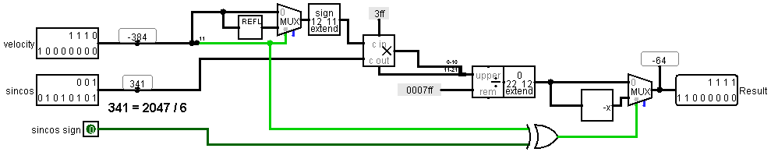
Calculating angle of reflection
Sine and cosine are stored as 12-bit values in RAM. The first bit is sign, other are an 11-bit positive number, where 0 represents 0 and 2047 represents 1
Velocity is a two’s complementary numbers
The scheme makes all numbers positive, multiplies everything and changes the sign in the end
Notes:
Timofey

Slide 10
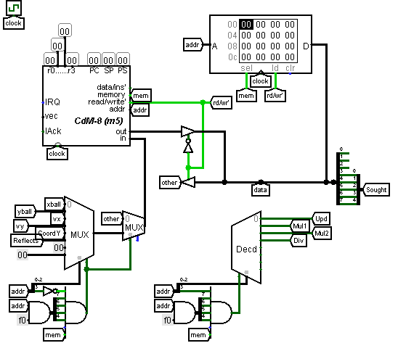
Moving the right bat
Our opponent is controlled with AI. The processor receives coordinates and velocity of the ball and adjusts the position of the right bat to hit the ball when it returns back.
Notes:
Maxim

Slide 11
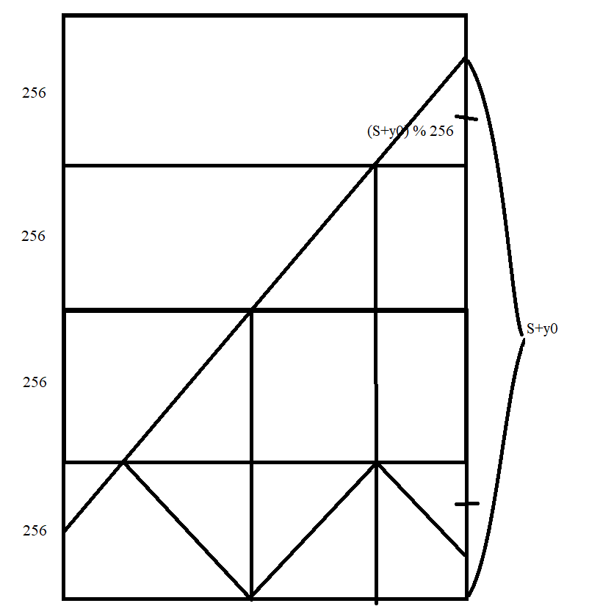
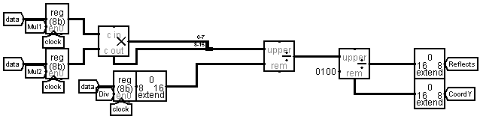
Moving the right bat
The sought coordinates of the right bat are calculated as the picture shows using information about velocity and coordinates of the ball and counting the formula below having all the carry bits in mind. Depending on the parity of the number of carry bits the formula is either distance from upper or lower wall.
( XRIGHT – XBALL ) * VY / VX
CDM-8 uses a peripheral scheme to calculate this formula.
Notes:
Maxim

Slide 12
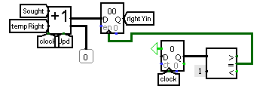
Moving the right bat
After getting the optimal Y coordinate for the right bat the kinematic controller moves it with a velocity of 2.5 display pixels per 10 ticks. The right bat can only move when the ball is in the left half of the display panel.
Notes:
Maxim

Slide 13
Time for computing Velocity of a ball
Notes:
Timofey

