Slide 1
IBM University Engagement Project Submission
“Predictive Maintenance of Industrial Machinery”

Slide 2

Project Tile – Predictive Maintenance of Industrial Machinery
Domain of Project – Machine Learning / Mechanical Engineering
Student Name | Recent Passport Photo | Email ID | Mobile number [WhatsApp]
MIRIYALA JASHMITHA |  | jaasmithamiriyala2006@gmail.com | 7674035894

Slide 3
Problem Statement No.39- Predictive Maintenance of Industrial Machinery
Develop a predictive maintenance model for a fleet of industrial machines to anticipate failures before they occur. This project involves analyzing sensor data from machinery to identify patterns that precede a failure. The goal is to create a classification model that can predict the type of failure (e.g., tool wear, heat dissipation, power failure) based on real-time operational data.
This will enable proactive maintenance, reducing downtime and operational costs.
Dataset –
Kaggle: Machine Predictive Maintenance Classification https://www.kaggle.com/datasets/shivamb/machine-predictive-maintenance-classification
Technology – IBM Cloud Lite services (mandatory)

Slide 4
Proposed Solution -
We propose an AI-powered Predictive Maintenance System using IBM watsonx.ai Studio and AutoAI. Machine sensor data (air temperature, process temperature, rotational speed, torque, tool wear) was collected and uploaded to watsonx.ai. AutoAI automatically performed data preprocessing, feature engineering, algorithm selection, and hyperparameter optimization.
Multiple classification models were generated and evaluated to identify the best-performing model for failure-type prediction. The selected model classifies machine status into categories such as No Failure, Tool Wear Failure, Heat Dissipation Failure, and Power Failure. The final model was deployed as an online web service and tested using real sensor input values, returning accurate predictions with confidence scores.

Slide 5
Technology Used
IBM Cloud – Provides the infrastructure to build, train, deploy, and scale the predictive maintenance model. IBM Cloud enables a reliable, secure, and scalable environment for deploying machine learning models.
ML Algorithm/Model Used: Batched Tree Ensemble Classifier (based on Snap Random Forest)
Accuracy Obtained: 0.995 (99.5%)
Enhancements and Hyperparameter Tuning: HPO-1 (Hyperparameter Optimization), Feature Engineering (FE), HPO-2, Batching (BATCH)

Slide 6
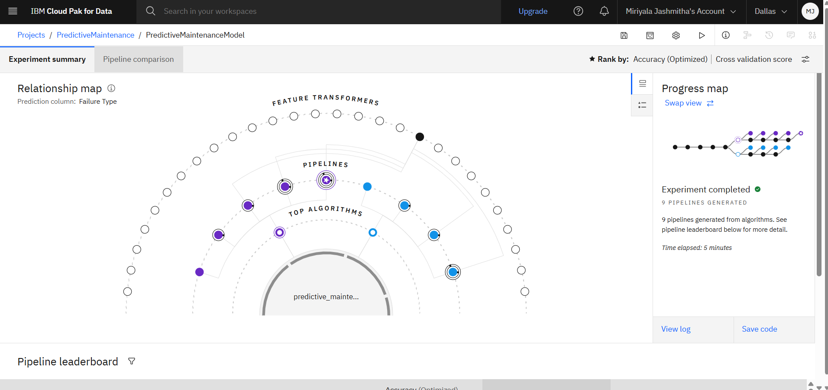
Training Screenshots-
Fig: AutoAI experiment showing 9 pipelines generated from the training dataset.

Slide 7
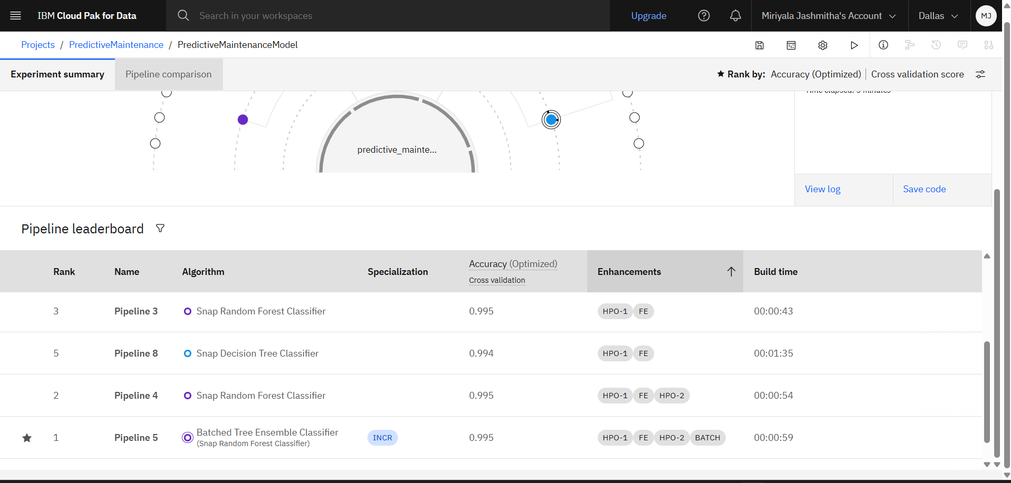
Best Model Screenshot:
Fig: Pipeline leaderboard ranking algorithms by accuracy — Rank 1: Batched Tree Ensemble Classifier (0.995).

Slide 8
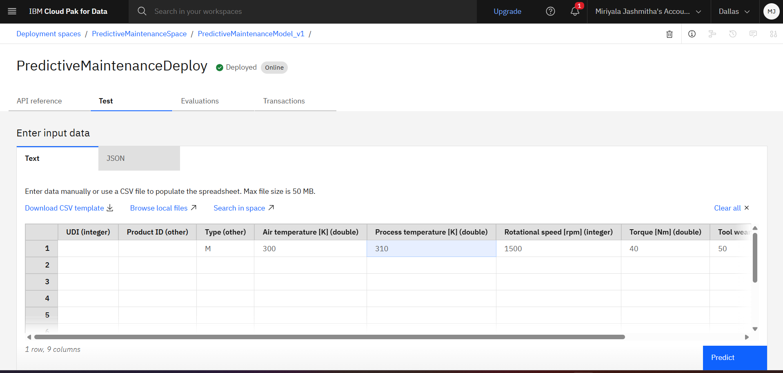
Testing Screenshot:
Fig: Model successfully deployed — status "Deployed", type "Online".

Slide 9
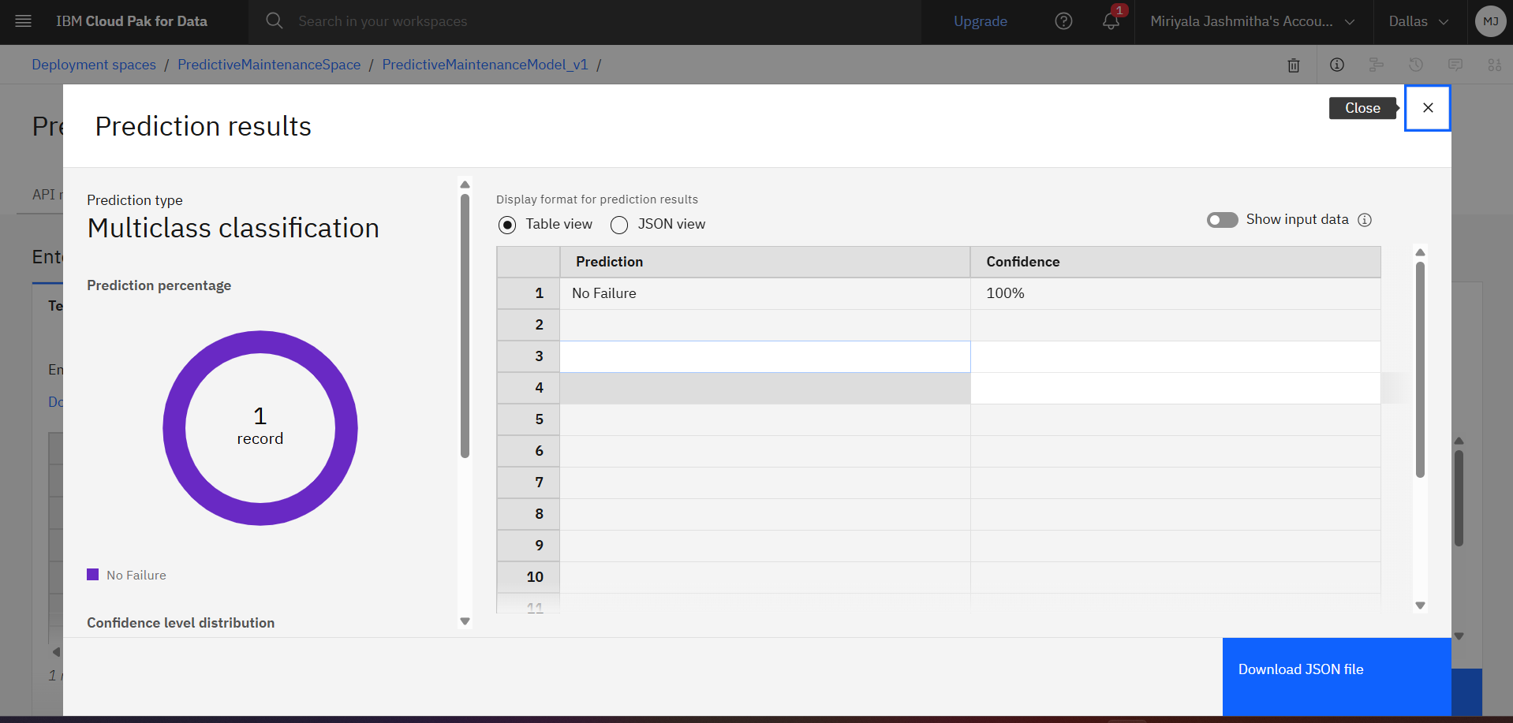
Testing Screenshot:
Fig: Model tested with sample input, returning prediction "No Failure" with 100% confidence

Slide 10
Novelty and Uniqueness
The solution automates industrial failure prediction, reducing manual monitoring effort and response time.
It uses IBM watsonx.ai AutoAI to automatically discover the best machine learning model without extensive coding.
The system can accurately classify machines into multiple failure categories through a single intelligent platform.
Automated feature engineering helps identify hidden patterns in sensor data linked to failure.
The model ensures consistent, unbiased failure prediction, minimizing human error in maintenance decisions.

Slide 11
Git Hub Link
https://github.com/MJ-0324-2006/predictive-maintenance-ps39
·
·
·

Slide 12
Future Scope
The system can be integrated with real-time IoT sensors on factory machines for continuous monitoring.
Additional machine types (pumps, motors, conveyors) can be included, enabling a unified predictive maintenance platform.
Real-time data streaming can improve early failure detection and reduce false alerts.
Advanced AI models in IBM watsonx.ai can be used to continuously improve prediction accuracy as new data becomes available.
The solution can be scaled across factories to support predictive, data-driven maintenance nationwide.
·
·
·

Slide 13
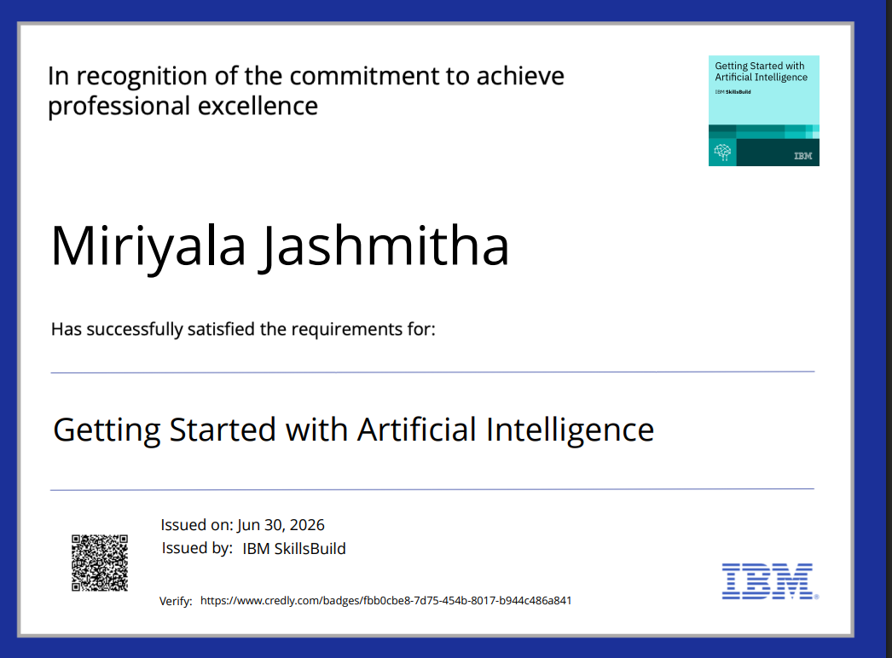
Certificates Earned:

Slide 14
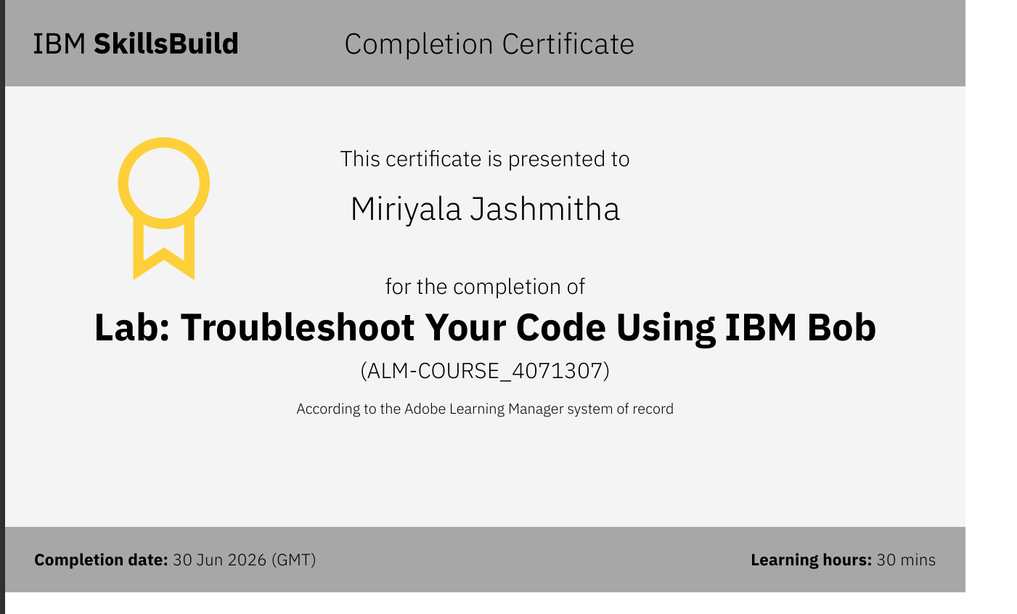
Certificates Earned:​

Slide 15


