Slide 1

The Age of Television Streaming TV
A content-creation analysis

Slide 2

Streaming Industry
Expected to grow by 6.8% with user penetration being 41.2% in 2020 and expected to hit 46.1% by 2025
Netflix $20.16 Billion revenue in 2019
Netflix 183 million paid subscribers
Prime Video 150 million paid subscribers
Hulu 35.5 million paid subscribers
HBO Go 43 million subscribers
A main metric is viewership in the 18-49 demographic for advertisers

Slide 3
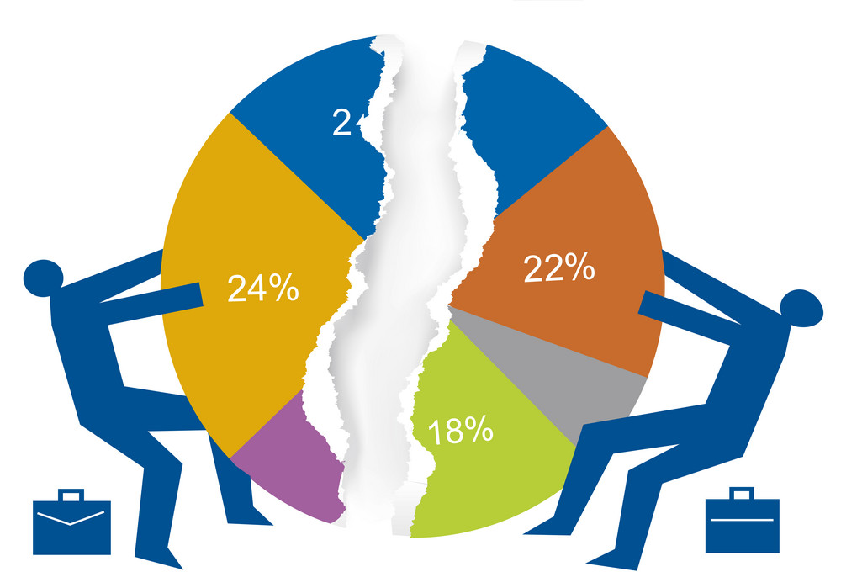
Business Opportunity
How do we get a piece
of the pie?

Slide 4
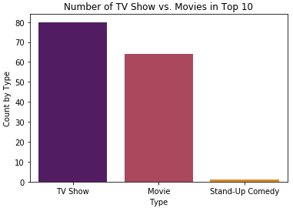
TV Shows vs. Movies
What do the numbers show?
Netflix Daily Top 10:
80 TV Shows
64 Movies
1 Stand-Up Comedy

Slide 5
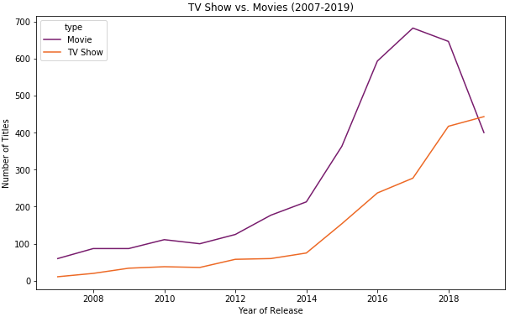
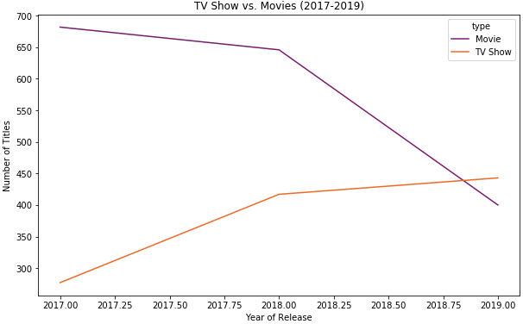
TV Shows vs. Movies (cont.)
2017 saw the apex for movies
TV Shows continued to trend upward
2019 TV Shows overtakes Movies as the #1 type of entertainment released

Slide 6
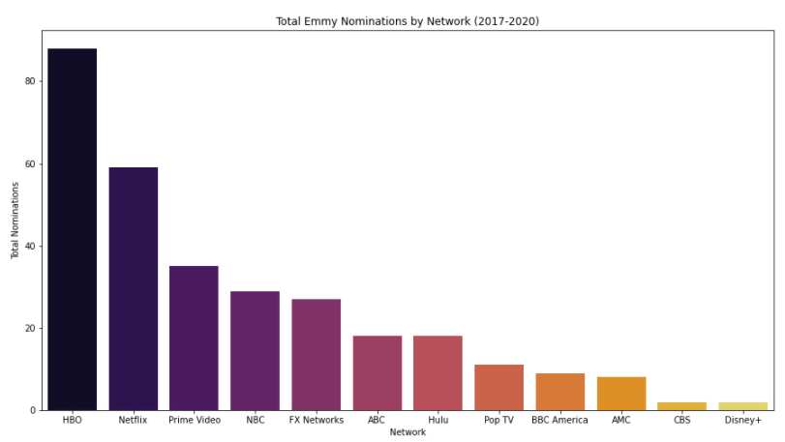
Success by Network
And the winner is…
Combined actor and show awards:
HBO has won the most Emmy awards
Netflix has won the 2nd most
Prime Video comes in 3rd

Slide 7
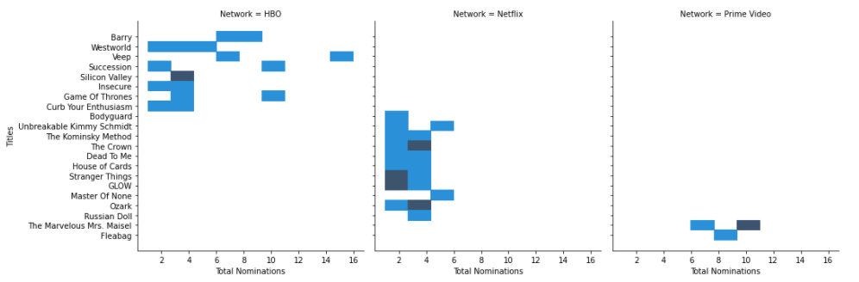
Success by Network (cont.)
Emmy winners by Network:
11 Netflix shows | 8 HBO shows | 2 Prime Video shows

Slide 8
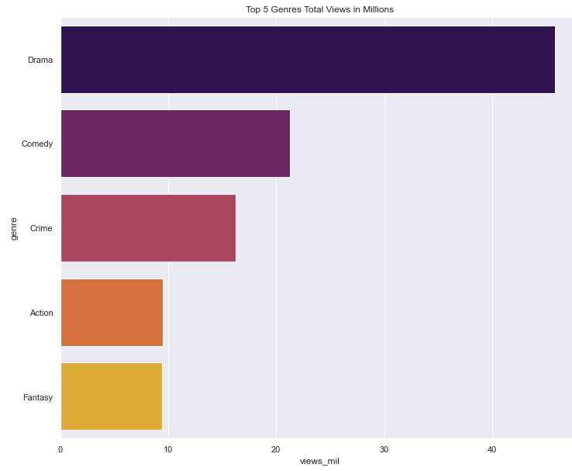
Success by Genre
Views by genre (in millions):
Drama 45.8
Comedy 21.3
Crime 16.2
Action 9.5
Fantasy 9.4

Slide 9
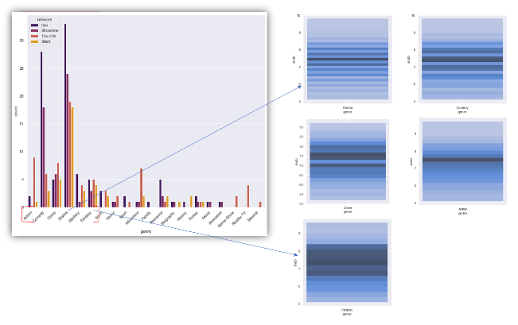
Success by Genre (cont.)
When we split the genres by network, Drama remains the most viewed genre!

Slide 10

Recommendations
Create a TV Show rather than a movie
Work with HBO, they are the most successful
Create a show in the Drama genre, with possible elements of either Fantasy or Crime

Slide 11
Future State
Given more time we would liked to have accomplished the following:
Analyze trends in TV vs. Movie viewership/ratings once the pandemic is over compared to the numbers we presented here
Leveraging the demographics of Microsoft’s 90 million Xbox Live subscriber base to promote our content to,
Implementing an algorithm to create a metric for success based on viewership, ratings and award nominations

Slide 12
Thank you!

