Slide 1


Lab Seminar 3
석사과정 장명준

Slide 2
CONTENTS
1. ZF-Net
Visualizing and Understanding Convolutional Network
* Unpooling, Deconvolution
2. Google LeNet
Going Deeper with Convolutions
* Inception Module
Reference

Slide 3
ZF-Net

Slide 4
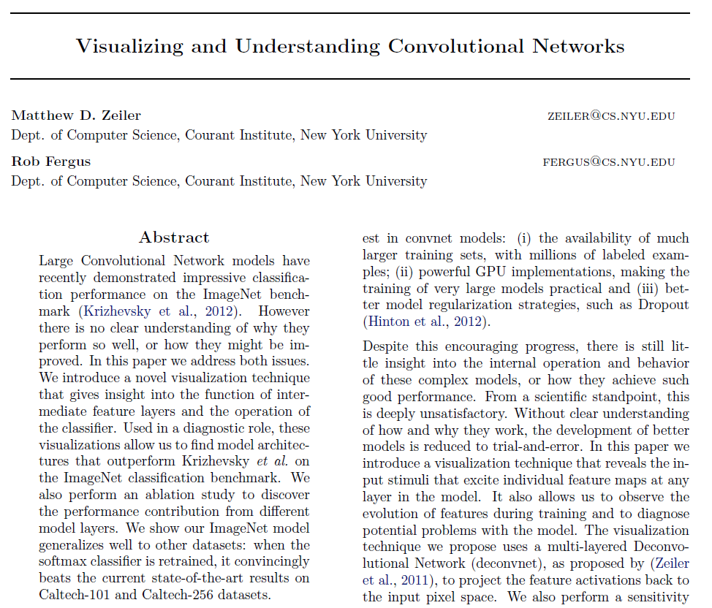
ZF-Net
Google LeNet
Reference

Slide 5
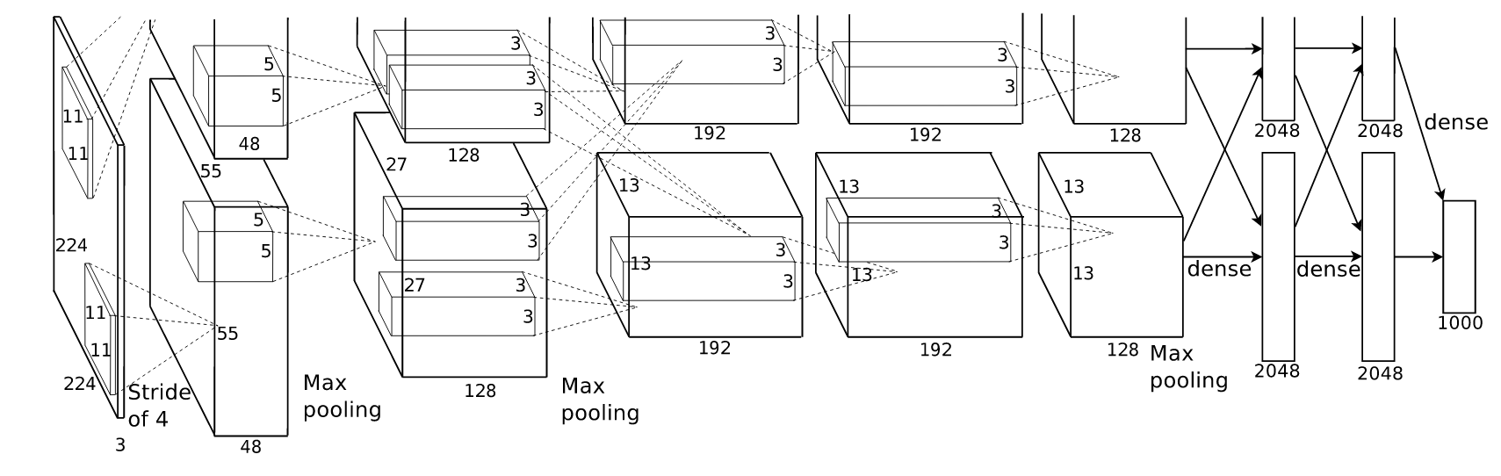

ZF-Net
Google LeNet
Reference
1) Idea
Visualize Feature Layer
- Un-pooling
- Deconvoltuion

Slide 6
ZF-Net
Google LeNet
Reference
2) Un-pooling
Remember location of maximum value before pooling
Restore input value in max location, otherwise 0
6 | 1 | 8 | 1
2 | 3 | 15 | 2
2 | 0 | 9 | 3
9 | 6 | 7 | 5
6 | 15
9 | 9
Pooling
Feature map
Below
Switch
4 | 0 | 0 | 0
0 | 0 | 6 | 0
0 | 0 | 5 | 0
7 | 0 | 0 | 0
4 | 6
7 | 5
Un-Pooling
Reconsturction above

Slide 7
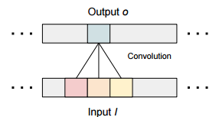
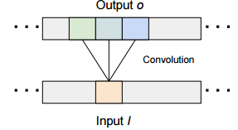




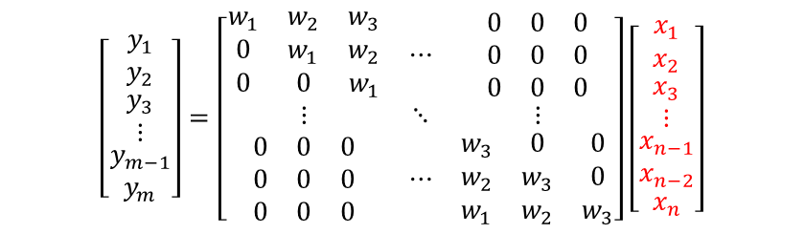




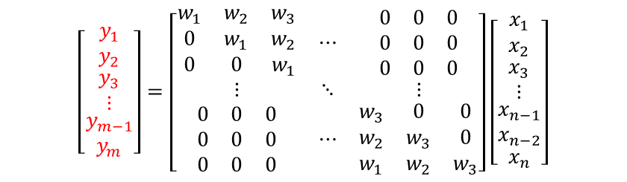

ZF-Net
Google LeNet
Reference
3) Deconvolution
Transposed convolution
Convolution
Deconvolution
Im et.al, Generating images with recurrent adversarial networks, Dec, 2016
Im et.al, Generating images with recurrent adversarial networks, Dec, 2016
Deconvolution is exactly same as backward convolution
$$\left[\begin{matrix}y_{1} \\ y_{2} \\ \begin{matrix}y_{3} \\ ⋮ \\ \begin{matrix}y_{m−1} \\ y_{m}\end{matrix}\end{matrix}\end{matrix}\right]=\left[\begin{matrix}\begin{matrix}w_{1} & w_{2} & w_{3} \\ 0 & w_{1} & w_{2} \\ 0 & 0 & w_{1}\end{matrix} & ⋯ & \begin{matrix}0 & 0 & 0 \\ 0 & 0 & 0 \\ 0 & 0 & 0\end{matrix} \\ ⋮ & ⋱ & ⋮ \\ \begin{matrix}0 & 0 & 0 \\ 0 & 0 & 0 \\ 0 & 0 & 0\end{matrix} & ⋯ & \begin{matrix}w_{3} & 0 & 0 \\ w_{2} & w_{3} & 0 \\ w_{1} & w_{2} & w_{3}\end{matrix}\end{matrix}\right]\left[\begin{matrix}x_{1} \\ x_{2} \\ \begin{matrix}x_{3} \\ ⋮ \\ \begin{matrix}\begin{matrix}x_{n−1} \\ x_{n−2}\end{matrix} \\ x_{n}\end{matrix}\end{matrix}\end{matrix}\right]$$
$$\left[\begin{matrix}y_{1} \\ y_{2} \\ \begin{matrix}y_{3} \\ ⋮ \\ \begin{matrix}y_{m−1} \\ y_{m}\end{matrix}\end{matrix}\end{matrix}\right]=\left[\begin{matrix}\begin{matrix}w_{1} & w_{2} & w_{3} \\ 0 & w_{1} & w_{2} \\ 0 & 0 & w_{1}\end{matrix} & ⋯ & \begin{matrix}0 & 0 & 0 \\ 0 & 0 & 0 \\ 0 & 0 & 0\end{matrix} \\ ⋮ & ⋱ & ⋮ \\ \begin{matrix}0 & 0 & 0 \\ 0 & 0 & 0 \\ 0 & 0 & 0\end{matrix} & ⋯ & \begin{matrix}w_{3} & 0 & 0 \\ w_{2} & w_{3} & 0 \\ w_{1} & w_{2} & w_{3}\end{matrix}\end{matrix}\right]\left[\begin{matrix}x_{1} \\ x_{2} \\ \begin{matrix}x_{3} \\ ⋮ \\ \begin{matrix}\begin{matrix}x_{n−1} \\ x_{n−2}\end{matrix} \\ x_{n}\end{matrix}\end{matrix}\end{matrix}\right]$$
$$Y$$
$$H$$
$$X$$
$$Y$$
$$H$$
$$X$$
$$Y=H∙X$$
$$Y=H∙X$$

Slide 8

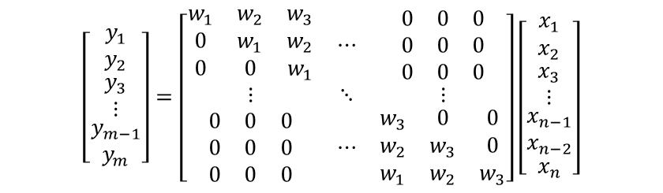
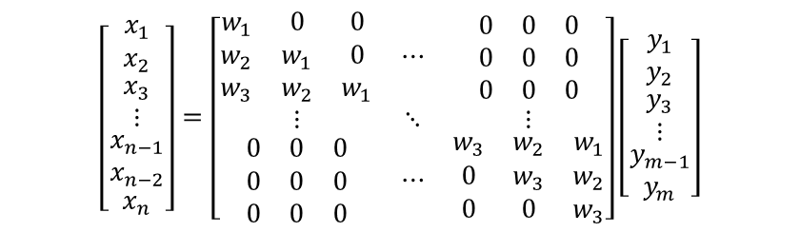
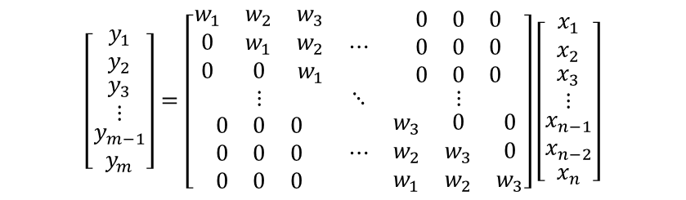

ZF-Net
Google LeNet
Reference
3) Deconvolution
Transposed convolution
Assumption : each columns of H are orthonormal
$$\left[\begin{matrix}y_{1} \\ y_{2} \\ \begin{matrix}y_{3} \\ ⋮ \\ \begin{matrix}y_{m−1} \\ y_{m}\end{matrix}\end{matrix}\end{matrix}\right]=\left[\begin{matrix}\begin{matrix}w_{1} & w_{2} & w_{3} \\ 0 & w_{1} & w_{2} \\ 0 & 0 & w_{1}\end{matrix} & ⋯ & \begin{matrix}0 & 0 & 0 \\ 0 & 0 & 0 \\ 0 & 0 & 0\end{matrix} \\ ⋮ & ⋱ & ⋮ \\ \begin{matrix}0 & 0 & 0 \\ 0 & 0 & 0 \\ 0 & 0 & 0\end{matrix} & ⋯ & \begin{matrix}w_{3} & 0 & 0 \\ w_{2} & w_{3} & 0 \\ w_{1} & w_{2} & w_{3}\end{matrix}\end{matrix}\right]\left[\begin{matrix}x_{1} \\ x_{2} \\ \begin{matrix}x_{3} \\ ⋮ \\ \begin{matrix}\begin{matrix}x_{n−1} \\ x_{n−2}\end{matrix} \\ x_{n}\end{matrix}\end{matrix}\end{matrix}\right]$$
$$H^{T}∙Y=H^{T}∙H∙X$$
$$X=H^{T}∙Y$$
Convolution
Deconvolution
$$\left[\begin{matrix}y_{1} \\ y_{2} \\ \begin{matrix}y_{3} \\ ⋮ \\ \begin{matrix}y_{m−1} \\ y_{m}\end{matrix}\end{matrix}\end{matrix}\right]=\left[\begin{matrix}\begin{matrix}w_{1} & w_{2} & w_{3} \\ 0 & w_{1} & w_{2} \\ 0 & 0 & w_{1}\end{matrix} & ⋯ & \begin{matrix}0 & 0 & 0 \\ 0 & 0 & 0 \\ 0 & 0 & 0\end{matrix} \\ ⋮ & ⋱ & ⋮ \\ \begin{matrix}0 & 0 & 0 \\ 0 & 0 & 0 \\ 0 & 0 & 0\end{matrix} & ⋯ & \begin{matrix}w_{3} & 0 & 0 \\ w_{2} & w_{3} & 0 \\ w_{1} & w_{2} & w_{3}\end{matrix}\end{matrix}\right]\left[\begin{matrix}x_{1} \\ x_{2} \\ \begin{matrix}x_{3} \\ ⋮ \\ \begin{matrix}\begin{matrix}x_{n−1} \\ x_{n−2}\end{matrix} \\ x_{n}\end{matrix}\end{matrix}\end{matrix}\right]$$
$$\left[\begin{matrix}x_{1} \\ x_{2} \\ \begin{matrix}x_{3} \\ ⋮ \\ \begin{matrix}\begin{matrix}x_{n−1} \\ x_{n−2}\end{matrix} \\ x_{n}\end{matrix}\end{matrix}\end{matrix}\right]=\left[\begin{matrix}\begin{matrix}w_{1} & 0 & 0 \\ w_{2} & w_{1} & 0 \\ w_{3} & w_{2} & w_{1}\end{matrix} & ⋯ & \begin{matrix}0 & 0 & 0 \\ 0 & 0 & 0 \\ 0 & 0 & 0\end{matrix} \\ ⋮ & ⋱ & ⋮ \\ \begin{matrix}0 & 0 & 0 \\ 0 & 0 & 0 \\ 0 & 0 & 0\end{matrix} & ⋯ & \begin{matrix}w_{3} & w_{2} & w_{1} \\ 0 & w_{3} & w_{2} \\ 0 & 0 & w_{3}\end{matrix}\end{matrix}\right]\left[\begin{matrix}y_{1} \\ y_{2} \\ \begin{matrix}y_{3} \\ ⋮ \\ \begin{matrix}y_{m−1} \\ y_{m}\end{matrix}\end{matrix}\end{matrix}\right]$$

Slide 9
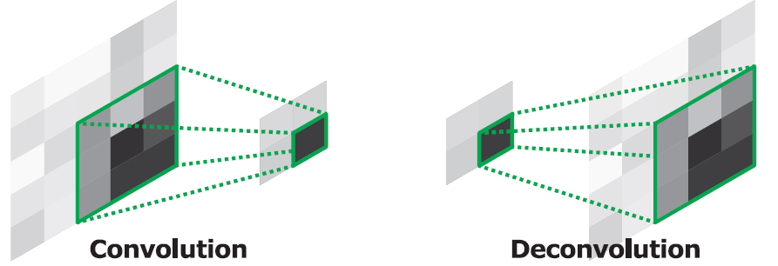

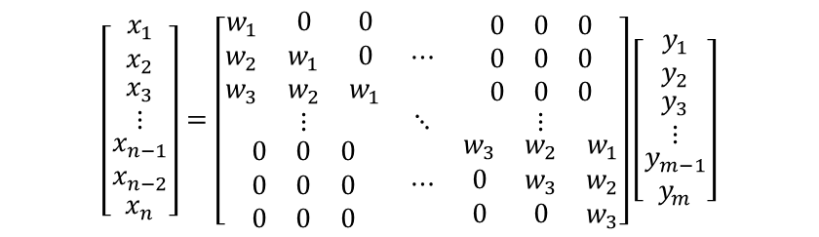
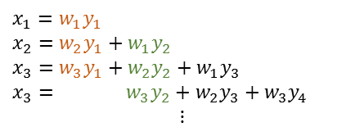


ZF-Net
Google LeNet
Reference
3) Deconvolution
1. How it works
$$X=H^{T}∙Y$$
$$\left[\begin{matrix}x_{1} \\ x_{2} \\ \begin{matrix}x_{3} \\ ⋮ \\ \begin{matrix}\begin{matrix}x_{n−1} \\ x_{n−2}\end{matrix} \\ x_{n}\end{matrix}\end{matrix}\end{matrix}\right]=\left[\begin{matrix}\begin{matrix}w_{1} & 0 & 0 \\ w_{2} & w_{1} & 0 \\ w_{3} & w_{2} & w_{1}\end{matrix} & ⋯ & \begin{matrix}0 & 0 & 0 \\ 0 & 0 & 0 \\ 0 & 0 & 0\end{matrix} \\ ⋮ & ⋱ & ⋮ \\ \begin{matrix}0 & 0 & 0 \\ 0 & 0 & 0 \\ 0 & 0 & 0\end{matrix} & ⋯ & \begin{matrix}w_{3} & w_{2} & w_{1} \\ 0 & w_{3} & w_{2} \\ 0 & 0 & w_{3}\end{matrix}\end{matrix}\right]\left[\begin{matrix}y_{1} \\ y_{2} \\ \begin{matrix}y_{3} \\ ⋮ \\ \begin{matrix}y_{m−1} \\ y_{m}\end{matrix}\end{matrix}\end{matrix}\right]$$
$$x_{1}=w_{1}y_{1}$$
$$x_{2}=w_{2}y_{1}+w_{1}y_{2}$$
$$x_{3}=w_{3}y_{1}+w_{2}y_{2}+w_{1}y_{3}$$
$$x_{3}= w_{3}y_{2}+w_{2}y_{3}+w_{3}y_{4}$$
$$⋮$$
$$y_{1} y_{2} y_{3}$$
$$y_{m−2} y_{m−1} y_{m}$$
Copying weight
2. Size of Deconvolution output
Noh et.al, Learning Deconvolution Network for Semantic Segmentation, May, 2015
o = (i – k + 2 * p)/s + 1
i = (o – k + 2 * p)/s + 1
o = (i - 1) * s + k – 2*p
o: output dimension, i: input dimension, k: kernel size, p: padding, s: stride

Slide 10
ZF-Net
Google LeNet
Reference
3) Deconvolution
3. Case study
Case1) i=2, p=0, k=2, s=1
0= (2-1)*1+2-0 = 3
Filter
0 | 0 0 | 1
0 0 | 0 2 2 0 | 3 3
4 | 6 6 | 9
0 | 0 | 1
0 | 4 | 6
4 | 12 | 9
0 | 1
2 | 3
0 | 1
2 | 3
Anil Thomas, Object recognition lecture note p.18
https://www.slideshare.net/nervanasys/anil-thomas-object-recognition?ref=http://neon.nervanasys.com/docs/latest/introductory_resources.html
Why Sum??
Summation cause overlap
More information : http://distill.pub/2016/deconv-checkerboard/
- Take average value for overlap
- Set stride size to prevent overlap
- Unlearned deconvolution + convolution

Slide 11

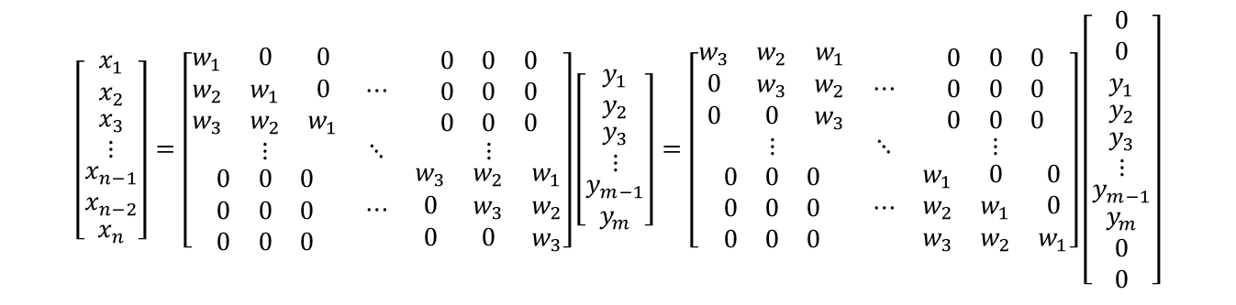



ZF-Net
Google LeNet
Reference
3) Deconvolution
3. Case study
In paper : “In practice this means flipping each filter vertically and horizontally”
$$\left[\begin{matrix}x_{1} \\ x_{2} \\ \begin{matrix}x_{3} \\ ⋮ \\ \begin{matrix}\begin{matrix}x_{n−1} \\ x_{n−2}\end{matrix} \\ x_{n}\end{matrix}\end{matrix}\end{matrix}\right]=\left[\begin{matrix}\begin{matrix}w_{1} & 0 & 0 \\ w_{2} & w_{1} & 0 \\ w_{3} & w_{2} & w_{1}\end{matrix} & ⋯ & \begin{matrix}0 & 0 & 0 \\ 0 & 0 & 0 \\ 0 & 0 & 0\end{matrix} \\ ⋮ & ⋱ & ⋮ \\ \begin{matrix}0 & 0 & 0 \\ 0 & 0 & 0 \\ 0 & 0 & 0\end{matrix} & ⋯ & \begin{matrix}w_{3} & w_{2} & w_{1} \\ 0 & w_{3} & w_{2} \\ 0 & 0 & w_{3}\end{matrix}\end{matrix}\right]\left[\begin{matrix}y_{1} \\ y_{2} \\ \begin{matrix}y_{3} \\ ⋮ \\ \begin{matrix}y_{m−1} \\ y_{m}\end{matrix}\end{matrix}\end{matrix}\right]=\left[\begin{matrix}\begin{matrix}w_{3} & w_{2} & w_{1} \\ 0 & w_{3} & w_{2} \\ 0 & 0 & w_{3}\end{matrix} & ⋯ & \begin{matrix}0 & 0 & 0 \\ 0 & 0 & 0 \\ 0 & 0 & 0\end{matrix} \\ ⋮ & ⋱ & ⋮ \\ \begin{matrix}0 & 0 & 0 \\ 0 & 0 & 0 \\ 0 & 0 & 0\end{matrix} & ⋯ & \begin{matrix}w_{1} & 0 & 0 \\ w_{2} & w_{1} & 0 \\ w_{3} & w_{2} & w_{1}\end{matrix}\end{matrix}\right]\left[\begin{matrix}\begin{matrix}0 \\ 0 \\ y_{1}\end{matrix} \\ y_{2} \\ \begin{matrix}y_{3} \\ ⋮ \\ \begin{matrix}y_{m−1} \\ \begin{matrix}y_{m} \\ 0 \\ 0\end{matrix}\end{matrix}\end{matrix}\end{matrix}\right]$$
$$n×m$$
$$m×1$$
$$n×(m+4)$$
$$(m+4)×1$$
Case1) i=2, p=0, k=2, s=1
0 | 0 | 0 | 0
0 | 0 | 1 | 0
0 | 2 | 3 | 0
0 | 0 | 0 | 0
Filter
0 | 0 | 1
0 | 4 | 6
4 | 12 | 9
3 | 2
1 | 0
flipped vertically & horizontally
0 | 1
2 | 3

Slide 12
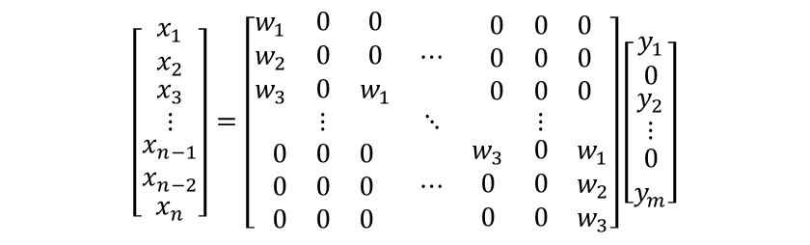
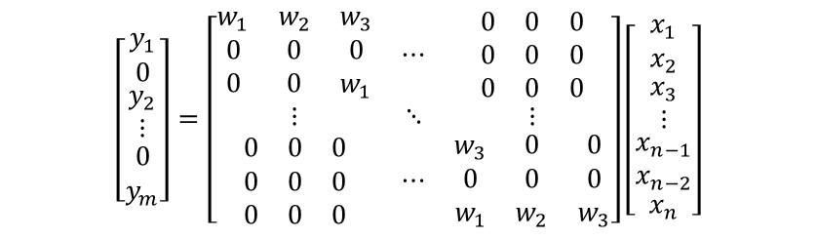
ZF-Net
Google LeNet
Reference
3) Deconvolution
3. Case study
Stride (s=2)
Convolution
Deconvolution
$$\left[\begin{matrix}y_{1} \\ 0 \\ \begin{matrix}y_{2} \\ ⋮ \\ \begin{matrix}0 \\ y_{m}\end{matrix}\end{matrix}\end{matrix}\right]=\left[\begin{matrix}\begin{matrix}w_{1} & w_{2} & w_{3} \\ 0 & 0 & 0 \\ 0 & 0 & w_{1}\end{matrix} & ⋯ & \begin{matrix}0 & 0 & 0 \\ 0 & 0 & 0 \\ 0 & 0 & 0\end{matrix} \\ ⋮ & ⋱ & ⋮ \\ \begin{matrix}0 & 0 & 0 \\ 0 & 0 & 0 \\ 0 & 0 & 0\end{matrix} & ⋯ & \begin{matrix}w_{3} & 0 & 0 \\ 0 & 0 & 0 \\ w_{1} & w_{2} & w_{3}\end{matrix}\end{matrix}\right]\left[\begin{matrix}x_{1} \\ x_{2} \\ \begin{matrix}x_{3} \\ ⋮ \\ \begin{matrix}\begin{matrix}x_{n−1} \\ x_{n−2}\end{matrix} \\ x_{n}\end{matrix}\end{matrix}\end{matrix}\right]$$
$$\left[\begin{matrix}x_{1} \\ x_{2} \\ \begin{matrix}x_{3} \\ ⋮ \\ \begin{matrix}\begin{matrix}x_{n−1} \\ x_{n−2}\end{matrix} \\ x_{n}\end{matrix}\end{matrix}\end{matrix}\right]=\left[\begin{matrix}\begin{matrix}w_{1} & 0 & 0 \\ w_{2} & 0 & 0 \\ w_{3} & 0 & w_{1}\end{matrix} & ⋯ & \begin{matrix}0 & 0 & 0 \\ 0 & 0 & 0 \\ 0 & 0 & 0\end{matrix} \\ ⋮ & ⋱ & ⋮ \\ \begin{matrix}0 & 0 & 0 \\ 0 & 0 & 0 \\ 0 & 0 & 0\end{matrix} & ⋯ & \begin{matrix}w_{3} & 0 & w_{1} \\ 0 & 0 & w_{2} \\ 0 & 0 & w_{3}\end{matrix}\end{matrix}\right]\left[\begin{matrix}y_{1} \\ 0 \\ \begin{matrix}y_{2} \\ ⋮ \\ \begin{matrix}0 \\ y_{m}\end{matrix}\end{matrix}\end{matrix}\right]$$
Case2) i=2, p=0, k=2, s=2
0= (2-1)*2+2-0 = 4
Filter
0 | 0 | 0 | 1
0 | 0 | 2 | 3
0 | 2 | 0 | 3
4 | 6 | 6 | 9
0 | 0 | 0 | 1
0 | 0 | 2 | 3
0 | 2 | 0 | 3
4 | 6 | 6 | 9
0 | 1
2 | 3
0 | 1
2 | 3

Slide 13
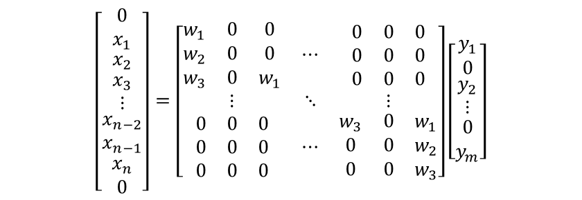
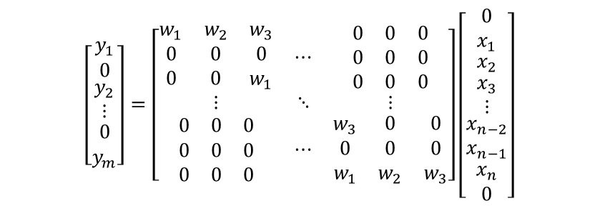
ZF-Net
Google LeNet
Reference
3) Deconvolution
3. Case study
- Padding (p = 1), s = 2
Convolution
Deconvolution
$$\left[\begin{matrix}y_{1} \\ 0 \\ \begin{matrix}y_{2} \\ ⋮ \\ \begin{matrix}0 \\ y_{m}\end{matrix}\end{matrix}\end{matrix}\right]=\left[\begin{matrix}\begin{matrix}w_{1} & w_{2} & w_{3} \\ 0 & 0 & 0 \\ 0 & 0 & w_{1}\end{matrix} & ⋯ & \begin{matrix}0 & 0 & 0 \\ 0 & 0 & 0 \\ 0 & 0 & 0\end{matrix} \\ ⋮ & ⋱ & ⋮ \\ \begin{matrix}0 & 0 & 0 \\ 0 & 0 & 0 \\ 0 & 0 & 0\end{matrix} & ⋯ & \begin{matrix}w_{3} & 0 & 0 \\ 0 & 0 & 0 \\ w_{1} & w_{2} & w_{3}\end{matrix}\end{matrix}\right]\left[\begin{matrix}\begin{matrix}0 \\ x_{1}\end{matrix} \\ x_{2} \\ \begin{matrix}x_{3} \\ ⋮ \\ \begin{matrix}\begin{matrix}x_{n−2} \\ x_{n−1}\end{matrix} \\ \begin{matrix}x_{n} \\ 0\end{matrix}\end{matrix}\end{matrix}\end{matrix}\right]$$
$$\left[\begin{matrix}\begin{matrix}0 \\ x_{1}\end{matrix} \\ x_{2} \\ \begin{matrix}x_{3} \\ ⋮ \\ \begin{matrix}\begin{matrix}x_{n−2} \\ x_{n−1}\end{matrix} \\ \begin{matrix}x_{n} \\ 0\end{matrix}\end{matrix}\end{matrix}\end{matrix}\right]=\left[\begin{matrix}\begin{matrix}w_{1} & 0 & 0 \\ w_{2} & 0 & 0 \\ w_{3} & 0 & w_{1}\end{matrix} & ⋯ & \begin{matrix}0 & 0 & 0 \\ 0 & 0 & 0 \\ 0 & 0 & 0\end{matrix} \\ ⋮ & ⋱ & ⋮ \\ \begin{matrix}0 & 0 & 0 \\ 0 & 0 & 0 \\ 0 & 0 & 0\end{matrix} & ⋯ & \begin{matrix}w_{3} & 0 & w_{1} \\ 0 & 0 & w_{2} \\ 0 & 0 & w_{3}\end{matrix}\end{matrix}\right]\left[\begin{matrix}y_{1} \\ 0 \\ \begin{matrix}y_{2} \\ ⋮ \\ \begin{matrix}0 \\ y_{m}\end{matrix}\end{matrix}\end{matrix}\right]$$
Case3) i=3, p=1, k=2, s=2
0= (3-1)*2+2-2*1= 4
0 | 0 | 0 | 1 | 0 | 2
0 | 0 | 2 | 3 | 4 | 6
0 | 2 | 0 | 3 | 0 | 4
4 | 6 | 6 | 9 | 8 | 12
0 | 3 | 0 | 4 | 0 | 5
6 | 9 | 8 | 12 | 10 | 15
Filter
0 | 2 | 3 | 4
2 | 0 | 6 | 0
6 | 6 | 9 | 8
3 | 0 | 4 | 0
0 | 1 | 2
2 | 3 | 4
3 | 4 | 5
0 | 1
2 | 3

Slide 14


















ZF-Net
Google LeNet
Reference
3) Deconvolution
4. Backpropagation
Computational graph
$$X_{0}$$
*
$$Y_{1}$$
$$W_{0}$$
$$X_{0}$$
$$W_{0}$$
$$W_{1}$$
$$W_{2}$$
$$W_{1}$$
*
$$X_{1}$$
+
$$Y_{2}$$
$$Y_{1}$$
$$Y_{2}$$
$$Y_{3}$$
$$Y_{4}$$
$${ X}_{0}$$
$${ X}_{1}$$
$$W_{0}$$
*
$$X_{0}$$
$$W_{2}$$
*
+
$$Y_{3}$$
$$X_{1}$$
$$W_{1}$$
*
$$X_{1}$$
*
$$Y_{4}$$
$$W_{2}$$

Slide 15















ZF-Net
Google LeNet
Reference
3) Deconvolution
4. Backpropagation
Computational graph
$$X_{0}$$
*
$$Y_{1}$$
$$L_{1}$$
$$W_{0}$$
$$\frac{∂L_{1}}{∂Y_{1}}$$
$$X_{0}$$
$$W_{1}$$
*
$$X_{1}$$
+
$$\frac{∂L_{2}}{∂Y_{2}}$$
$$Y_{2}$$
$$L_{2}$$
$$W_{0}$$
*
$$X_{0}$$
$$W_{2}$$
*
+
$$\frac{∂L_{3}}{∂Y_{3}}$$
$$Y_{3}$$
$$L_{3}$$
$$X_{1}$$
$$W_{1}$$
*
$$X_{1}$$
*
$$Y_{4}$$
$$W_{2}$$
$$\frac{∂L_{4}}{∂Y_{4}}$$
$$L_{4}$$

Slide 16



ZF-Net
Google LeNet
Reference
3) Deconvolution
4. Backpropagation
Computational graph
$$X_{0}$$
*
$$Y_{1}$$
$$L_{1}$$
$$W_{0}$$
$$\frac{∂L_{1}}{∂Y_{1}}$$
$$X_{0}$$
$$W_{1}$$
*
$$\frac{∂L_{2}}{∂Y_{2}}$$
$$X_{1}$$
+
$$\frac{∂L_{2}}{∂Y_{2}}$$
$$Y_{2}$$
$$L_{2}$$
*
$$\frac{∂L_{2}}{∂Y_{2}}$$
$$W_{0}$$
$$X_{0}$$
$$W_{2}$$
*
$$\frac{∂L_{3}}{∂Y_{3}}$$
+
$$\frac{∂L_{3}}{∂Y_{3}}$$
$$Y_{3}$$
$$L_{3}$$
$$X_{1}$$
$$\frac{∂L_{3}}{∂Y_{3}}$$
$$W_{1}$$
*
$$X_{1}$$
*
$$Y_{4}$$
$$W_{2}$$
$$\frac{∂L_{4}}{∂Y_{4}}$$
$$L_{4}$$

Slide 17












ZF-Net
Google LeNet
Reference
3) Deconvolution
4. Backpropagation
Computational graph
$$X_{0}$$
$$\frac{∂L_{1}}{∂Y_{1}}W_{0}$$
*
$$Y_{1}$$
$$L_{1}$$
$$W_{0}$$
$$\frac{∂L_{1}}{∂Y_{1}}X_{0}$$
$$\frac{∂L_{1}}{∂Y_{1}}$$
$$X_{0}$$
$$\frac{∂L_{2}}{∂Y_{2}}W_{1}$$
$$W_{1}$$
*
$$\frac{∂L_{2}}{∂Y_{2}}$$
$$\frac{∂L_{2}}{∂Y_{2}}X_{0}$$
$$X_{1}$$
$$\frac{∂L_{2}}{∂Y_{2}}W_{0}$$
+
$$\frac{∂L_{2}}{∂Y_{2}}$$
$$Y_{2}$$
$$L_{2}$$
*
$$\frac{∂L_{2}}{∂Y_{2}}$$
$$W_{0}$$
$$\frac{∂L_{2}}{∂Y_{2}}X_{1}$$
$$X_{0}$$
$$\frac{∂L_{3}}{∂Y_{3}}W_{2}$$
$$W_{2}$$
*
$$\frac{∂L_{3}}{∂Y_{3}}$$
$$\frac{∂L_{3}}{∂Y_{3}}X_{0}$$
$$\frac{∂L_{3}}{∂Y_{3}}W_{1}$$
+
$$\frac{∂L_{3}}{∂Y_{3}}$$
$$Y_{3}$$
$$L_{3}$$
$$X_{1}$$
$$\frac{∂L_{3}}{∂Y_{3}}$$
*
$$W_{1}$$
$$\frac{∂L_{3}}{∂Y_{3}}X_{1}$$
$$X_{1}$$
$$\frac{∂L_{4}}{∂Y_{4}}W_{2}$$
*
$$Y_{4}$$
$$W_{2}$$
$$\frac{∂L_{4}}{∂Y_{4}}X_{1}$$
$$\frac{∂L_{4}}{∂Y_{4}}$$
$$L_{4}$$

Slide 18



ZF-Net
Google LeNet
Reference
3) Deconvolution
4. Backpropagation
Computational graph
$$X_{0}$$
$$\frac{∂L_{1}}{∂Y_{1}}W_{0}$$
*
$$Y_{1}$$
$$L_{1}$$
$$W_{0}$$
$$\frac{∂L_{1}}{∂Y_{1}}X_{0}$$
$$\frac{∂L_{1}}{∂Y_{1}}$$
$$X_{0}$$
$$\frac{∂L_{2}}{∂Y_{2}}W_{1}$$
$$W_{1}$$
*
$$\frac{∂L_{2}}{∂Y_{2}}$$
$$\frac{∂L_{2}}{∂Y_{2}}X_{0}$$
$$X_{1}$$
$$\frac{∂L_{2}}{∂Y_{2}}W_{0}$$
+
$$\frac{∂L_{2}}{∂Y_{2}}$$
$$Y_{2}$$
$$L_{2}$$
*
$$\frac{∂L_{2}}{∂Y_{2}}$$
$$W_{0}$$
$$\frac{∂L_{2}}{∂Y_{2}}X_{1}$$
$$X_{0}$$
$$\frac{∂L_{3}}{∂Y_{3}}W_{2}$$
$$W_{2}$$
*
$$\frac{∂L_{3}}{∂Y_{3}}$$
$$\frac{∂L_{3}}{∂Y_{3}}X_{0}$$
$$\frac{∂L_{3}}{∂Y_{3}}W_{1}$$
+
$$\frac{∂L_{3}}{∂Y_{3}}$$
$$Y_{3}$$
$$L_{3}$$
$$\frac{∂L}{∂W_{0}}=\frac{∂L_{1}}{∂Y_{1}}X_{0}+\frac{∂L_{2}}{∂Y_{2}}X_{1}$$
$$X_{1}$$
$$\frac{∂L_{3}}{∂Y_{3}}$$
*
$$W_{1}$$
$$\frac{∂L_{3}}{∂Y_{3}}X_{1}$$
$$\frac{∂L}{∂W_{1}}=\frac{∂L_{2}}{∂Y_{2}}X_{0}+\frac{∂L_{3}}{∂Y_{3}}X_{1}$$
$$X_{1}$$
$$\frac{∂L_{4}}{∂Y_{4}}W_{2}$$
$$\frac{∂L}{∂W_{2}}=\frac{∂L_{3}}{∂Y_{3}}X_{0}+\frac{∂L_{4}}{∂Y_{4}}X_{1}$$
*
$$Y_{4}$$
$$W_{2}$$
$$\frac{∂L_{4}}{∂Y_{4}}X_{1}$$
$$\frac{∂L_{4}}{∂Y_{4}}$$
$$L_{4}$$

Slide 19
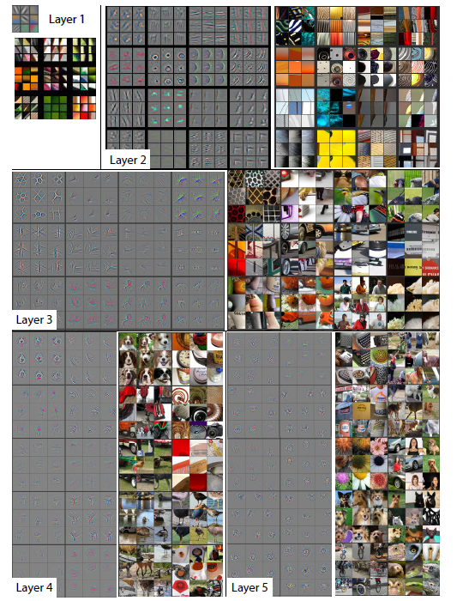
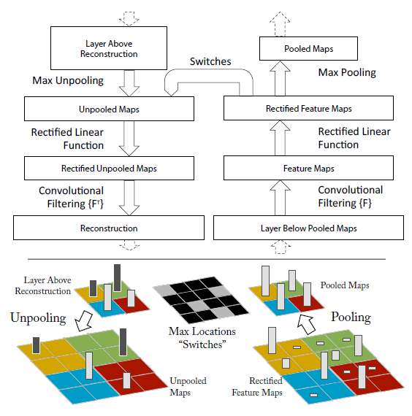
ZF-Net
Google LeNet
Reference
4) Visualization
Matthew D. Zeiler, Rob Fergus , Visualizing and Understanding Convolutional Networks, Nov, 2013

Slide 20
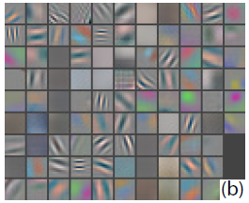
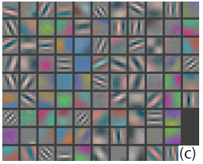
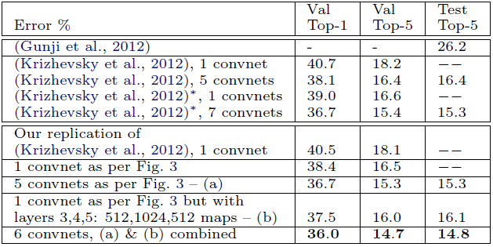
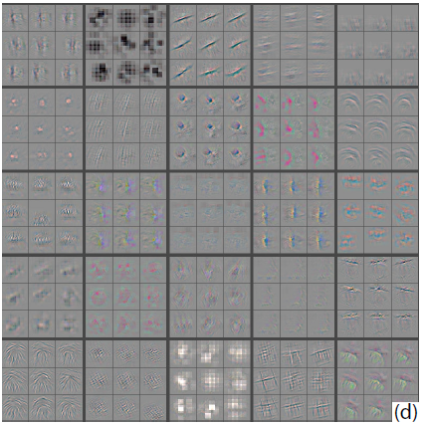
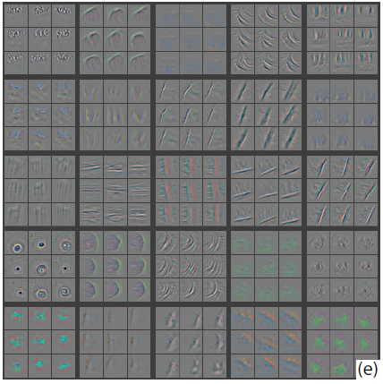
ZF-Net
Google LeNet
Reference
5) Model modification
1. Problem of Alexnet
1st layer : dead features due to large filter size and stride
- 2nd layer : aliasing artifacts caused by large stride
2. Solutions
Reduce 1st layer filter size from 11x11 to 7x7
Reduce stride of convolution in 1st and 2nd layer from 4 to 2
3. Result
Matthew D. Zeiler, Rob Fergus , Visualizing and Understanding Convolutional Networks, Nov, 2013

Slide 21
Google Lenet

Slide 22
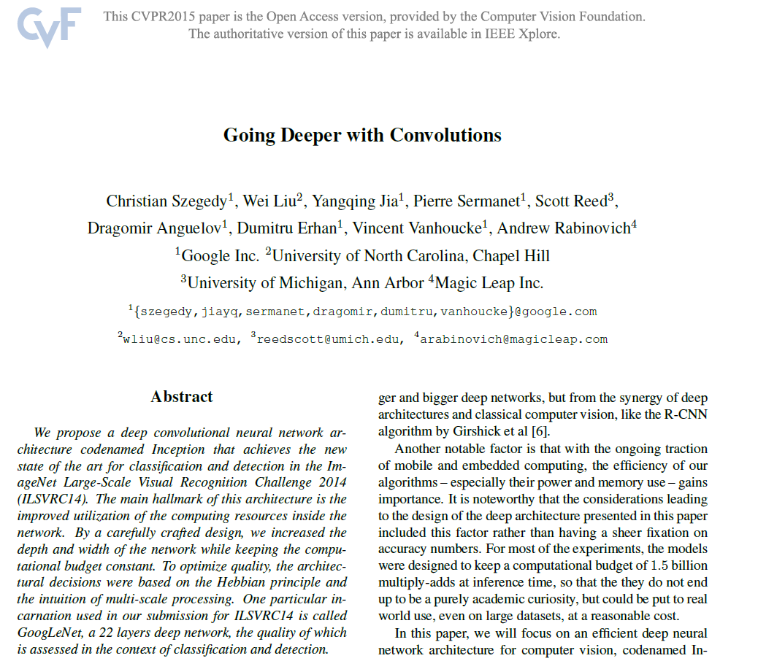
ZF-Net
Google LeNet
Reference

Slide 23
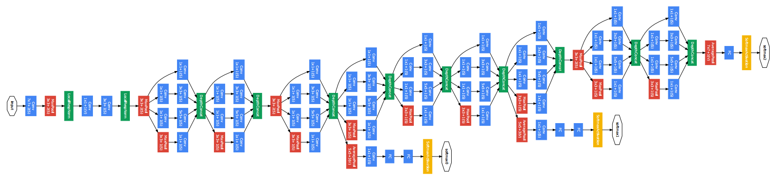
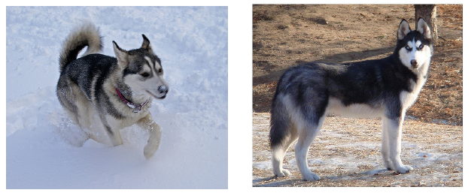
ZF-Net
Google LeNet
Reference
1) Idea
To improve performance of CNN : Increase size of network
Large number of parameters
Prone to overfitting
Need lots of good data (expensive)
2. Increase in computational resources
Make it Sparse!
- Inception module

Slide 24
ZF-Net
Google LeNet
Reference
2) Inception module
1) Main idea
Construct optimal local sparse structure Repeat it
“One can should analyze the correlation statistics of the last layer and cluster them into groups of units with high correlation” (Arora et al, 2013)
Assumption
Each unit from an earlier layer corresponds to some region of the input image
Units are grouped into filter banks
Highly correlated features
1x1 conv
Filter F
Input
Layer k

Slide 25
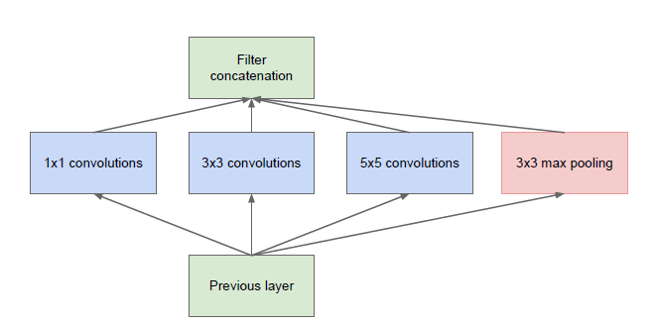
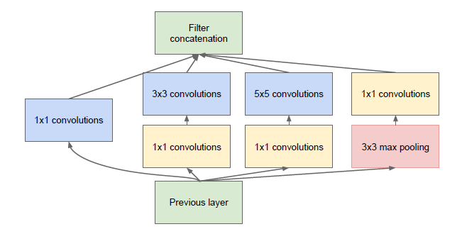
ZF-Net
Google LeNet
Reference
2) Inception module
2) Architecture
Inception module, naïve version
Q. Is 1x1 is enough????
35
15
15
10
15
15
15
15
10
10
5
15
15
15
15
3x3 conv
(3x3x5)
5x5 conv
(5x5x5)
1x1 conv
(1x1x5)
Max pooling
Problem : Filter depth is large when it goes deeper
5
15
2. Inception module with dimensionality reduction
- Introduce 1x1 conv for dimensionality reduction
15

Slide 26
ZF-Net
Google LeNet
Reference
2) Inception module
2) Architecture
2. Inception module with dimensionality reduction
# of parameters of 5x5 conv for same output
# of parameters of this inception module
5x5x128x96 = 307,200
(1x1x128)x(64+32+16+16) + (5x5x16)x8
+ (3x3x32)x8 = 21,888
96
# of parameters of naïve inception module
15
(1x1x128)x64 + (5x5x128)x8
+ (3x3x128)x8 = 43,008
15
8
15
8
15
16
15
15
3x3 conv
(3x3x32)
15
5x5 conv
(5x5x16)
15
1x1 conv
(1x1x128)
64
15
32
15
16
15
128
15
15
15
15
15
1x1 conv
(1x1x128)
1x1 conv
(1x1x128)
1x1 conv
(1x1x128)
Max pooling
128
15
15
Q. What about 2x2, 3x3 conv for dimensionality reduction?
: Compressed information is hard to process

Slide 27
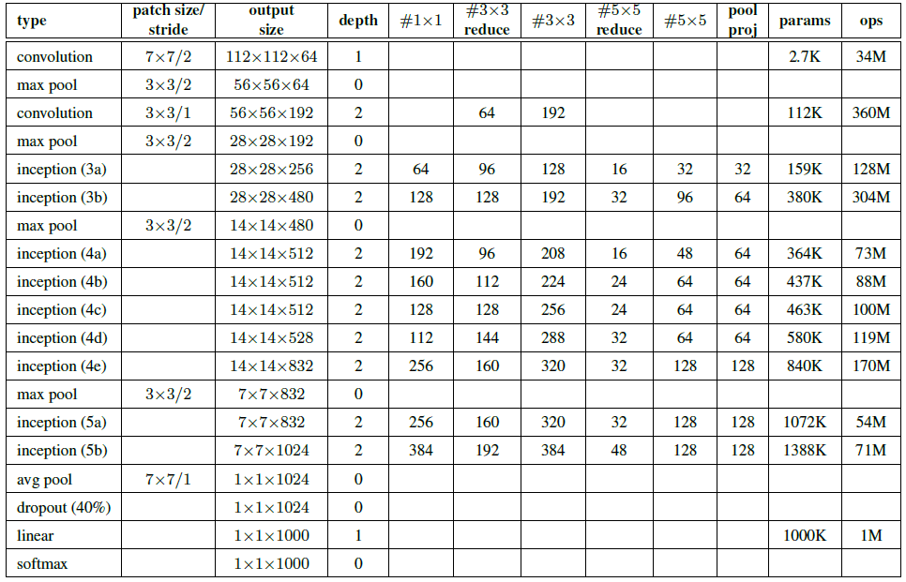
ZF-Net
Google LeNet
Reference
3) Model structure
Inception(5a)
Inception(5b)
Inception(4a)
Inception(4b)
Inception(4c)
Inception(4d)
Inception(4e)
Inception(3a)
Inception(3b)

Slide 28
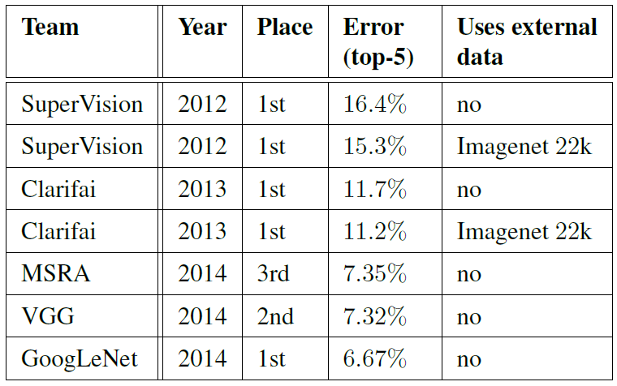
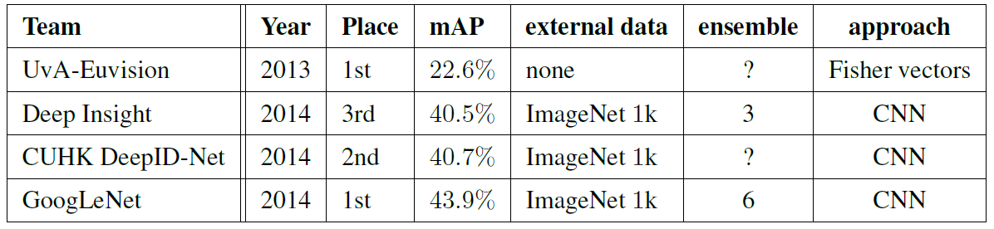
ZF-Net
Google LeNet
Reference
4) Result
1. Classification
2. Detection

Slide 29
ZF-Net
Google LeNet
Reference
Matthew D. Zeiler, Rob Fergus, “Visualizing and Understanding Convolutional Networks”, Nov, 2013
Matthew D. Zeiler, Graham W. Taylor, Rob Fergus,” Adaptive deconvolutional networks for mid and high level feature learning”, Nov, 2011
Matthew D. Zeiler, Dilip Krishnan, Graham W. Taylor, Rob Fergus, “Deconvolutional Networks”, In CVPR, 2010
Christian Szegedy, Wei Liu, Yangqing Jia, Pierre Sermanet, Scott Reed, Dragomir Anguelov, Dumitru Erhan, Vincent Vanhoucke, Andrew Rabinovich, “Going Deeper with Convolutions”, Sep, 2014
S. Arora, A. Bhaskara, R. Ge, T. Ma, “Provable bounds for learning some deep representations”, CoRR, 2013
Noh et.al, Learning Deconvolution Network for Semantic Segmentation, May, 2015
Jason Park, Image segmentation lecture note
http://dsba.korea.ac.kr/wp/wp-content/seminar/CS231n/CS231n%20seminar%20-%2013.%20Segmentation%20and%20attention-%20%EB%B0%95%EC%9E%AC%EC%84%A0.pdf
http://www.cs.toronto.edu/~guerzhoy/320/lec/upsampling.pdf
Anil Thomas, Object recognition lecture note
https://www.slideshare.net/nervanasys/anil-thomas-object-recognition?ref=http://neon.nervanasys.com/docs/latest/introductory_resources.html
http://distill.pub/2016/deconv-checkerboard/

Slide 30


