Slide 1

Dungeon Crawler
By MJ Schnee, Nick Bryant, and Freja Kahle
Advisor: Dr. John Gallagher
Notes:
FREJA START

Slide 2
Project Purpose and Goal Statements
Project Purpose
Develop a multiplayer dungeon crawler video game taking inspiration from the Dungeon & Dragons Adventure System board games
Goal Statements
Create a unique set of rules and mechanics for the game.
Allow players to connect online and play with others virtually.
Make a product that’s fun and easy to play with others.

Slide 3
Intellectual Merits
This project will focus on creating a virtual board game which can be played with others across the internet. The rules and mechanics of the game will be inspired by the game loop of the Dungeons & Dragons board games but will be original and unique. Since the game will be virtual, the rules and mechanics can be automated somewhat, which allows us to create mechanics that would not be possible with a physical game, such as automating random encounters. We will be using the Unity game engine to create the game along with the free assets it provides for students. The product should be a fun and unique cooperative online board game.

Slide 4
Broader Impacts
Our game will have an impact in the realm of entertainment and games. We believe the project will benefit society by bringing people together to play a cooperative game. Our desired outcome is simple: to have people enjoy playing our game.

Slide 5
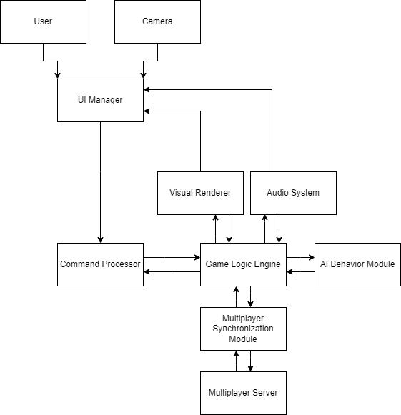
In-Depth Design Diagram

Slide 6

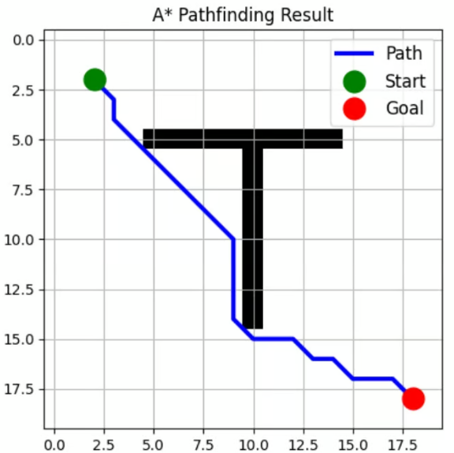
Technologies
Game-Engine
Unity, a modern game engine used by Indie and AAA developer studios alike.
AI
A* pathfinding and graph traversal algorithm. Similar to Dijkstra’s Algorithm but more informed and uses best-first-search. It attempts to take shortest path regardless of barriers and expands around obstacles to find shortest path in an optimal time.

Slide 7
Milestones
1/31 – A scene with simple UI and a character
2/7 – A scene with placeholder UI and character
2/14 – A scene with modeled, moveable, and turn-based players
2/21 – Dungeon exploration with placeholder combat
Beyond – End game goals, functioning combat, enemy variety, treasure

Slide 8
Results
So far, our game is turn-based with 2 movable characters that can explore 2 new dungeon tiles that will each spawn an enemy. Currently our game does not have combat implemented and is very limiting in exploration. We will be moving through our test plan and implementing as many high-impact features as possible, aiming for the best game we can create within our given time constraint.

Slide 9
Challenges
Time Constraint
Making a game in such a short time window is difficult. To remedy this, we set simple goals for ourselves to achieve weekly and ensured a playable demo each week to prove those goals were met.
Assets
Our game had no budget, and we don’t have artistic skills. To ensure our game looks good, we needed to utilize any student given assets (models, animations, sounds etc.).
Learning
All of us are new to game development, as such we needed to take our time and learn the complexities of it through the tutorials that our game engine provided.

