Slide 1

ML22/23-15 Approve Prediction of Multisequence Learning
Syed Faizan Ul Hassan Zahidi (1386370)
Muhammad Jasim Suhail (1393020)

Slide 2
Introduction
Understand MultisequenceLearning
Read dataset (multiple sequences) from saved file
Read test dataset (subsequences) from saved file
Calculate accuracy of predicted element
Create synthetic dataset (addition)

Slide 3
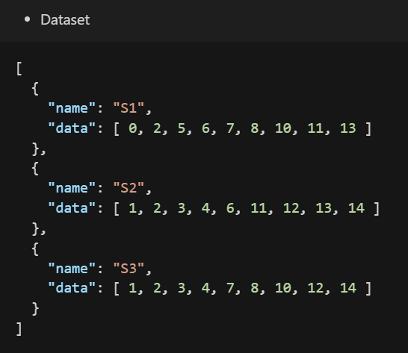
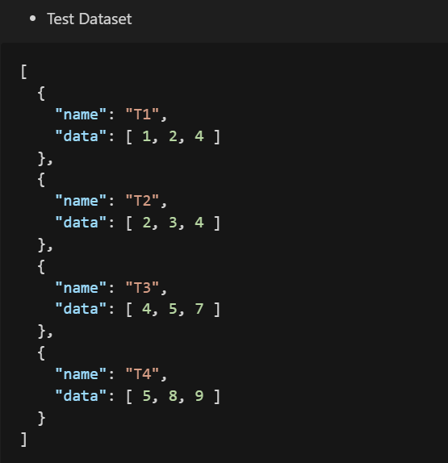
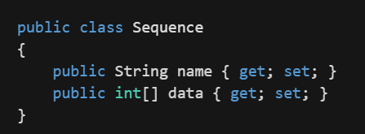
Implementation: Data Model
Sequence is the model of how we process and store the dataset.

Slide 4
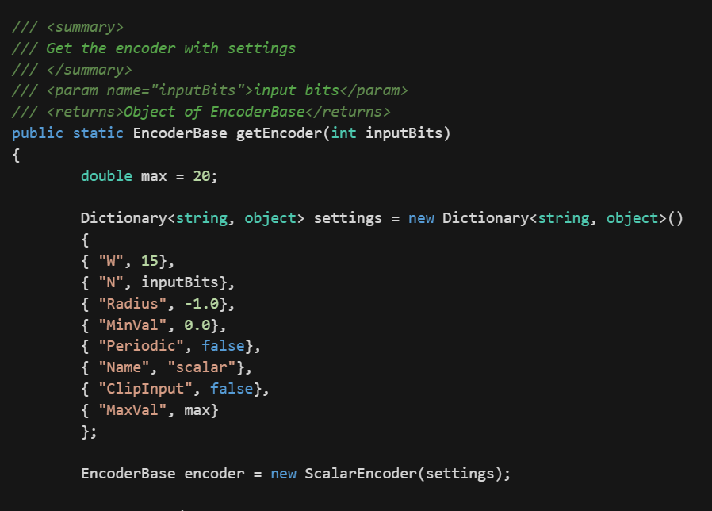
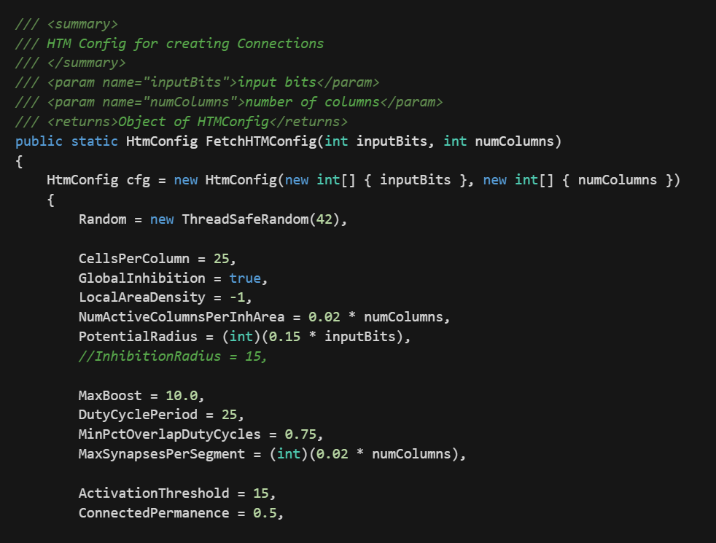
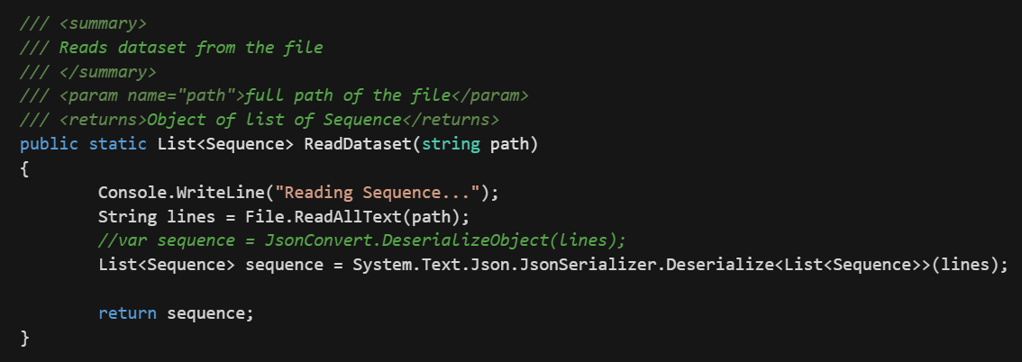
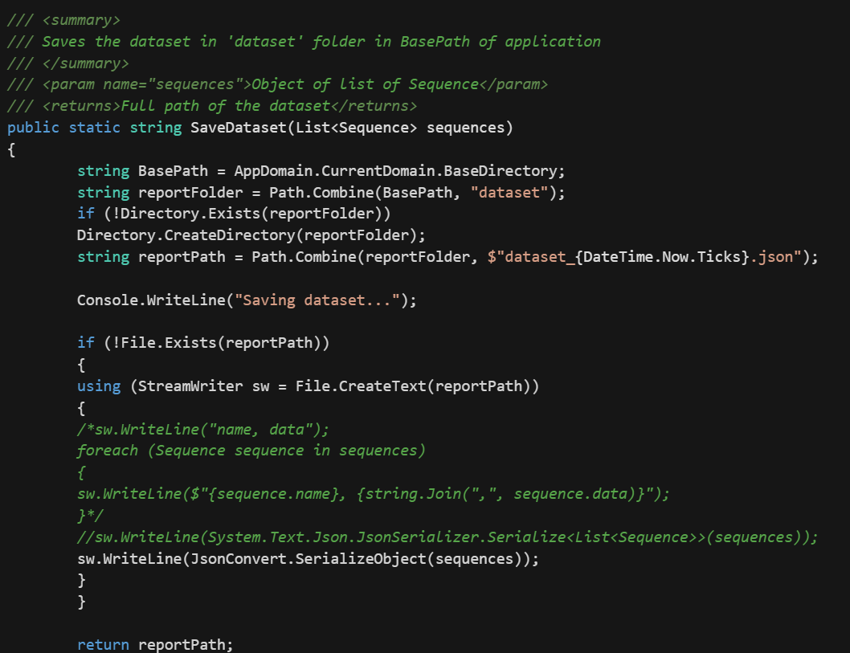
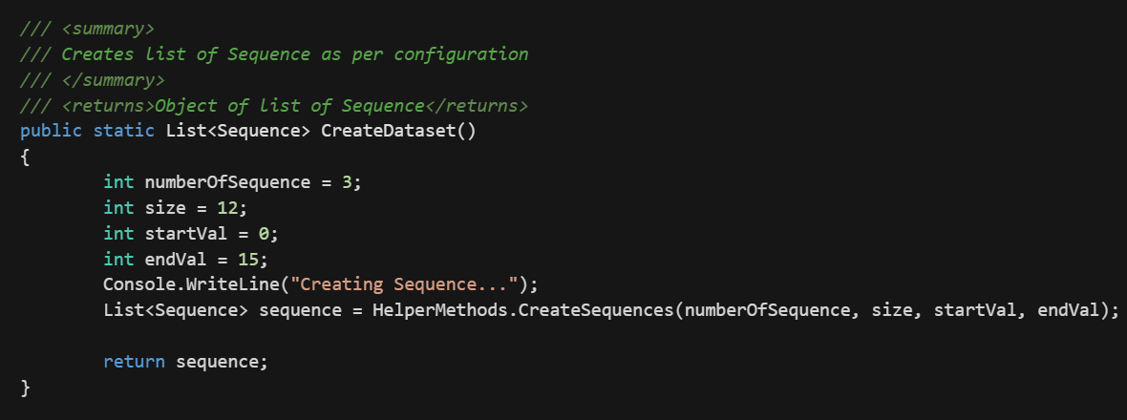
Implementation: Methods
FetchHTMConfig()
getEncoder()
ReadDataset()
CreateDataset()
SaveDataset()

Slide 5
Implementation: Synthetic Dataset
‘n’ number of sequences
‘x’ size of a sequence
‘a’ start range
‘b’ end range

Slide 6
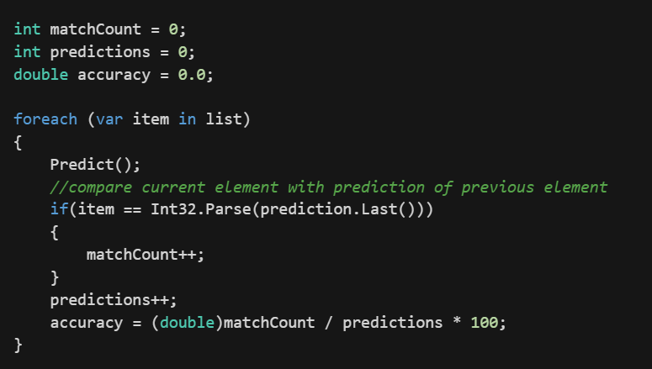
Implementation: Calculating accuracy
Calculating accuracy in PredictNextElement()

Slide 7
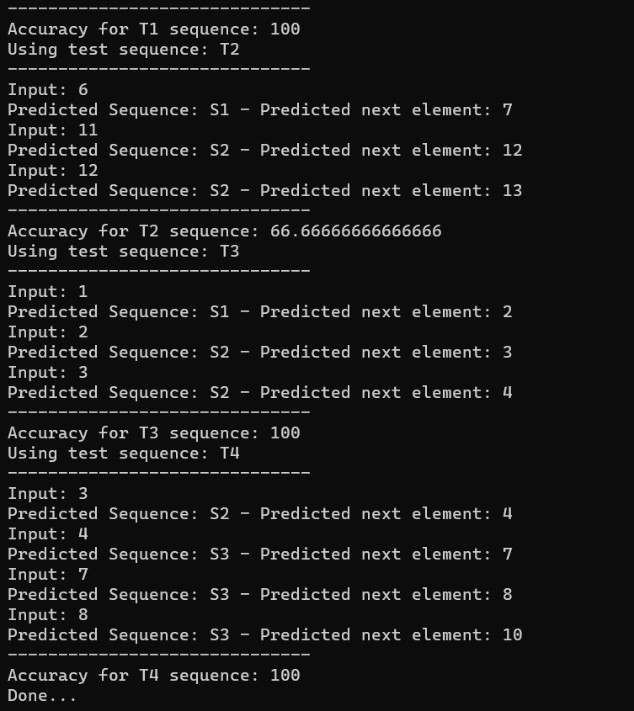
Results
Ran max possible number of times
Tried different dataset

Slide 8
Improvements
Need to create test data out of synthetic dataset
Run in cloud for fast execution
Configuration file for configuration of synthetic dataset

Slide 9

Thankyou

