Slide 1
딥러닝 AlexNet 논문 리뷰
2070031 박민지

Slide 2
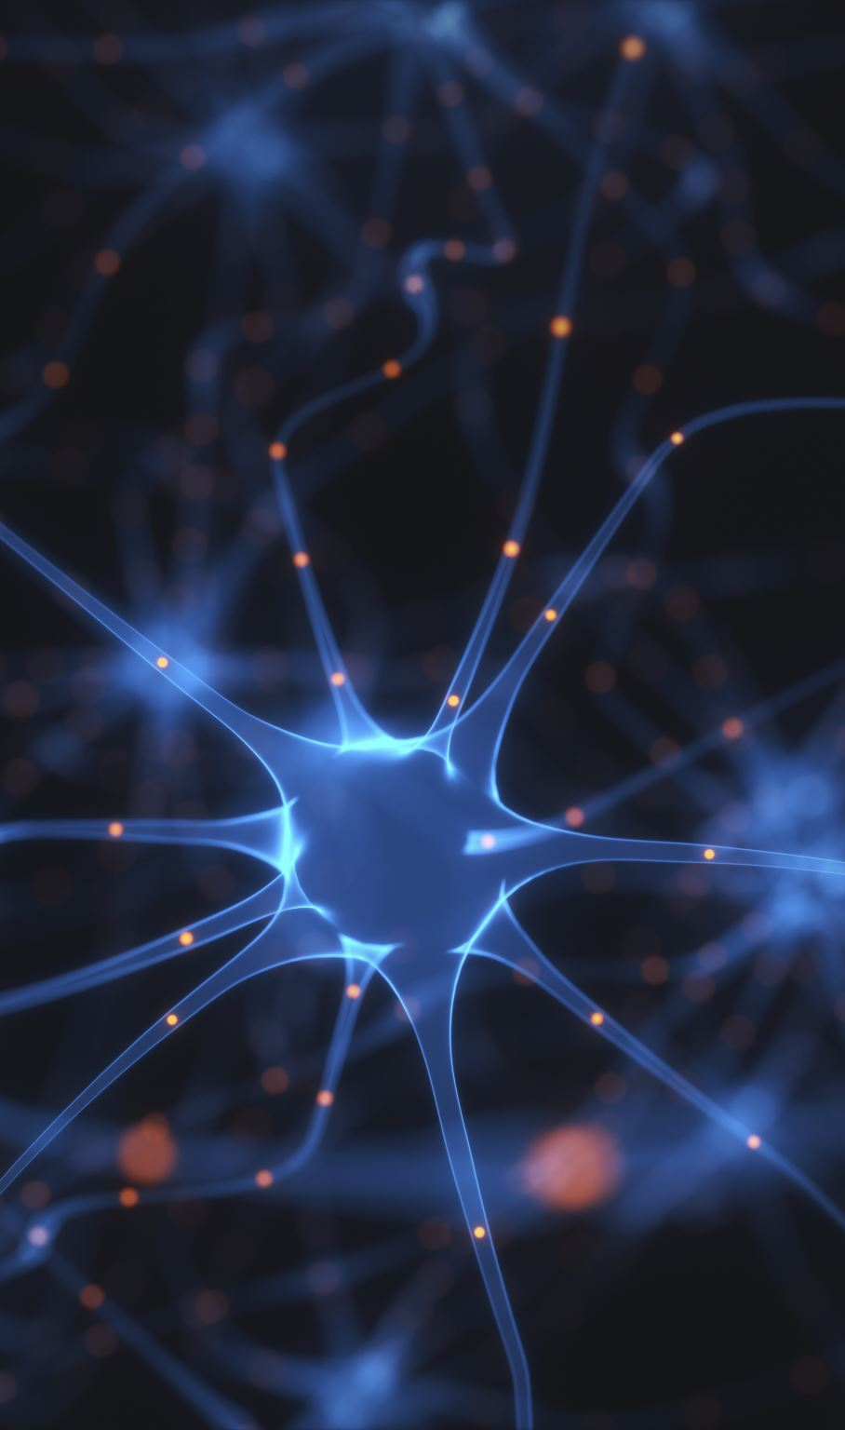
ImageNet Classification with Deep Convolutional Neural Networks
Alex Krizhevsky
Ilya Sutskever
Geoffrey E. Hinton

Slide 3
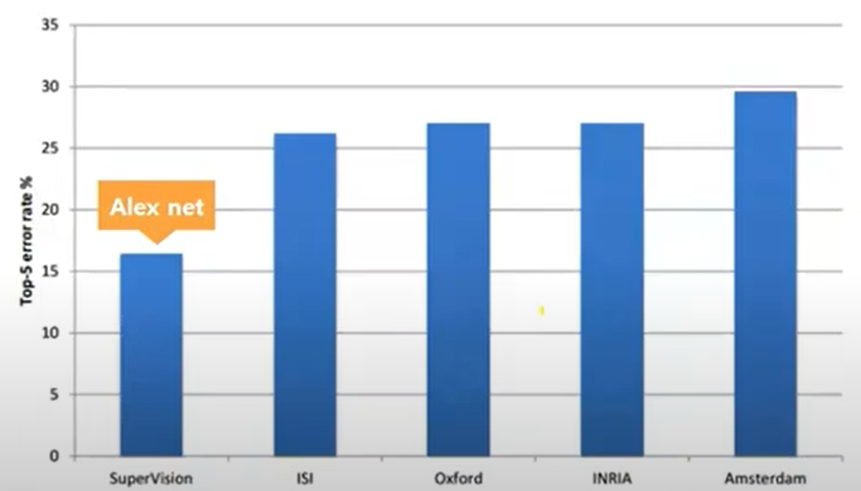
Abstract
To classify the 1.2 million high-resolution images in the ImageNet ILSVRC-2010 contest into the 1000 different classes.
Large deep convolutional neural network
Top-1 error rates 37.5%, top-5 error rates 17.0%
5 convolutional layers (some of which are followed by max-pooling layers) + 3 fully connected layers with1000-way softmax
Non-saturating neurons, a very efficient GPU implementation of the convolution operation, dropout
Achieved first-best entry in ILSVRC-2012.

Slide 4
1. Introduction
CNN 모델 선정 이유:
compared to standard feedforward neural networks with similarly sized layers, CNNs have much fewer connections and parameters and so they are easier to train, while their theoretically best performance is likely to be only slightly worse.
좋은 GPU들과 충분한 양의 label 된 데이터들 덕분에 거대한 모델을 학습시킬 수 있었다.
과정/성과 요약:
one of the largest CNNs, achieved good results.
Contains a number of new and unusual features => improve its performance and reduce its training time. (Section 3)
Used several effective techniques for preventing overfitting (Section 4)
5 convolutional layers + 3 fully-connected layers. Removing any convolutional layer => inferior performance.
The network’s size is limited mainly by the amount of memory available on current GPUs and by the amount of training time.

Slide 5
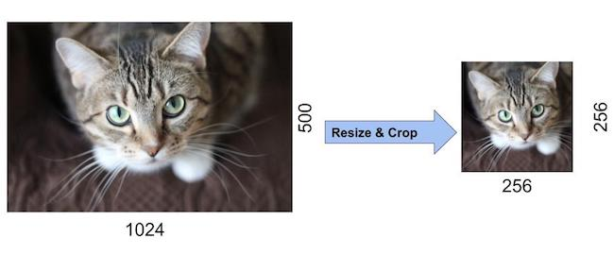
2. The Dataset
ILSVRC-2010: only version of ILSVRC for which the test set labels are available
Variable-resolution images -> fixed resolution of 256 x 256
Did not pre-process the images except for subtracting the mean activity over

Slide 6
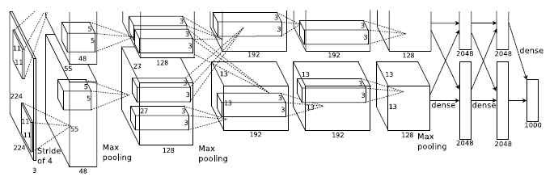
3. The Architecture
8 learned layers <= 5 convolutional + 3 fully-connected

Slide 7
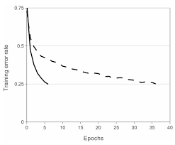
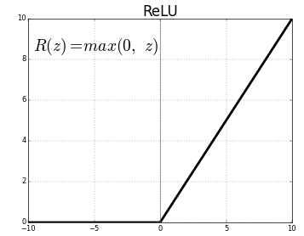
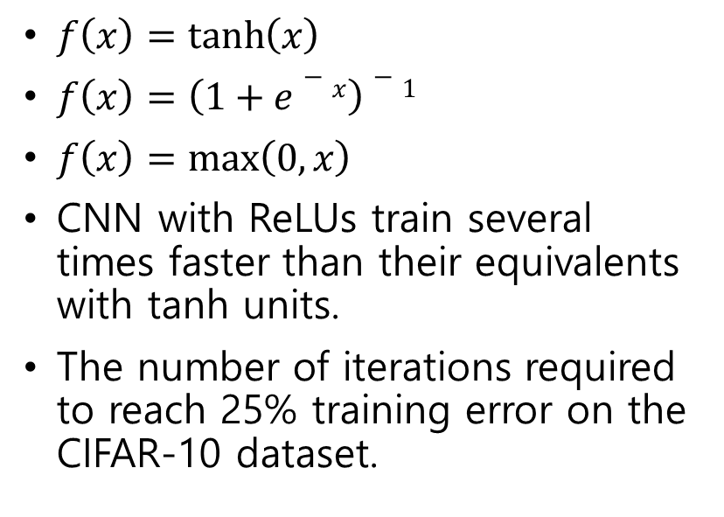
3.1 ReLU Nonlinearity
$f\left(x\right)=\tanh\left(x\right)$
$f\left(x\right)=\left(1+e−x\right)−1$
$f\left(x\right)=\max\left(0, x\right)$
CNN with ReLUs train several times faster than their equivalents with tanh units.
The number of iterations required to reach 25% training error on the CIFAR-10 dataset.

Slide 8

3.2 Training on Multiple GPUs
Spread the net across two GPUs.
Cross-GPU parallelization.
Puts half of the kernels (or neurons) on each GPU.
The GPUs communicate only in certain layers.
Reduces top-1 and top-5 error rates by 1.7% and 1.2%.
The two-GPU net takes slightly less time to train than the one-GPU net.

Slide 9
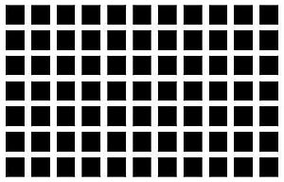
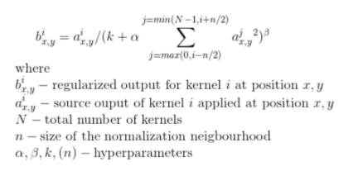
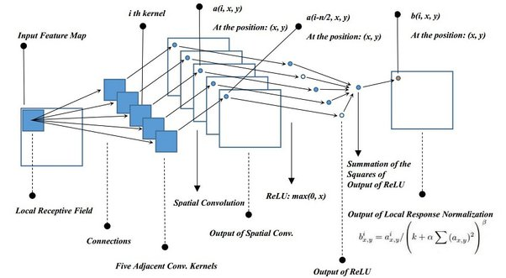

3.3 Local Response Normalization
ReLUs do not require input normalization to prevent them from saturating.
However, we still find that the following local normalization scheme aids generalization.
Implements a form of lateral inhibition.
$k=2, n=5, α=10−4, β=0.75$
Brightness normalization
Responses normalization reduces our top-1 and top-5 error rates by 1.4% and 1.2%, respectively.
Notes:
lateral inhibition 현상을 모델링한 것이 바로 local response normalization이다. Lateral inhibition은 강한 뉴런의 활성화가 다른 주변 뉴런을 억제하는 현상. 강하게 활성화된 뉴런의 주변 이웃들에 대해서 normalization을 실행한다. 주변에 비해 어떤 뉴런이 비교적 강하게 활성화되어 있다면, 그 뉴런의 반응은 더욱더 돋보이게 될 것이다. 반면 강하게 활성화된 뉴런 주변도 모두 강하게 활성화되어 있다면, local response normalization 이후에는 모두 값이 작아질 것이다.
요새는 LRN 안쓰고 Batch Normalization을 주로 쓴다고 한다.

Slide 10
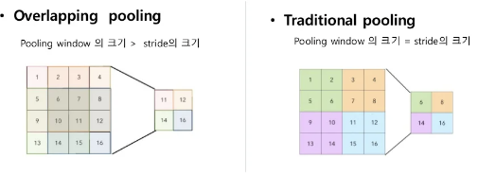
3.4 Overlapping Pooling
Pooling layers in CNNs summarize the outputs of neighboring groups of neurons in the same kernel map.
Traditional local pooling: s = z
Overlapping pooling: s < z
S = 2, z = 3
Reduces the top-1 and top-5 error rates by 0.4% and 0.3%, respectively, as compared with the non-overlapping scheme s = 2, z = 2
models with overlapping pooling find it slightly more difficult to overfit.

Slide 11
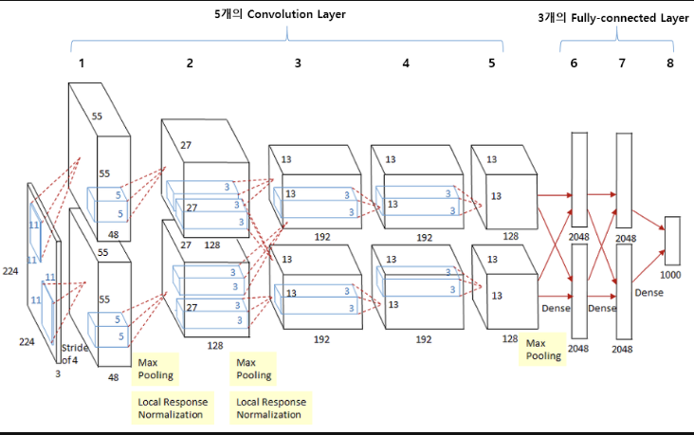
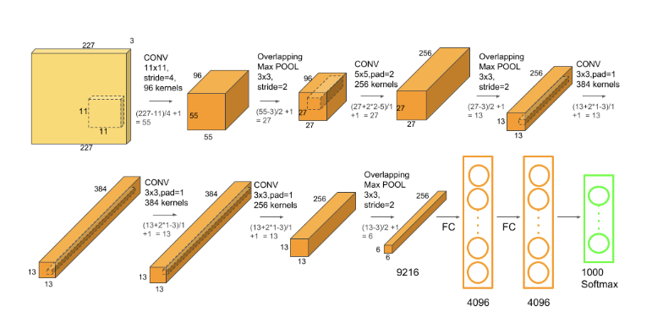
3.5 Overall Architecture

Slide 12
4. Reducing Overfitting
60 million parameters.
Two primary ways in which we combat overfitting

Slide 13
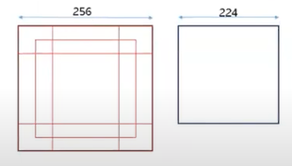
4.1 Data Augmentation
The easiest and most common method to reduce overfitting on image data is to artificially enlarge the dataset.
1. generating image translations and horizontal reflections.
- extract random 224 x 224 patches (and their horizontal reflections) from the 256 x 256 images
- (256-224)x(256-224)x2=2048.
- test time: extract five 224x224 patches as well as their horizontal reflections, hence 10 patches.
2. altering the intensities of the RGB channels in training images.

Slide 14
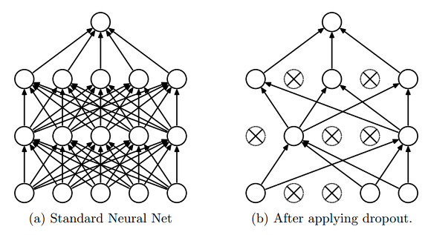
4.2 Dropout
A very efficient version of model combination.
Zero the output of each hidden neuron with probability 0.5.
The neurons which are dropped out do not contribute to the forward pass and do not participate in back-propagation.
Every time an input is presented, the neural network samples a different architecture. All these architectures share weights.
Reduces complex co-adaptations of neurons, since a neuron cannot rely on the presence of other neurons. It is forced to learn more robust features that are useful in conjunction with many different random subsets of the other neurons.
At test time, we use all the neurons but multiply their outputs by 0.5
Cf) co-adaptations(상호 적응): 신경망 학습 시, 어느 시점에서 같은 층의 두 개 이상의 노드의 입력 및 출력 연결 강도가 같아지면, 아무리 학습이 진행되어도 그 노드들은 같은 일을 수행하게 되어 불필요한 중복이 생기는 문제. 구체적으로, 결국 여러 노드들이 하나의 노드로 작동하는 것으로써, 이후 어떠한 학습을 통해서도 다른 값으로 나눠질 수 없고 노드의 낭비가 발생. 컴퓨팅 파워와 메모리의 낭비. 그리고 영향력이 강한 노드는 더 강해지고 약한 노드는 더 약해지다가 overfitting이 된다.
Notes:
다양한 모델로 예측해서 예측을 종합하는게 test error를 줄이는데 매우 좋지만, 이건 이런 큰 neural network에서는 너무 많은 것이 요구된다. 하지만 이 여러 모델을 컴비네이션하는 것의 매우 효율적인 버전이 있는데, 그것이 드롭아웃.

Slide 15
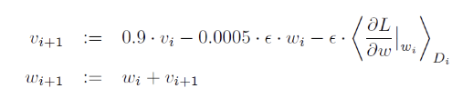
5. Details of learning
Optimizer: SGD + momentum(0.9)
Batch size: 128
Weight decay: 0.0005
Initialized the weights in each layer from a zero-mean Gaussian distribution with standard deviation 0.01. Initialized the neuron biases in the second, fourth, and fifth convolutional layers, as well as in the fully-connected hidden layers, with the constant 1. This initialization accelerates the early stages of learning by providing the ReLUs with positive inputs. Initialized the neuron biases in the remaining layers with the constant 0.
Learning rate: divide the learning rate by 10 when the validation error rate stopped improving with the current learning rate. The learning rate was initialized at 0.01. It reduced 3 times prior to termination.
Trained the network for roughly 90cycles.
Notes:
i 는 iteration, v는 momentum 변수, e는 learning rate라고 합니다. 마지막 <dl/dw> 식은 i번째 batch에서 W_i를 사용하여 구한 gradient들의 평균이다.

