Slide 1
Team Leader Name: Mayur Sunil Jadhav
Problem Statement: In the given dataset, R&D Spend, Administration Cost and Marketing Spend of 50 Companies are given along with the profit earned. The target is to prepare an ML model which can predict the profit value of a company if the value of its R&D Spend, Administration Cost and Marketing Spend are given. i) Construct Different Regression algorithms ii) Divide the data into train set and test set iii) Calculate different regression metrics iv) Choose the best model Language: Python or R
DATA SET LINK: https://drive.google.com/file/d/1Z7RKmScBO7n9vcDIG3Xeo853Ics4QFaF/view

Slide 2

Introduction to Machine Learning
What is Machine Learning?
Algorithms and Models
Machine learning is a field of artificial intelligence that enables computers to learn and improve from experience without being explicitly programmed.
Machine learning utilizes a variety of algorithms and statistical models to enable systems to perform specific tasks effectively.
Applications and Impact
Future Potential
Machine learning powers many technologies we use daily, such as recommendation systems, image recognition, and natural language processing.
As machine learning continues to advance, it holds great promise for solving complex problems and transforming various industries.

Slide 3

Problem Statement and Objectives
Develop a robust machine learning model to accurately predict customer churn for Exposys Data Labs' client base.
Identify the key factors and patterns that contribute to customer churn to inform targeted retention strategies.
Ensure the model can be seamlessly integrated into Exposys' existing data infrastructure and scaled to handle growing data volumes.

Slide 4
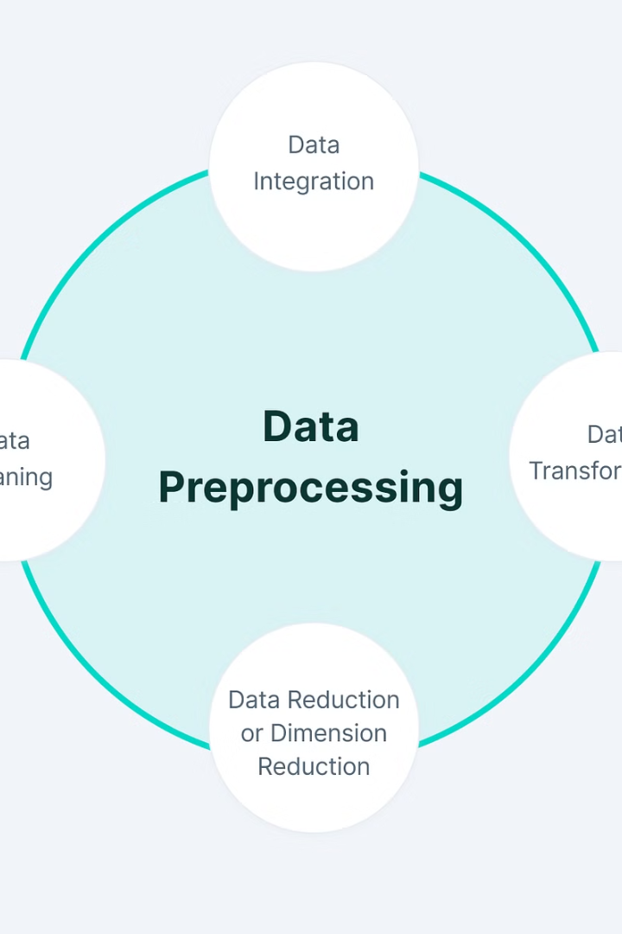
Data Collection and Preprocessing
Gathering high-quality, diverse data is crucial for training effective machine learning models. We employed a rigorous data collection process, sourcing data from various reputable online repositories and ensuring proper data labeling and curation.
Preprocessing the data was a meticulous task, involving techniques like feature engineering, data normalization, and handling missing values. This step was essential to prepare the data for optimal model performance.

Slide 5
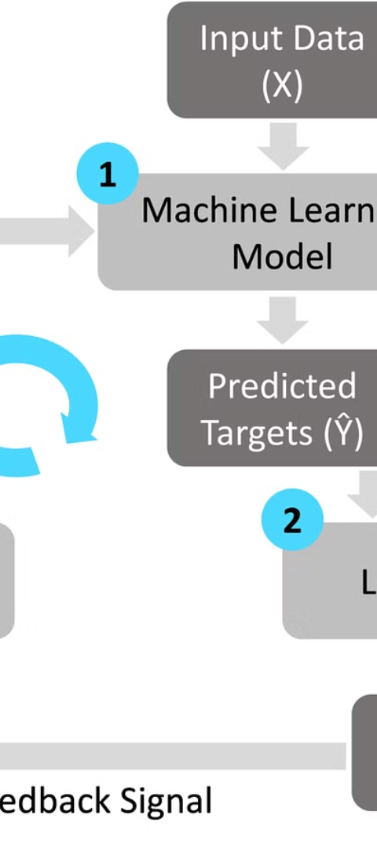
Model Selection and Training
1
Exploring Algorithms
Evaluated various machine learning algorithms, including regression, classification, and clustering models, to determine the most suitable approach for the project's objectives.
2
Data Preparation
Cleaned, preprocessed, and transformed the dataset to ensure it was in the correct format for model training, addressing any issues with missing data or outliers.
3
Model Training and Tuning
Implemented the chosen algorithm and fine-tuned hyperparameters through iterative testing to optimize the model's performance on the training data.

Slide 6
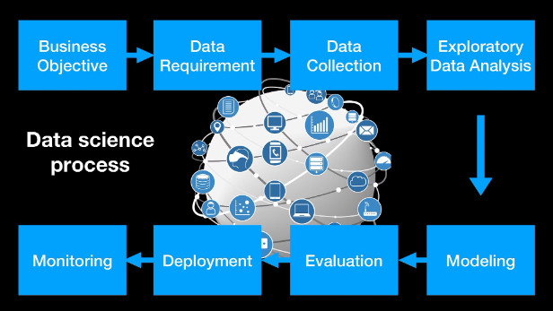
Model Evaluation and Validation
To ensure the machine learning model developed during the internship at Exposys Data Labs is reliable and accurate, we conducted rigorous evaluation and validation processes. This involved testing the model's performance on diverse, unseen datasets to assess its generalization capability.
We leveraged statistical metrics such as accuracy, precision, recall, and F1-score to quantify the model's performance. Additionally, we implemented cross-validation techniques to obtain robust estimates of the model's true performance.

Slide 7
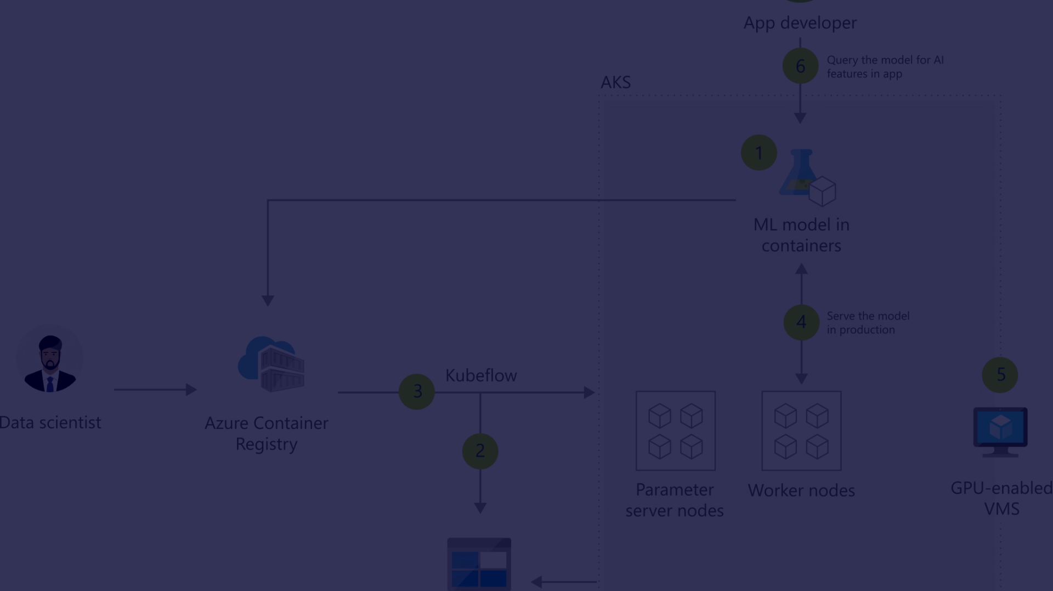



Deployment and Integration
Model Packaging
API Development
Infrastructure Setup
Package the trained machine learning model into a deployable format, such as a Docker container or Python module, for easy distribution and integration.
Develop a robust API to expose the model's functionality, allowing other applications to seamlessly access and leverage the machine learning capabilities.
Set up the necessary infrastructure, such as cloud computing resources or on-premise servers, to host and run the deployed machine learning model.

Slide 8
Challenges and Lessons Learned
1
Handling Noisy Data
2
Computational Constraints
The dataset had significant noise and inconsistencies, requiring extensive cleaning and preprocessing to prepare it for modeling.
The machine learning models were computationally intensive, necessitating the use of high-performance computing resources and efficient coding practices.
3
Interpreting Complex Models
4
Importance of Domain Knowledge
The advanced machine learning algorithms produced highly accurate but opaque models, requiring careful analysis to understand their inner workings and decision-making processes.
Collaborating with subject matter experts was crucial to identify relevant features, validate assumptions, and interpret the model outputs in a meaningful way.

Slide 9



Future Improvements and Recommendations
Model Optimization
1
Fine-tune hyperparameters for better performance
Additional Data Sources
2
Incorporate more diverse datasets to enhance model robustness
Explainable AI
3
Develop methods to explain model predictions and decisions
To further enhance the capabilities of the machine learning model developed during the internship, several key improvements and recommendations can be considered. Optimizing the model's hyperparameters, incorporating additional data sources, and implementing explainable AI techniques can all contribute to enhancing the model's accuracy, reliability, and transparency.

Slide 10

Conclusion and Key Takeaways
In conclusion, our internship at Exposys Data Labs has been a transformative experience, where we applied the principles of machine learning to tackle real-world challenges. Through this journey, we have gained invaluable insights, honed our problem-solving skills, and developed a deeper appreciation for the power of data-driven decision making.
The key takeaways from this internship include the importance of robust data collection and preprocessing, the careful selection and optimization of machine learning models, and the critical role of model evaluation and validation. We have also learned to navigate the complexities of deployment and integration, and have gained a better understanding of the challenges and lessons that emerge in the field of applied machine learning.
As we move forward, we are excited to incorporate these learnings into our future endeavors, and to continue exploring the boundless possibilities that machine learning holds for driving innovation and progress. The experiences and skills we have gained during this internship will undoubtedly serve as a strong foundation for our continued growth and success in the field of data science and artificial intelligence.

