Slide 1

Dokumentation – Hands On Session
Mikka Jenne
19. November 2020

Slide 2
Agenda
Überblick
Einrichten der IDE Visual Studio Code
Erstellen und Aufsetzen eines Firebase Projekts
Einblick in die Konsole
Veranschaulichung CRUD

Slide 3
Überblick
Hands On Session
Erstellen und Aufsetzen eines Firebase Projekts
Einblick und Aufbau der Firebase Konsole
CRUD Operationen an einem Beispiel

Slide 4
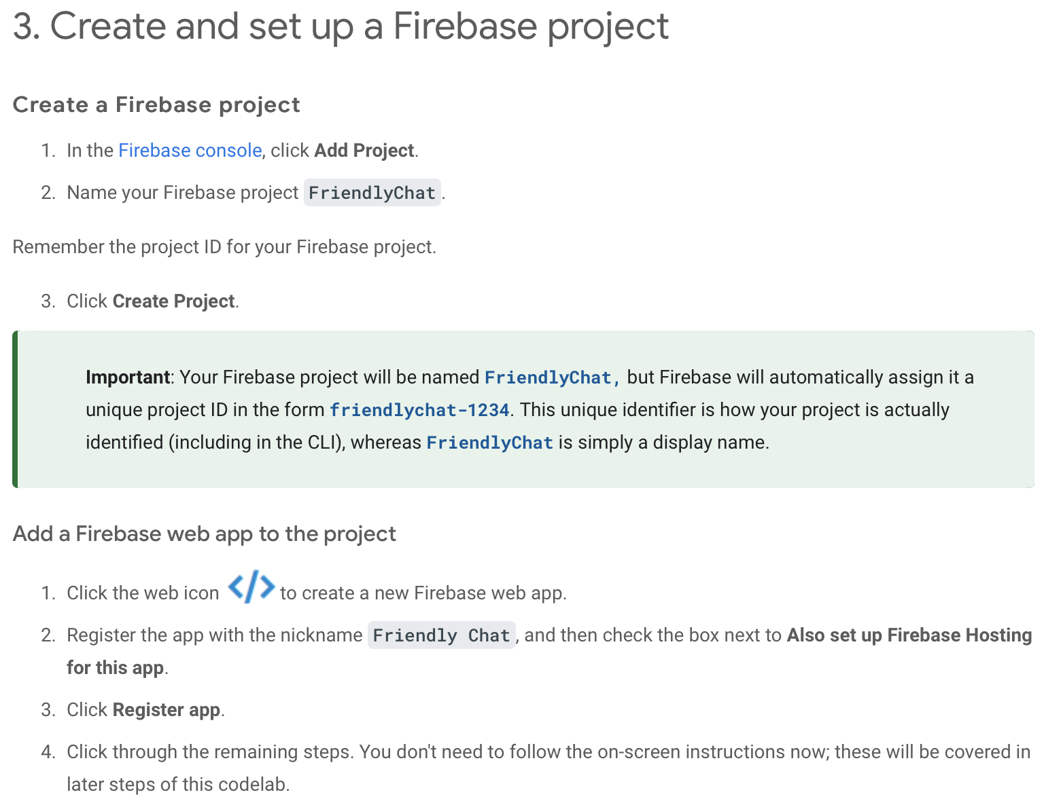
Erstellen eines Firebase Projekts

Slide 5
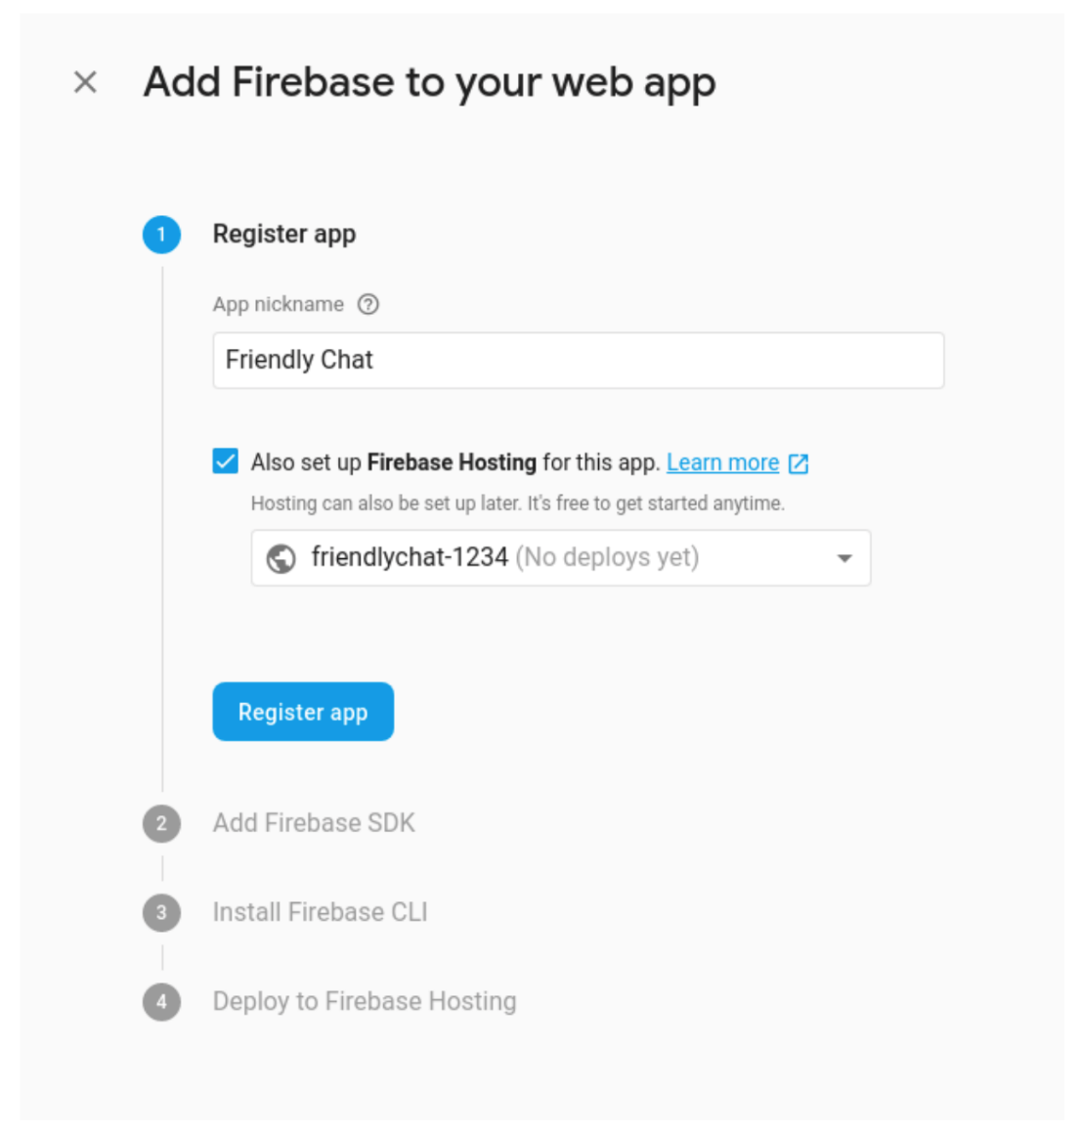
Erstellen eines Firebase Projekts

Slide 6
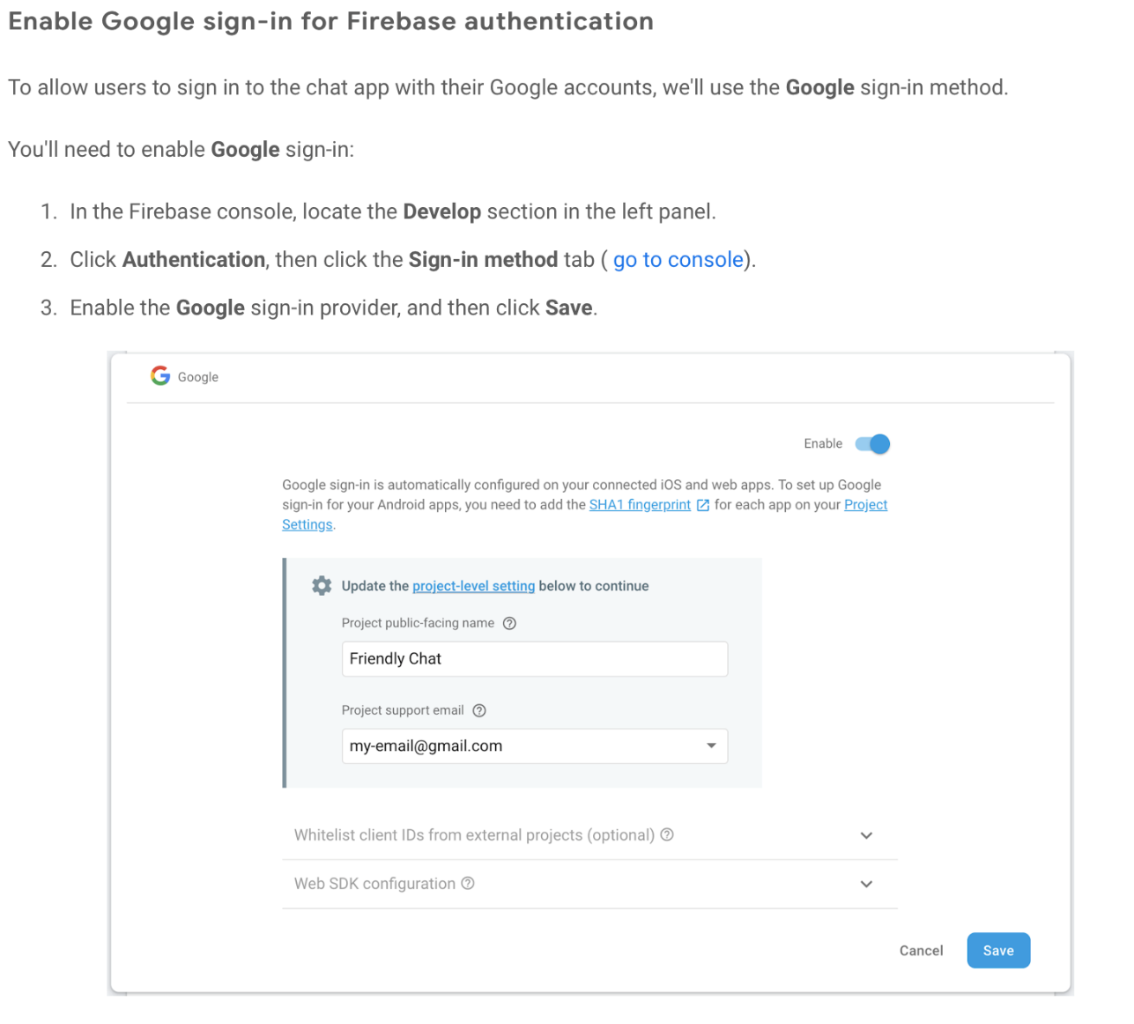
Erstellen eines Firebase Projekts

Slide 7
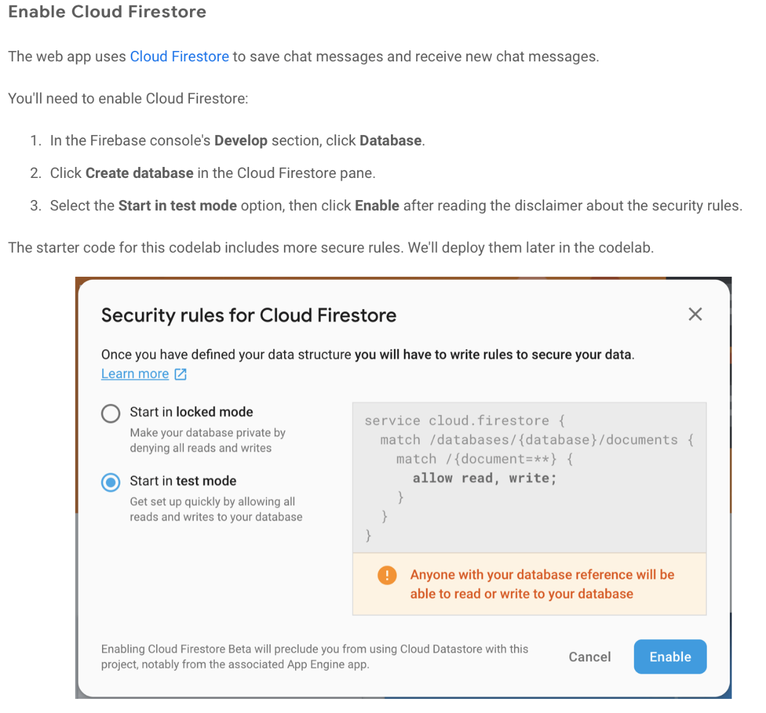
Erstellen eines Firebase Projekts

Slide 8
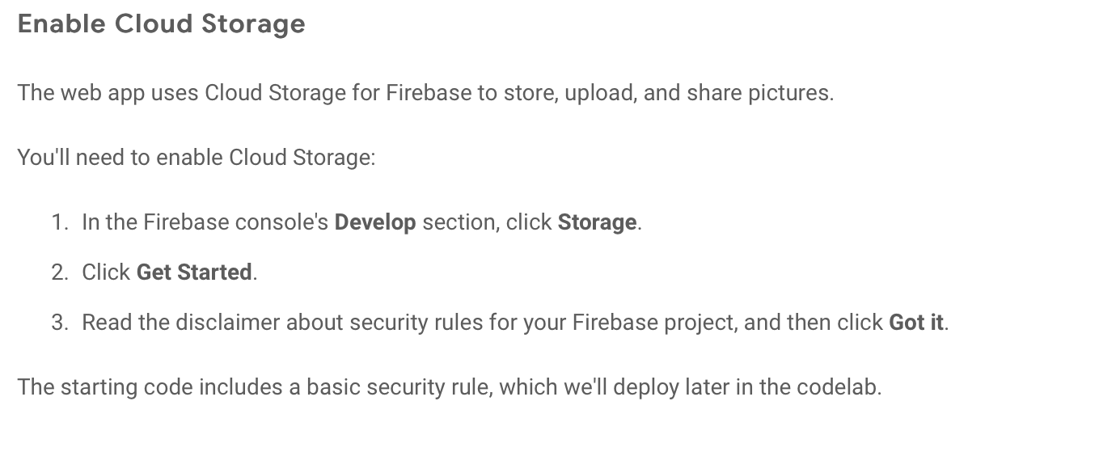
Erstellen eines Firebase Projekts

Slide 9
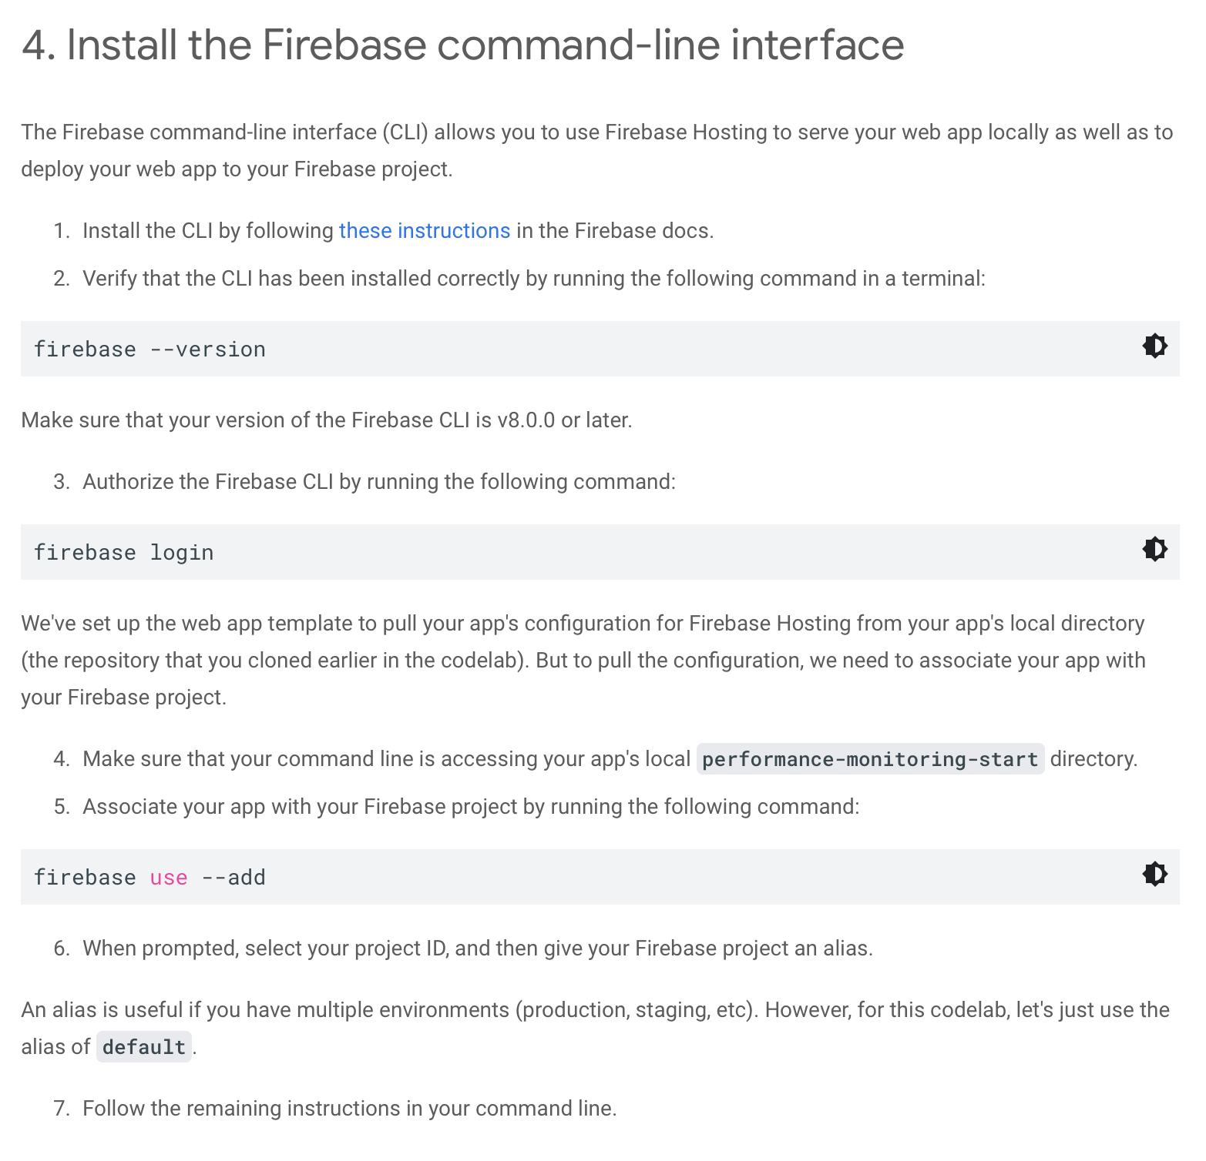
Erstellen eines Firebase Projekts

Slide 10
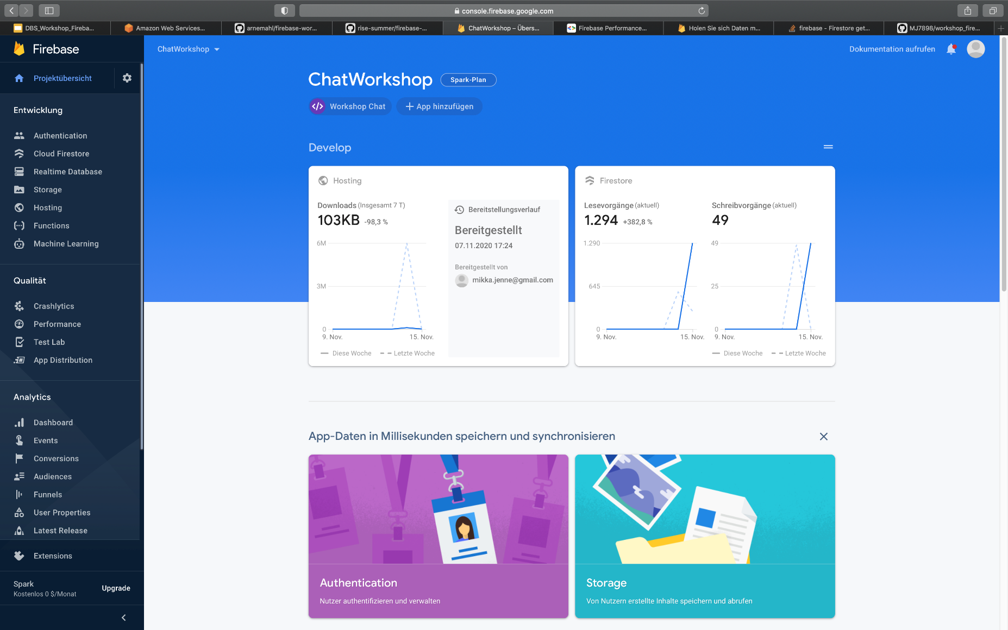
Einblick in die Konosle

Slide 11
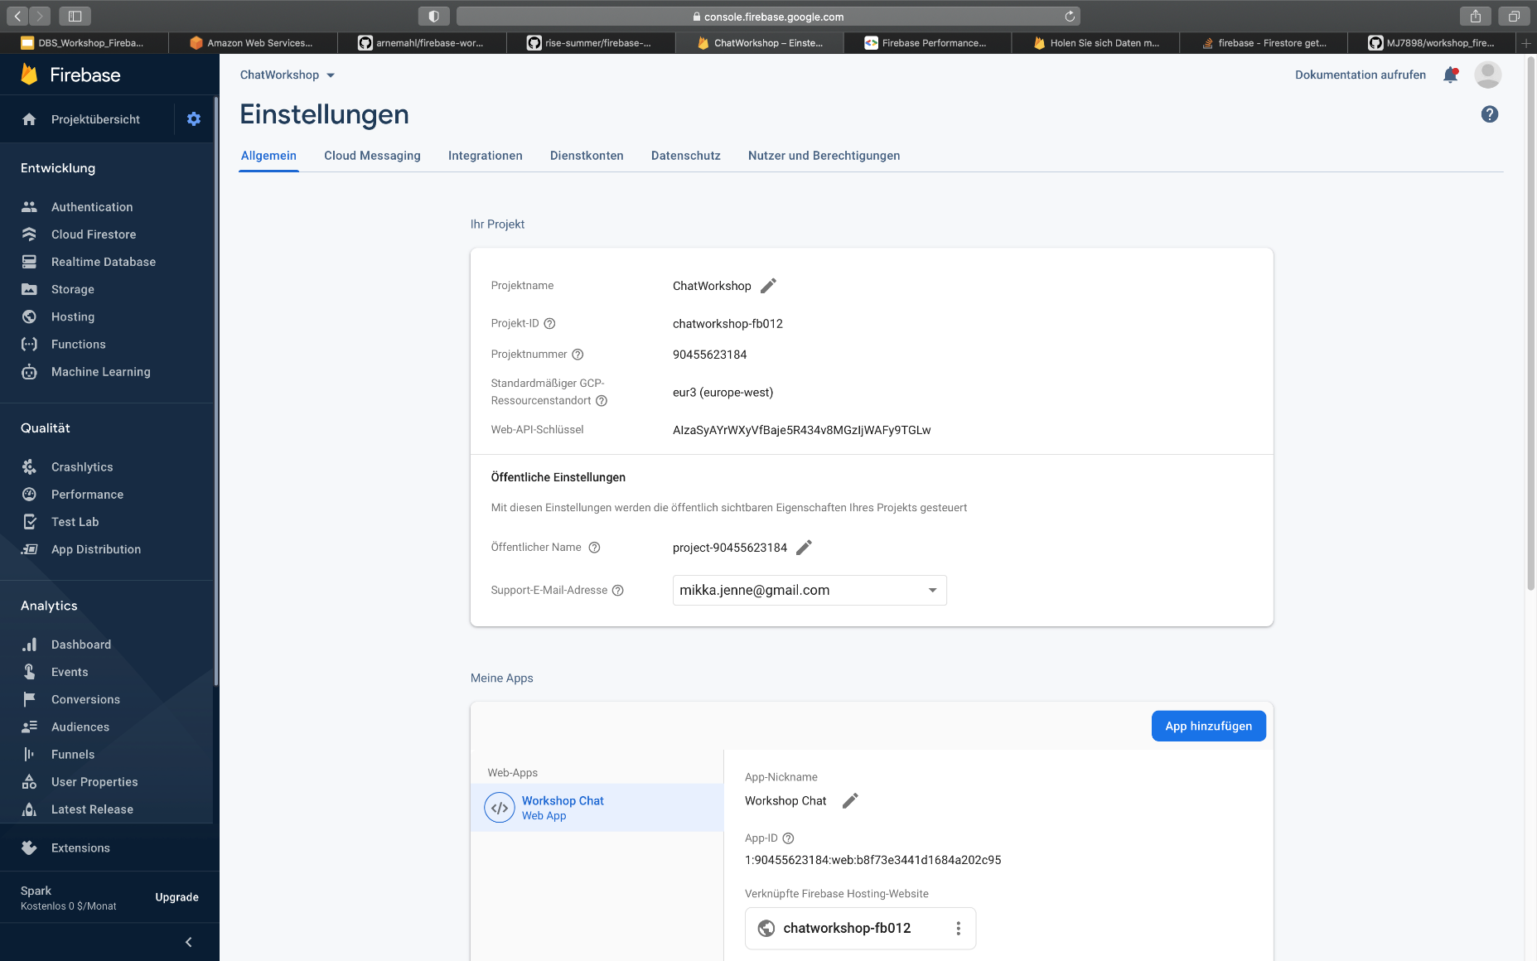
Einblick in die Konosle

Slide 12
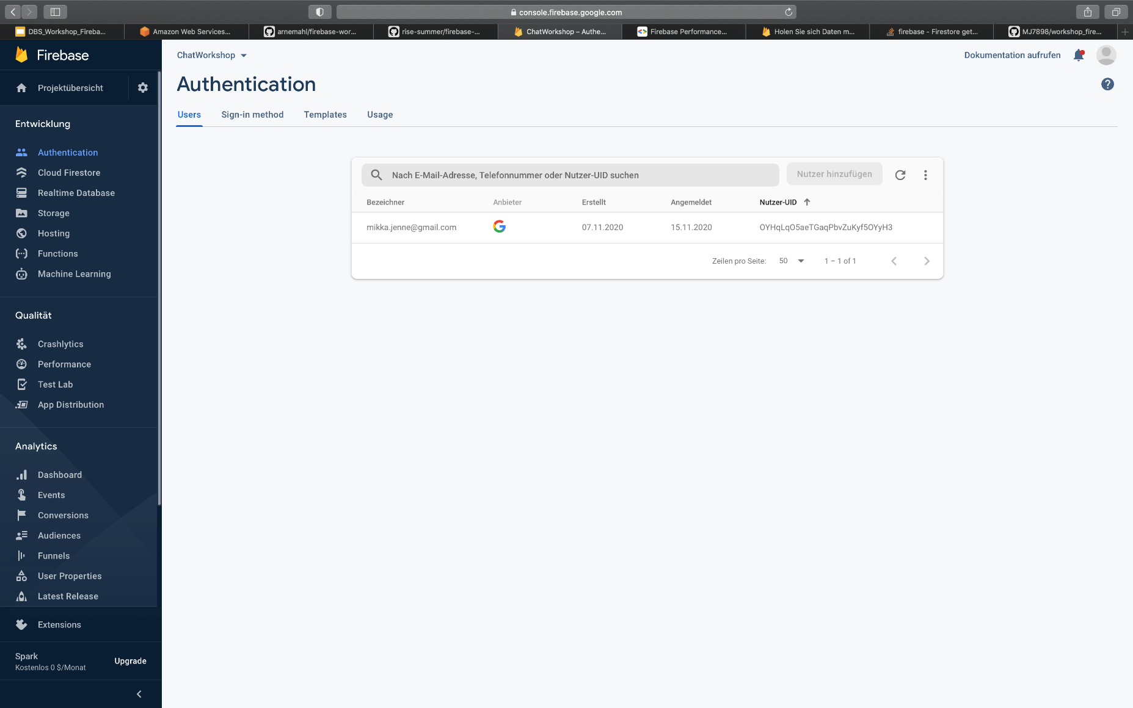
Einblick in die Konosle

Slide 13
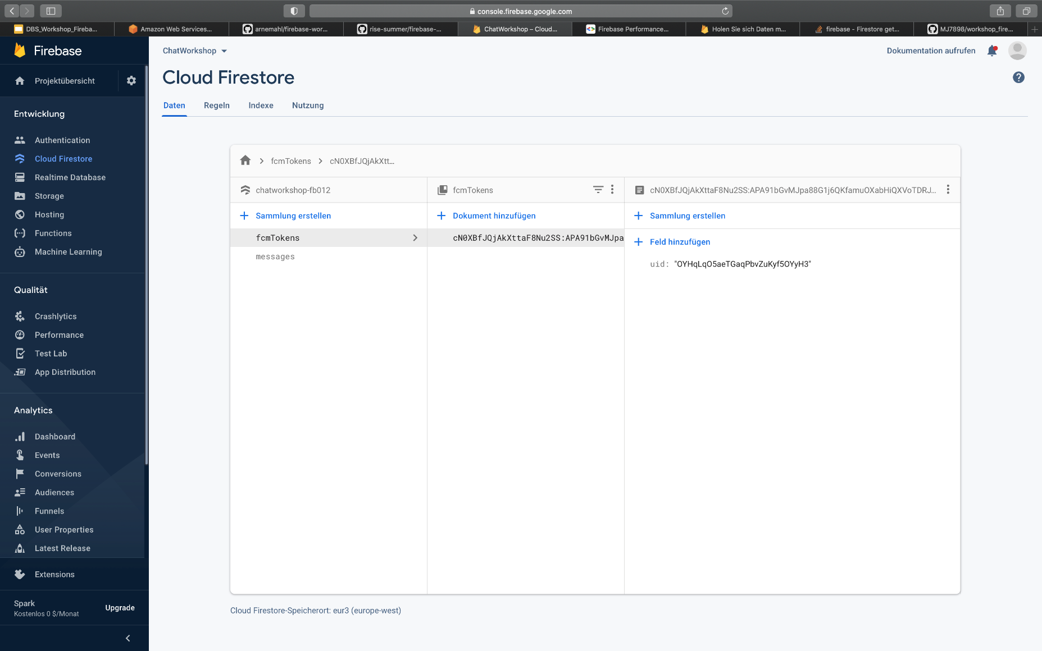
Einblick in die Konosle

Slide 14
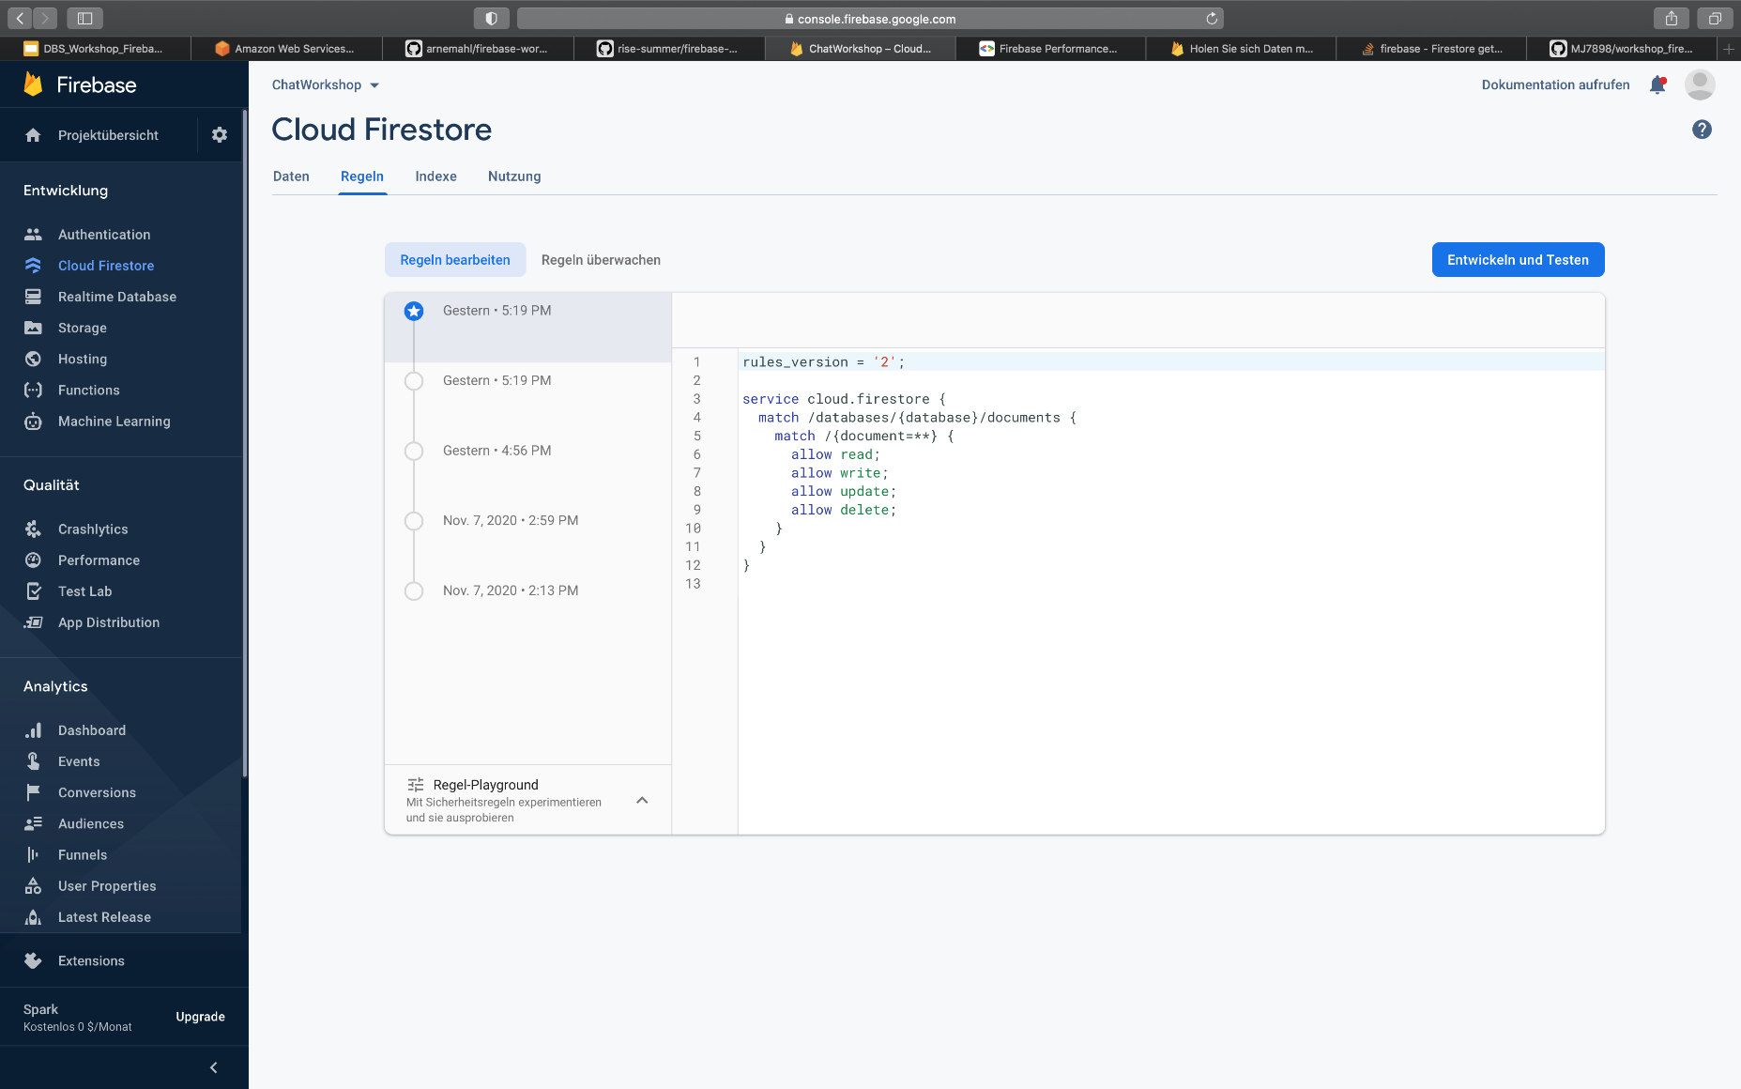
Einblick in die Konosle

Slide 15
Veranschaulichung CRUD
// Add a new document in collection "cities„
db.collection("cities").doc("LA").set({
name: "Los Angeles",
state: "CA",
country: "USA„
})
.then(function() {
console.log("Document successfully written!");
})
.catch(function(error) {
console.error("Error writing document: ", error);
});

Slide 16
Veranschaulichung CRUD
// Add a new document with a generated id.
db.collection("cities").add({
name: "Tokyo",
country: "Japan„
})
.then(function(docRef) {
console.log("Document written with ID: ", docRef.id);
})
.catch(function(error) {
console.error("Error adding document: ", error);
});

Slide 17
Veranschaulichung CRUD
db.collection("cities").get().then(function(querySnapshot) {
querySnapshot.forEach(function(doc) {
// doc.data() is never undefined for query doc snapshots console.log(doc.id, " => ", doc.data());
});
});

Slide 18
Veranschaulichung CRUD
db.collection("cities").where("capital", "==", true)
.get()
.then(function(querySnapshot) {
querySnapshot.forEach(function(doc) {
// doc.data() is never undefined for query doc
console.log(doc.id, " => ", doc.data());
});
})
.catch(function(error) {
console.log("Error getting documents: ", error);
});

Slide 19
Veranschaulichung CRUD
var washingtonRef = db.collection("cities").doc("DC");
// Set the "capital" field of the city 'DC‚
return washingtonRef.update({
capital: true
})
.then(function() {
console.log("Document successfully updated!");
})
.catch(function(error) {
// The document probably doesn't exist.
console.error("Error updating document: ", error);
});

Slide 20
Veranschaulichung CRUD
db.collection("cities").doc("DC").delete().then(function() {
console.log("Document successfully deleted!");
})
.catch(function(error) {
console.error("Error removing document: ", error);
});

Slide 21
Veranschaulichung CRUD
var cityRef = db.collection('cities').doc('BJ');
// Remove the 'capital' field from the document
var removeCapital = cityRef.update({
capital: firebase.firestore.FieldValue.delete()}
);

Slide 22
Quellen
https://codelabs.developers.google.com/codelabs/firebase-perf-mon-web/#2
https://codelabs.developers.google.com/codelabs/firebase-perf-mon-web/#3
https://console.firebase.google.com/project/chatworkshop-fb012/firestore/data~2Fmessages~2F95h4rpALlcs7M0s6uBPW
https://firebase.google.com/docs/firestore/manage-data/add-data

Slide 23
About CGI
Founded in 1976, CGI is among the largest IT and business consulting services firms in the world. Operating in hundreds of locations across the globe, CGI delivers end-to-end services and solutions, including strategic IT and business consulting, systems integration, intellectual property, and managed IT and business process services.
CGI works with clients through a local relationship model complemented by a global delivery network to help clients achieve their goals, including becoming customer-centric digital enterprises.
cgi.com

