Slide 1
Time series
Mohamed Imran
Data Scientist – Ganit Inc.

Slide 2
What is a Time Series?
Series of data points plotted over time.
It is a sequence taken at successive equally spaced points in time.
Used in forecasting.

Slide 3
How did our forefathers do the forecasting?

Slide 4
Traditional methods:
SMA (Simple Moving Average/Rolling Statistics)
WMA (Weighted Moving Average)
EWMA (Exponential Weighted Moving Average)

Slide 5
SMA:
A simple moving average is calculated from the average of the closing prices for the time period being examined.
Date | Turnover
June | $250, 000.00
July | $901, 050.00
August | $501, 010.00
September | $700, 011.00
October | $900,100.00
The SMA(3) for the month of November is: (501,010 + 700,010 + 900,100)/3 = 700,373
The SMA(3) for the month of December is: (700,010 + 900,100 + 700,373)/3 = 766,827

Slide 6
WMA
Weighted moving average assigns a heavier weighting to more current data points since they are more relevant than data points in the distant past. The sum of the weighting should add up to 1 (or 100%).
Date | Closing Price | Weighting
October | $90.90 | 5/15
September | $90.36 | 4/15
August | $90.28 | 3/15
July | $90.83 | 2/15
June | $90.91 | 1/15
The denominator is calculated as : 1+2+3+4+5 = 15
In the example above, the weighted 5-day moving average is $90.62
((90.9*(5/15))+(90.36*(4/15))+(90.28*(3/15))+(90.83*(2/15))+(90.91*(1/15)))

Slide 7
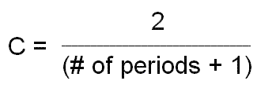
EWMA:
An exponential moving average (EMA) is similar to SMA, but whereas SMA removes the oldest prices as new prices become available, an exponential moving average calculates the average of all historical ranges, starting at the point you specify.
To calculate EMA, take current price and multiply it by a constant, C. Take previous period’s EMA and multiply it by 1 minus that constant, C. Add the two values together.
If you are calculating your first EMA value where there is no previous day’s EMA, use SMA instead. The formula for deriving the value of the constant, C is:

Slide 8
What is Stationary?

Slide 9
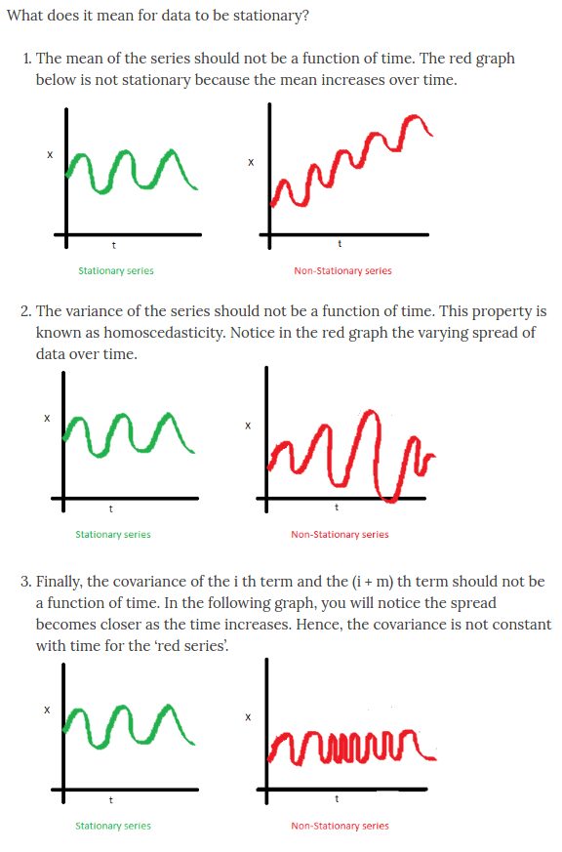
Checks for Stationarity:
No mean
No Variance/Covariance

Slide 10
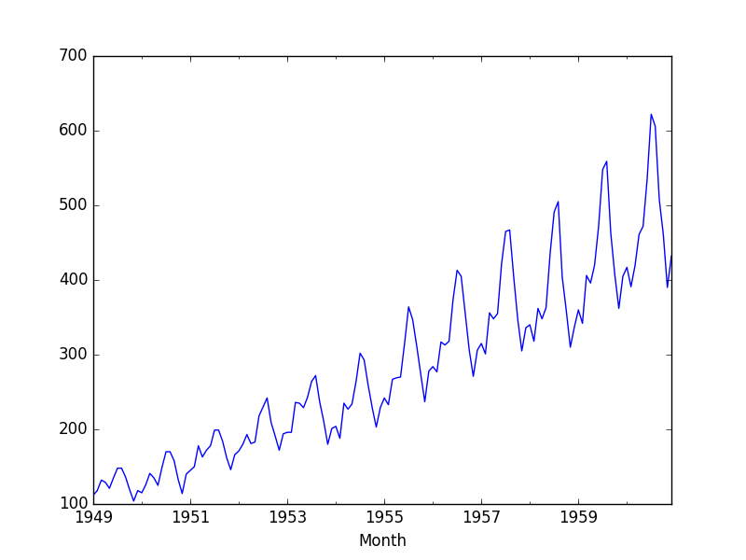
Rolling mean:
Take the past year’s data (12 months) and calculate the mean.
Compare it with the successive years.
If mean is a function of time (mean increases), the Time Series in not Stationary.

Slide 11
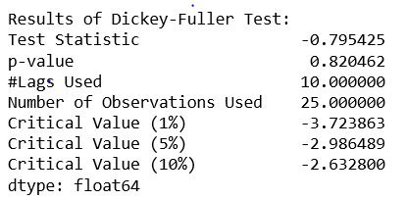
Dickey-Fuller test:
If the test statistics is greater than the critical values, then the series is not Stationary.

Slide 12
So, what is making a Time Series non-stationary?

Slide 13
So, what is making a Time Series non-stationary?
Trend
Seasonality

Slide 14
Well, how do we remove Trend and Seasonality?

Slide 15
Well, how do we remove Trend and Seasonality?
Differencing
Decomposition

Slide 16
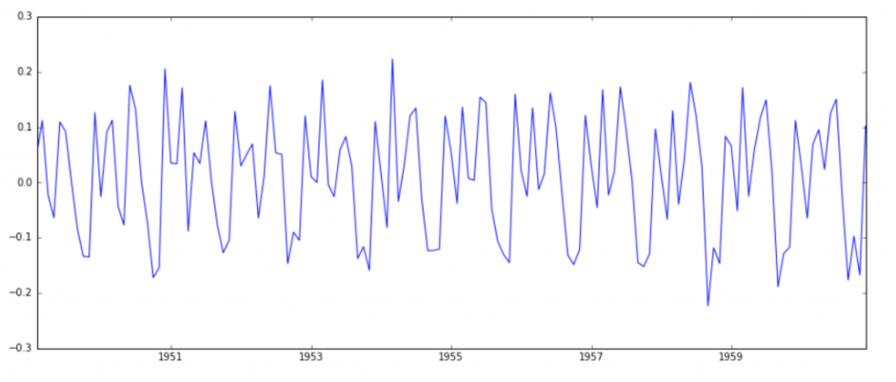
Differencing:
Taking difference of an observation of a particular instance with that of a previous instance.

Slide 17

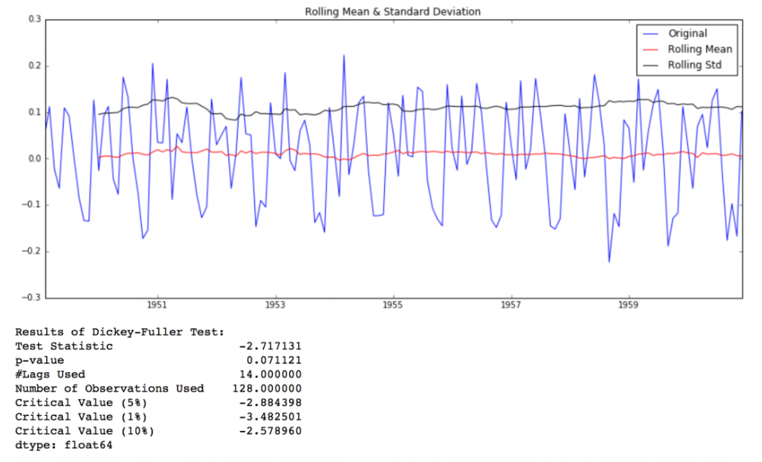
What are the observations as a result of Differencing?

Slide 18
Rolling mean and standard deviation is constant. Dickey-Fuller Test Statistics is less than 10% of critical values

Slide 19
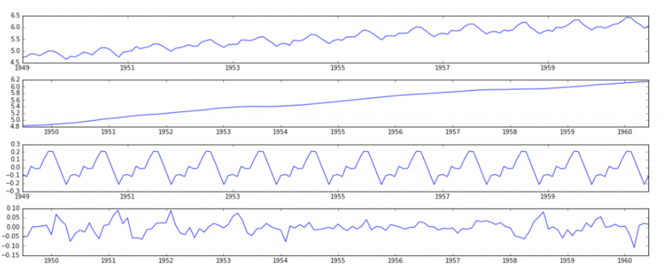
Decomposition: The trend and seasonality are modeled separately, then the rest of the series is returned

Slide 20
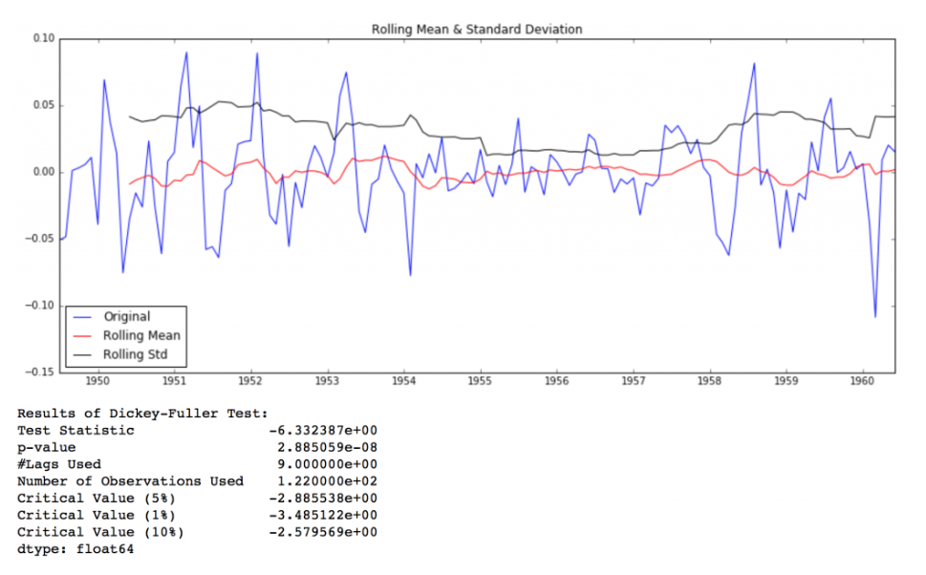
Mean and standard deviation has improved The Dickey-Fuller test statistic is significantly lower than the 1% critical value. So this TS is very close to stationary.

Slide 21
Forecasting.

Slide 22
ARIMA:
Auto-Regressive Integrated Moving Averages.
It depends on the parameters (p, d, q)
p - is just lags of dependent variable.
q – is lagged forecast errors in prediction equation.
d - the number of non-seasonal differences

Slide 23
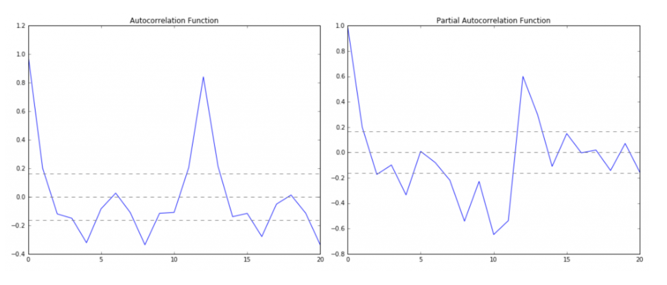
How to determine p and q values?
p – The lag value where the PACF chart crosses the upper confidence interval for the first time.
q – The lag value where the ACF chart crosses the upper confidence interval for the first time.

Slide 24
Auto-Arima
Auto arima gives the p, d and q values.
Run the function with the Time Series data to get these values.

Slide 25
Other forecasting algorithms in R:
HW
BSTS
Croston
Arima_NS
Arima_NS_Boxcox
fbprophet

