Slide 1

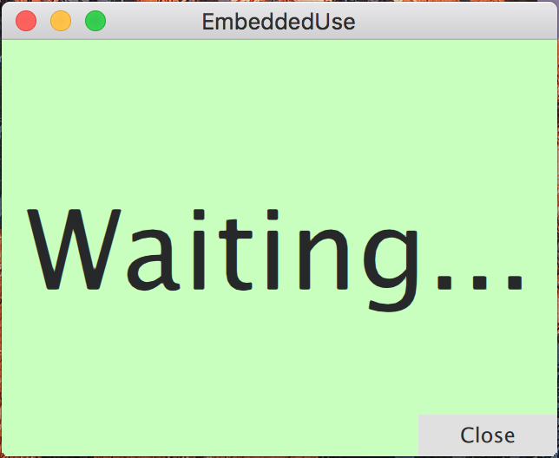

open
close
QTimer::singleShot(500, ...)

