Slide 1
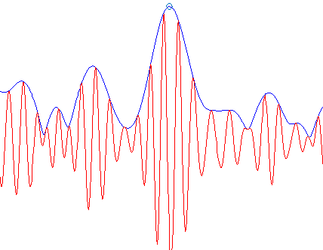
info_collect_for_NN_network_burst_separatePNITN.mat
Significant burst
Pre-burst (50ms)
Threshold to determine burst period
Within burst

Slide 2
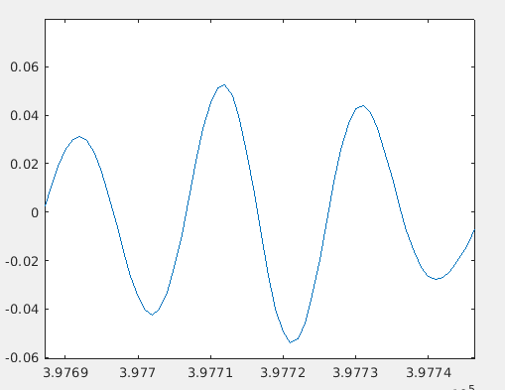
info_collect_for_NN_network_cycle_separatePNITN.mat
0 ms
[-50 0]ms
[0 30]ms
1st peak amp.
2nd peak amp.
Cycle len.
Time window for collecting data

