Slide 1
LIME over time
Matthew Carroll – University of Missouri

Slide 2
Introduction

Slide 3
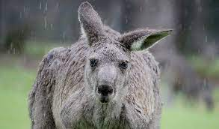
Data
Rain in Australia
https://www.kaggle.com/jsphyg/weather-dataset-rattle-package
Combination of Words and Numeric Values
Encompasses 49 Cities/Airports
24 Values Recorded
Once a Day:
Date, Location, MinTemp, MaxTemp, Rainfall, Evaporation, Sunshine, Wind Gust Direction, Wind Gust Speed, Rain Today (Y/N), Rain Tomorrow (Y/N)
Measured at 9am and 3pm:
Wind Direction, Wind Speed, Humidity, Pressure, Cloud Cover, Temperature

Slide 4
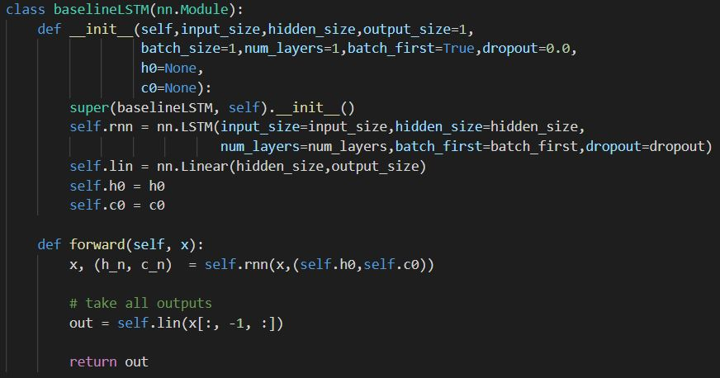
LSTM
Implemented in PyTorch
Hidden and Cell states initialized using Normal Distribution (mean=0, variance=1)
Used 35 hidden layer connections
Also ran standard RNN and GRU models

Slide 5
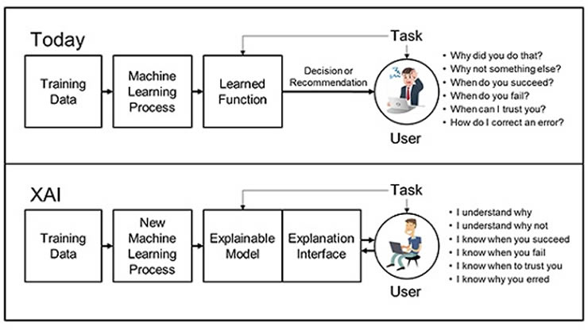
XAI
Why: We want to explain why a prediction occurs from the NN
Audience: lay person
The initial goal was not to make a tool to debug an LSTM (although this did happen)
The output is meant to be easily readable for anybody (not just ML practitioners)
Thus, we focus on interpretability of results and how we can improve that

Slide 6
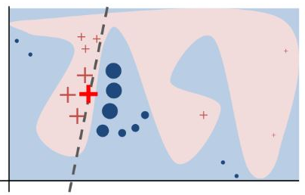
LIME
LIME – Local Interpretable Model-Agnostic Explanations
The idea is to draw an easily explainable decision boundary that works well for the local area and simulates the complex NN boundary
In addition, this is meant to treat each ML model the same (they are all considered black box to LIME)
How?

Slide 7
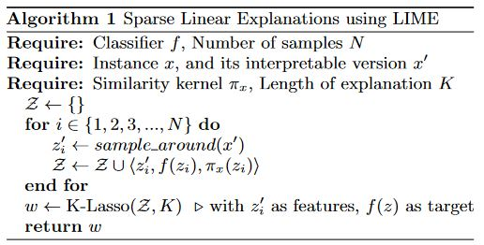
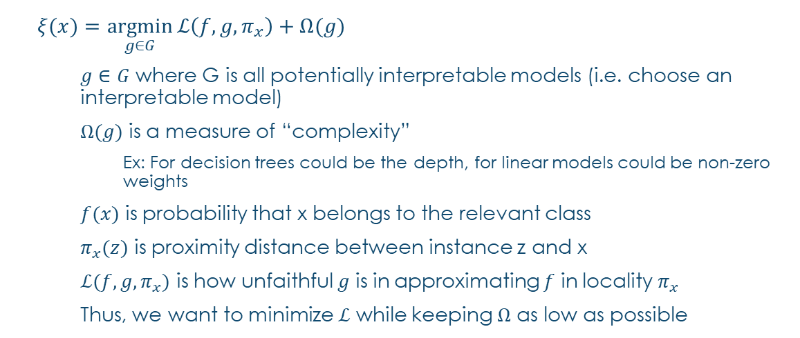
Lime
$ξ(x)=\underset{g∈G}{argmin}{ℒ\left(f,g,π_{x}\right)+Ω(g)}$
$g∈G$ where G is all potentially interpretable models (i.e. choose an interpretable model)
$Ω(g)$ is a measure of “complexity”
Ex: For decision trees could be the depth, for linear models could be non-zero weights
$f(x)$ is probability that x belongs to the relevant class
$π_{x}(z)$ is proximity distance between instance z and x
$ℒ(f,g,π_{x})$ is how unfaithful $g$ is in approximating $f$ in locality $π_{x}$
Thus, we want to minimize $ℒ$ while keeping $Ω$ as low as possible

Slide 8
Methods

Slide 9
Preprocessing
Lots of NA in the data
This caused problems so they were replaced with a -100 (variable chosen as it was not included as an actual value in any other setting)
All wind directions had to be switched to a numeric scale as follows:
N = 1; NNE = 1.25; NE = 1.5; ENE = 1.75; E = 2 and so on
The cities were split into sequences of 100 (this expanded the number of samples from the 49 cities to 1444 samples)

Slide 10
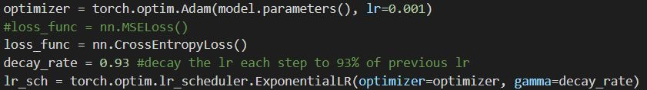
LSTM (Loss and Optimizer)
Adam Optimizer
Learning Rate of 0.001
Exponential Decay on Learning Rate of 93% each epoch
100 epochs
Two different models:
Classification
Mean Squared Error Loss
Regression
Cross Entropy Loss
Trained RNNs, LSTMs, and GRUs
LSTM and GRU outperformed RNNs

Slide 11
LIME Application
LIME by default uses Ridge Regression Models to find the local fit
Both classification and Regression
The data was padded at the front of each sample to ensure they had the same sequence length (this is required per LIME)
Used the experimental RecurrentTabularExplainer class
LIME treats the regression and Classification problem similarly
Treats regression as a 2 class problem with negative and positive influences to the line

Slide 12
Results

Slide 13
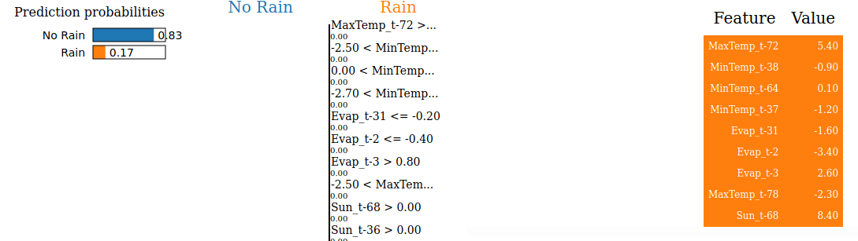
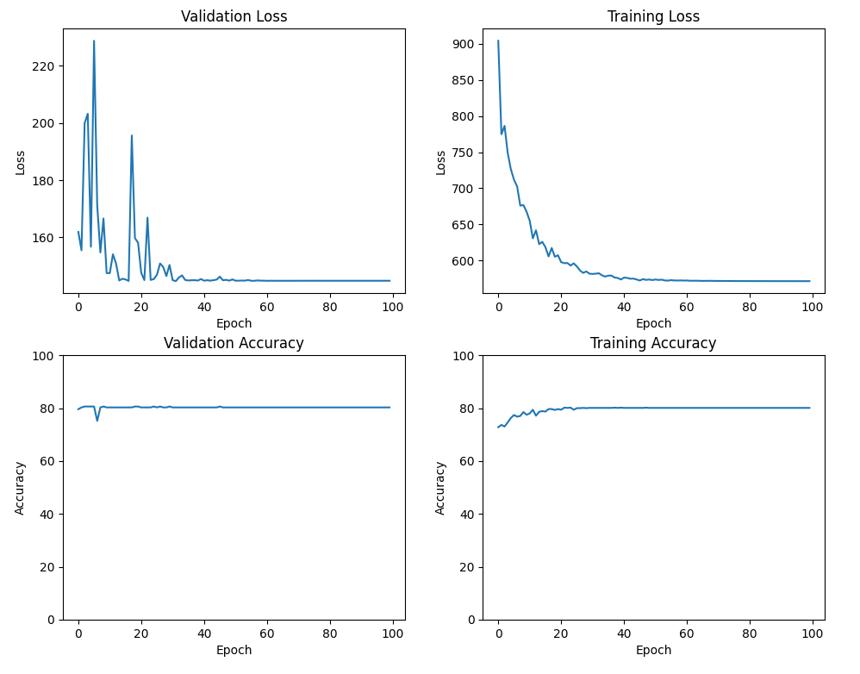
Classification

Slide 14
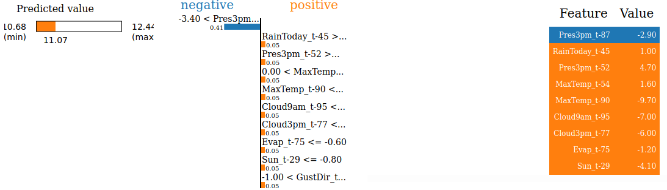
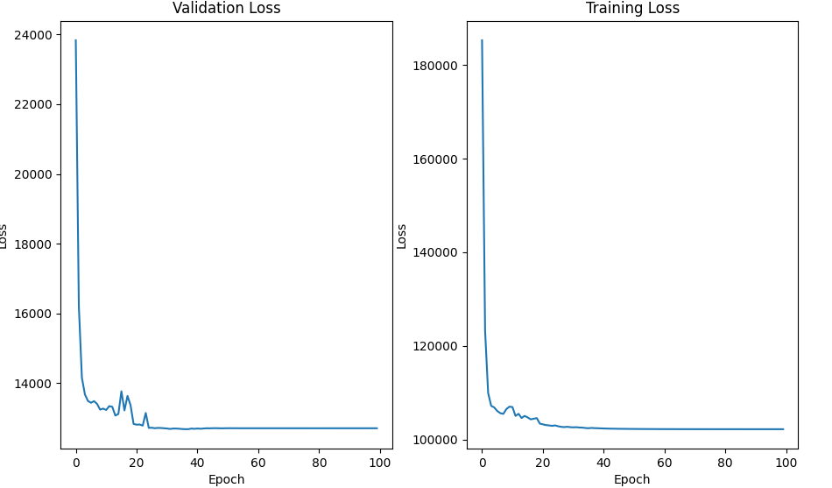
Regression

Slide 15
References (And Questions!)
Ribeiro, Marco Tulio, et al. “‘Why Should I Trust You?’: Explaining the Predictions of Any Classifier.” ArXiv:1602.04938 [Cs, Stat], Aug. 2016. arXiv.org, http://arxiv.org/abs/1602.04938.
PyTorch. https://www.pytorch.org. Accessed 10 May 2021.
Hochreiter, Sepp, and Jürgen Schmidhuber. "Long short-term memory." Neural computation 9.8 (1997): 1735-1780.
https://www.kaggle.com/jsphyg/weather-dataset-rattle-package

