Slide 1
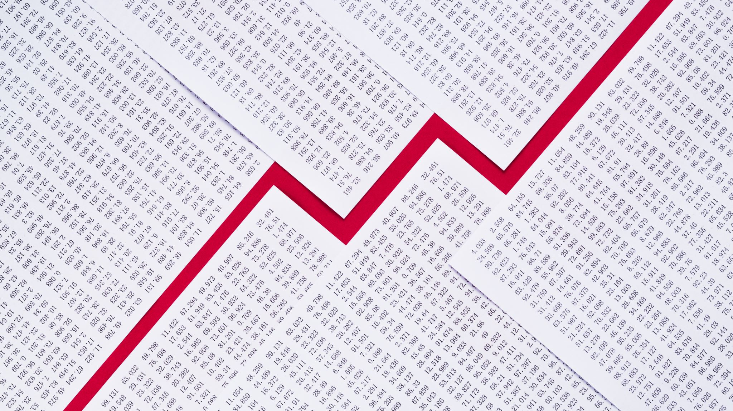
AAPL Stock and Reddit
Derek Bobbitt, Claire Plourde, Macy Broderick, Matthew Clarke

Slide 2

$GME: Social Media & Wall Street
Quick Class Poll: Who remembers the GameStop Saga?
Brought social media to mainstream attention as a form of influence in financial markets. Culture Theory.
In trading communities, it's now pretty common for algos and quants to include scraping SM sentiment in their trading bots
Can we really say it is worth it to look at Reddit activity and sentiment when predicting stock performance?
Goal: Explore the relationship of Reddit sentiment and stock performance, and vice versa.
Notes:
$GME: Social Media & Wall Street
< Class Poll: Who remembers the $GME Saga? >
The GameStop Saga was the first time social media was truly brought to mainstream attention as a form of influence in financial markets.
Although it was common in day and quantitative trading communities to scrape social media data as part of their analysis or data for training trading bots, now analyzing social sentiment became a crucial step across most trading strategies even in corporate finance.
The idea that a group can organize through social media, invest in sync or at the very least in tandem, had never been seen before at the scale seen with the r/wallstreetbets community, but now that is was a reality, we’ve seen this trend grow greatly.
However, can we really say it is worth it to look at any one social media platform and find a statistically significant correlation when utilizing sentiment analysis?
Our goal with this research project is to explore the relationship of Reddit sentiment and stock performance, and vice versa (important for later)

Slide 3

Our Data
Datasets: 'Five Years of AAPL on Reddit' + 'AAPL Daily Stock Performance'
All AAPL mentions on Reddit, from Nov 2016 to Oct 2021
Data includes values that was useful for sentiment and time-based analysis
Why enrich our data with AAPL stock performance?
Notes:
Our Data
Datasets: 'Five Years of AAPL on Reddit' + 'AAPL Daily Stock Performance'
All mentions of AAPL from Nov 2016 to Oct 2021
Data includes values that was useful for sentiment and time-based analysis
Why enrich our data with AAPL stock performance?
In addition to the Reddit dataset, we used a dataset labeled “AAPL Daily Stock Performance” from Yahoo Finance to enhance our existing data. The combination of the two datasets allowed us to analyze the relationship between Reddit posts and comments and Apple’s stock price over time.

Slide 4
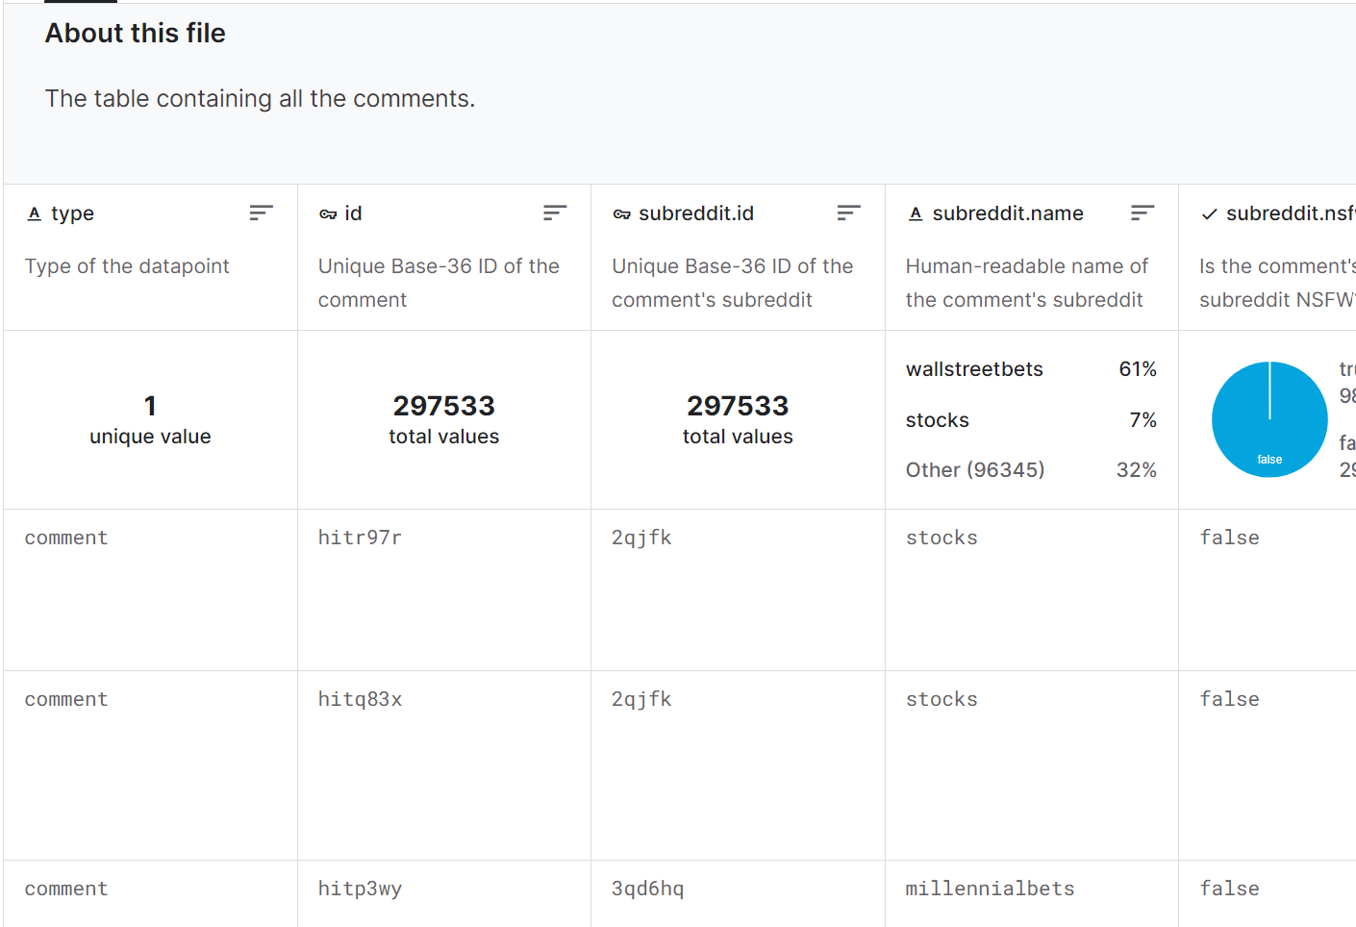
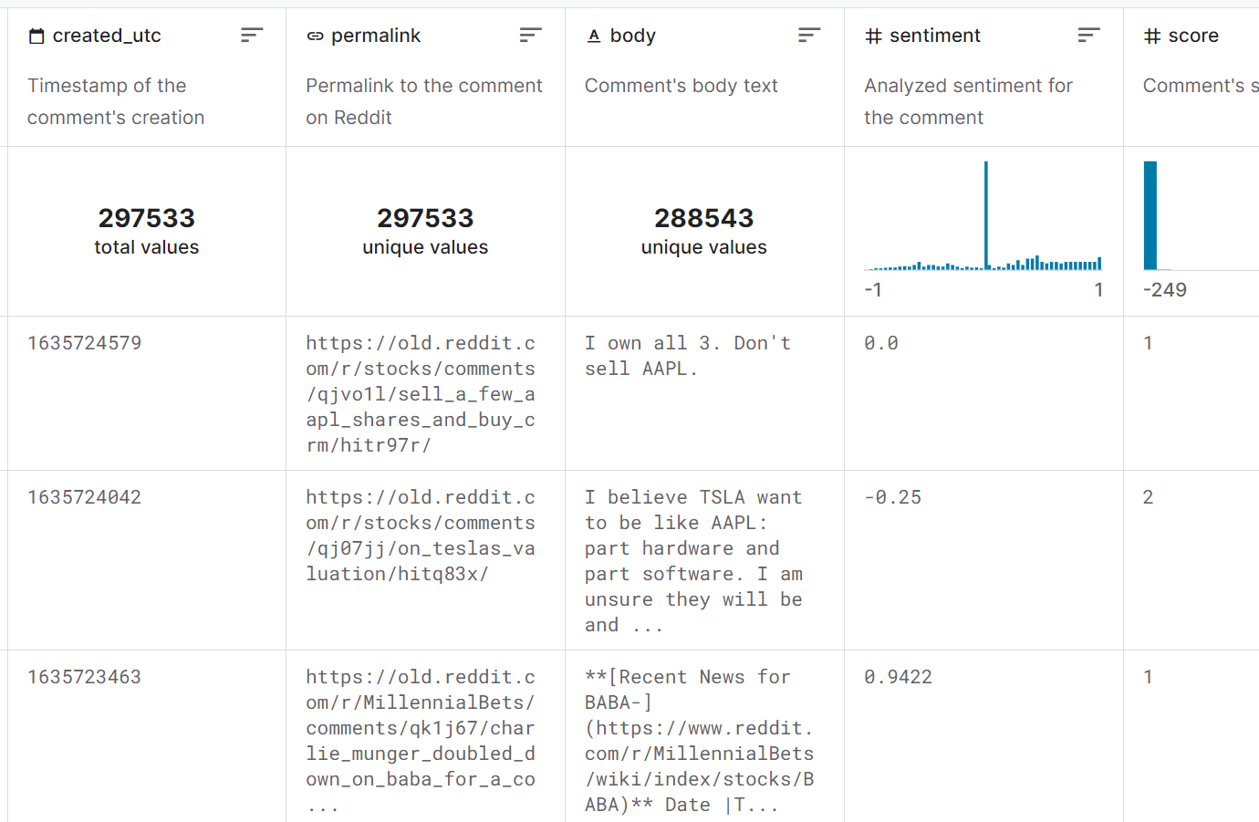
Why these Datasets?
Team interest from $GME Saga and social sentiment effect on stock market
AAPL is the largest company in the world ==> LOTs of coverage
Would this apply to a popular comp?
Dataset had necessary text and numeric data for our sentiment analysis – clear connection to AAPL stock data for enrichment
Notes:
Why These Datasets?
Team interest from $GME Saga and social sentiment effect on stock market
As for the scope of our research, we chose to investigate if sentiment could really move some of the world’s largest companies or if GME was the exception, not the rule. Accordingly, we chose to look at Apple, the largest company in the world. This means that there’s a lot of coverage and an abundance of data.
AAPL is the largest company in the world ==> LOTs of coverage
We asked: would this kind of social sentiment pressure apply to a popular comp?
Dataset had necessary text and numeric data for our sentiment analysis – clear connection to AAPL stock data for enrichment

Slide 5
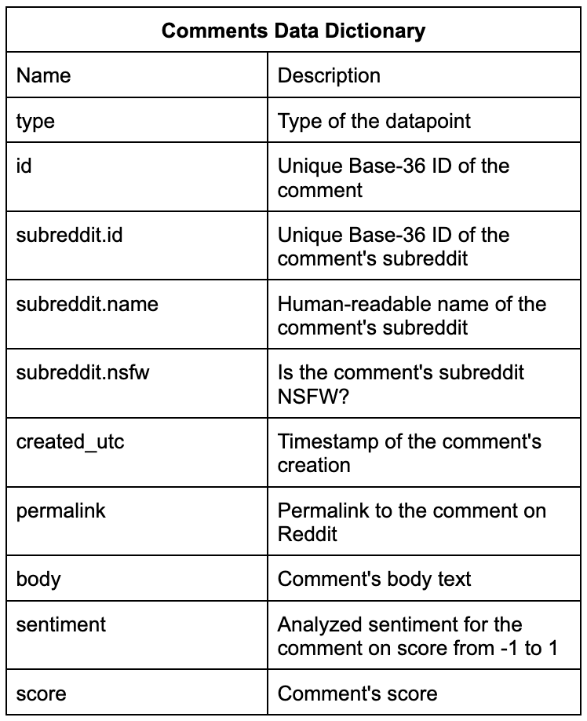
Data Journey Contents and Management
Dataset contained two csv files:
Comments.csv
297,533 rows
Posts.csv
15,483 rows
Notes:
The dataset we chose consisted of 2 files. One contained data on the Reddit comments mentioning the AAPL stock ticker. This file had 297,533 rows of data. The other file contained data on the Reddit posts with mentions of the AAPL stock ticker. This file had 15,483 rows of data.
The information available to us in these datasets included things like the subreddit name, the timestamp, the body text of the comments and posts, etc. The data dictionary for the comments file can be seen on this slide. The posts dataset followed mostly the same structure with similar information available.

Slide 6
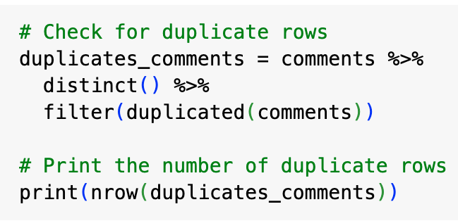
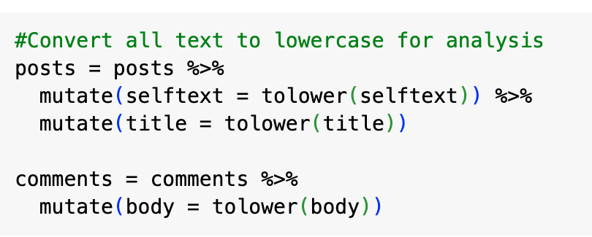
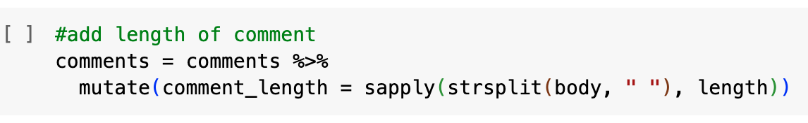
Data Journey Preparing the Data
Data Cleaning:
Created_utc
NSFW
Subreddit.name == '???'
Sentiment & Score
Notes:
Our dataset came very clean, but in order to clean it further we began in excel with the following steps:
created_utc (timestamp) was originally a number, so we had to use a formula to change this to date time format.
NSFW (if the subreddit is qualified as not safe for work) was originally true or false. We used find and replace to change these values to 1 and 0.
Subreddit.name listed as ‘???’ we looked up this line of data based on the other categories such as the link to find the actual name of the subreddit and replaced it.
Sentiment and Score columns had to be changed to numeric data types.
Further, in R we checked for duplicate rows, converted all text data to lowercase, and added a column calculating the column length which would be used in our later analysis.

Slide 7
Data Journey Challenges and Triumphs
Missing Values
Enhancing our Data
Making Data Uniform
Datatypes
Notes:
Some of the challenges we ran into in this process included:
Missing values - Specifically in the sentiment score column, there were quite a few rows with missing data. We added in 0 for these columns, a neutral value, as not to affect the analysis.
Enhancing our data - The information available in our dataset was slightly limited due to the low number of usable columns in each dataset. Because of this, we decided to enhance our data with additional information about current events at the time of certain trends in our data.
Making data uniform for usability - This wasn’t too challenging, but it did require a little bit of additional work to make sure all of our data was in the proper format and prepared for analysis so it would be accurate.
Datatypes - We had to change some of the datatypes, such as the timestamp, to make sense of them in terms of the analysis. Additionally, some of the datatypes, such as the ones with character values, were more difficult to use in our analysis in terms of quantifying.

Slide 8

Exploratory Data Analysis

Slide 9
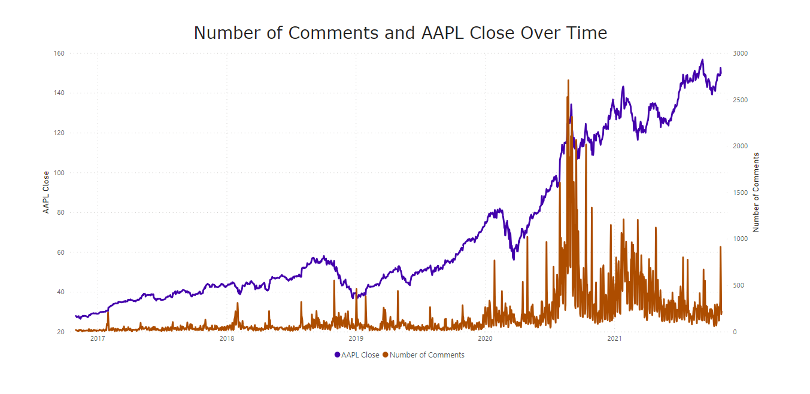
August 2020: Four for one stock split
2019: Growth due to AirPods
October 2018:
Announced stop of sales reporting
Covid
Feb 2021: Gamestop Short Squeeze
Notes:
Purpose: set up a timeline of events
Takeaway: ups and downs in AAPL stock, Reddit comments respond to events
AAPL stock price and number of comments about the AAPL stock over time
Looking at the trend of the stock, there are a few key events
In October 2018, Apple announced they would stop reporting sales of iPhone, iPad, and Mac
Seen by the public as a way to hide any struggles they were having, stock took a nosedive, lots of chatter on Reddit
In 2019, the second gen of AirPods was a huge success, which translated into growth for the company
Early 2020 drop due to Covid
At the end of August 2020, Apple announced a four for one stock split (investors will get three shares for every share they hold)
Caused a lot of people to buy and then sell shortly after
Also explains a lot of activity on Reddit that day, people providing advice, telling other people to buy
Late January 2021: Gamestop Short Squeeze
Short sellers borrow shares and immediately sell them, hoping to buy them back at a lower price later, return them to the lender at a profit
This practice is common on stocks that don’t have a lot of value, one of which is Gamestop, a once popular but now dying video game company
The Reddit community wallstreetbets decided the short squeeze this stock and other low value stocks by driving up the price and causing huge losses for short sellers
AAPL was not one of these stocks but this movement caused a small economic panic in the stock market
We can see here that this panic did affect the AAPL price
The Gamestop short squeeze had lasting effects on Reddit chatter around stocks: more comments than ever before

Slide 10
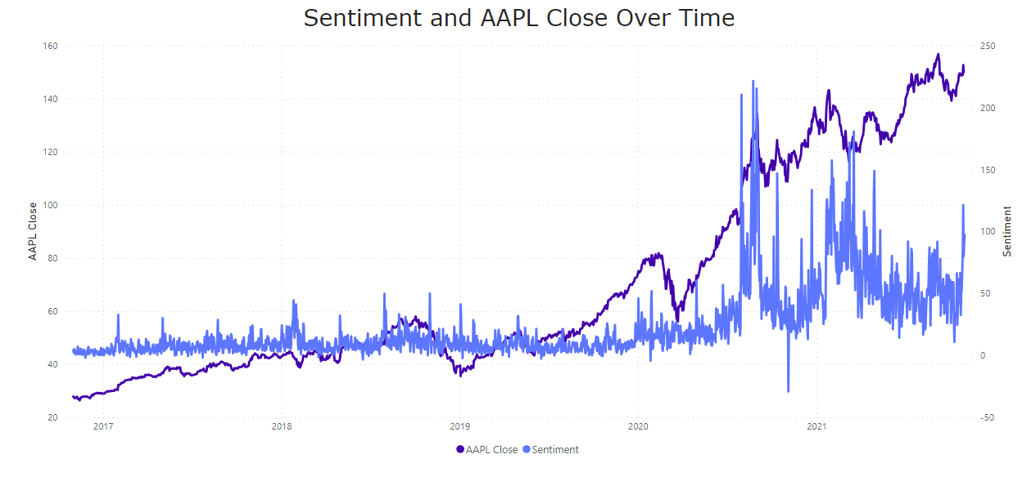
Notes:
Sentiment vs AAPL Stock price over time
Sentiment was pretty neutral, slightly positive until August 2020
It is clear people really loved Apple’s idea to do a four for one stock split, sentiment was hugely positive
Goes into a huge dip in late 2020 (November 4th)
Apple had dropped for the second time in a few weeks
The election of 2020 (Biden v Trump) happened on November 3rd, a lot of tension
Very positive from that moment on
Another spike in March 2021, had been falling for a while, a lot of people happy about the lower price
Even though APPL was not directly affected by the Gamestop Short Squeeze, it got a lot more people interested in investing, which led to more conversation and an overall positive sentiment
Macy and Matt will go into specifics later about what these posts are talking about and focusing on

Slide 11
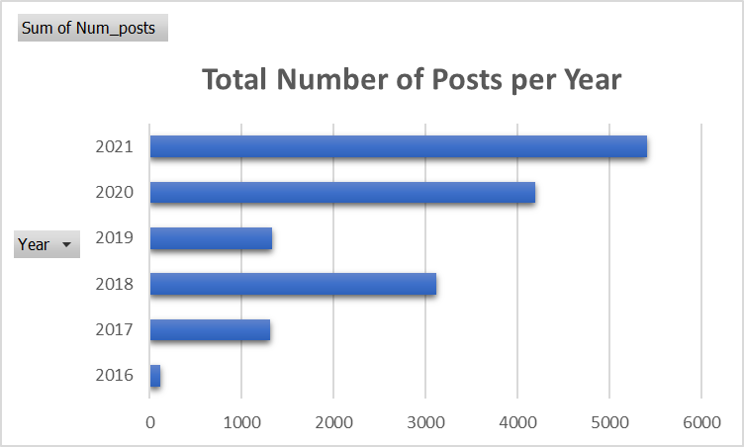
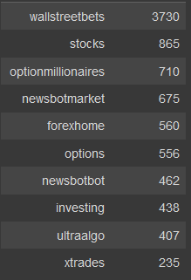
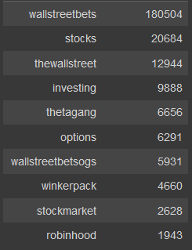
Summary Statistical Analysis
Average Comment Sentiment:
0.155344
Average Comment Score:
5.19916
Posts per Subreddit
Comments per Subreddit
Average Post Score:
27.3624
Notes:
Purpose: Provide an overview of the dataset through summary statistics
Takeaway: Reddit's popularity
On the right side, the mean of the comment sentiment, comment score, and post score are displayed to quickly inform the viewer of the important variables that this project focuses on.
The score variable is subjective in the sense that users decide whether they like or dislike though controls called "upvotes" and "downvotes
- The data suggests that the average comment's sentiment is slightly positive, which for a public forum is good to note. Some consideration should be made since the assumptons from the word dictionary cannot be observed.
- Next to the average are two tables overlayed highlighting the total posts per subreddit and comments per subreddit
- These data points highlight the potential for cultural theory to be observed as each subreddit has a different culture and having the majority of data points from one subreddit could influence the results.
- Wallstreetbets was the most active subreddit in terms of posts and comments about Apple, surprising considering Apple is assumed to be a safe stock, and Wallstreetbets is known for more reckless investing.
- And finally, a bar graph highlighting the total number of posts per year.
- The most interesting part of the graph comes from the 2021 column as the dataset only recorded up to October 2021 so in 9 months, Apple was mentioned in more posts compared to other years.
- This data provides a concise overview on what we have explored through data analysis

Slide 12
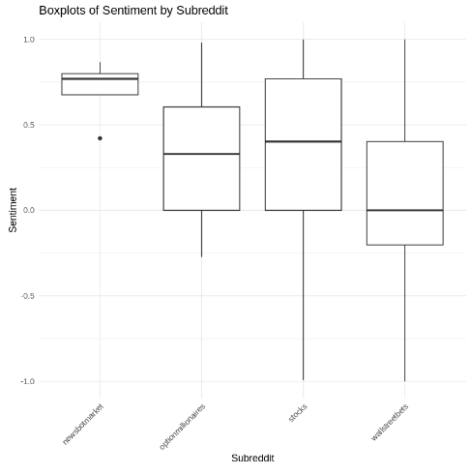
Notes:
Purpose: break down sentiment by subreddit
Takeaway: Different types of subreddits present different opinions on a similar subject and where you choose to get your information will affect the sentiment of the information
Next, we will look at sentiment broken down by subreddit
Top 4 subreddits based on activity
Newsbotmarket: news based subreddit, not a lot of opinion
Optionmillionaries, stocks, and wallstreetbets: dedicated to stock discussion, what stocks to invest in, recent trends, a lot more opinion based
The news based subreddit has the highest average sentiment, does not have a large spread
The opinion based subreddits have a lower average sentiment and a larger spread
Wallstreetbets has a lower, neutral average, probably due to lots of positive sentiment and lots of negative sentiment
Stocks and optionmillionaires have a higher average than wallstreetbets
If you’re looking for strictly positive outlook on stocks, you should browse newbotmarket
If you’re looking for a large spread in opinions but still overall positive, view stocks or optionmillionares
If you’re looking for the most extreme opinions, browse wallstreetbets
Where you get your information matters!

Slide 13
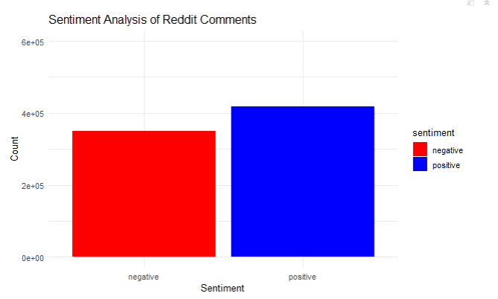
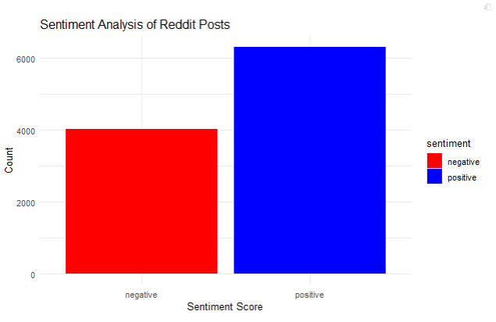
Sentiment – Posts v Comments
Notes:
Purpose: To show the difference in sentiment between comments and posts
Takeaway: There were more positive than negative sentiment in each group, and comments clearly had the larger dataset, but posts had a better positive-negative ration than in comments
Next, we will look at sentiment broken down by positive and negative
There were over 400,000 positive words in the comments dataset, whereas posts contained just above 6,000
The Positive-negative ratio for posts were roughly 3:2, whereas for comments it was ~4:3
A possible expanation for the higher ratio is due to the higher standards held for posts; nearly all subreddits have one or many moderators to review the content people want to share in the community, and that proces is not applied to comments
So comments can naturally be more raunchy, hateful, and longer than posts
Additionally, the general rule for investing is to buy a stock and hold in hopes of the price to increase so it is unlikely that people will post negative things regarding Apple If they are also invested in the company, and the average retail investor is not exposed to shorts.

Slide 14
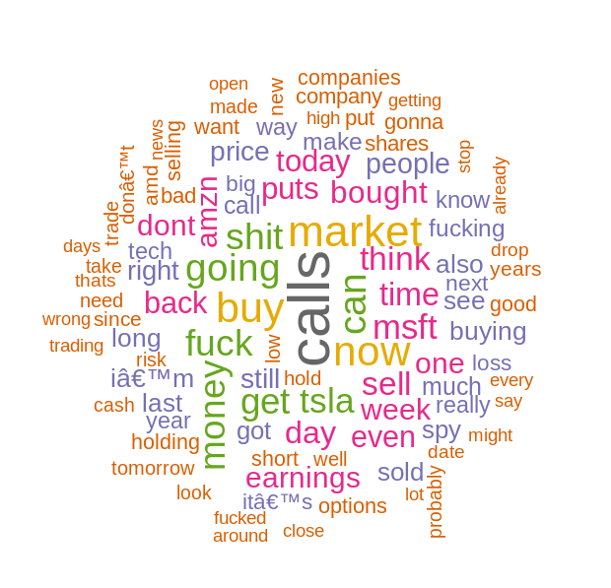
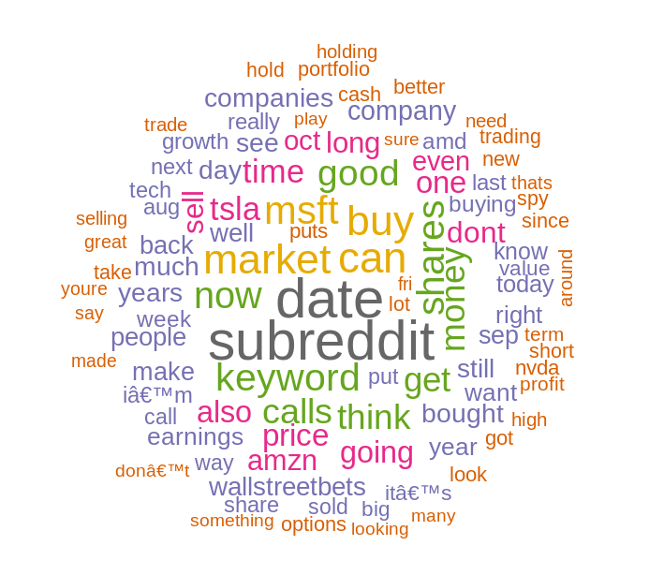
Text Analysis Story
Negative
Comments
Positive
Comments
custom_stop_words = c(stopwords("en"), "aapl", "stock", "apple", "stocks", "like", "will", "just")
Notes:
Most of our analysis so far has been text based, focused on the trends in the sentiment of our text data. We took this moment to look into the meaning behind what we are analyzing, by looking at what the most frequently used words are in comments that are deemed to have a negative sentiment versus a positive sentiment. We filtered out stop words as well as a few additional words that overwhelmed our word clouds and did not add particular meaning to our data. These additional words can be seen at the bottom of the screen. Our resulting word clouds do have many similarities, but also some stark differences. Both have mostly seemingly neutral words without context such as “market”, “think”, “buy”, etc. While the specific differences include the words focused on loss on the left and growth on the right. Additionally, the negative word cloud contains many swear words. After looking at these word clouds we can see how this sentiment analysis may be helpful in understanding how people were feeling in terms of loss and growth, but we can also see how some of the assignments of sentiment to words may be a little more ambiguous and require a contextual analysis to really understand the sentiment of the data.

Slide 15
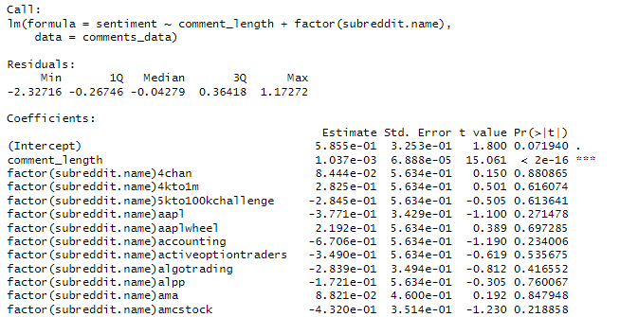

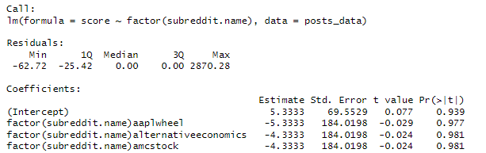

Multiple Linear Regression
To see the influence of other variables on the sentiment score of comments and posts
Notes:
Purpose: See if there was significant influence from a variable on sentiment and score
Takeaway: Only comment length and a few subreddits showed statistical significance when using the comments data, and nothing was reported when looking at score in the posts data
R^2 measures the percent of variability in Y that is explained in the regression
Both had really low R^2 values, 0.1533 and 0.03266 respectively, and is not considered accurate enough to draw conclusions from.
The more popular/active subreddits had slight significance for comments, but would be validated with a higher R^2
Very cool to draw from the other MSBA class to see the applicability of these models
Very high SE for factor(Subreddit name) in posts multiple linear regression model

Slide 16

Conclusion + Improvements
Unique relationships? For the most part, no.
Might be that stock performance influences social media rather than the other way around for a company
Future Improvements:
Analyze different sized companies - does this same analysis work for a small company with a Mkt Cap below $100M? $10M? Does sentiment affect smaller companies more than larger companies?
Cross-Platform Data – test hypotheses to see which platform sentiment fit the stock data best?
Instead of Stock Price, look at Volume as a closely-related Indicator?
Cross-Analyze with News Data – analyze text for all stories on AAPL by day

Slide 17
Questions?

Slide 18
Thank you!

