Slide 1

Introducing

Slide 2
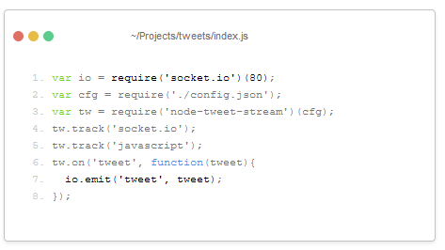
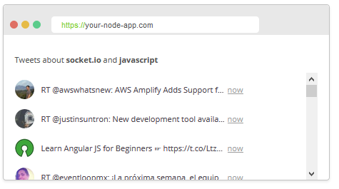
What is Socket.IO?
JavaScript web communication library
Communication is…
Real-time
Event-based
Bi-directional
Platform independent
Focus on speed, reliability, ease of use

Slide 3
Socket.IO vs. WebSocket
WebSocket is a technology; Socket.IO is a library
Socket.IO uses WebSocket when it’s available
Easier than vanilla WebSocket, at the cost of overhead
Socket.IO API similar for both server and client
Additional features: arbitrary events, namespaces, rooms

Slide 4
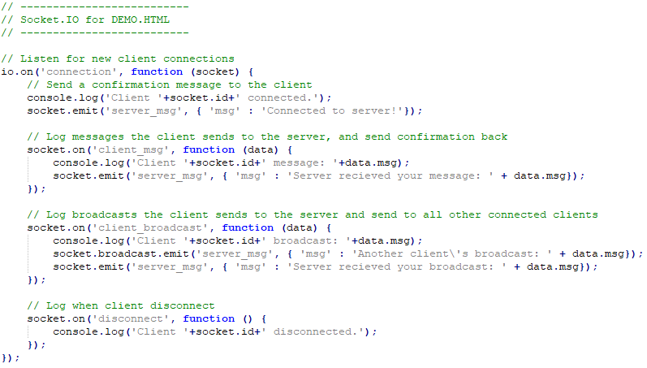
Using Socket.IO
Install with: npm install socket.io
Create connections and receive messages:
Server:
io = require('socket.io')(server);
io.on('connection', function (socket) {
socket.on('event', callback );
});
Client:
socket = io();
socket.on('event', callback );
Send messages:
socket.emit('event', 'message');
socket.in('room’).broadcast.emit('event', 'message');

Slide 5
Demo
GitHub Repo: https://github.com/MJClarke93/SocketDemo

