Slide 1
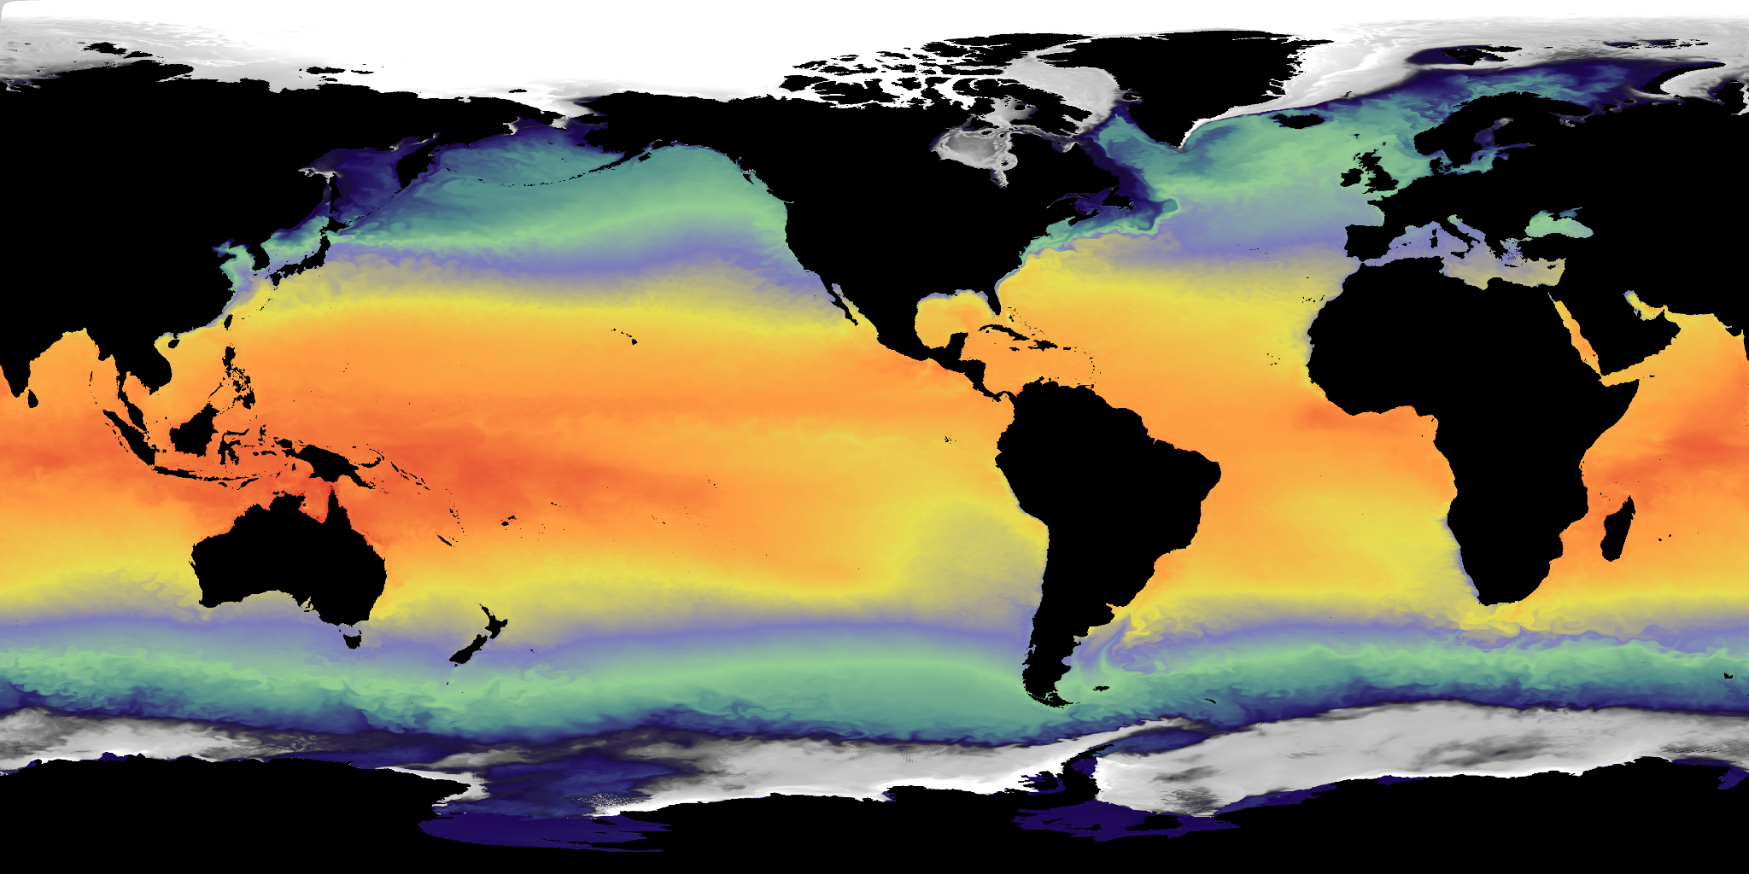
Plans for High Resolution Ocean Model Development for Observing System Evaluation
Prepared by: M. Harrison, NOAA/GFDL

Slide 2
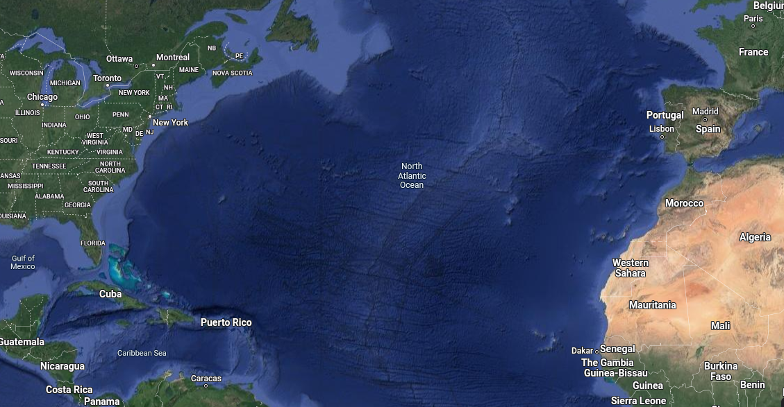
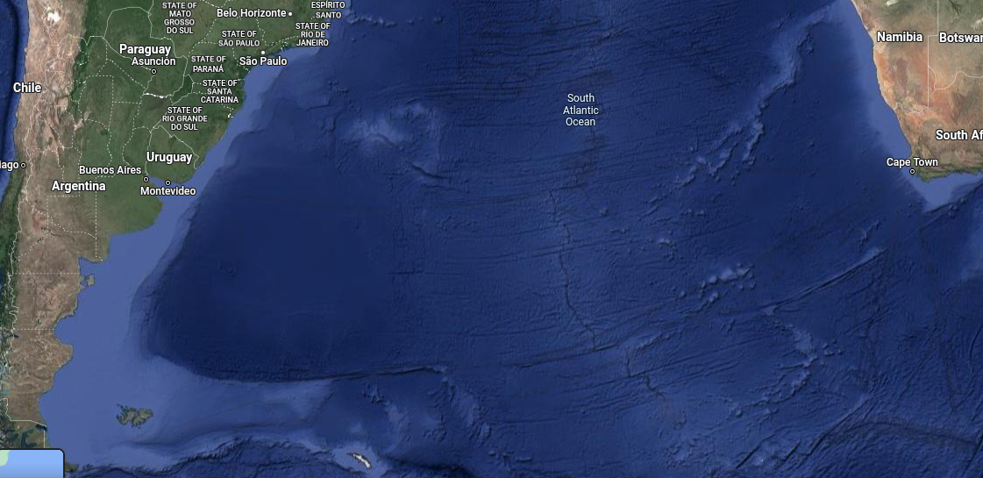
AMOC Observational Team
GFDL Observational Partners:
Renellys Perez (NOAA/AOML)
Shenfu Dong (NOAA/AOML)
Tiago Bilo (AOML/CIMAS/UMiami)
Denis Volkov (CIMAS/UMiami)
Matthieu Le Henaff (CIMAS/UMiami)
26N
34S

Slide 3
Experience using MOM6 for Climate Hindcast/Projections
Lagrangian vertical coordinate models are less susceptible to numerical mixing problems - motivation for MOM6 and ALE (Arbitrary Lagrangian Eulerian) approach.
MOM6-ALE (HYCOM1) has less spurious heat uptake than MOM6-z, making it easier to compare to observations
Currently published MOMO6 models have a too shallow AMOC at resolutions up to 25km (Adcroft, JAMES, 2008).
Sensitive to momentum closure, with more dissipative numerics producing deeper circulation (e.g. Ilicak, Ocean Modeling, 2012).
Initialized from WOA data, model overflow regions are too light and MOC is shallow starting in Year 1.
Accurately modeling the freshwater circulation is important part of reducing oceanic interior drift (Harrison et al, JAMES, 2022)
No reliance on artificial SSS nudging.
Currently Evaluating MOM6 at 7km using Global RTOFS grid and bathymetry - forced with MERRA-2
Current results suggest deeper and more realistic AMOC (as expected)
More realistic rate of ocean heat uptake presumably due to better eddy representation

Slide 4
Experimental Design for Retrospective Simulations
Existing forcing protocols (OMIP) use multi-century spinup procedure by cycling (1960-2000) forcing in order to accommodate interior ocean drifts, in addition to using SSS nudging.
Newer forcing procedure (Harrison et al, JAMES, 2022)
uses land hydrology model to close the freshwater cycle
avoids the use of SSS nudging.
This greatly reduces interior ocean drift after initialization , reducing spinup time.
Forcing with MERRA-2,JRA55-do and plans for ERA5

Slide 5
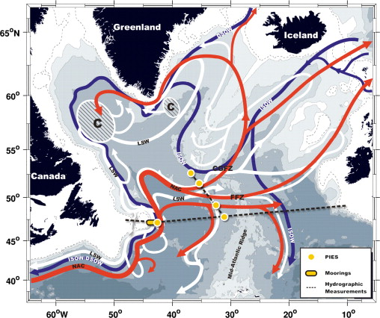
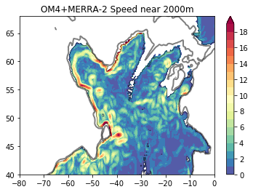
AMOC Deep Flow Source Regions
Model captures deep (cyclonic) western boundary current system in the NAtl

Slide 6
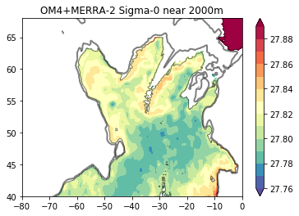
OM4 (25km) 2000m Speed (cm/s) and Potential Density
However, density in the boundary current are only slightly higher than in the interior Labrador and Irminger Seas - indicative of the mostly barotropic along-slope circulation and lack of dense return flow, relative to observations.

Slide 7
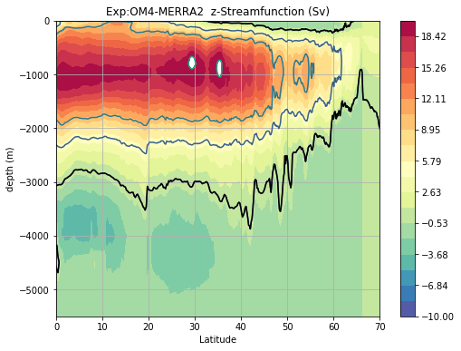
AMOC too shallow with ALE in OM4 (25km)

Slide 8
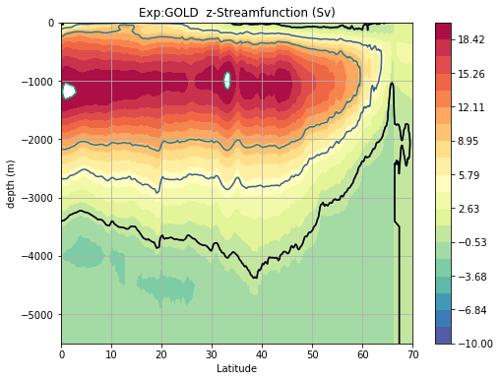
Lagrangian Coordinate Model has stronger deep limb

Slide 9
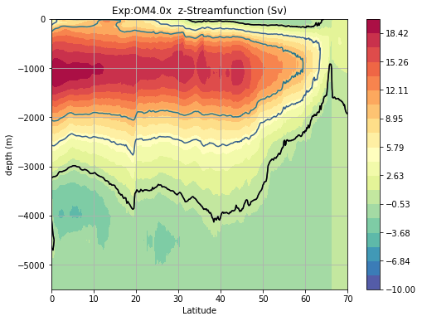
ALE model with alternate momentum closure

Slide 10
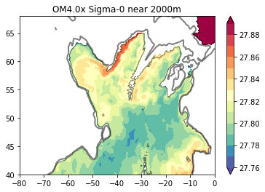
ArakawaHsu90 - 2000m Potential Density

Slide 11

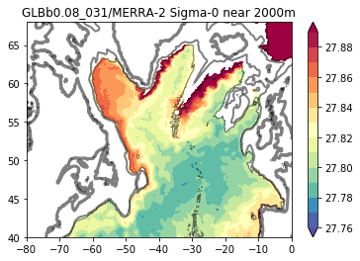

2000m Potential Density (Yr4)
Global 1/12 (Proto)

Slide 12
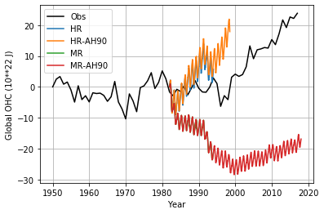
Global Ocean Heat Content
7km model has more realistic ocean heat content - presumably due to improved eddy representation, as well as less numerical mixing
Global 1/12 (Proto)
OM4 runs (25km)

Slide 13
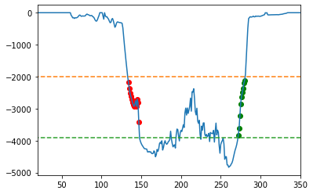
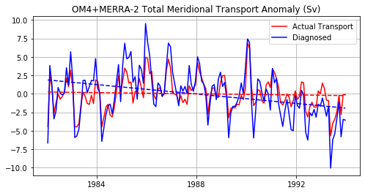
Bottom pressure sampling in model at 50N in the Atlantic
======OM4+MERRA-2======
Start Time= 1982/01
End Time= 1993/12
Depth range= 1875-4250 meters
Avg Transport (Sv)= -3.987707
RMS Diagnosed Transport (Sv)= 3.3731950479906976
Linear Trend Diagnosed (Sv yr-1) -0.02660858759362768
Linear Trend (Sv yr-1) -0.0033845096914868443
RMS Actual Transport (Sv)= 2.1556845
RMS Transport Error (Sv)= 1.8211262048641474
Correlation coefficient = 0.8738803945401747
PBW
PBE

Slide 14
Summary/Plans
Global 1/12 degree prototype simulations (Years 1-4) show improved performance relative to ¼ degree simulations (OM4)
Dense Overflows in North Atlantic
Dense Antarctic overflows (not shown)
More realistic OHU relative to OM4
Deeper AMOC
Develop hindcast simulations for observational evaluation (1992-present)
Initial 10 year spinup
Compare to Atlantic Deep Western Boundary Current Timeseries
OSNAP
26N
16N
34S

