Slide 1
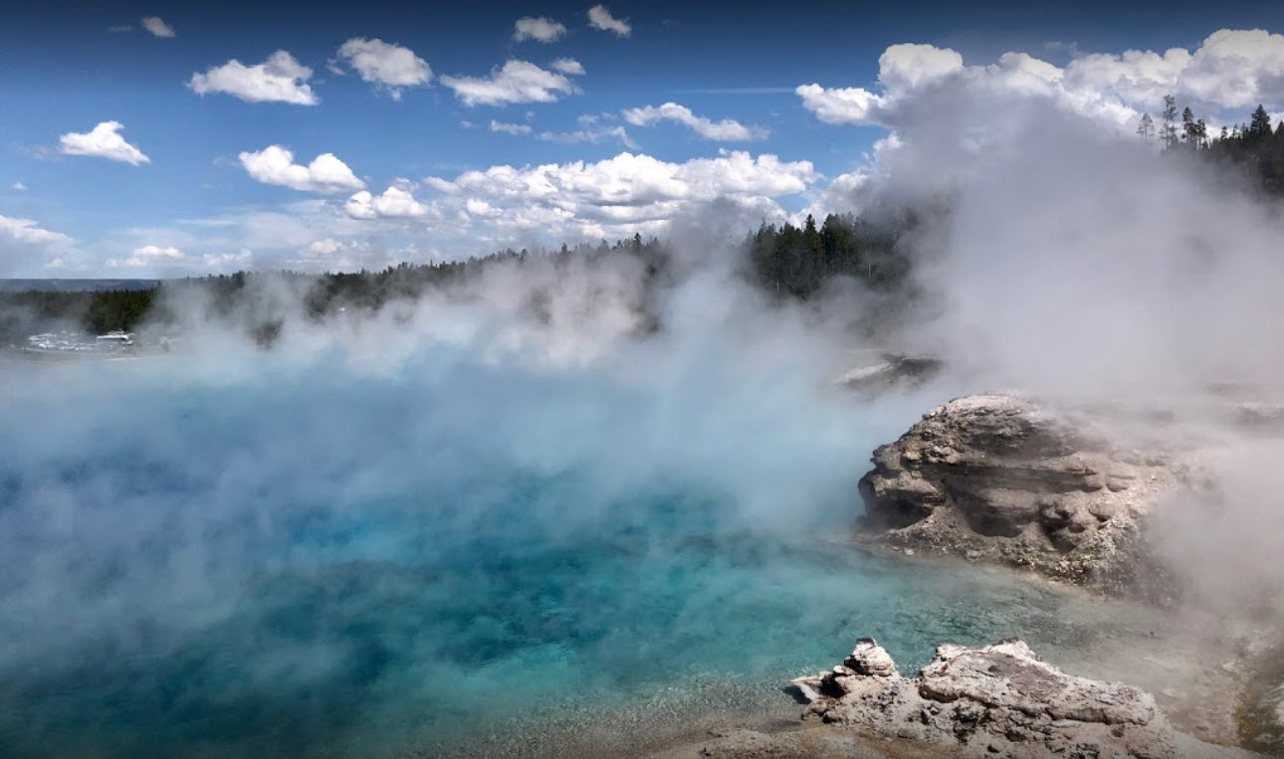
Biodiversity for the National Parks
Matt Cleveland
January 11th, 2019

Slide 2
Describing the Data in species_info.csv
Findings
There are 5541 distinct records out of the 5824 records in the csv file.
Out of all of those records there are 7 different species; which consist of the following:
Mammal
Bird
Reptile
Amphibian
Fish
Vascular Plant
Nonvascular Plant
5363 records originally have NULL values for the conservation_status field.
I eventually filled those values with “No Intervention”
Different types of conservation statuses:
Species of concern
Threatened
Endangered
In Recovery
No Intervention (after we replace the NULL values)
See Chart #2 for the number of species that fall into each conservation status. Chart #3 portrays that data as a bar graph.
Mammals seem to be the most likely to be protected (17.05%) according to the data given; whereas vascular plants are the least likely (1.08%) of being protected. The lower the % - the more likely to be endangered.
The above statement, that some species are more likely to be endangered, was also proved by both of our chi-squared tests.
Will explain this further in the next slide(s).

Slide 3
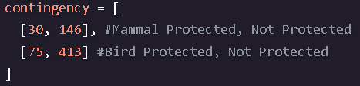
Significance Calculations
To answer the question "are certain types of species more likely to be endangered?“ I needed to compare two different species likelihood of becoming endangered. The best way to do this would be analyzing the p-value returned from chi-squared test that would be run against a contingency table.
First I compared birds and mammals by creating a contingency table; which looks like this:
When running the chi-squared test against the above contingency table I noticed that there was a only a small difference (0.688) in the percentages; which proves that the difference was a result of chance.

Slide 4


Significance Calculations Continued..
Next I used the chi-squared test to compare reptiles and mammals. The p-value this time was 0.038. This is a lot more significant than the other test; which left me with the answer to the question – certain types of species ARE more likely to be endangered than others.
Please see the two different chi-squared tests below:
Birds & Mammals:
Reptiles & Mammals:

Slide 5
Recommendations
Conservationists should use this data to help focus on the species that are not protected as well as the others; which should help lower the likelihood of a species becoming endangered.
The pivot tables along with the bar charts should be reloaded on a normal basis, so that conservationists can switch focus to the species that are least protected at that specific time.

Slide 6

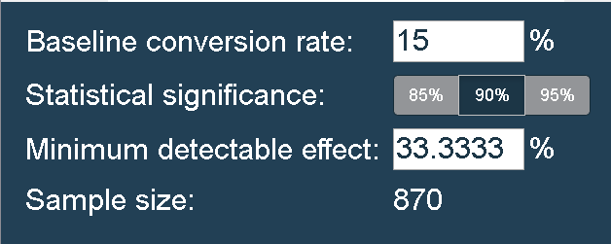
Sample Size
Since it was recorded that 15% of sheep at Bryce National Park have foot and mouth disease – we will use that as our baseline.
The Park Rangers at Yellowstone National Park also wanted to be able to detect reductions of >5%.
With those numbers – I was able to calculate the minimal detectable effect % by using the following formula below:
I was then able to use the calculator given to input these numbers and get our sample size (see below).
NOTE: 90% was given in the directions as our default level of significance.

Slide 7
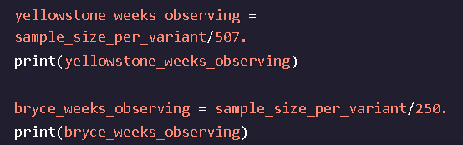
Sample Size Continued..
Yellowstone was significant they would have to observe at least 870 sheep.
Then, using the observation data you analyzed earlier, you found that this would take approximately one week of observing in Yellowstone to see that many sheep, or approximately two weeks in Bryce to see that many sheep.
calculate the sample size necessary for confident measurements in a disease reduction study.
As seen in the previous slide – the sample size per variant for Yellowstone National Park is 870.
In order to observe enough sheep at Yellowstone National Park – scientists would have to spend over 1 week observing; whereas they would have to spend a little over 3 weeks to do the same at Bryce National Park.
I was able to calculate the above answers by using the following calculations:

Slide 8
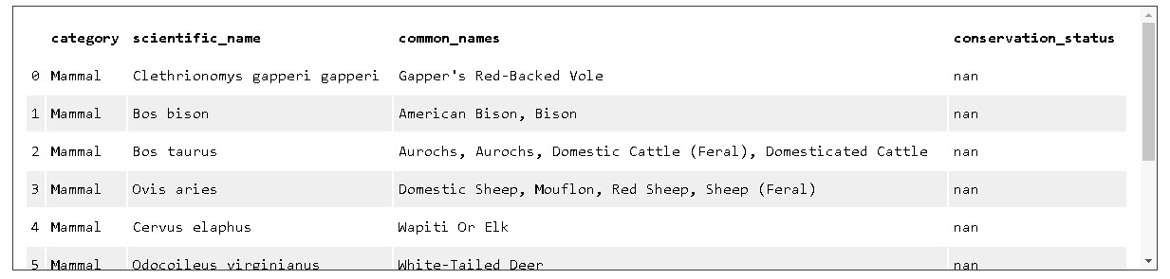
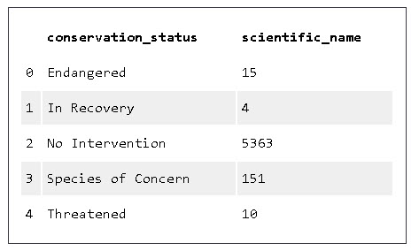
Graphs, Charts & Tables
1. Output from the original csv file (species.csv)
2. Number of conservations among the species given in the original csv file.
NOTE: This data is after I filled in all of the NULL data.

Slide 9
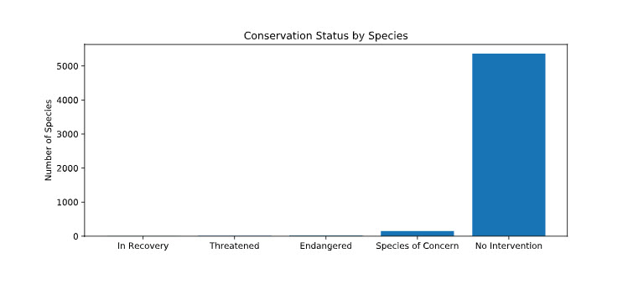
Graphs, Charts & Tables Part 2
3. Conservation Status by Species Bar Graph

Slide 10
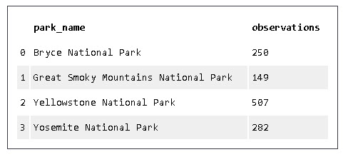
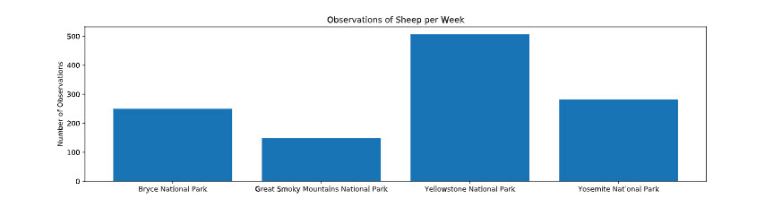
Graphs, Charts & Tables Part 3
4. Observations per Park
5. Observations per Park Bar Graph

