Slide 1
IBM University Engagement Project Submission
“Exploring the Power of Agentic AI with IBM Granite and LangFlow”

Slide 2

Project Tile – ResearchPilot
Domain of Project – Education/ Research Assistance
Student Name | Recent Passport Photo | Email ID | Mobile number [WhatsApp]
JHAI.M |  | kingjhai1276@gmail.com | +918248318103

Slide 3
Problem Statement -
Problem Statement : Research Agent
The Challenge
Researchers, students, and academicians spend significant time reading lengthy research papers, extracting key insights, understanding methodologies, and comparing findings across multiple publications. Research information is often scattered across numerous documents, making literature review and knowledge extraction a time-consuming process. Manually searching, summarizing, and analyzing research papers can reduce productivity and slow down innovation.
The Objective
Build an AI-Powered Research Agent that assists users in exploring and understanding research papers using IBM Watsonx and Granite foundation models.The solution should:
Evidence-Based Responses – Provide answers supported by retrieved document content.
Research Paper Summarization – Generate concise summaries of uploaded research papers.
Question Answering System – Allow users to ask natural language questions about research documents.
Document Grounded Retrieval – Retrieve relevant information from research papers using RAG (Retrieval-Augmented Generation).
Methodology Extraction – Identify and explain research methods used in papers.
Cross-Paper Analysis – Compare concepts, approaches, and findings across multiple papers.
Research Assistance – Help users quickly understand complex research topics and identify future research directions

Slide 4
Technology Used
Tech Stack (Mandatory)
I used IBM Watsonx.ai + IBM Granite Models + Retrieval-Augmented Generation (RAG)
Technology | Purpose
IBM Watsonx.ai | AI development platform used for Prompt Lab experimentation, model access, and document-grounded AI workflows
IBM Granite Models | Foundation models used for research paper summarization, question answering, and contextual response generation
LangChain | Orchestrates document retrieval, prompt management, and RAG workflow
FAISS Vector Database | Stores document embeddings and performs semantic similarity search
RAG (Retrieval-Augmented Generation) | Retrieves relevant paper content before generating responses, improving answer relevance and grounding
Python | Core programming language used for backend development
Flask | Lightweight web framework used to build the ResearchPilot application
HTML / CSS / JavaScript | Frontend technologies used for the user interface
HuggingFace Embeddings | Converts document chunks into vector embeddings for semantic search

Slide 5
Proposed Solution -
Proposed Solution: ResearchPilot – AI-Powered Research Agent
ResearchPilot is an AI-powered Research Agent developed using IBM Watsonx.ai, IBM Granite Foundation Models, and Retrieval-Augmented Generation (RAG) to simplify academic research and literature exploration.
The system enables users to upload research papers, automatically process document content, perform semantic search, and receive contextual answers grounded in the uploaded documents.At its core, ResearchPilot uses a Retrieval-Augmented Generation (RAG) workflow. Research papers are converted into vector embeddings and stored in a FAISS vector database. When a user submits a query, the system retrieves the most relevant document sections and provides them as context to IBM Granite models for answer generation.
Core Functionalities:
Research Paper Analysis Automatically processes and indexes uploaded research papers for intelligent retrieval.
Research Summarization Generates concise summaries of research papers, helping users quickly understand key contributions and findings.
Question Answering System Allows users to ask natural language questions and receive contextual answers based on document content.
Methodology & Insight Extraction Identifies research methodologies, key findings, and future research directions from academic papers.
Multi-Document Retrieval Supports retrieval of relevant information across multiple research papers using semantic search.
Evidence-Based Responses Displays retrieved evidence and source references, improving transparency and trustworthiness.

Slide 6
System component Used -
1) Research Paper Upload Module Allows users to upload academic research papers in PDF format for analysis, indexing, and retrieval.
2) IBM Watsonx.ai Platform Used for Prompt Lab experimentation, document grounding, model access, and AI workflow development.
3) IBM Granite Model (ibm/granite-8b-code-instruct) Foundation model used for research paper summarization, question answering, methodology extraction, and contextual response generation.
4) Retrieval-Augmented Generation (RAG) Engine Retrieves relevant information from uploaded research papers before generating responses, ensuring document-grounded and evidence-based answers.
5) FAISS Vector Database Stores document embeddings and performs semantic similarity search to retrieve the most relevant research content.
6) Research Question Answering Interface Provides an interactive interface where users can ask natural language questions and receive contextual answers with supporting evidence.

Slide 7
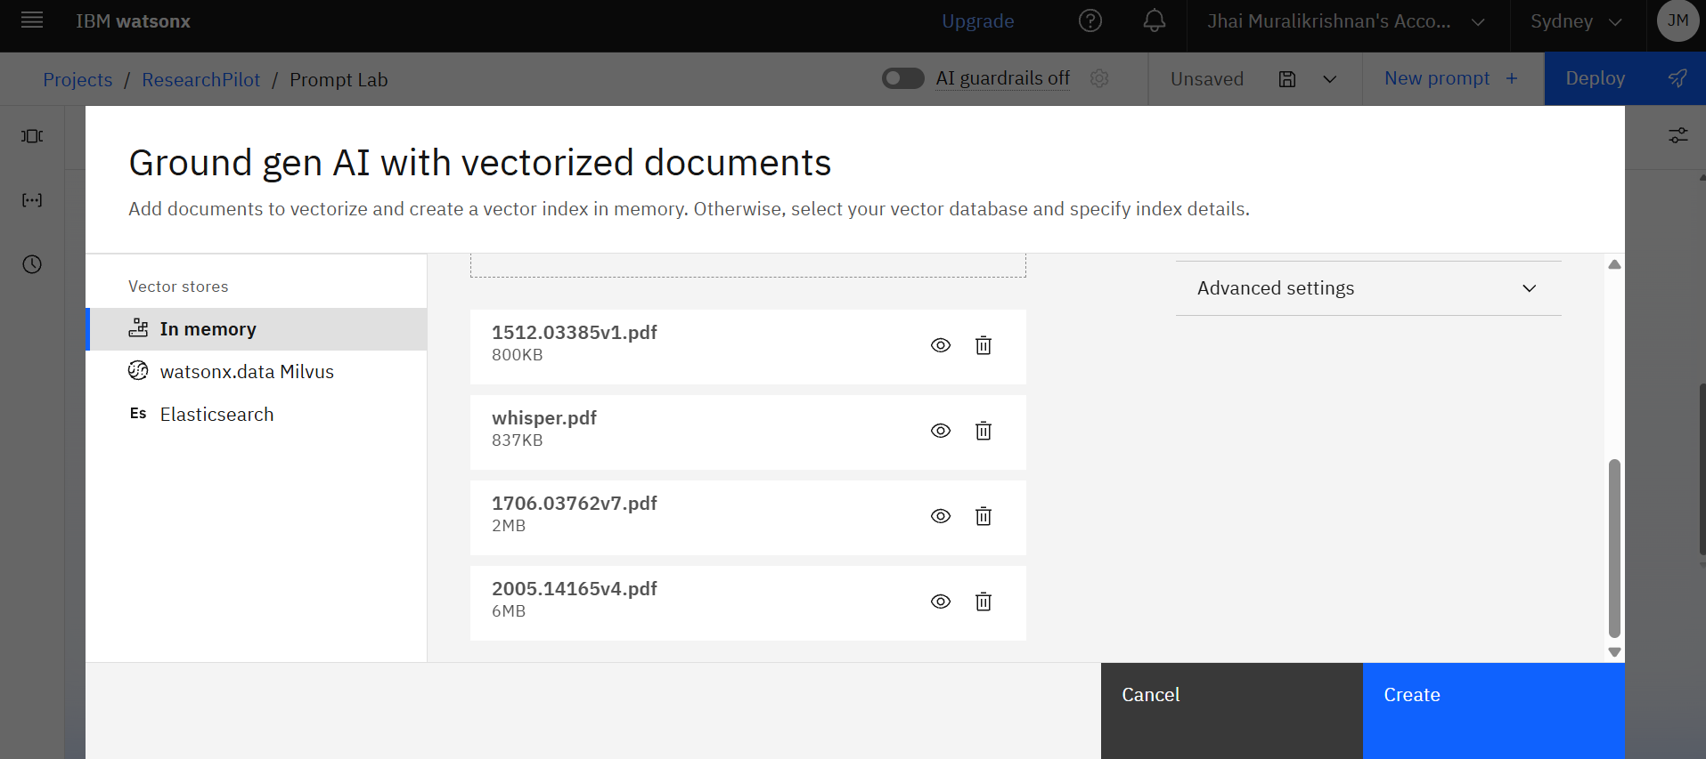
Screenshots

Slide 8
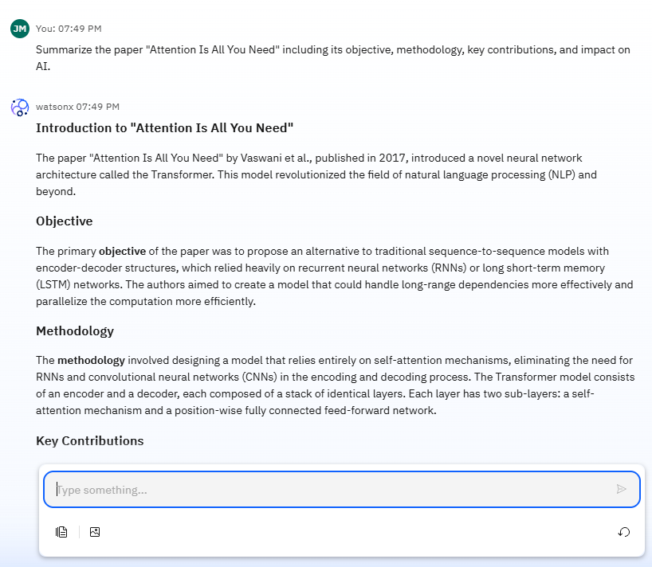
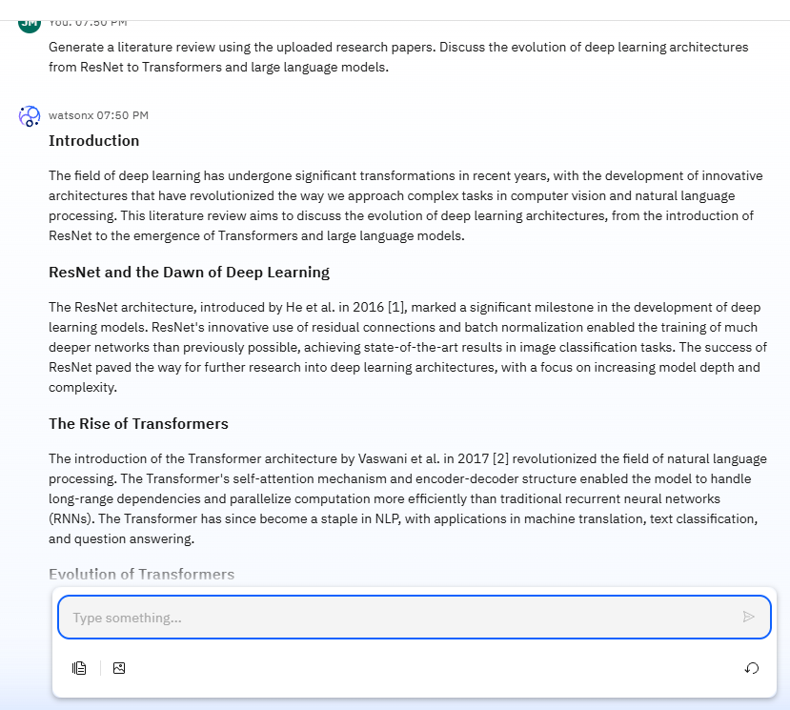
Screenshots

Slide 9
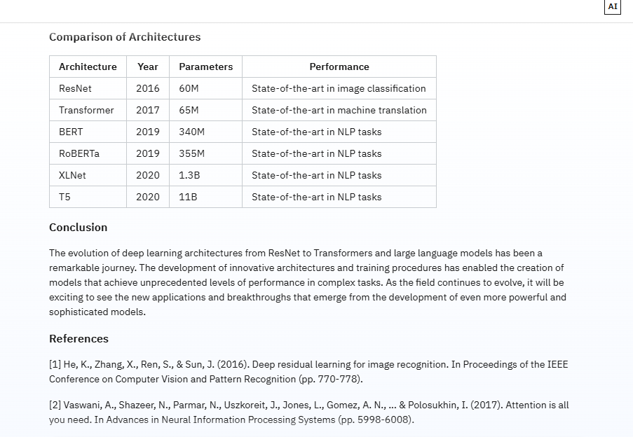
Screenshots

Slide 10
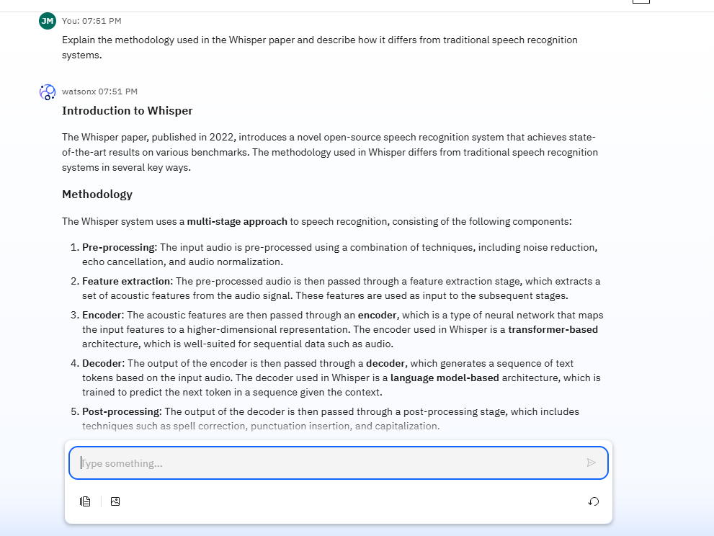
Screenshots

Slide 11
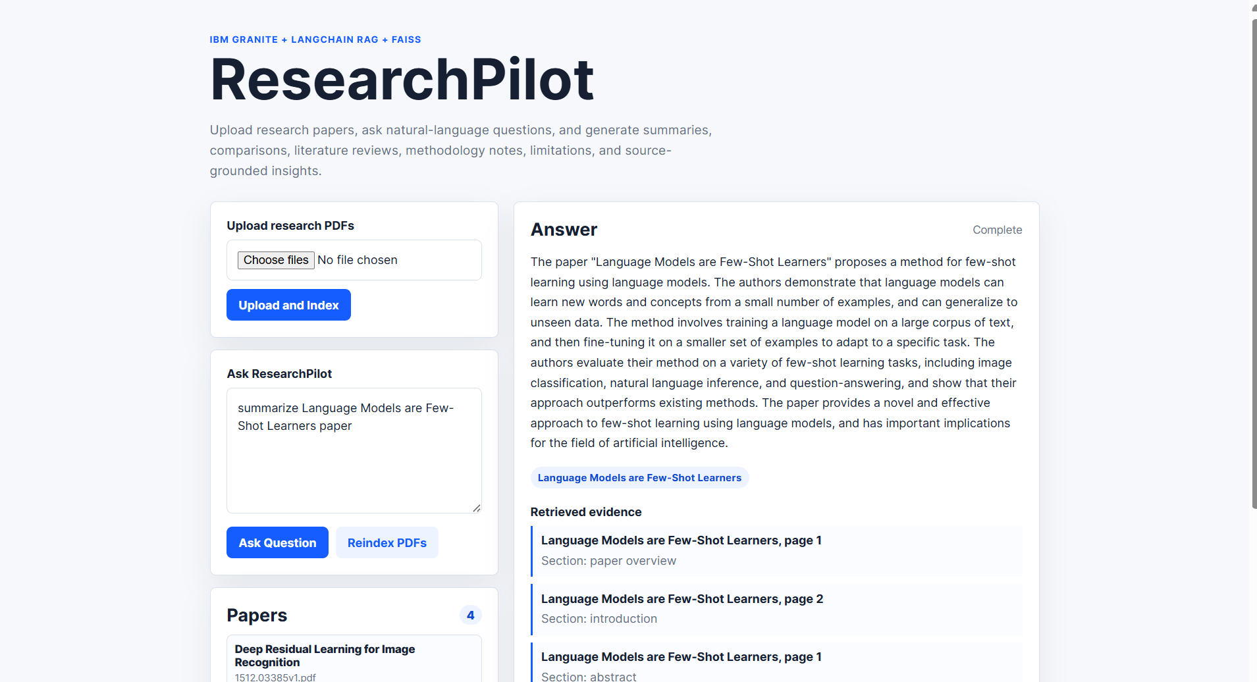
Screenshots

Slide 12
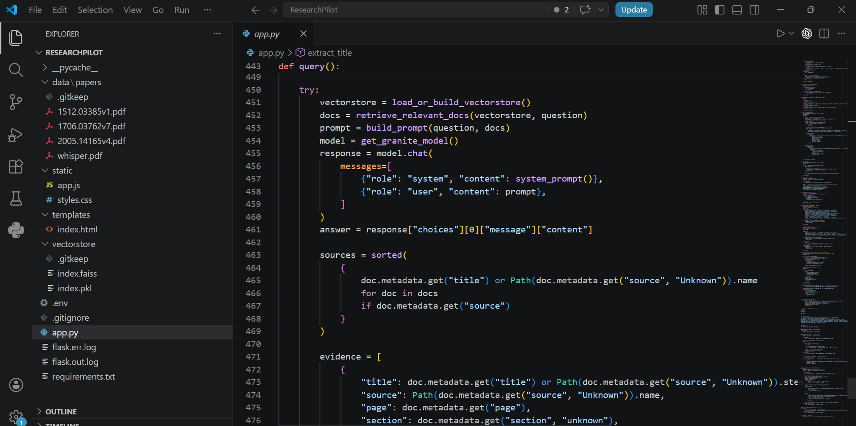
Screenshots

Slide 13
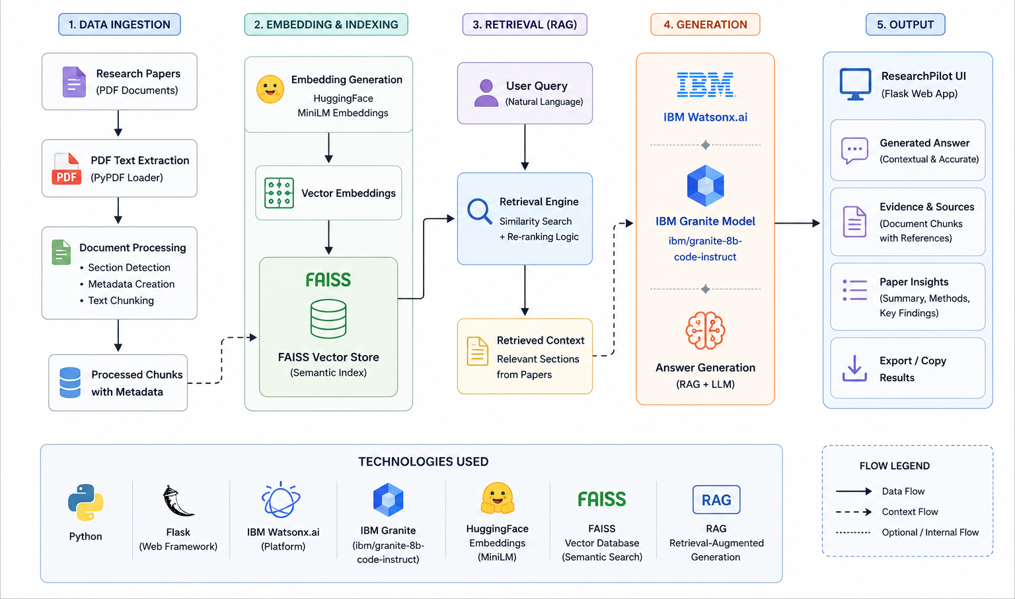
Architecture blueprint

Slide 14
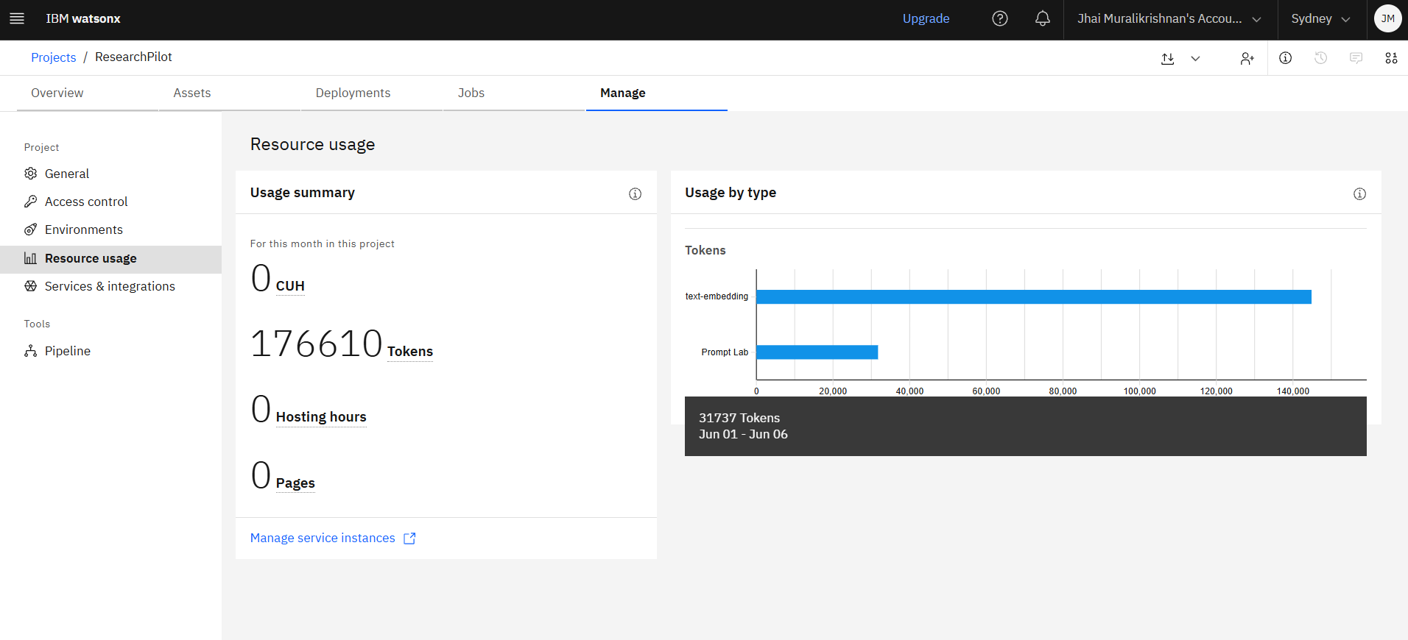
Token Usage

Slide 15
Novelty and Uniqueness
ResearchPilot combines IBM Watsonx.ai, IBM Granite Foundation Models, and Retrieval-Augmented Generation (RAG) to create an intelligent research assistant for academic paper analysis.
Document-Grounded Responses – Answers are generated using content retrieved directly from uploaded research papers, improving relevance and reliability.
Semantic Research Search – Uses vector embeddings and FAISS to locate meaningful information based on context rather than simple keyword matching.
Multi-Paper Knowledge Discovery – Enables users to explore, compare, and analyze insights across multiple research papers.
Evidence-Based AI Responses – Displays retrieved document sections and source references to enhance transparency and trust.
Research-Focused Assistance – Supports paper summarization, methodology extraction, literature exploration, and question answering through a single interface.
IBM Granite Integration – Leverages IBM Granite models via Watsonx.ai to generate contextual research insights and explanations.
Outcome
ResearchPilot transforms traditional research paper reading into an interactive AI-assisted experience, helping students and researchers save time, discover insights faster, and better understand complex academic content.

Slide 16
Git Hub Link
https://github.com/MJKING1276/ResearchPilot-researchagent-ibm
·
·
·

Slide 17
Future Scope
1. Advanced Multi-Document Reasoning
Enable deeper analysis and comparison across multiple research papers to generate more comprehensive research insights.
2. Automatic Citation Generation
Provide references and citations directly from source papers to support academic writing and literature reviews.
3. Enhanced Retrieval Accuracy
Implement advanced retrieval and reranking techniques to improve the relevance and quality of generated responses.
4. Research Trend & Knowledge Visualization
Introduce interactive dashboards to visualize research topics, trends, and relationships between papers.
5. Voice and Multilingual Support
Enable voice-based interaction and support for multiple languages to improve accessibility and usability.
·
·
·

Slide 18


