Slide 1
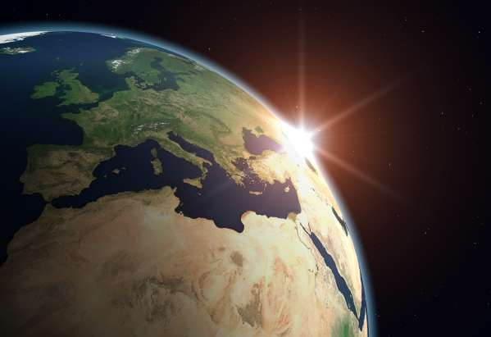
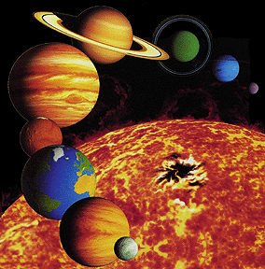
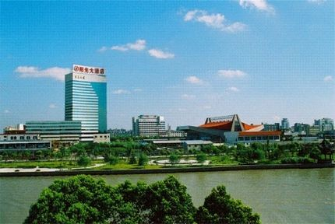
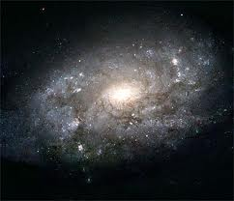
Welcome to the Lab for Unit 4!

Slide 2
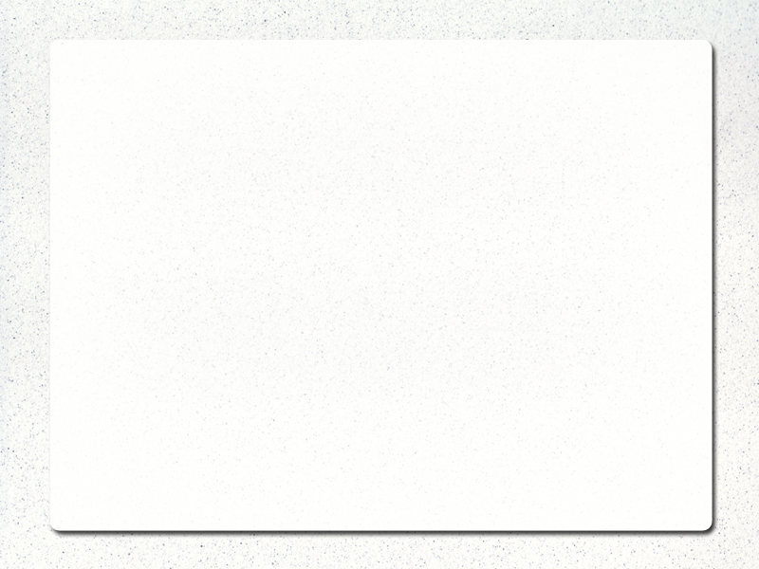
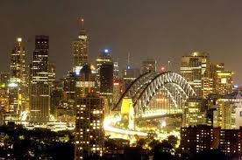
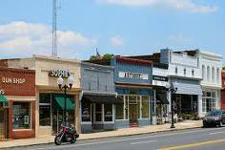
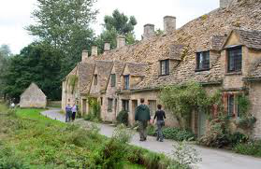
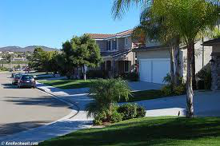
Invent your own Utopia

Slide 3
Plan a City
For this assignment, you will create a website for a city straight out of your imagination.
The city can be located anywhere and can be any kind of city. Any size, any population, anything you can think of. Use your imagination!

Slide 4
Rules for you new city
Your city cannot be perfect. You will have 12 points that you can give to 8 categories. For each category:
0 points = bad
1 point = average
2 points = good
3 points = excellent
When designing your city, remember the strong and weak points of your city.

Slide 5
Here are the 8 categories
 | 0 Points | 1 Point | 2 Points | 3 Points
Cost of Living | Very expensive | Expensive | Moderate | Cheap
Crime | Very high | High | Moderate | Very safe
Entertainment | Boring | So-so | Decent | Fun/Exciting
Pollution | Heavy/smog | Medium | Mild | Very clean
Scenery | Ugly | Drab | Typical | Beautiful
Taxes | High | Above avg. | Below avg. | Low
Transportation | Heavy/long No transit | Usually heavy Car required | Bad rush hour some walking | Walkable Good transit
Weather | Always cold | Usually cold | 4 seasons | Always warm

Slide 6
Create a Webpage for your City
The webpage must be at least 4 pages.
All pages should be connected to a CSS file.
All pages must incorporate Responsive Design techniques.
The page should look good on both a computer and a cell phone.
I would like you to try to use the Grid View Responsive Design techniques explained in W3Schools.
You should use Semantic Elements instead of div and span whenever possible.
Your site should have a nice menu or navigation bar connecting the site’s pages.

Slide 7
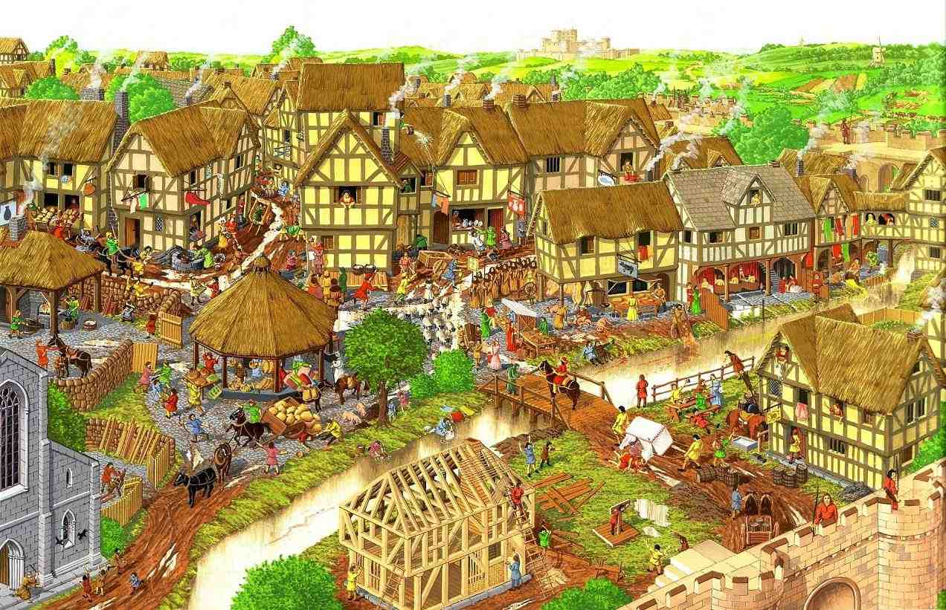
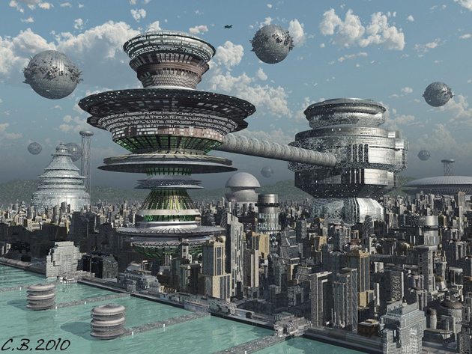
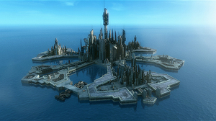
Ideas for Pages

Slide 8
General Information About Your City
What is the name of the city?
How big is it?
How many people live there?
Where is it located?
What is the land like around they city?
Is the city famous for anything?
What kind of people live there?
What kind of people travel there?

Slide 9
Biggest Attractions
Top hot spots
Best restaurants
Entertainment
Major Events

Slide 10
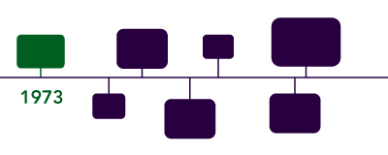
History
When Founded
Major Events
Major Accomplishments
Things like this

Slide 11
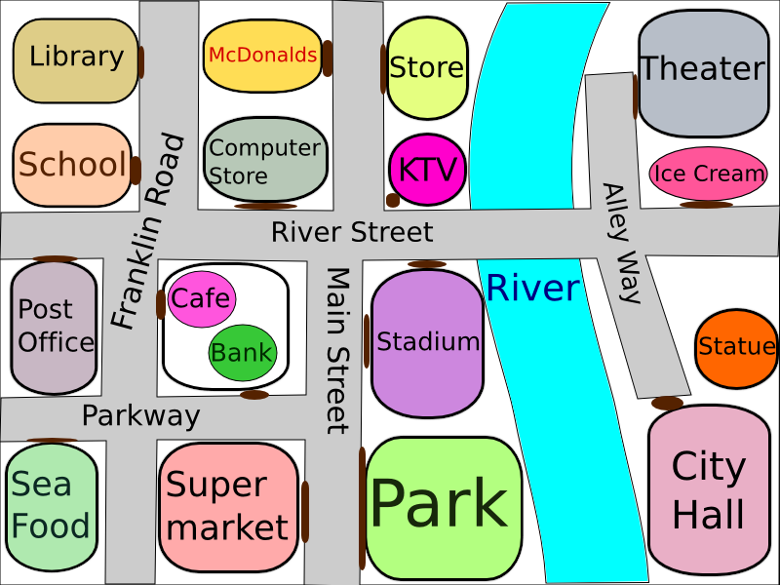
Perhaps a Map of the City

Slide 12
Grading
This will be the biggest assignment for the term, and as such will be worth 40 points instead of 20.
The key 4 items that I will be looking for are:
Responsive Design.
You should use CSS to alter the page layout depending on whether this is being used on a large device like a PC or a small device like a phone.
Use of the CSS Grid-View technique.
There are may good ways to arrange a page. The Grid-View is one such way, and the one I would like you to used for this assignment.
This will really come into play for the larger devices.
Semantic Tags
These really assist with the organization and readability of an HTML page.
Nice navigation
Plain links won’t cut it here.

