Slide 1
CallableStatement
The CallableStatement interface provides methods to execute the stored procedures.
we can create an object of the CallableStatement (interface)
Use the prepareCall() method of the Connection interface.
This method accepts a string variable representing a query to call the stored procedure and returns a CallableStatement object.
A Callable statement can have input parameters, output parameters or both.
To pass input parameters to the procedure call
Use place holder and
set values to these using the setter methods (setInt(), setString(), setFloat())
Syntax: CallableStatement cstmt = con.prepareCall("{call procedurename(?, ?, ?)}");
Ex: CallableStatement cstmt = con.prepareCall("{call myProcedure(?, ?, ?)}");

Slide 2
More about CallableStatement
The CallableStatement object uses three types of parameters when calling a stored procedure. These parameters are:-
IN
It contains any data that needs to be passed to the stored procedure and whose value is assigned using the setxxx() method as described. (input to stored procedure)
OUT
It contains the value returned by the stored procedures if any. It must be registered using the registerOut() method and then is later received by the J2EE component using the getxxx() method (output from the stored procedure)
INOUT.
It is a single parameter that is used to both pass information to the stored procedure and retrieve information from a stored procedure using the techniques described 9(input to and output from the stored procedure)
The registerOutParameter() method requires two parameters.
The first parameter is an integer that represents the number of the parameter.
The second parameter is the datatype of the value returned by the stored procedure.

Slide 3
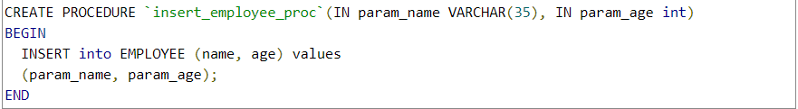
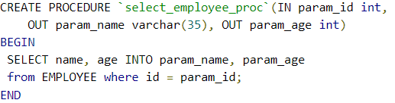
Type of parameters used n CallableStatement
1. CallableStatement example-Executing stored procedure having IN params
execute a stored procedure that has only IN params
CallableStatement cStatement = connection.prepareCall( "{call insert_employee_proc(?, ?)}");
// Setting params
cStatement.setString(1, “Kumar");
cStatement.setInt(2, 30);
int count = cStatement.executeUpdate();
System.out.println("Count of rows inserted " + count);
2. CallableStatement example-Executing stored procedure having IN and OUT params
execute a stored procedure that has both IN and OUT params
CallableStatement cStatement = connection.prepareCall( "{call select_employee_proc(?, ?, ?)}");
// Setting params cStatement.setInt(1, 26);
// Registering OUT parameters Using
cStatement.registerOutParameter(2, JDBCType.VARCHAR);
cStatement.registerOutParameter(3, JDBCType.INTEGER);
cStatement.executeQuery();

Slide 4
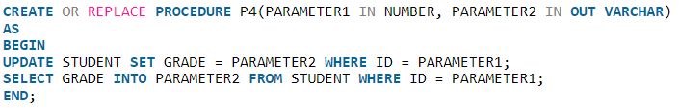
Examples
3. CallableStatement example-Executing stored procedure having INOUT params
execute a stored procedure to IN params and OUT params
CallableStatement ctmt = connection.prepareCall("{call P4(?, ?)}");
//Setting IN Parameters
cstmt.setInt(1, 123);
cstmt.setString(2, "LAST");
//Registering OUT parameters
cstmt.registerOutParameter(2, Types.VARCHAR);
//STEP 4 : Executing The CallableStatement
cstmt.execute();
//Retrieving OUT parameter
String grade = cstmt.getString(2);
System.out.println(grade);

Slide 5
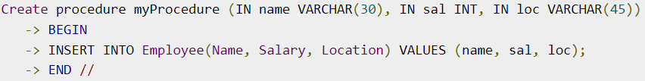
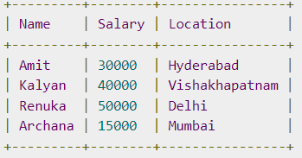
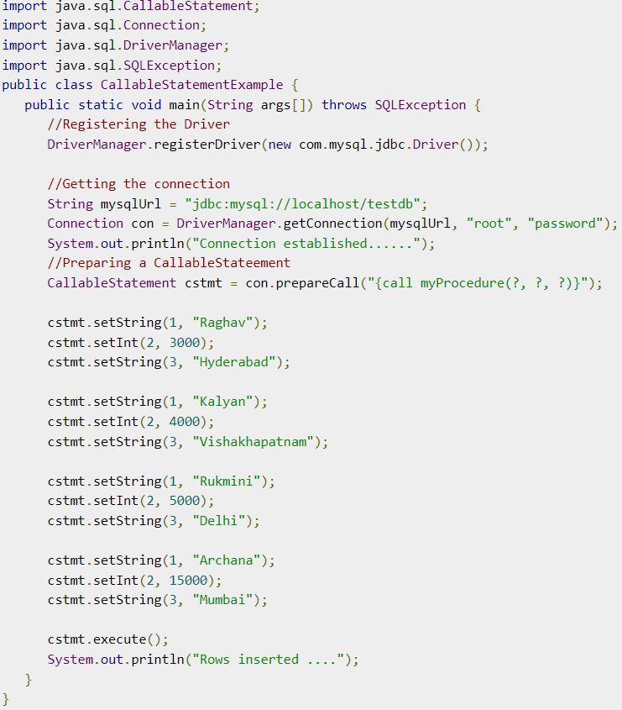

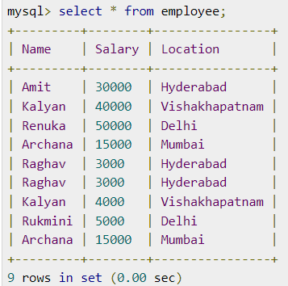
Example

