Slide 1
DATA VISUALIZATION
Topic : An Explanation Level Of Detail
TEAM MEMBERS :
208W1A1298
208W1A12A0

Slide 2

INTRODUCTION
The Marks Cards in Tableau provide some of the most powerful functionality in the program because they allow you to modify a view’s design, visualization type, user experience, and granularity of analysis all in one place.

Slide 3
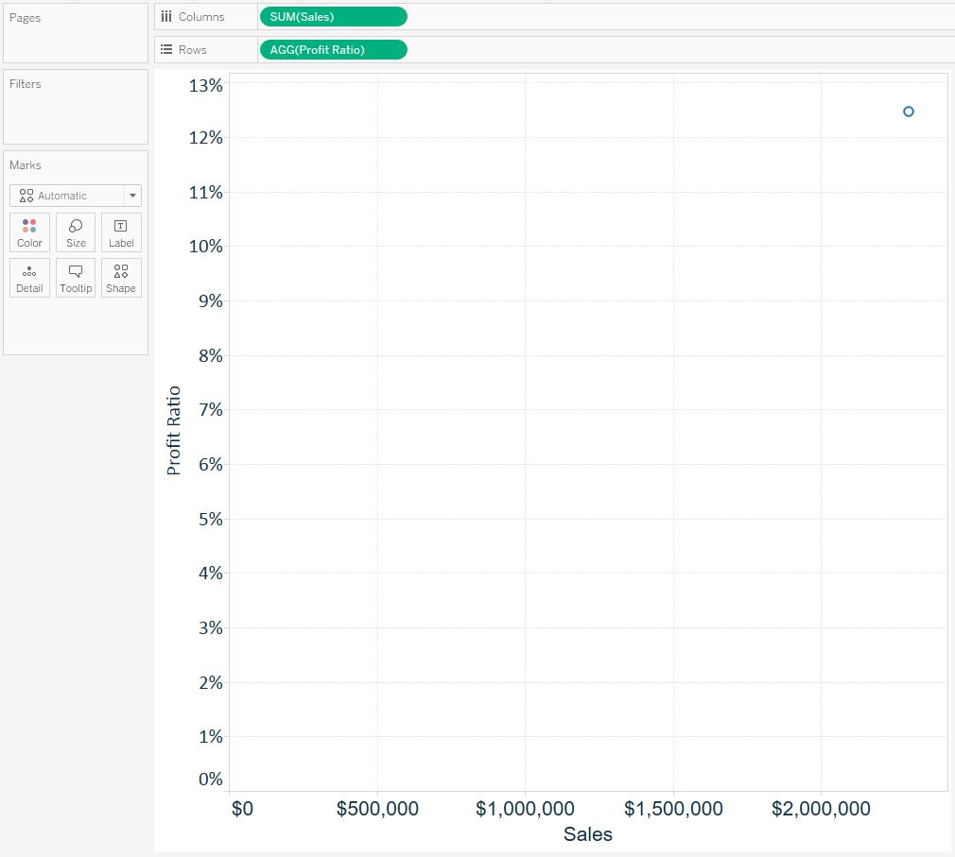
Before Applying the Marks Card
To help illustrate how each Marks Card impacts the marks on a view, we will be using this simple scatter plot looking at Profit Ratio and Sales:

Slide 4
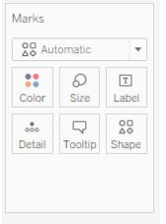
Marks Card
As you can see on the Marks Shelf, there are six different Marks Cards: Color, Size, Label, Detail, Tooltip, and Shape.
Note that the Shape Marks Card is not available for every view, but appeared because we are creating a scatter plot in this example.
To help explain what each of these cards does, we are going to start a little out of order and discuss the Detail Marks Card.
It helps us to think about level of detail as the most granular level where the analysis takes place.

Slide 5
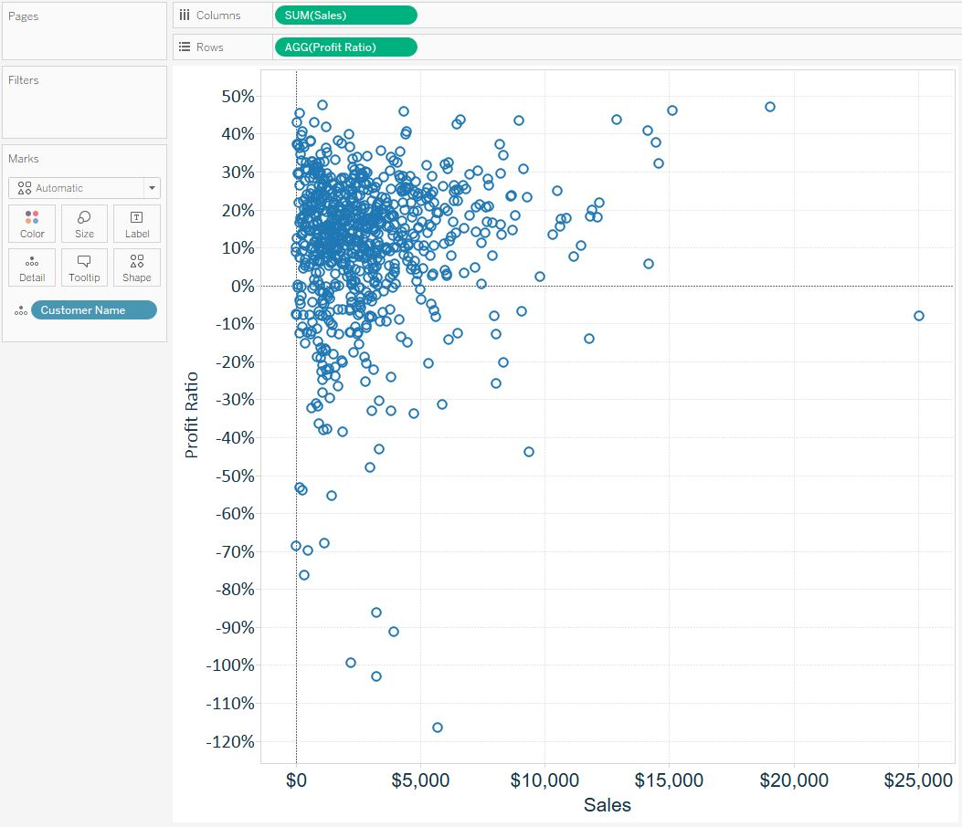
After Adding The Marks Card
Consider the scatter plot pictured above. At this point, we are not slicing and dicing the Profit Ratio and Sales measures by any dimension. For that reason, you see just a single mark, which represents the intersection of Profit Ratio and Sales for every record combined in the Sample – Superstore data set.
As you add dimensions to the view, the analysis becomes more granular, so the level of detail changes.
For example, if we wanted to do this Profit Ratio versus Sales comparison at the customer level, we can drag and drop the Customer Name dimension from the Dimensions Shelf to the Detail Marks Card.

Slide 6


