Slide 1


Department of Information Technology
V R Siddhartha Engineering College
Machine Learning project
Assignment-2
Presented by
Kommareddy Leela Satya (208W1A1292)
Motamarri Jaya Naga Venkata Sai (208W1A12A0)
Tummala Venkata Naga Nymisha(208W1A12C6)
Submitted to
Dr.T.Anuradha
PhD, Professor, IT

Slide 2
Problem Statement
CLASSIFICATION: DIABETES HEALTH INDICATORS
The problem statement involves developing a predictive model to classify individuals as having or not having prediabetes or diabetes using a dataset with 21 feature variables. The model should accurately predict the target variable and provide insights into the factors that contribute to the development of diabetes. The ultimate goal is to help healthcare professionals identify individuals at risk for developing diabetes and implement preventive measures, which can improve the quality of life for affected individuals and reduce the burden of the disease on the healthcare system.

Slide 3
Scope of the Project
The scope of the project involves developing a predictive model to classify individuals as having or not having prediabetes or diabetes using machine learning techniques.
The project will include data preprocessing, model training and testing, and evaluation of the model’s performance. The project’s focus is to provide insights into the factors that contribute to the development of diabetes and to help healthcare professionals identify individuals at risk for developing diabetes and implement preventive measures.
The final deliverable will be a functional predictive model that can aid in the early detection and management of diabetes.

Slide 4
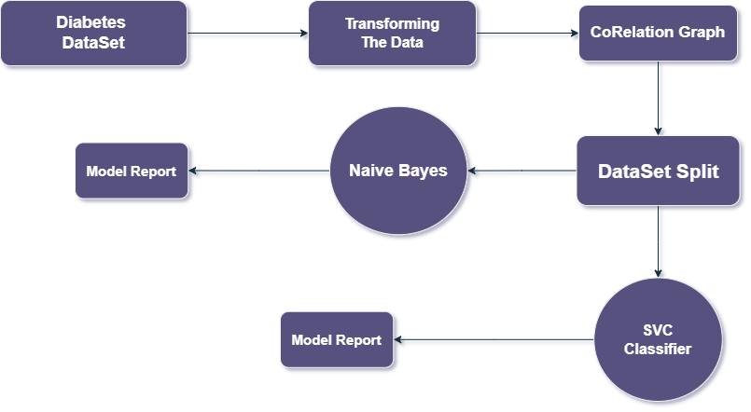
Architecture Diagram

Slide 5
Data Set Description
The dataset is focused on diabetes and contains 21 feature variables that are used to predict the target variable Diabetesbinary, which has two classes: 0 for no diabetes and 1 for prediabetes or diabetes.
The dataset includes various health indicators such as blood pressure, BMI, age, and glucose levels that are known to contribute to the development of diabetes.
The dataset's purpose is to develop a predictive model to accurately classify individuals as having or not having prediabetes or diabetes.
The model can help healthcare professionals identify individuals at risk for developing diabetes and implement preventive measures to reduce the burden of the disease on the healthcare system.

Slide 6
Evaluation Measures
The evaluation measures used in the above code are:
Classification report: The classification report gives a summary of the precision, recall, f1-score, and support for each class (0 and 1) in the predicted output.
Accuracy score: The accuracy score is calculated as the ratio of the correctly predicted instances to the total number of instances. It gives an overall measure of the model's performance.
Both the SVC and Gaussian Naive Bayes classifiers are evaluated using these measures.

Slide 7
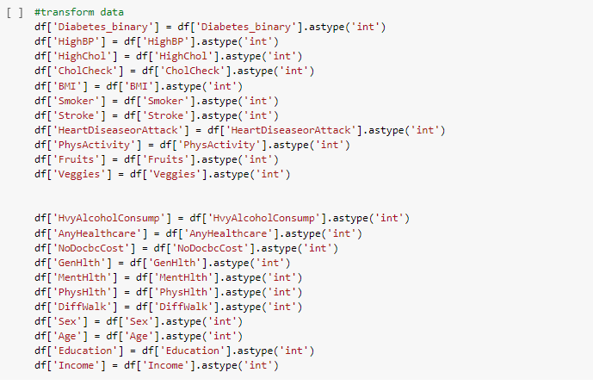

Slide 8
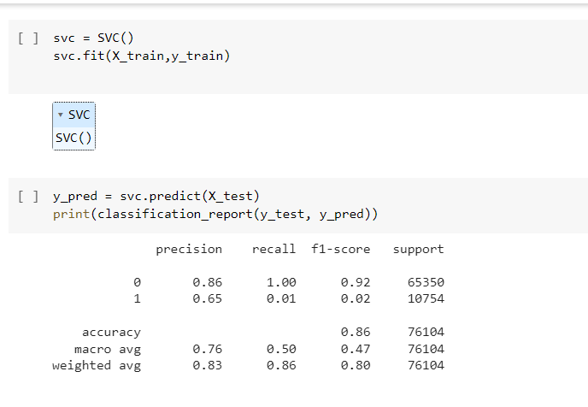

Slide 9
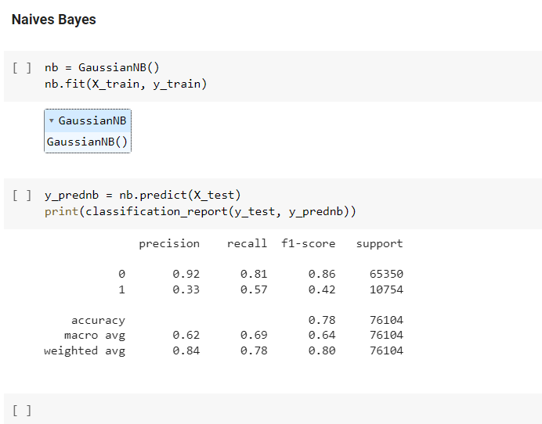

Slide 10
Problem Statement
REGRESSION: STUDENT GRADE PREDICTION
The problem is to predict the final year grade (G3) of students in two different subjects, Mathematics and Portuguese language, based on their demographic, social, and school-related features, as well as their grades from the first two periods (G1 and G2). The target attribute (G3) is strongly correlated with G1 and G2, but predicting G3 without G1 and G2 is still valuable. The data was collected from two Portuguese schools using school reports and questionnaires. The task can be modeled as a regression problem.

Slide 11
Scope of the Project
The scope of the project is to predict the final year grade of secondary education students in mathematics and Portuguese language based on their demographic, social, and school-related features.
The data was collected using school reports and questionnaires, and two datasets are provided for the two distinct subjects. The target attribute, G3, has a strong correlation with attributes G2 and G1, which correspond to the 1st and 2nd-period grades.
The project aims to model the datasets under regression tasks and evaluate the performance of different regression models in predicting the final year grade.

Slide 12
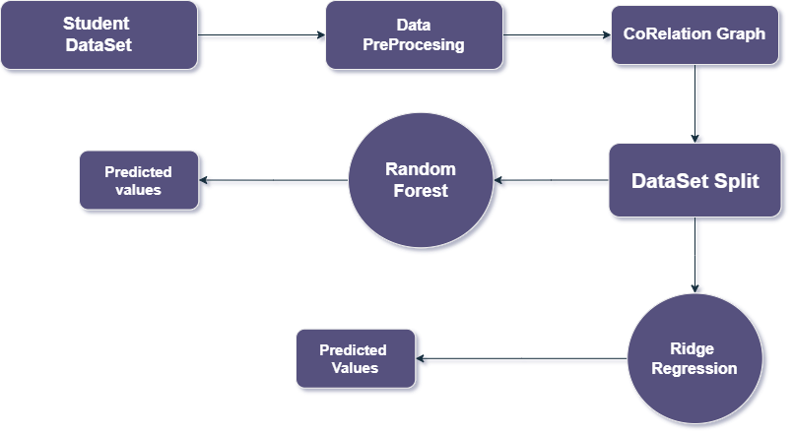
Architecture Diagram

Slide 13
Data Set Description
The dataset used in this project includes information on student performance in two subjects (Mathematics and Portuguese language) from two Portuguese schools.
The data was collected through school reports and questionnaires and includes demographic, social, and school-related features.
The target attribute is the final year grade (G3), which has a strong correlation with the grades from the first and second periods (G1 and G2).

Slide 14
Evaluation Measures
The evaluation results for the regression problem of predicting student grades using the Ridge and Random Forest models show that both models are able to make reasonably accurate predictions.
The Ridge model has a mean squared error of 0.455, which indicates that on average, the model's predictions are off by around 0.68 letter grades (assuming a 4-point grading scale).
The Random Forest model has a slightly lower mean squared error of 0.402, indicating that it is slightly more accurate in its predictions.

Slide 15
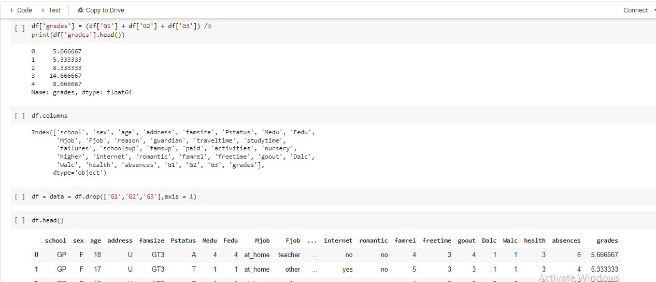

Slide 16
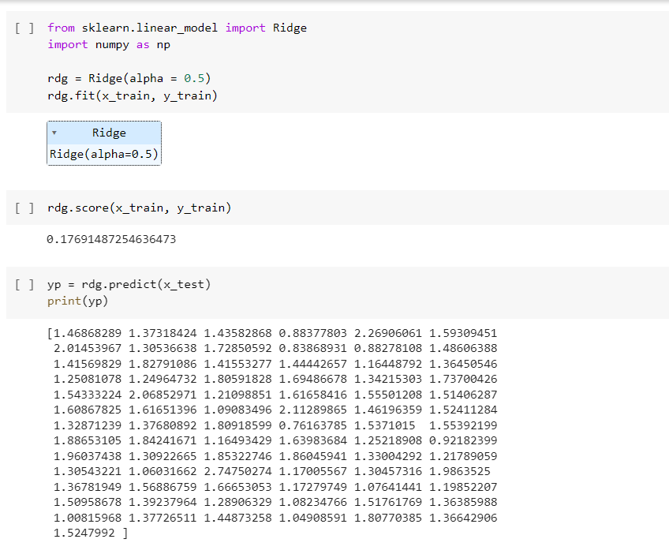

Slide 17
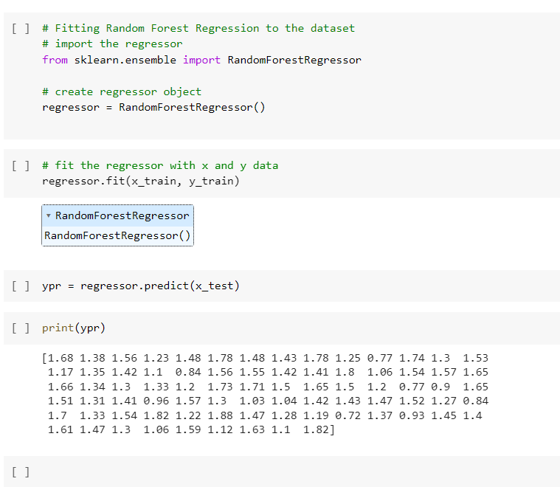

Slide 18
Conclusion
In conclusion, both tasks showcase the potential of machine learning algorithms in solving real-world problems. The first task demonstrates the effectiveness of even basic algorithms in predicting customer purchases, while the second task highlights the importance of data preprocessing and algorithm selection for more complex problems. Ultimately, both tasks illustrate how machine learning can improve decision-making and provide valuable insights for businesses and educational institutions.

Slide 19
References
[1]
https://www.kaggle.com/code/bayunova/diabetes-health-indicators
[2]
https://www.kaggle.com/code/nasere/diabetes-health-prediction
[3]
http://scikit-learn.org/stable/modules/generated/sklearn.linear_model.RidgeCV.html
[4]
http://scikit-learn.org/stable/modules/generated/sklearn.ensemble.RandomForestRegressor.html

Slide 20
Thank You

