Slide 1
MACHINE LEARNING
Course Outcomes
and
Syllabus

Slide 2
Course Outcomes
CO1: Understand the fundamental concepts of machine learning
CO2: Apply linear, distance based, and decision tree based models
CO3: Analyze probabilistic, neural network models
CO4: Design a suitable machine learning model for a given scenario

Slide 3
Syllabus
Unit I
The ingredients of machine learning: Tasks, Models, Features
Binary classification and related tasks: Classification, Assessing classification performance, Visualising classification performance
Beyond binary classification: Multi-class classification, Regression
Unit II
Decision Tree learning – Introduction, Decision tree representation, Appropriate problems for decision tree learning, The basic decision tree learning algorithm, Inductive bias in decision tree, Issues in decision tree learning.
Linear models: The least-squares method, Multivariate linear regression, Support vector machines, Soft margin SVM, Going beyond linearity with kernel methods.

Slide 4
Syllabus
Unit III
Distance Based Models: Introduction, Nearest Neighbours classification, Distance based clustering, K-Means algorithms, Clustering around medoids, Hierarchical Clustering.
Bayesian Learning: Introduction, Bayes theorem, Bayes optimal classifier, Naïve Bayes classifier, Bayesian belief networks.
Unit IV
Artificial Neural Networks: Introduction, Neural network representation, appropriate problems for neural network learning, Multilayer networks and the back propagation, Advanced topics in Artificial Neural Networks
Reinforcement Learning: Introduction, Learning tasks, Q-learning

Slide 5
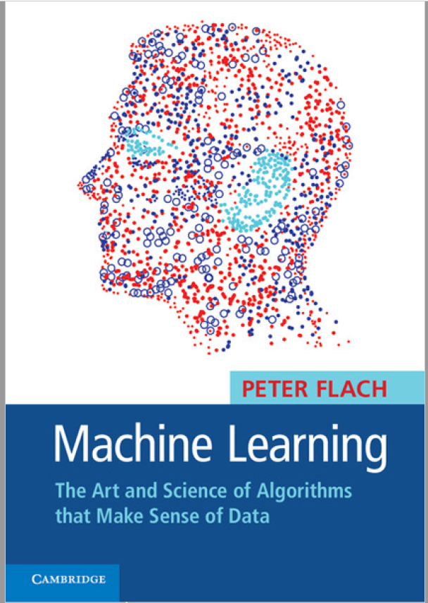
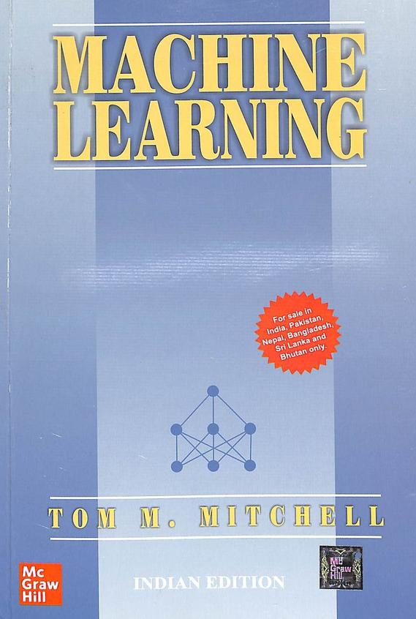
Text Books

