Slide 1


Department of Information Technology
V R Siddhartha Engineering College
Software testing methodology project
Assignment-2
Presented by
Mohammad Rizwanullah (208W1A1299)
Motamarri Jaya Naga Venkata Sai (208W1A12A0)
Submitted to
Dr . K . Sita Kumari
PhD, Professor, IT

Slide 2
Problem Statement - 1
5 . Write the Automation Test Scripting for the following Scenarios.
a) Verify if Special Characters are allowing in the First and Last name
b) Verify if Email field is accepting only numbers as Email (without @ and
.com or .co.in etc.,)
c) Verify if Email field is accepting only Special Characters as Email (without
@and .com or .co.in etc.,)

Slide 3
SCOPE OF THE PROJECT
The project involves testing the input validation functionality of a web application. Specifically, the following scenarios need to be tested:
Verify if Special Characters are allowing in the First and Last name: This test case involves checking if special characters such as !@#$%^&*()_+ are allowed in the First and Last name fields. The expected behavior is that special characters should not be allowed, and an appropriate error message should be displayed to the user.
Verify if Email field is accepting only numbers as Email (without @ and .com or .co.in etc.,): This test case involves testing the email validation functionality by entering only numbers in the email field. The expected behavior is that an error message should be displayed to the user, indicating that a valid email address is required.
Verify if Email field is accepting only Special Characters as Email (without @and .com or .co.in etc.,): This test case involves testing the email validation functionality by entering special characters such as !@#$%^&*()_+ in the email field. The expected behavior is that an error message should be displayed to the user, indicating that a valid email address is required.

Slide 4
Software Requirements
Eclipse Integrated Developed Environment with version 2022 – 2023
Selenium, WebDriver Manger, apache, testing-metrics
Install Testng Package from the Eclipse market Place
Java Development kit of version 8
Java runtime environment of version 19 (minimum requirement )
System with minimum 4GB Ram

Slide 5
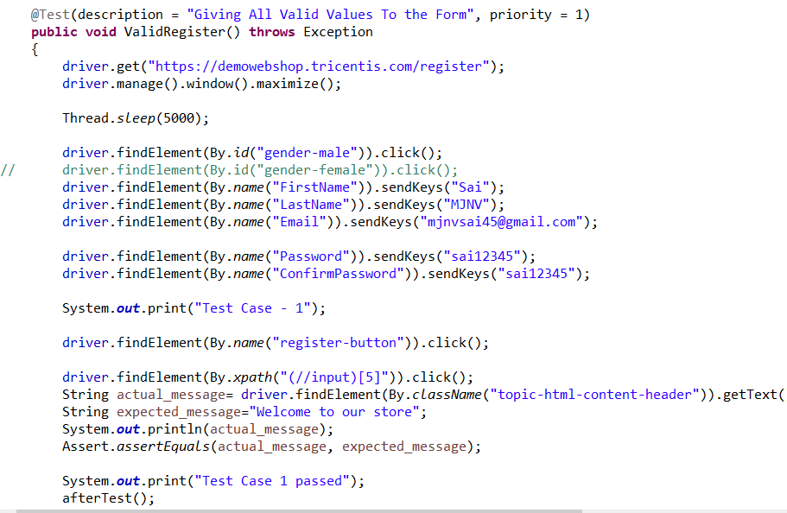
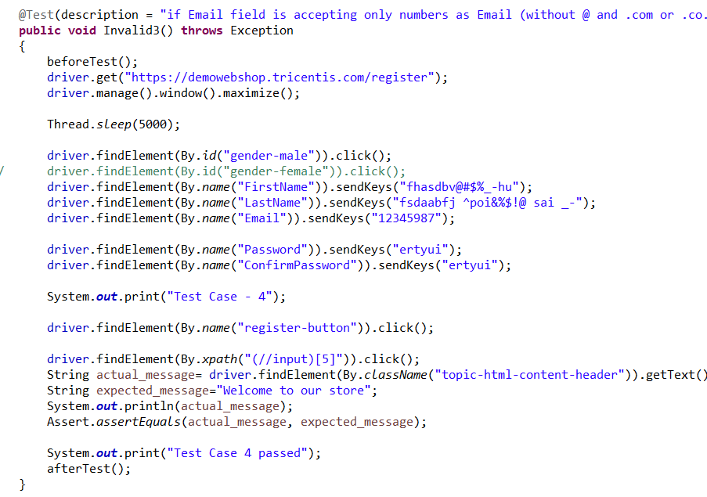
Implementation Steps

Slide 6
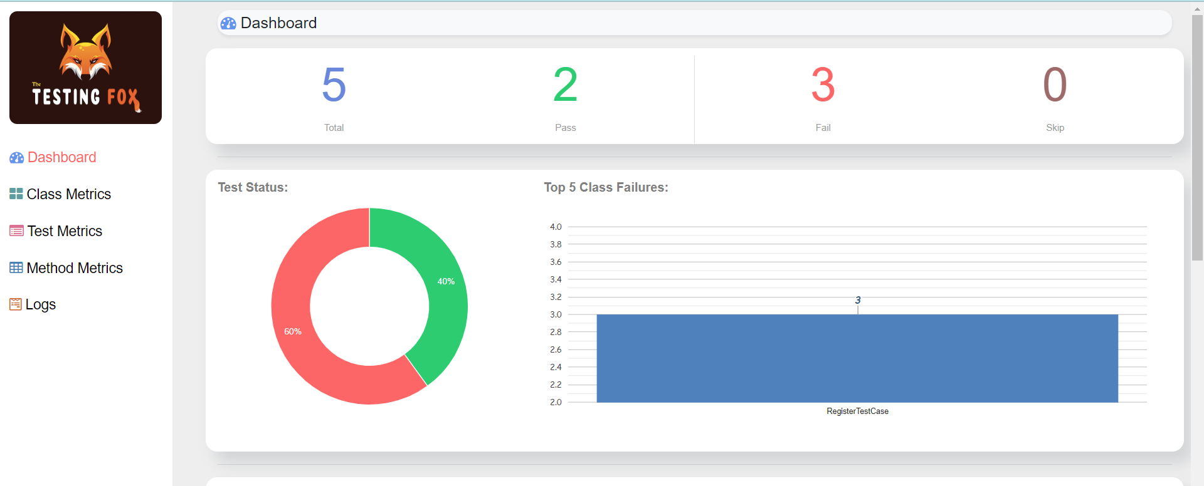
RESULT ANALYSIS

Slide 7
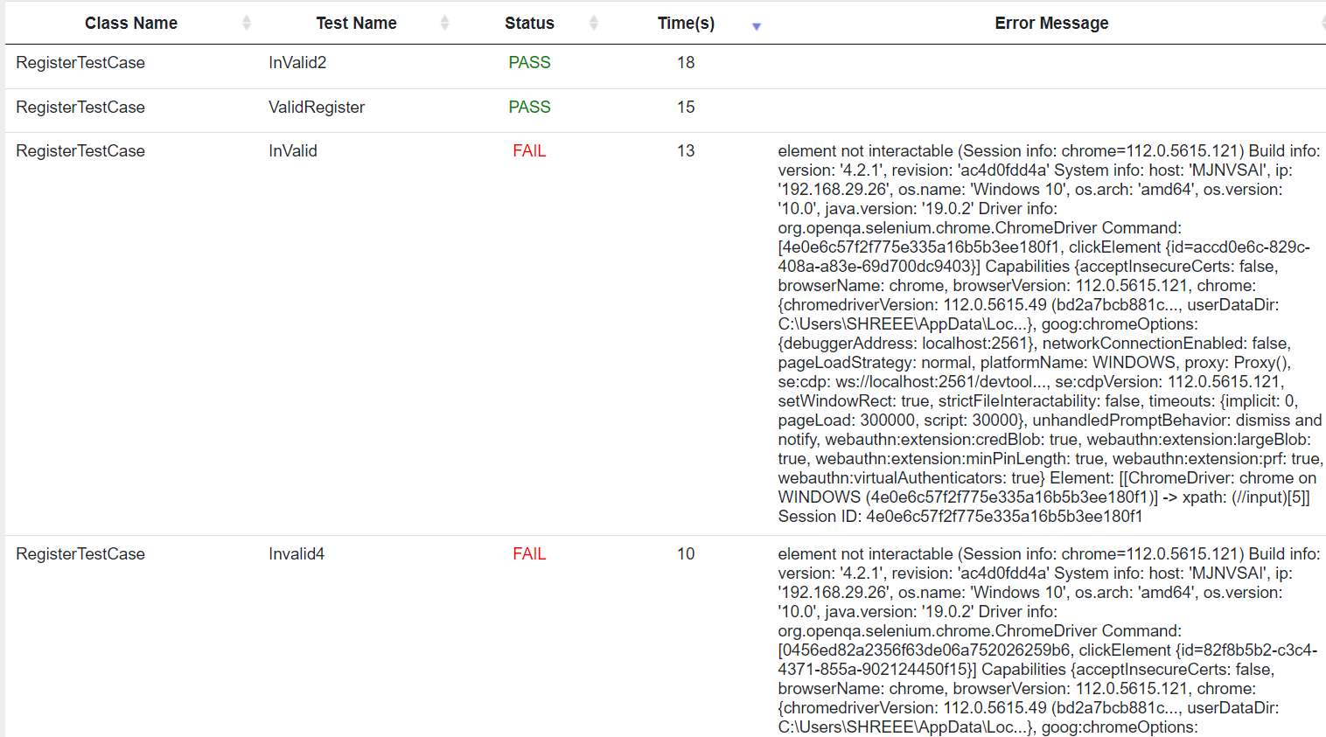

Slide 8
Problem Statement - 2
Write the Automation Test Scripting for the following Scenarios.
a) Verify if a user will be able to login with a valid Email and valid
Password
b) Verify if a user cannot login with a Invalid Email and valid
Password.
c) Verify if a user cannot login with a valid Email and Invalid Password.

Slide 9
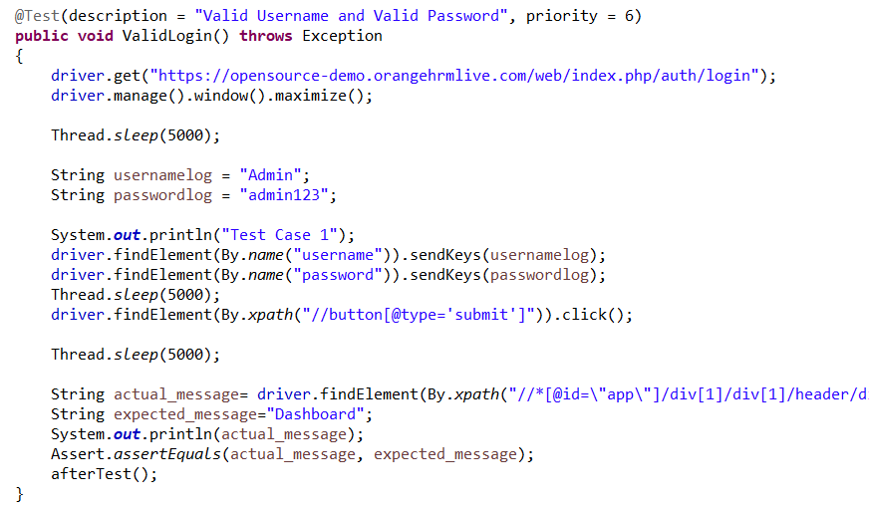
Implementation Steps For Register TestCases

Slide 10
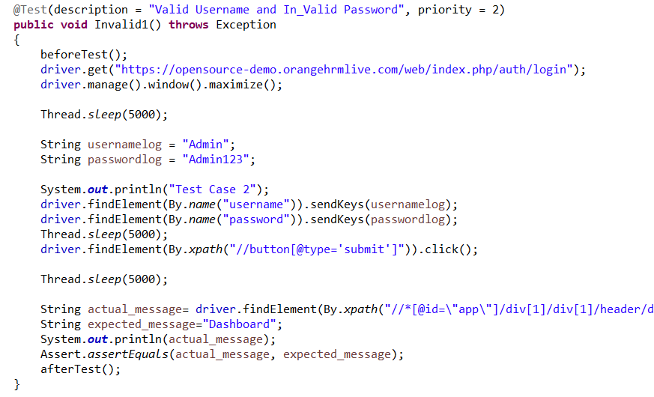

Slide 11
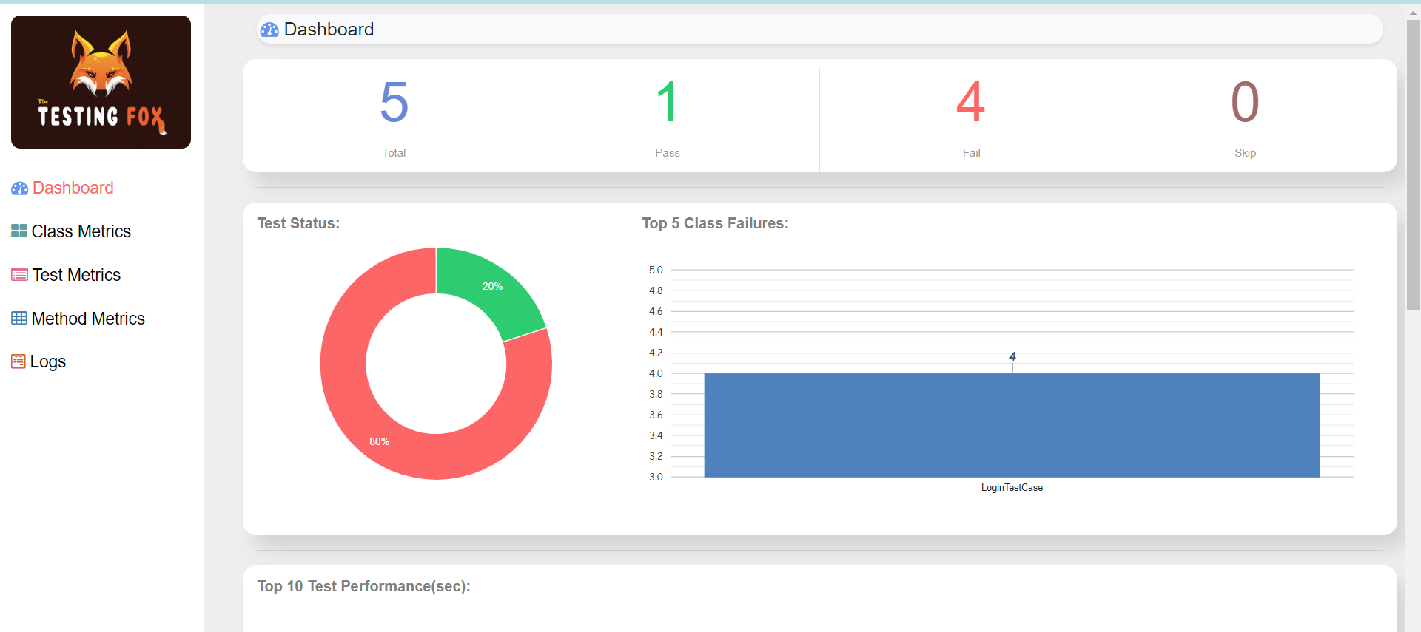
RESULT ANALYSIS

Slide 12
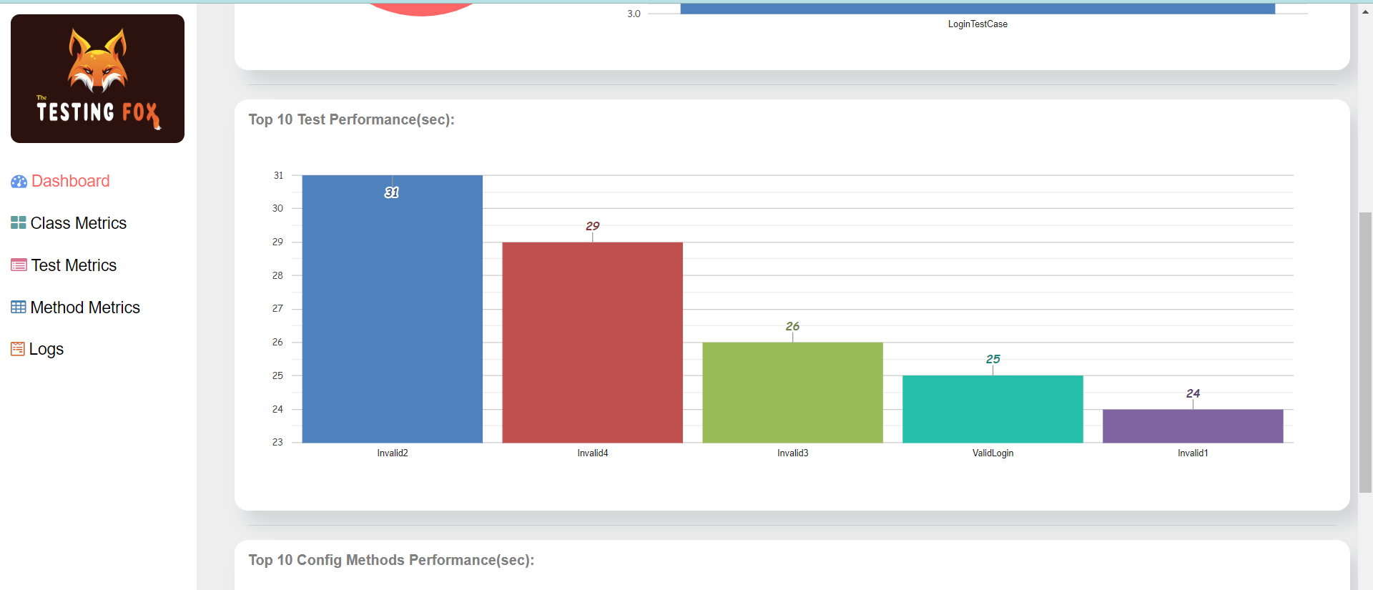

Slide 13
THE END

