Slide 1
Primary expressions
A primary expression consists of only one operand with no operator.
In c the operand in the primary expression can be a name, a constant.
Ex:- a, cost, percent
A primary expression can be a constant .
A primary expression can be a parenthesized expression .any value enclosed in parenthesis must be reduce to a single value.
Ex : c= (2*4+7)

Slide 2
Postfix expression
A postfix expression consists of one operand followed by one operator.
Operand
Operator

Slide 3
Postfix increment
It is a postfix expression.
If we need a variables value to be incremented by one, then we use postfix increment operator.
ex: a++
x=a++

Slide 4
Postfix decrement
It is a postfix expression. If we need a variables value to be decremented by 1 then we use postfix decrement operator.
Ex:- a—
x=a--

Slide 5
Prefix expression
A prefix expression consists of an operator followed by an operand . The operand of a prefix expression must be a variable.
Operator
Operand

Slide 6
Prefix increment
Prefix increment operator forms a prefix expression .the value of the variable is incremented by 1 .
Ex: ++a
C=++a

Slide 7
Prefix decrement
Prefix decrement operator also forms a prefix expression. the value of the variable is decremented by 1.
Ex: --a
X=--a

Slide 8
Unary expression
It consists of an operator followed by an operand like a prefix expression .
the sizeof operator tells us the size of data type .
ex: sizeof(x)
Unary plus and unary minus operators are used to compute the arithmetic value of an operand.
The third unary operator is cast. the cast operator converts one expression data type in to another.

Slide 9
Binary expressions
Binary expressions are formed by an operand ,operator, operand combination.
Operator
Operator
Operand

Slide 10
Multiplicative expressions : in a binary expression if the operator used is multiply, divide or modulus operator, then that expression is a multiplicative expression .
Additive expression :the operator used is addition or subtraction operator.
Assignment expressions :the assignment expression evaluates the operand on the right side of the assignment operator (=) and places its value in the variable on the left.
Simple assignment
Compound assignmnet

Slide 11
Simple assignment :the value of the right operand is assigned to the left operand .
ex: a=2
b=a+1
Compound assignment : a compound assignment is a shorthand notation for a simple assignment .
ex: x+=3 is evaluated as x=x+3

Slide 12
Ternary expressions
A ternary expression also called as a conditional expression.
ex: con?exp1:exp2
x=a>b?a:b

Slide 13
Precedence and associativity
Precedence is used to determine the order in which different operators in a complex expression are evaluated.
Ex: 2+3 *4

Slide 14
Associativity
It is used to determine the order in which operators with the same precedence are evaluated in a complex expression .
Associativity can be left –right or right –left.
Ex 1: 3*8/4%4*5
Ex 2: a+=b*=c-=5

Slide 15
Side effects
A side effect is an action that results from the evaluation of an expression .
Ex:x=x+4

Slide 16
Statements
A statement causes an action to be performed by the program.
Null statement: the null statement is just a semicolon.
Expression statement: an expression is turned into a statement by placing a semicolon (;) after it
ex: x=4;

Slide 17
Return statement :a return statement terminates a function .
syntax: return expression;
ex: return 0;

Slide 18
Compound statements
A compound statement is a unit of code consisting of zero or more statements.it is also known as block.

Slide 19
conditional statements
The conditional statements in C are the decision making statements.
1.if statement 2. if-else statement 3. ternary statement or ternary operator 4. nested if-else statement 5. switch statement

Slide 20
if statement
The syntax of if statement is:
if (test Expression)
{
// statement(s)
}

Slide 21
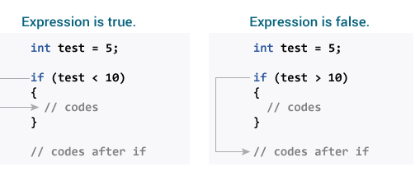

Slide 22
#include <stdio.h>
Void main()
{
int number;
printf("Enter an integer: ");
scanf("%d", &number);
// Test expression is true if number is less than 0
if (number < 0)
{
printf("You entered %d.\n", number);
}
printf("The if statement is easy.");
getch ();
}

Slide 23
if-else statement
The if statement may have an optional else block.
The syntax of if-else statement is:
if (test Expression) {
// statement(s) inside the body of if
}
else {
// statement(s) inside the body of else
}

Slide 24
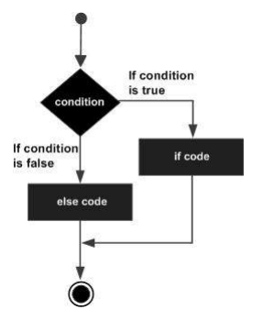
Flow Diagram

Slide 25
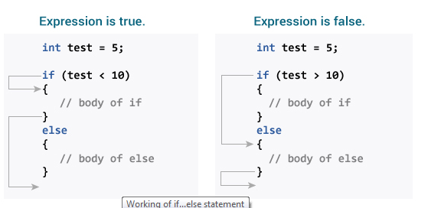

Slide 26
#include <stdio.h>
Void main()
{
int number;
printf("Enter an integer: ");
scanf("%d",&number);
// True if remainder is 0
if( number%2 == 0 )
printf("%d is an even integer.",number);
else
printf("%d is an odd integer.",number);
getch();
}

Slide 27
Biggest of two numbers
include <stdio.h>
Void main()
{
int num1, num2;
printf("Enter two integers :");
scanf("%d %d", &num1, &num2);
if (num1 > num2)
{
printf("Largest number is %d.", num1);
}
else
{
printf("Largest number is %d.", num2);
}
getch ();
}

