Slide 1
20ES1103 Programming for Problem Solving
UNIT II

Slide 2
Introduction to the C Language
Background of C program

Slide 3
Brief History of C
The C programming language was developed in the Bell Labs of AT&T by an employee called Dennis Ritchie between 1969 and 1973 while working on Unix operating system.
He created this language using ALGOL, BCPL, and B the languages that were used before C was created.
Ritchie added many powerful features to C and used it to further develop the UNIX operating system.
American National Standards Institute (ANSI) in 1983, formed a committee to provide a comprehensive definition to the C language and thus came into existence the new ANSI C language with better features.

Slide 4
What is C Character set?
C Character set is a collection of characters supported in C programming language.
C Programming language has a rich set of characters which are used to construct c program instructions.
1

Slide 5
What does C Character Set contains?
Alphabets
- C Language supports all alphabets of English. It supports both UPPERCASE & lowercase letters
Digits
- C Language supports 10 digits to construct numbers. Those 10 digits are 0,1,2,3,4,5,6,7,8,9
Special Symbols
- C supports a rich set of special symbols that include symbols to perform mathematical operations, condition checking, white space, back space, etc…
2

Slide 6
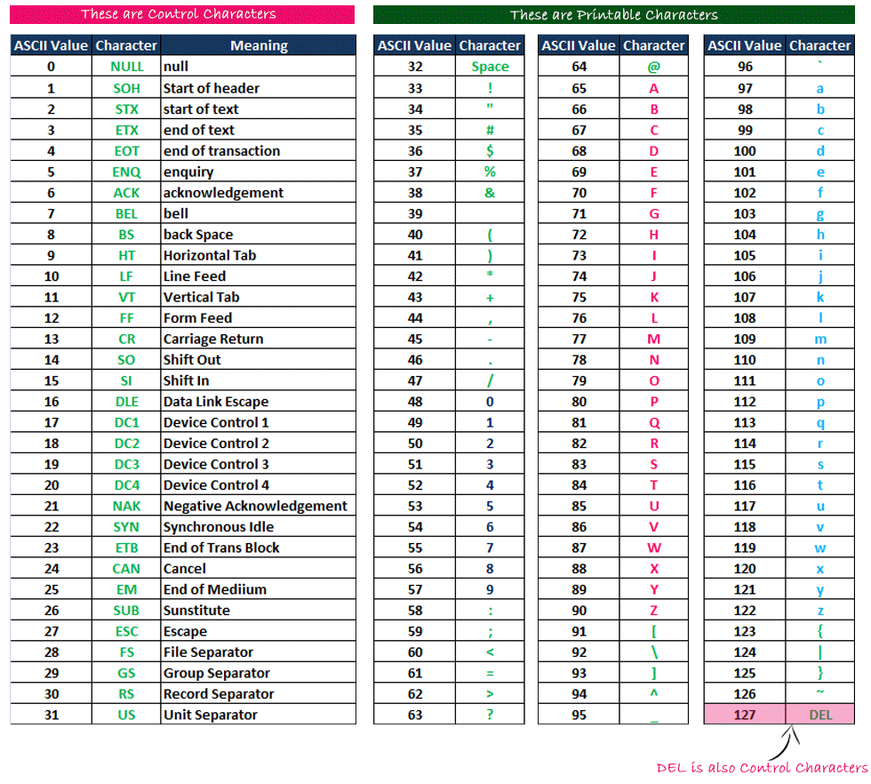
Commonly used Special Symbols with ASCII Values
3

Slide 7
A Trigraph sequences provides a way to enter certain characters that are not available on some keyboards. Each trigraph sequence consists of three characters (two question marks followed by another character) as shown below.
Trigraph sequence | Translation
??= | # Number sign
??( | [ Left bracket
??/ | \ Back slash
??) | ] Right bracket
??' | ^ Caret
??< | { Left brace
??! | | Vertical bar
??> | } Right brace
??- | ~ Tilde

Slide 8
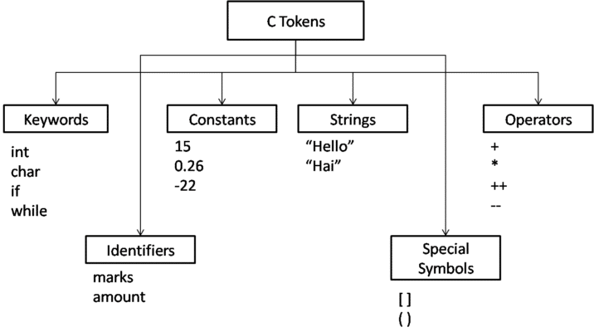
C Tokens:
In C programs, each word and punctuation is referred to as a token.
C Tokens are the smallest building block or smallest unit of a C program.

Slide 9
Identifiers

Slide 10
C Identifiers
Identifier refers to name given to entities such as variables, functions, structures etc.
Identifiers must be unique. They are created to give a unique name to an entity to identify it during the execution of the program. For example:
int money;
double accountBalance;
Here, money and accountBalance are identifiers.
Also remember, identifier names must be different from keywords. You cannot use int as an identifier because int is a keyword.

Slide 11
Rules for naming identifiers
o First character must be an alphabet (or underscore).
o Must consist of only letters(a-z,A-Z), digits(0-9) or underscore.
o Only first 31 characters are significant.
o Cannot use a Keyword.
o Must not contain white space.

Slide 12
Types

Slide 13
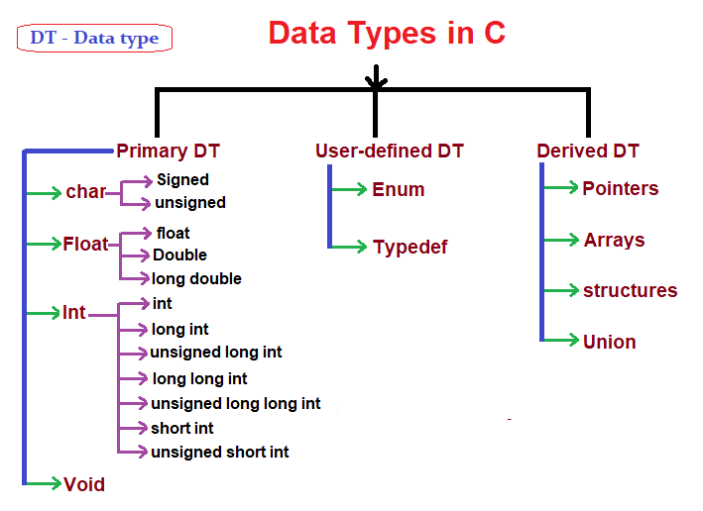
Datatypes:

Slide 14
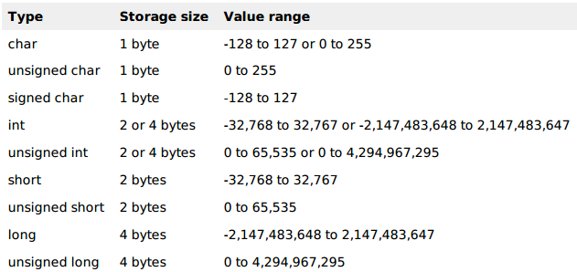

Slide 15
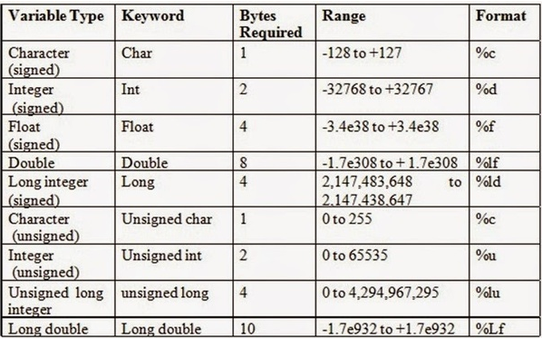

Slide 16
Void Types:
The void type has no values. It is used to represent the type of function. The type of function is said to be void when it does not return any value to the calling function.

Slide 17
Variables

Slide 18
Variables in C
A variable is nothing but a name given to a storage area that our programs can manipulate.
A variable definition tells the compiler where and how much storage to create for the variable.
A variable definition specifies a data type and contains a list of one or more variables of that type as follows −
Syntax:
type variable_list;
Ex: int i, j, k;
char c, ch;
float f, salary;
double d;

Slide 19
type variable_name = value;
int d = 3, f = 5; // declaration and initializing d and f.
char x = 'x'; // the variable x has the value 'x'.

Slide 20
Constants

Slide 21
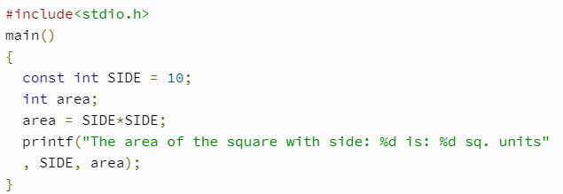
Constants
C Constants are also like normal variables. But, only difference is, their values can not be modified by the program once they are defined.
Constants refer to fixed values. They are also called as literals
Constants may be belonging to any of the data type.
Syntax:
const type constant_name;

Slide 22
TYPES OF C CONSTANT:
Integer constants
Real or Floating point constants
Octal & Hexadecimal constants
Character constants
String constants
Backslash character constants

Slide 23
Input/Output

Slide 24
Input/Output
Input means to provide the program with some data to be used in the program and Output means to display data on screen or write the data to a printer or a file.
The standard input-output header file, named stdio.h contains the definition of the functions printf() and scanf(), which are used to display output on screen and to take input from user respectively.

Slide 25
printf()
The printf() method, in C, prints the value passed as the parameter to it, on the console screen.
printf(“%X”, variableOfXType);
where %X is the format specifier in C. It is a way to tell the compiler what type of data is in a variable

Slide 26
scanf()
The scanf() method, in C, reads the value from the console as per the type specified.
scanf(“%X”, &variableOfXType);
where %X is the format specifier in C.
It is a way to tell the compiler what type of data is in a variable
& is the address operator in C, which tells the compiler to change the real value of this variable, stored at this address in the memory.

Slide 27
Keywords
Keywords are pre-defined words in a C compiler.
Each keyword is meant to perform a specific function in a C program.
Since keywords are referred names for compiler, they can’t be used as variable name.
C language supports 32 keywords which are given below.

Slide 28
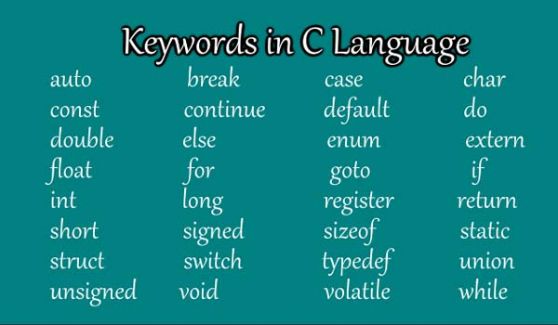

Slide 29
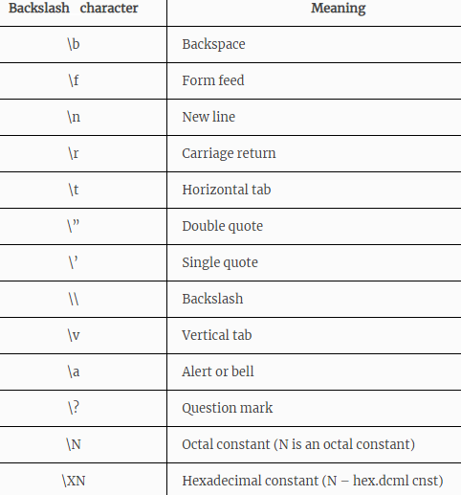

Slide 30
Structure of a C Program

Slide 31
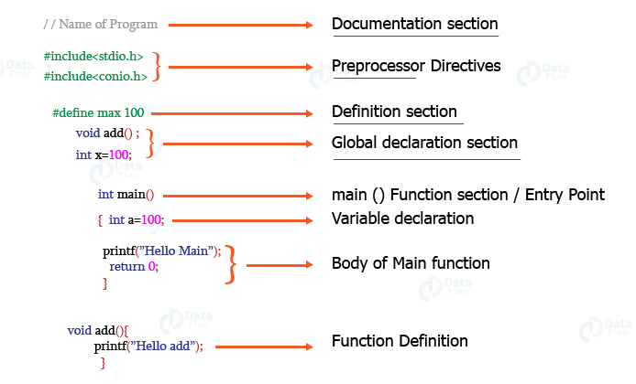

Slide 32
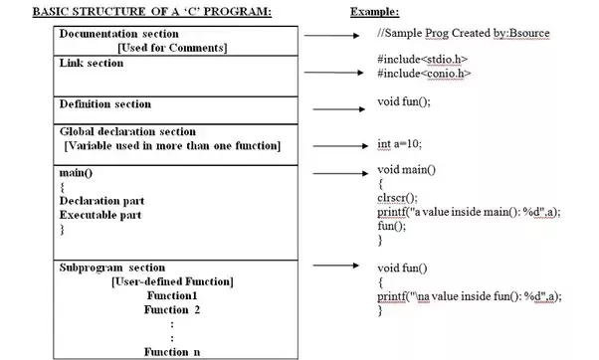
Example Program

Slide 33
//Program to add two numbers:
#include <stdio.h>
void main()
{
int number1, number2, sum;
printf("Enter two integers: ");
scanf("%d %d", &number1, &number2);
// calculating sum
sum = number1 + number2;
printf("%d + %d = %d", number1, number2, sum);
getch();
}

Slide 34
Logical Data and Operators

Slide 35
C – Operators
The symbols which are used to perform logical and mathematical operations in a C program are called C operators.
These C operators join individual constants and variables to form expressions.
Operators, functions, constants and variables are combined together to form expressions.
Consider the expression A + B * 5. where, +, * are operators, A, B are variables, 5 is constant and A + B * 5 is an expression.

Slide 36
Different types of operators
Arithmetic operators
Assignment operators
Relational operators
Logical operators
Bit wise operators
Conditional operators (ternary operators)
Increment/decrement operators
Special operators

Slide 37
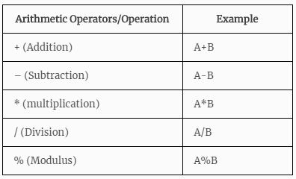

Slide 38
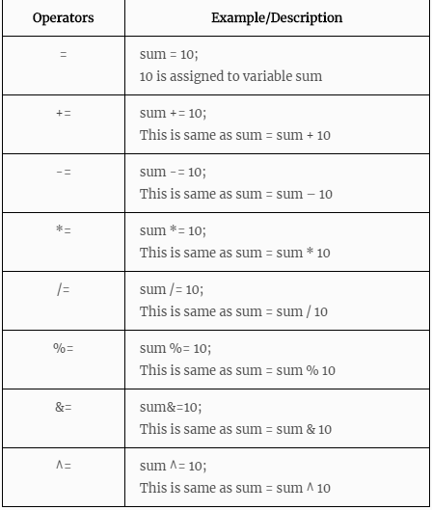
Assignment Operators

Slide 39
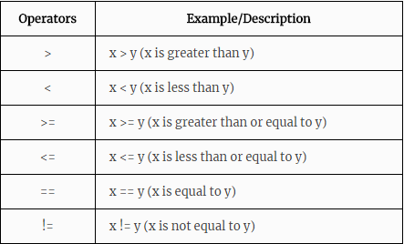
Relational Operators

Slide 40
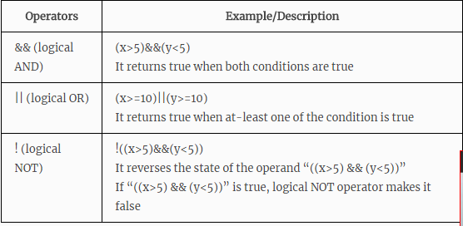
Logical Operators

Slide 41
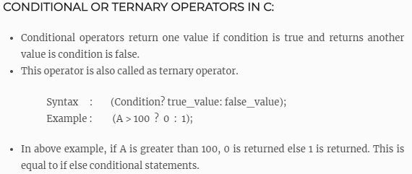
big = a > b ? (a > c ? a : c) : (b > c ? b : c) ;

Slide 42
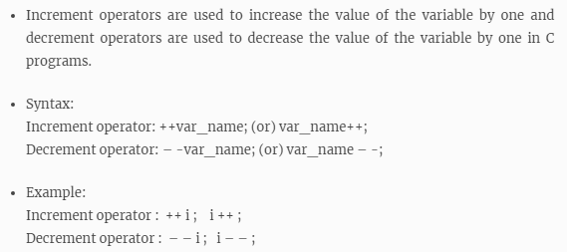
Increment/decrement operators

Slide 43
Expressions

Slide 44
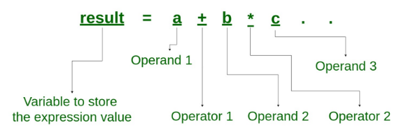
Expressions
An expression is a combination of operators, constants and variables. An expression may consist of one or more operands, and zero or more operators to produce a value.

Slide 45
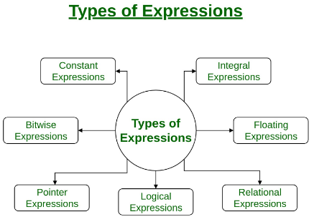

Slide 46
Constant expressions: Constant Expressions consists of only constant values. A constant value is one that doesn’t change.
Integral expressions: Integral Expressions are those which produce integer results after implementing all the automatic and explicit type conversions.
Floating expressions: Float Expressions are which produce floating point results after implementing all the automatic and explicit type conversions.
Relational expressions: Relational Expressions yield results of type bool which takes a value true or false. When arithmetic expressions are used on either side of a relational operator, they will be evaluated first and then the results compared. Relational expressions are also known as Boolean expressions.

Slide 47
Logical expressions: Logical Expressions combine two or more relational expressions and produces bool type results.
Pointer expressions: Pointer Expressions produce address values.
Bitwise expressions: Bitwise Expressions are used to manipulate data at bit level. They are basically used for testing or shifting bits.

Slide 48
Precedence and Associativity

Slide 49
Precedence and Associativity
The symbols which are used to perform logical and mathematical operations in a C program are called C operators.
These C operators join individual constants and variables to form expressions.
Operators, functions, constants and variables are combined together to form expressions.
Consider the expression A + B * 5. where, +, * are operators, A, B are variables, 5 is constant and A + B * 5 is an expression.

Slide 50
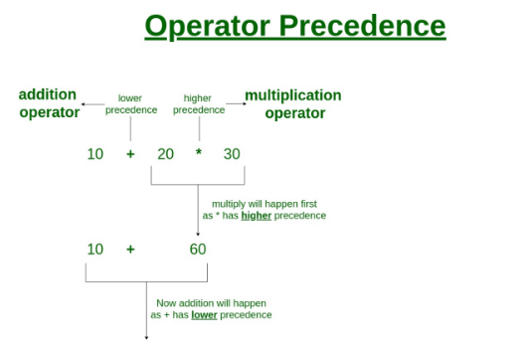
Operator Precedence in C
Operator precedence determines which operator is evaluated first when an expression has more than one operators.

Slide 51
Operators Associativity
Operators Associativity is used when two operators of same precedence appear in an expression. Associativity can be either Left to Right or Right to Left.
For example multiplication and division arithmetic operators have same precedence, lets say we have an expression 5*2/10, this expression would be evaluated as (5*2)/10 because the associativity is left to right for these operators.

Slide 52
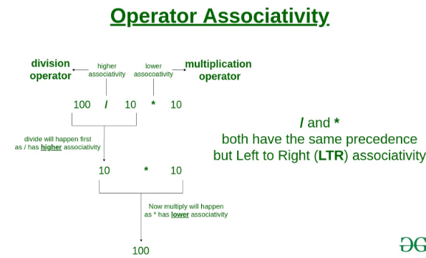

Slide 53
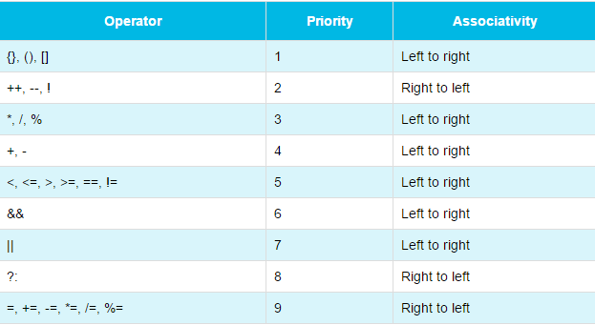

Slide 54
Evaluating Expressions

Slide 55
Evaluating Expressions
In the C programming language, an expression is evaluated based on the operator precedence and associativity.
When there are multiple operators in an expression, they are evaluated according to their precedence and associativity.
The operator with higher precedence is evaluated first and the operator with the least precedence is evaluated last.
10 + 4 * 3 / 2
4 * 3 ====> 12 12 / 2 ===> 6 10 + 6 ===> 16 The expression is evaluated to 16.

Slide 56
Write a C Program to evaluate
x= a-b/3+c*2-1;
y= a-b/(3+c)*(2-1);
z=a-(b/(3+c)*2)-1;

Slide 57
Type Conversion

Slide 58
Type Conversion
Type casting refers to changing a variable of one data type into another.
Two Types
Implicit Type Conversion
Explicit Type Conversion
Advantages of Type Conversion
This is done to take advantage of certain features of type hierarchies or type representations.
It helps us to compute expressions containing variables of different data types.

Slide 59
Implicit Type Conversion
When the type conversion is performed automatically by the compiler without programmers intervention, such type of conversion is known as implicit type conversion or type promotion.
int x;
If(x>0)
{
printf("%c", x); /*Implicit casting from int to char %c*/
}

Slide 60
Explicit Type Conversion
The type conversion performed by the programmer by posing the data type of the expression of specific type is known as explicit type conversion. The explicit type conversion is also known as type casting.
Type casting in c is done in the following form:
(data_type)expression;
where, data_type is any valid c data type, and expression may be constant, variable or expression.

Slide 61
int x;
If(x>0)
{
printf("%c", (char)x); /*Explicit casting from int to char*/
}

Slide 62
Example of Typecasting
int x=7, y=5 ;
float z;
z=x/y; /*Here the value of z is 1*/
If we want to get the exact value of 7/5 then we need explicit casting from int to float:
int x=7, y=5;
float z;
z = (float)x/(float)y; /*Here the value of z is 1.4*/

Slide 63
#include<stdio.h>
void main()
{
int a = 25, b = 13;
float result;
result = a/b;
// display only 2 digits after decimal point
printf("(Without typecasting) 25/13 = %.2f\n", result );
result = (float)a/b;
// display only 2 digits after decimal point
printf("(With typecasting) 25/13 = %.2f\n", result );
getch();
}

Slide 64
Statements in C

Slide 65
Statements in C
The bodies of C functions (including the main function) are made up of statements.
Two types
Simple statements
Compound Statements
Simple statements that do not contain other statements
Compound statements that have other statements inside them.
Control structures are compound statements like if/then/else, while, for, and do..while that control how or whether their component statements are executed.

Slide 66
Simple Statements
The simplest kind of statement in C is an expression (followed by a semicolon, the terminator for all simple statements)
x = 2; /* an assignment statement */
x = 2+3; /* another assignment statement */
2+3; /* has no effect---will be discarded by smart compilers */
puts("hi"); /* a statement containing a function call */
root2 = sqrt(2); /* an assignment statement with a function call */

Slide 67
Compound statements
Compound statements come in two varieties:
conditionals
loops
These are compound statements that test some condition and execute one or another block depending on the outcome of the condition.
if(houseIsOnFire)
{
/* ouch! */
scream();
runAway();
}
The body of the if statement is executed only if the expression in parentheses at the top evaluates to true

Slide 68
Storage Class

Slide 69
storage class
A storage class represents the visibility and a location of a variable. It tells from what part of code we can access a variable. A storage class in C is used to describe the following things:
The variable scope.
The location where the variable will be stored.
The initialized value of a variable.
A lifetime of a variable.
Who can access a variable?

Slide 70
Types Storage Classes
There are FOUR types of storage classes
Automatic Storage class (auto)
Register Storage class (register)
Static Storage class (static)
External Storage class (extern)

Slide 71
Auto Storage Class
The variables defined using auto storage class are called as local variables. Auto stands for automatic storage class.
The auto storage class is the default storage class for all local variables.
{
int mount;
auto int month;
}
The example above defines two variables with in the same storage class. 'auto' can only be used within functions, i.e., local variables.

Slide 72
Extern Storage Class in C
Extern stands for external storage class. Extern storage class is used when we have global functions or variables which are shared between two or more files.
Keyword extern is used to declaring a global variable or function in another file to provide the reference of variable or function which have been already defined in the original file.
Example, extern void display();

Slide 73
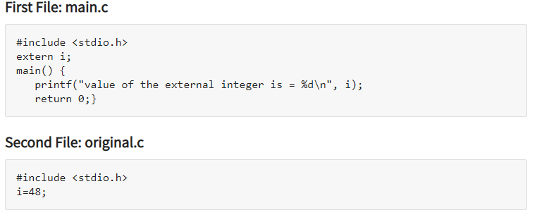

Slide 74
Static Storage Class in C
The static variables are used within function/ file as local static variables. They can also be used as a global variable
Static local variable is a local variable that retains and stores its value between function calls or block and remains visible only to the function or block in which it is defined.
Static global variables are global variables visible only to the file in which it is declared.
Example: static int count = 10;

Slide 75
#include <stdio.h>
/* function declaration */
void func(void);
static int count = 5; /* global variable */
main()

Slide 76
Register storage class
The register storage class is used to define local variables that should be stored in a register instead of RAM.
{
register int miles;
}

Slide 77
Selection

Slide 78
Two-way selection
The two-way selection is the basic decision statement for computers.
The decision is based on resolving a binary expression, and then executing a set of commands depending on whether the response was true or false.
C, like most contemporary programming languages, implements two-way selection with the if…else statement.
An if…else statement is a paired statement used to selectively execute code based on two alternatives.

Slide 79
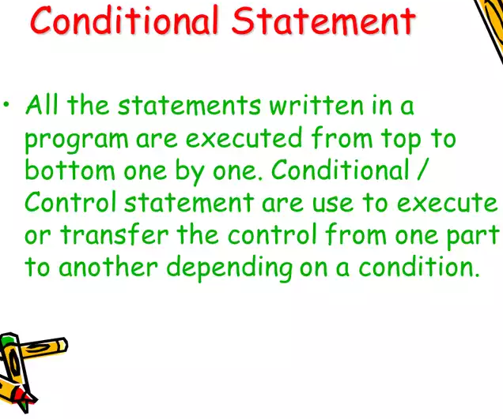

Slide 80
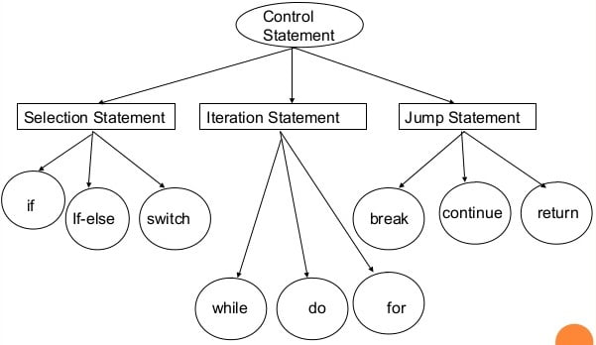

Slide 81
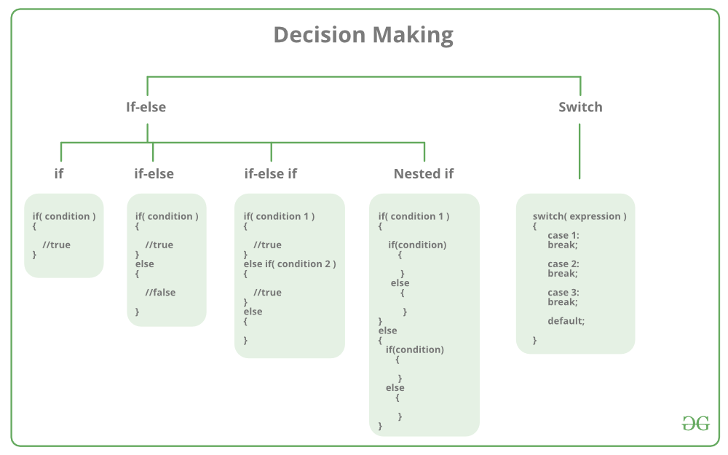

Slide 82
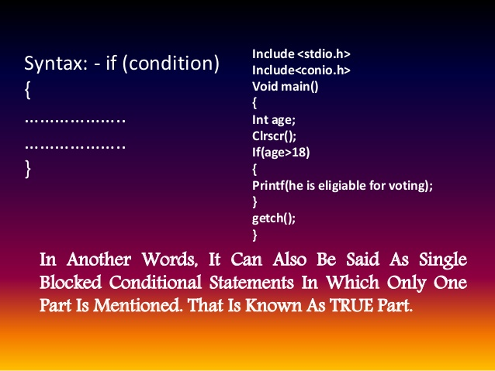

Slide 83
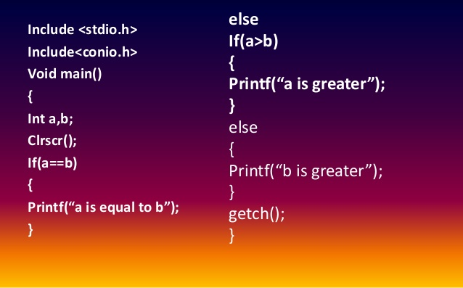
Write a program to input two numbers and print the greatest number in C

Slide 84
Multiway Selection

Slide 85
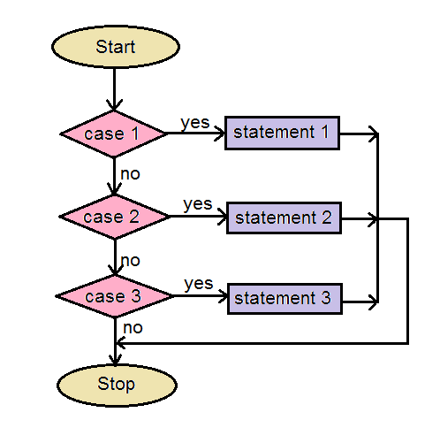
Multi-way Selection: switch statement
A multi-way selection statement is used to execute at most ONE of the choices of a set of statements presented.
Syntax of the multi-way select statement:
switch(EXPRESSION)
{
case 1: one or more statements; break;
case 2: one or more statements; break;
...
default: one or more statements;
}

Slide 87
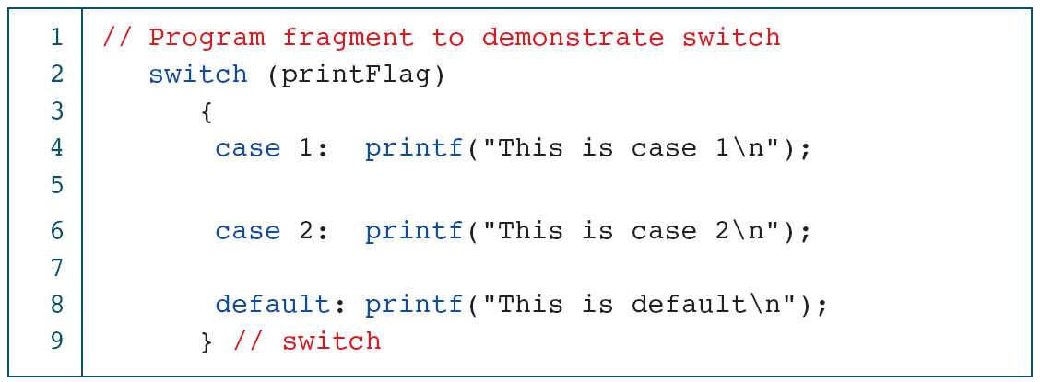

Slide 88
Repetition: Concept of a Loop

Slide 89
Concept of a Loop
In programming, a loop is used to repeat a block of code until the specified condition is met.
A loop consists of two parts, a body of a loop and a control statement. The control statement is a combination of some conditions that direct the body of the loop to execute until the specified condition becomes false.

Slide 90
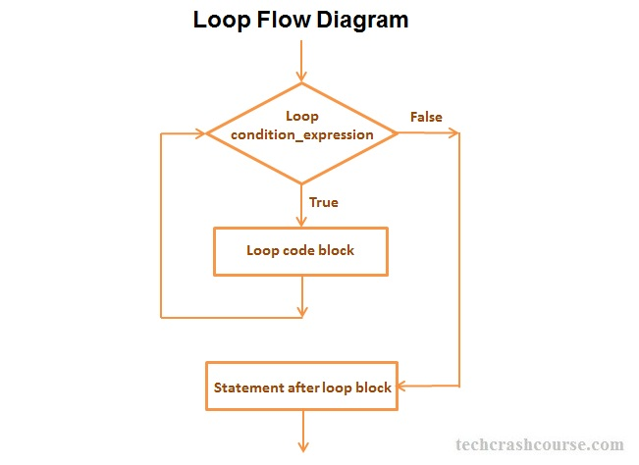

Slide 91
Types of Loops
Depending upon the position of a control statement in a program, a loop is classified into two types:
1. Entry controlled loop
2. Exit controlled loop
In an entry controlled loop, a condition is checked before executing the body of a loop. It is also called as a pre-checking loop.
In an exit controlled loop, a condition is checked after executing the body of a loop. It is also called as a post-checking loop.

Slide 92
The control conditions must be well defined and specified otherwise the loop will execute an infinite number of times. The loop that does not stop executing and processes the statements number of times is called as an infinite loop.
An infinite loop is also called as an "Endless loop." Following are some characteristics of an infinite loop:
1. No termination condition is specified.
2. The specified conditions never meet.
The specified condition determines whether to execute the loop body or not.

Slide 93
'C' programming language provides us with three types of loop constructs:
1. The while loop
2. The for loop
3. The do-while loop
The first two are pretest loops, and the third is a post-test loop. We can use all of them for event-controlled and counter-controlled loops.

Slide 95
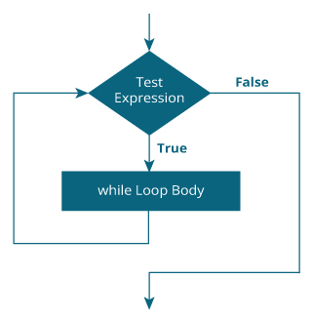
While Loop
A while loop is the most straightforward looping structure. The basic format of while loop is as follows:
while (test Expression)
{
statements inside the body of the loop
}

Slide 96
Example: Write a c program to print series of numbers from 1 to 10 using a while loop.
#include<stdio.h>
#include<conio.h>
void main()
{
int num=1; //initializing the variable
while(num<=10) //while loop with condition
{
printf("%d\n",num);
num++; //incrementing operation
}
getch();
}

Slide 97
Write a C program to print the Reverse of a given number using while loop.
For example, if the input is 123, the output will be 321. In the program, we use the modulus operator (%) to obtain digits of the number. To invert the number write its digits from right to left.

Slide 98
#include <stdio.h>
void main()
{
int n, rev = 0, rem;
printf("Enter an integer: ");
scanf("%d", &n);
while (n != 0)
{
rem = n % 10;
rev = rev * 10 + rem;
n =n/ 10;
}
printf("Reversed number = %d", rev);
getch();
}

Slide 99
Write a C program to generate Fibonacci series up to n number using while loop.
The Fibonacci sequence is a sequence where the next term is the sum of the previous two terms. The first two terms of the Fibonacci sequence are 0 followed by 1.
The Fibonacci sequence:
0, 1, 1, 2, 3, 5, 8, 13, 21

Slide 100
#include<stdio.h>
#include<conio.h>
main()
{
int f1=0,f2=1,f3,i=3,len;
printf("enter length of the fibonacci series:");
scanf("%d",&len);
printf("%d\t%d",f1,f2); // It prints the starting two values
while(i<=len) // checks the condition
{
f3=f1+f2; // performs add operation on previous two values
printf("\t%d",f3); // It prints from third value to given length
f1=f2;
f2=f3;
i=i+1; // incrementing the i value by 1
}
getch();
}

Slide 101
C program is used to display the multiplication table of a given number
#include <stdio.h>
void main()
{
int num, i = 1;
printf(" Enter any Number:");
scanf("%d", &num);
printf("Multiplication table of %d: ", num);
while (i <= 10)
{
printf("%d * %d = %d", num, i, num * i);
i++;
}
getch();
}

Slide 102
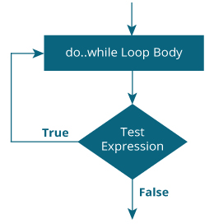
do…while
do
{
// statements inside the body of the loop
}
while (testExpression);

Slide 103
Do—while Example Program: Program to print numbers
#include <stdio.h>
void main ()
{
int a = 10;
/* do loop execution */
do
{
printf("value of a: %d\n", a);
a = a + 1;
}
while( a < 20 );
getch();
}

Slide 104
// Program to add numbers until the user enters zero
#include <stdio.h>
void main()
{
int number, sum = 0;
// the body of the loop is executed at least once
do
{
printf("Enter a number: ");
scanf("%d", &number);
sum += number;
}
while(number != 0);
printf("Sum = %d",sum);
getch();
}

Slide 105
For Loop
A for loop is a repetition control structure that allows you to efficiently write a loop that needs to execute a specific number of times.
Syntax :
for ( init; condition; increment )
{
statement(s);
}

Slide 106
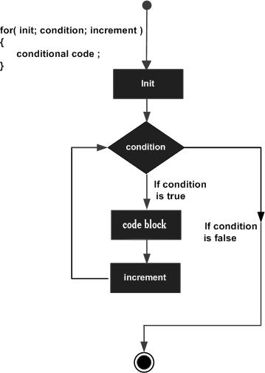

Slide 107
C program to print numbers from 1 to 10
#include <stdio.h>
void main()
{
int i;
for (i = 1; i < 11; ++i)
{
printf("%d ", i);
}
getch();
}

Slide 108
Program to print numbers
#include <stdio.h>
void main ()
{
int a;
/* for loop execution */
for( a = 10; a < 20; a = a + 1 )
{
printf("value of a: %d\n", a);
}
getch();
}

Slide 109
Sum of Natural Numbers Using for Loop
#include <stdio.h>
void main()
{
int n, i, sum = 0;
printf("Enter a positive integer: ");
scanf("%d", &n);
for (i = 1; i <= n; ++i)
{
sum += i;
}
printf("Sum = %d", sum);
return 0;
}

Slide 110
Unconditional Jump Statements
Jump statements interrupt the sequential execution of statements, so that execution continues at a different point in the program.
The break statement
The continue statement
The goto Statement
the return statement

Slide 111
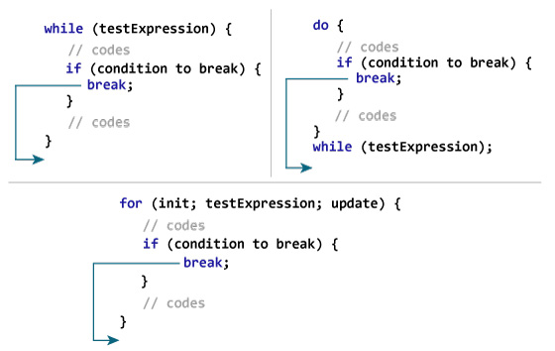
Break Statement
The break statement terminates execution of the immediately enclosing while , do, for, or switch statement.
syntax:
break;

Slide 112
# include <stdio.h>
void main()
{
int i, number, sum = 0;
for(i=1; i <= 10; ++i)
{
printf("Enter a n%d: ",i);
scanf("%d", &number);
// If the user enters a negative number, the loop ends
if(number < 0)
{
break;
}
sum += number; // sum = sum + number;
}
printf("Sum = %d",sum);
getch();
}

Slide 113
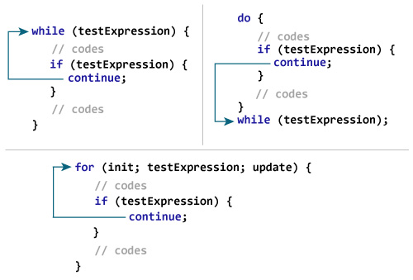
The Continue Statement
The continue statement skips the current iteration of the loop and continues with the next iteration.
Syntax:
continue;

Slide 114
Continue Statement
// C program to explain the use of continue statement
#include <stdio.h>
void main()
{
int i=0;
clrscr();
while(i<=10)
{
if(i == 6)
continue;
printf("%d ", i);
i++;
}
getch();
}

Slide 115
Multiplication table using Continue Statement
#include <stdio.h>
void main()
{
int num, i = 1;
printf(" Enter any Number:");
scanf("%d", &num);
printf("Multiplication table of %d: ", num);
while (i <= 10)
{
i++;
if(i==5)
continue;
printf("%d * %d = %d", num, i, num * i);
}
getch();
}

Slide 116
The return statement
The return statement terminates execution of a function and returns control to the calling function, with or without a return value. A function may contain any number of return statements. The return statement has the following syntax:
Syntax:
return expression(opt);

Slide 117
Goto Statement
The goto statement unconditionally transfers program control to a labeled statement

Slide 118
Use of goto statement
#include #include void main() { int n; clrscr(); printf("Enter a number:="); scanf("%d",&n); if(n%2==0) goto even; else goto odd;
even: printf("\nThe number is EVEN");
exit(0); odd: printf("The number is ODD"); getch(); }

Slide 119
Sum of 1 to n Natural Numbers using goto
#include<stdio.h>
#include<conio.h>
void main()
{
int i=1,n,sum=0;
printf("Enter the value of n");
scanf("%d",&n);
x: if(i<=n)
{
sum=sum+i;
i++;
goto x;
}
printf("sum is %d",sum);
getch();
}

Slide 120
Nested Loops in C
Nested loop means a loop statement inside another loop statement. That is why nested loops are also called as “loop inside loop“.
Syntax: Nested for loop
for ( initialization; condition; increment )
{
for ( initialization; condition; increment )
{
// statement of inside loop
}
// statement of outer loop
}

Slide 121
Nested While Loop:
while(condition)
{
while(condition)
{
// statement of inside loop
}
// statement of outer loop
}
Nested do-While Loop:
do
{
do{
// statement of inside loop
}while(condition);
// statement of outer loop
}while(condition);

Slide 122
here is no rule that a loop must be nested inside its own type. In fact, there can be any type of loop nested inside any type and to any level.
do
{
while(condition)
{
for ( initialization; condition; increment )
{
// statement of inside for loop
}
// statement of inside while loop
}
// statement of outer do-while loop
}while(condition);

Slide 123
// C program that uses nested for loop to print a square pattern
#include <stdio.h>
void main()
{
int i, j, N;
printf("Enter number of rows: ");
scanf("%d", &N);
/* Iterate through N rows */
for(i=1; i<=N; i++)
{
/* Iterate over columns */
for(j=1; j<=N; j++)
{
printf("*");
}
/* Move to the next line/row */
printf("\n");
}
getch();
}

Slide 124
#include <stdio.h>
void main()
{
for (int i=0; i<2; i++)
{
for (int j=0; j<4; j++)
{
printf("%d, %d\n",i ,j);
}
}
getch();
}

Slide 125
write a C program to print multiplication table from 1 to 5.
#include <stdio.h>
void main()
{
int i, j;
for(i=1; i<=10; i++)
{
for(j=1; j<=5; j++)
{
printf("%d*%d=%d",i,j,(i*j));
}
printf("\n");
}
getch();
}
Output Displays:
For i=1 it prints the product of i and j
1 2 3 4 5
Similarly for i=2 it prints
2 4 6 8 10

Slide 126
Recursion

Slide 127
Recursion
Recursion is the process of repeating items in a self-similar way. In programming languages, if a program allows you to call a function inside the same function, then it is called a recursive call of the function.
void recursion()
{
recursion(); /* function calls itself */
}
int main()
{
recursion();
}

Slide 128
Generate the Fibonacci series for a given number using a recursive function
#include <stdio.h>
int fibonacci(int i)
{
if(i == 0)
{
return 0;
}
if(i == 1)
{
return 1;
}
return fibonacci(i-1) + fibonacci(i-2);
}
int main()
{
int i;
for (i = 0; i < 10; i++) {
printf("%d\t\n", fibonacci(i));
}
return 0;
}

Slide 129
Sum of Natural Numbers Using Recursion
#include <stdio.h>
int sum(int n);
void main()
{
int number, result;
printf("Enter a positive integer: ");
scanf("%d", &number);
result = sum(number);
printf("sum = %d", result);
getch();
}
int sum(int n) {
if (n != 0)
// sum() function calls itself
return n + sum(n-1);
else
return n;
}

Slide 130
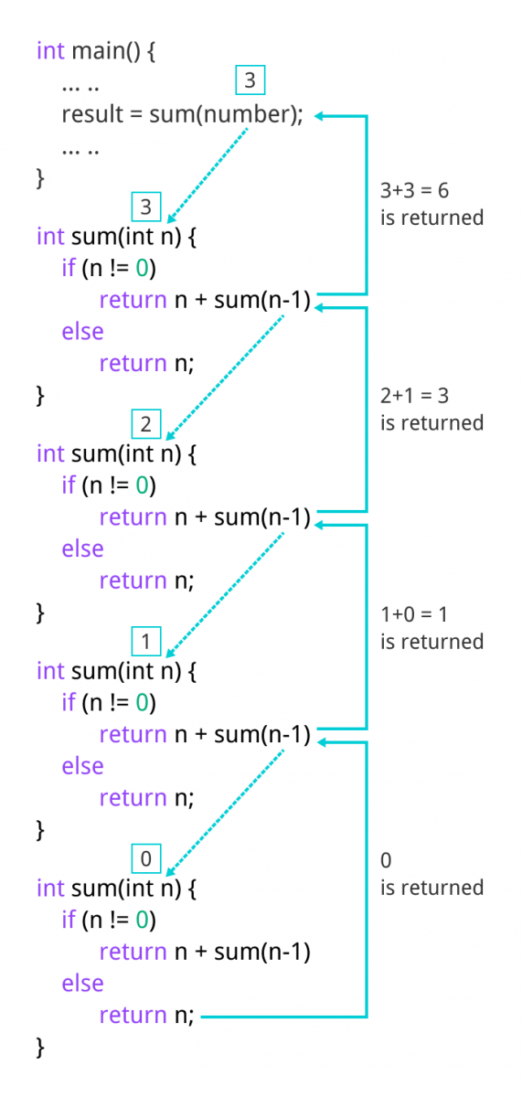

Slide 131
The Calculator Program
switch(ch)
{
case '+':
result=num1+num2;
break;
case '-':
result=num1-num2;
break;
case '*':
result=num1*num2;
break;
case '/':
result=(float)num1/(float)num2;
break;
case '%':
result=num1%num2;
break;
default:
printf("Invalid operation.\n");
}
printf("Result: %d %c %d = %f\n",num1,ch,num2,result);
return 0;
}
/*C program to design calculator with basic operations using switch.*/
#include <stdio.h>
int main()
{
int num1,num2;
float result;
char ch; //to store operator choice
printf("Enter first number: ");
scanf("%d",&num1);
printf("Enter second number: ");
scanf("%d",&num2);
printf("Choose operation to perform (+,-,*,/,%): ");
scanf(" %c",&ch);
result=0;

Slide 132
Arrays

Slide 133
Arrays in c
An array is defined as an ordered set of similar data items. All the data items of an array are
stored in consecutive memory locations in RAM. The elements of an array are of same data type and each item can be accessed using the same name.
Syntax:
datatype arrayname[arraysize];
Example:
int data[100];
float mark[5];
It's important to note that the size and type of an array cannot be changed once it is declared.

Slide 134
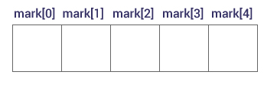
Access Array Elements
Suppose you declared an array mark as above. The first element is mark[0], the second element is mark[1] and so on.

Slide 135
How to initialize an array?
It is possible to initialize an array during declaration. For example,
Ex:
int mark[5] = {19, 10, 8, 17, 9};
(or)
int mark[] = {19, 10, 8, 17, 9};
Here, we haven't specified the size. However, the compiler knows its size is 5 as we are initializing it with 5 elements.
// print the first element of the array
printf("%d", mark[0]);
// print the third element of the array
printf("%d", mark[2]);
// print ith element of the array
printf("%d", mark[i-1]);

Slide 136
Example 1: Array Input/Output
// Program to take 5 values from the user and store them in an array
// Print the elements stored in the array
#include <stdio.h>
void main()
{
int values[5],i;
printf("Enter 5 integers: ");
// taking input and storing it in an array
for(i = 0; i < 5; ++i)
{
scanf("%d", &values[i]);
}
printf("Displaying integers: ");
// printing elements of an array
for(i = 0; i < 5; ++i)
{
printf("%d\n", values[i]);
}
return 0;
}

Slide 137
Two dimensional (2D) arrays in C programming with example
An array of arrays is known as 2D array. The two dimensional (2D) array in C programming is also known as matrix. A matrix can be represented as a table of rows and columns.

Slide 138
#include<stdio.h>
void main()
{
int a[2][3], i, j;
for(i=0; i<2; i++)
{
for(j=0;j<3;j++)
{
printf("Enter value for a[%d][%d]:", i, j);
scanf("%d", &a[i][j]);
}
}

Slide 139
//Displaying array elements
printf("Two Dimensional array elements:\n");
for(i=0; i<2; i++)
{
for(j=0;j<3;j++)
{
printf("%d ", a[i][j]);
}
}
}
getch();
}

Slide 140
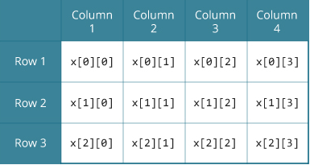
Multidimensional Arrays
Here, you will learn to work with multidimensional arrays (two-dimensional and three-dimensional arrays) with the help of examples.
In C programming, you can create an array of arrays. These arrays are known as multidimensional arrays.
For example:
float x[3][4];
Here, x is a two-dimensional (2d) array. The array can hold 12 elements. You can think the array as a table with 3 rows and each row has 4 columns

Slide 141
Similarly, you can declare a three-dimensional (3d) array.
For example 1:
float y[2][4][3];
Here, the array y can hold 24 elements.
Example 2:
int Employees[2][4][3] = { { {10, 20, 30}, {15, 25, 35}, {22, 44, 66}, {33, 55, 77} }, { {1, 2, 3}, {5, 6, 7}, {2, 4, 6}, {3, 5, 7} } };
Here, We have 2 tables and the 1st table holds 4 Rows * 3 Columns, and the 2nd table also holds 4 Rows * 3 Columns

Slide 142
For a large number of rows and columns, we can access them using For Loop. Say, for example, to access array Employees[10][25][60]
int tables, rows, columns;
for (tables = 0; tables < 10; tables ++)
{
for (rows = 0; rows < 25; rows++)
{
for (columns =0; columns < 60; columns++)
{
Printf(“%d”, Employees[tables][rows][columns]);
}
}
}

Slide 143
Multi Dimensional Array in C Example
// Printing values with proper index.
printf("\nDisplaying values:\n");
for(i = 0; i < 2; i++)
{
printf("\n");
for(j = 0; j < 3; j++)
{
printf("\n");
for(k = 0; k < 2; k++)
{
printf("%d\t",threed[i][j][k]);
}
}
}
getch();
}
// C Program to store and print 12 values entered by the user
#include<stdio.h>
void main()
{
int i,j,k,threed[2][3][2];
clrscr();
printf("Enter 12 values: \n");
for(i = 0; i < 2; i++)
{
for(j = 0; j < 3; j++)
{
for(k = 0; k < 2;k++)
{
scanf("%d", &threed[i][j][k]);
}
}
}

Slide 144
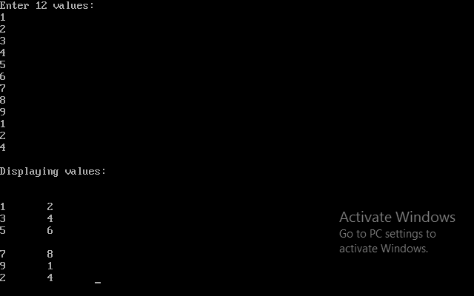
Output:

Slide 145
Example Programs
Using while, for, do-while

Slide 146
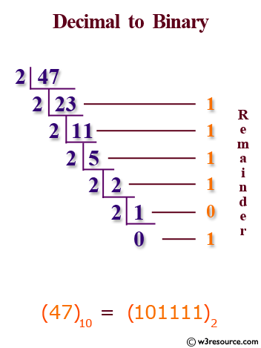
Decimal to Binary

Slide 147
C program to convert decimal to binary using while loop
#include <stdio.h>
void main()
{
long long decimal, tempDecimal, binary;
int rem, place = 1;
binary = 0;
/* Input decimal number from user */
printf("Enter any decimal number: ");
scanf("%lld", &decimal);
tempDecimal = decimal;
/* Decimal to binary conversion */
while(tempDecimal > 0)
{
rem = tempDecimal % 2;
binary = (rem * place) + binary;
tempDecimal /= 2;
place *= 10;
}
printf("Decimal number = %lld\n", decimal);
printf("Binary number = %lld", binary);
getch();
}

Slide 148
factorial of a Number
The factorial of a Number n, denoted by n!, is the product of all positive integers less than or equal to n
For example,
6! = 6 * 5 * 4 * 3 * 2 * 1 = 720

Slide 149
C Program to find factorial of a given number using while
include<stdio.h>
#include<conio.h>
void main()
{
int n,i,f;
f=i=1;
clrscr();
printf("Enter a Number to Find Factorial: ");
scanf("%d",&n);
while(i<=n)
{
f=f*i;
i++;
}
printf("The Factorial of %d is : %d",n,f);
getch();
}

Slide 150
Write a c program to check whether a number is strong or not
Definition of strong number:
A number is called strong number if sum of the factorial of its digit is equal to number itself. For example: 145 since
1! + 4! + 5! = 1 + 24 + 120 = 145

Slide 151
Program
#include<stdio.h>
void main()
{
int num,i,f,r,sum=0,temp;
printf("Enter a number: ");
scanf("%d",&num);
temp=num;
while(num>0)
{
i=1;
f=1;
r=num%10;
while(i<=r)
{
f=f*i;
i++;
}
sum=sum+f;
num=num/10;
}
if(sum==temp)
printf("%d is a strong number",temp);
else
printf("%d is not a strong number",temp);
getch();
}

Slide 152
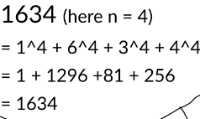
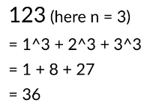
Amstrong
A number is an Armstrong number when the sum of nth power of each digit is equal to the number itself. Here n is the number of digits in the given number.
For example
Amstrong Number
Not Amstrong Number

Slide 153
//amstrong number
#include<stdio.h>
#include<conio.h>
#include<math.h>
void main()
{
clrscr();
int n,t,n1,count=0,r,sum=0;
clrscr();
printf("enter n value");
scanf("%d",&n);
n1=n;
t=n;
while(n>0)
{
count=count+1;
n=n/10;
}
while(n1>0)
{
r=n1%10;
sum=sum+pow(r,count);
n1=n1/10;
}
if(sum==t)
{
printf("\n amstrong");
}
else
{
printf("not amstrong");
}
getch();
}

Slide 154
C Program to find a Prime Number
#include <stdio.h>
void main()
{
int n, i, c = 0;
printf("Enter any number n:");
scanf("%d", &n);
for (i = 1; i <= n; i++)
{
if (n % i == 0)
{
c++;
}
}
if (c == 2)
{
printf("n is a Prime number");
}
else
{
printf("n is not a Prime number");
}
getch();
}

Slide 155
Write a C Program to Find Maximum and Minimum Element in an Array
/* Assume first element as maximum and minimum */
max = arr[0];
min = arr[0];
for(i=1; i<size; i++)
{
/* If current element is greater than max */
if(arr[i] > max)
{
max = arr[i];
}
/* If current element is smaller than min */
if(arr[i] < min)
{
min = arr[i];
}
}
/* Print maximum and minimum element */
printf("Maximum element = %d\n", max);
printf("Minimum element = %d", min);
getch();
}
#include <stdio.h>
#define MAX_SIZE 100 // Maximum array size
void main()
{
int arr[MAX_SIZE];
int i, max, min, size;
/* Input size of the array */
printf("Enter size of the array: ");
scanf("%d", &size);
/* Input array elements */
printf("Enter elements in the array: ");
for(i=0; i<size; i++)
{
scanf("%d", &arr[i]);
}

Slide 156
Generate Fibonacci series upto n number using dowhile
#include<stdio.h>
void main()
{
int i,n,f,f1,f2;
printf("Enter Number of Fibonacci Values Needed : ");
scanf("%d",&n);
f=0;
f1=1;
f2=1;
do
{
i++;
printf("%d\n",f);
f1=f2;
f2=f;
f=f1+f2;
}
while(i<=n+1);
}

Slide 157
C program for Palindrome number using For Loop
#include<stdio.h>
#include<conio.h>
void main()
{
int i,n,r,s=0;
clrscr();
printf("\n Enter The Number:");
scanf("%d",&n);
//LOOP TO FIND REVERSE OF A NUMBER
for(i=n;i>0; )
{
r=i%10;
s=s*10+r;
i=i/10;
}
if(s==n)
{
printf("\n %d is a Palindrome Number",n);
}
else
{
printf("\n %d is not a Palindrome Number",n);
}
getch();
}

Slide 158
C program to find Perfect Number or Not using For Loop
for(i=1;i<n;i++)
{
if(n%i==0)
{
sum=sum+i;
}
}
/* if-else condition to print Perfect Number or Not */
if(sum==n)
printf("\n %d is a Perfect Number.",n);
else
printf("\n %d is Not a Perfect Number.",n);
getch();
}
#include<stdio.h>
#include<conio.h>
void main()
{
int n, i, sum=0;
clrscr();
printf(" Enter a number: ");
scanf("%d", &n);

Slide 159
Print * in equilateral triangle pattern in C using for loop
#include <stdio.h>
void main()
{
int n,i,j;
n = 5; // number of rows.
for(i = 1; i <= n; i++)
{
for(j = 1; j <= n-i; j++)
{
printf(" ");
}
}
for(j = 1; j <= i; j++)
printf("* ");
printf("\n");
}
getch();
}

Slide 160
prime numbers between 1 to n using for loop
if(num%i==0){
count++;
break;
}
}
if(count==0 && num!= 1)
printf("%d ",num);
}
getch();
}
#include<stdio.h>
int main()
{
int num,i,count,n;
printf("Enter max range: ");
scanf("%d",&n);
for(num = 1;num<=n;num++){
count = 0;
for(i=2;i<=num/2;i++){

