Slide 1


Department of Information Technology
V R Siddhartha Engineering College
Innovation , IPR & entrepreneurship
Home Assignment
Presented by
Submitted To :
Y . Kalyan Chakravarthy
Department Of IT
208W1A1270
208W1A1280
208W1A1290
208W1A12A0

Slide 2
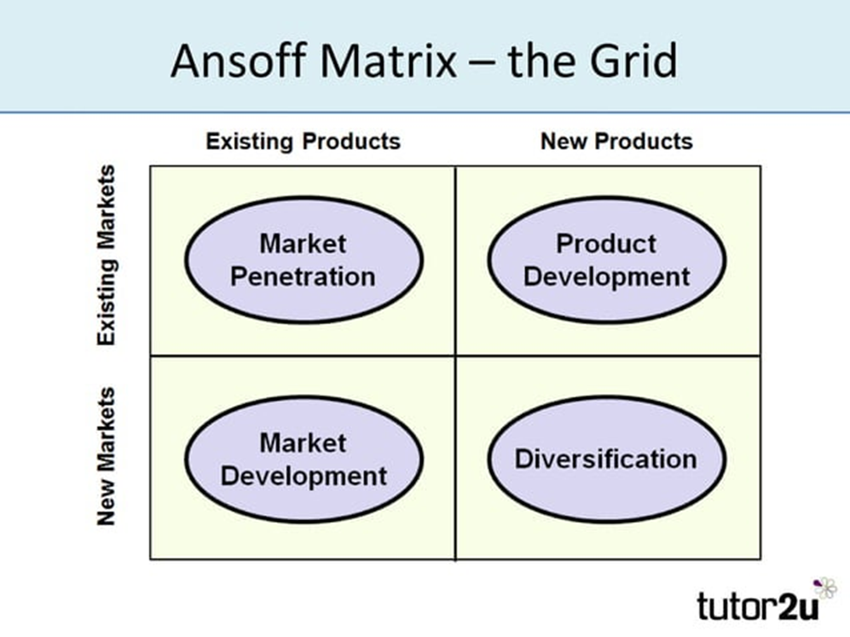
Ansoff Matrix
A Marketing Planning Model That Helps a Business determine it’s product and market startegy

Slide 3
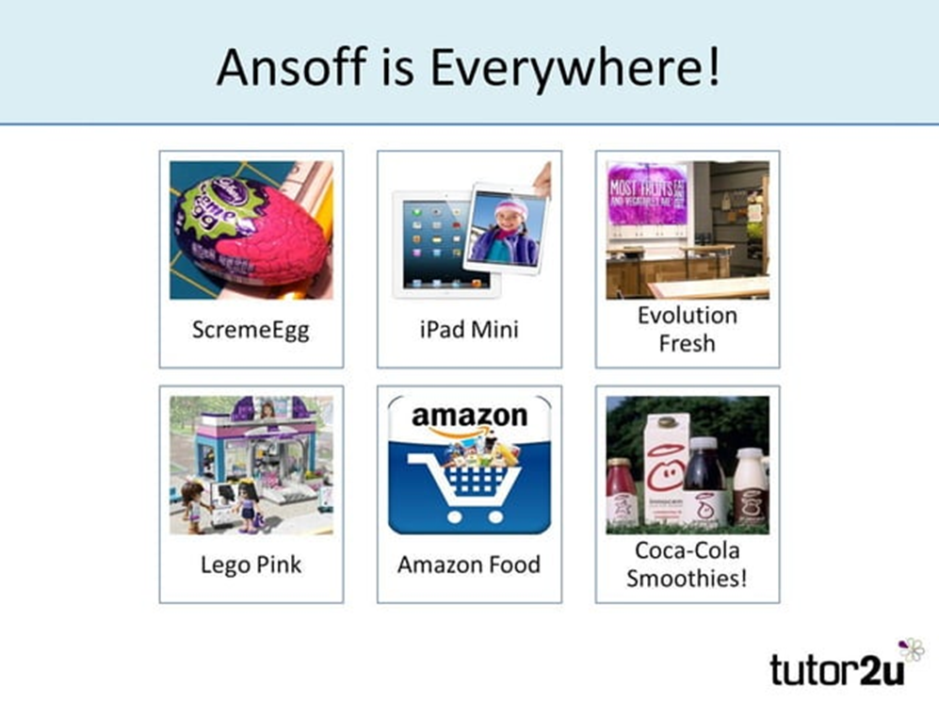
Working of Ansoff matrix
Ansoff's matrix suggests that a business' growth strategy depends on whether it markets new or existing products in new or existing markets.
The output from the matrix is a series of four suggested growth strategies which set the direction for the business strategy

Slide 4
Aim Of Market penetration
Business as usual
Maintain the market share of current products
Secure Dominance of Growth markets
Restructure a market by driving out of competitors
Increase usage by existing customers.

Slide 5


Slide 6


Slide 7

This Photo by Unknown Author is licensed under CC BY-SA-NC

