Slide 1
Data Visualization
Toipcs to be covered
Data representation
Data presentation
Submitted By:
208W1A12A0 – IT-B

Slide 2
The visualization anatomy – data representation
The process of identifying the most effective and appropriate solution for representing our data is unquestionably the most important feature of our visualization design. Working on this layer involves making decisions that cut across the artistic and scientific foundations of the field.
Choosing the correct visualization "method" for the stories we're telling Accommodating the physical properties of your data .
Facilitating the desired degree of precision.
Creating an appropriate metaphor to depict our subject stylistically.

Slide 3
Choosing the correct visualization method
For example, a bar chart serves the function of comparing categories of values; a line chart, by contrast, enables us to show changes of values over time, geo-spatial data can often be best displayed over a map.
There are a number of ways of classifying the variety of methods for visualizing data but here is a suggested taxonomy :
Comparing categorical values
Assessing hierarchies and part-of-a-whole relationships
Showing changes over time
Mapping geo-spatial data
Charting and graphing relationships

Slide 4
2. Considering the physical properties of our data
Now, we're looking to narrow down our search further by thinking about which types of charts will most effectively accommodate the variables of data we're looking to portray.
The quantity and nature of the variables you are using will have a significant influence on reducing the range of suitable chart types you might be able to use within the method family you have chosen. As discussed earlier, this process of eliminating choices can only be of help to us as we move forward.

Slide 5
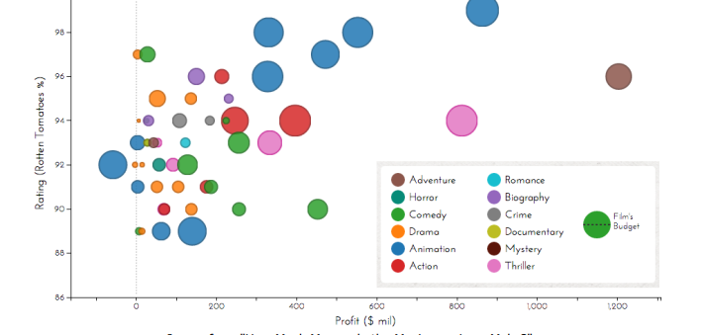
3. Determining the degree of accuracy in interpretation
we do, but the inclusion of terms such as "maximize" and "as possible" allude to the specter of alternative influences. You see, for certain contexts, as we outlined in the early chapters, you might be seeking to explore different aesthetic forms of representation. And yes, sometimes this might involve certain sacrifices in terms of the precision of interpretation.
To frame this section, we first need to learn about visual variables. A visual variable is the specific form we assign to data in order to represent it visually. It could be the length or height of a bar, the position of a point on an axis, the color of a county on a map, or the connection between two nodes in a network.
Each of the chart types that we come to take as common representation methods are based on the deployment of a single or, more commonly, combination of several visual variables at once. Using multiple variables, in particular, enables a designer to efficiently express extra layers of meaning behind the properties of a single mark, as the next example demonstrates.

Slide 6
4. Creating an appropriate design metaphor
It may be that our initial thoughts around what we would hope to achieve are revised as we learn more about the data and the stories we can and may wish to tell. For instance, we might have initially thought there could be a rich narrative emerging that could have been portrayed quite powerfully and emotionally. As you learn more about your data and its potential deployment representation-wise, it may be that you realize a more analytical approach is more suitable.
Visual metaphors are about integrating a certain visual quality in your work that somehow conveys that extra bit of connection between the data, the design, and the topic. It goes beyond just the choice of visual variable, though this will have a strong influence.

Slide 7
The visualization anatomy – data presentation
The presentation of data involves thinking about pretty much every other design feature that might be included in our visualization. Here, we are determining the following :
The use of color
The potential of interactive features
The explanatory annotation
The architecture and arrangement

Slide 8
Visual inference means data inference : If it looks like data, it should be data. If it isn't data then you've incorrectly conveyed a sense of representation where there isn't any and design refinement is required. An example might be the use of a color to represent a certain sentiment. If that color is used on a bar chart or is picked for the background of a label or call-out, but it is no longer connected to the representation of any sentiment meaning, this may trick the reader who has programmed their visual sense to spot this inference.
Facilitating the resemblance of data : Let the data breathe. We talked about this in the discussion about Jacques Bertin's interpretative acts, but the presentation layers of your visualization will have a great impact on this. Ensuring a reader can discriminate between data categories and values is usually influenced by the background artifacts and surrounding apparatus. Throughout your design, make sure your data stands out clearly as the principle visual component.

