Slide 1
CASE STUDY : BANKERS’S PROBLEM
SUBMITTED TO :
DR . T . ANURADHA
PROFESSOR
IT - DEPARTMENT
GROUP MEMBER’S :
208W1A1292
208W1A12A0
208W1A12C6

Slide 2
PROBLEM
A single processor system has three resource types X, Y and Z, which are shared by three processes. There are 5 units of each resource type. Consider the following scenario, where the column alloc denotes the number of units of each resource type allocated to each process, and the column request denotes the number of units of each resource type requested by a process in order to complete execution. Which of these processes will finish LAST?
PROCESS | ALLOCATION | REQUEST
P0
P1
P2
X | Y | Z
1 | 2 | 1
2 | 0 | 1
2 | 2 | 1
X | Y | Z
1 | 0 | 3
0 | 1 | 2
1 | 2 | 0

Slide 3
ALGORITHM : FOR BANKER’S PROBLEM
-------------------------------------------------------------------------------------
STEP 1 : Create 2 matrixes for allocation and request matrixes which are
given in the problem and P0,P1,P2 are process’s
STEP 2 : Assign the matrix [ 5, 5, 5 ] to the Total matrix
STEP 3 : Now add all column wise elements together in allocation matrix and assign each sum
of column values to the Total_allocation matrix
STEP 4 : Now subtract the total and total_allocation matrixes and assign the resultant matrix
to the Available matrix
STEP 5 : now compare the available matrix and process allocation if it is greater then add
both the matrixes and assign it to the Available matrix.
STEP 6 : repeat the step 5 until all the process is in safe sequence
STEP 7 : print the Safe Sequence
-------------------------------------------------------------------------------------

Slide 4
Step-01:
With the instances available currently, only the requirement of the process P1 can be satisfied.
So, process P1 is allocated the requested resources.
It completes its execution and then free up the instances of resources held by it. Then,
Available = [ 0 1 2 ] + [ 2 0 1]
Available = [ 2 1 3 ]
According to question:
Total = [ X Y Z ] = [ 5 5 5 ]
Total _Alloc = [ X Y Z ] = [5 4 3]
Now,
Available = Total – Total_Alloc
Available = [ 5 5 5 ] – [5 4 3]
Available = [ 0 1 2 ]
Step-02:
With the instances available currently, only the requirement of the process P0 can be satisfied.
So, process P0 is allocated the requested resources.
It completes its execution and then free up the instances of resources held by it.Then,
Available = [ 2 1 3 ] + [ 1 2 1 ]
Available = [ 3 3 4 ]

Slide 5
Step-03:
With the instances available currently, the requirement of the process P2 can be satisfied.
So, process P2 is allocated the requested resources.
It completes its execution and then free up the instances of resources held by it. Then,
Available = [ 3 3 4 ] + [ 2 2 1 ]
Available = [ 5 5 5 ]
Thus,
There exists a safe sequence P1, P0, P2 in which all the processes can be executed.
So, the system is in a safe state.
Process P2 will be executed at last.

Slide 6
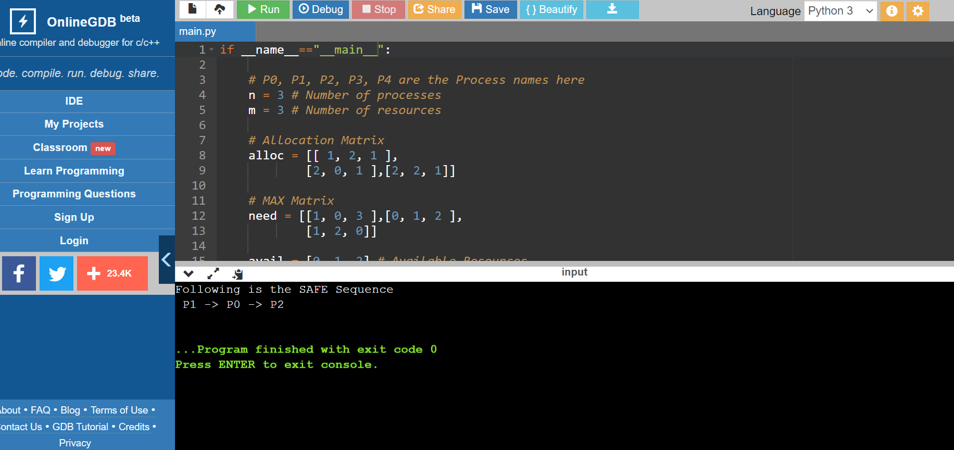
OUTPUT :

