Slide 1

Learn OpenUI5 step by step
Lesson #3
Presented by: Mahdi J.Ansari
www.mjzsoft.com
linkedin.com/in/mjbza/

Slide 2
What do we know now?
Web IDE
API Reference
Sample Applications
XML View
i18n
Auto translation service
RTL support

Slide 3
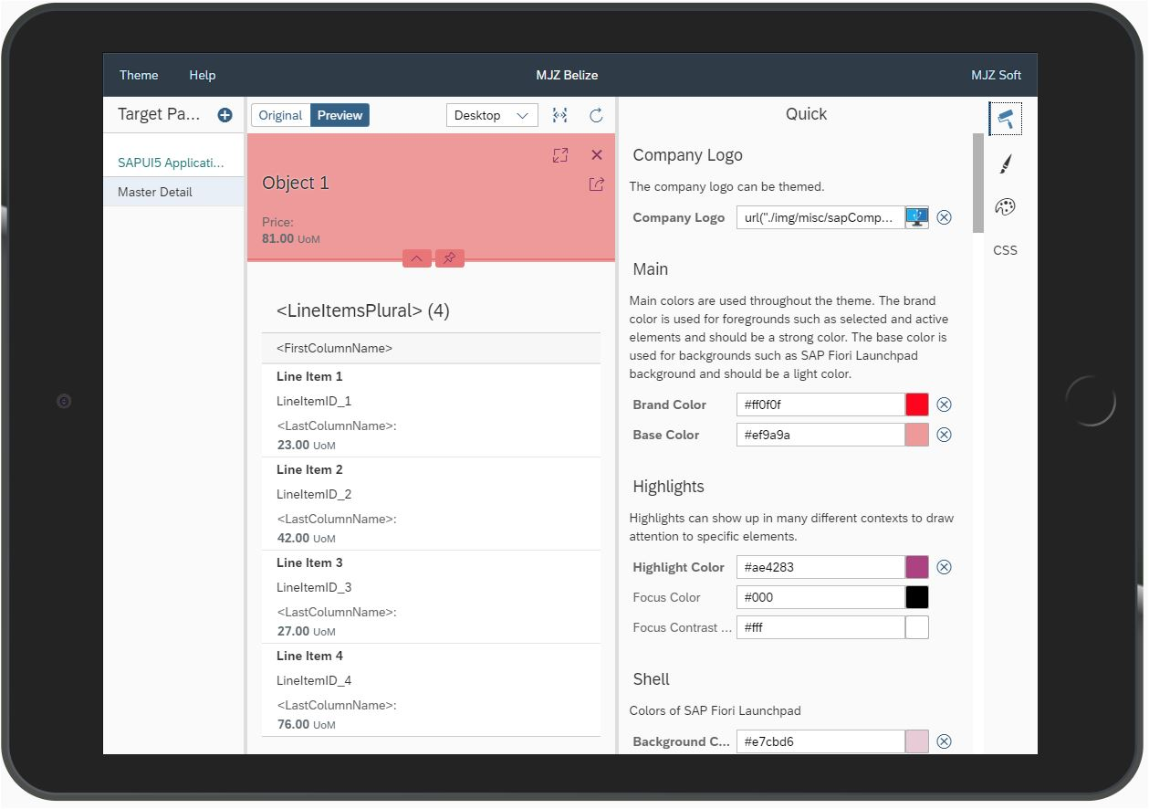
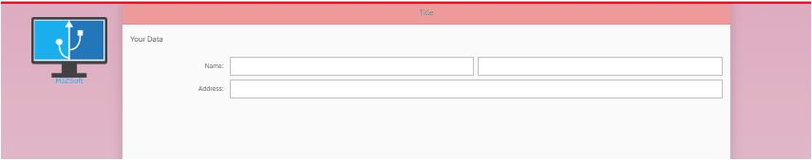
App#7: UI Theme Designer
1- By bootstrap configuration:
<script id="sap-ui-bootstrap"
src="resources/sap-ui-core.js"
data-sap-ui-theme="mjzbelize"
data-sap-ui-theme-roots= '{"mjzbelize":"/resources/UI5"}' ... >
2 -Use the URL parameter sap-ui-theme.
Example:
?sap-ui-theme=my_theme_name@url

Slide 4
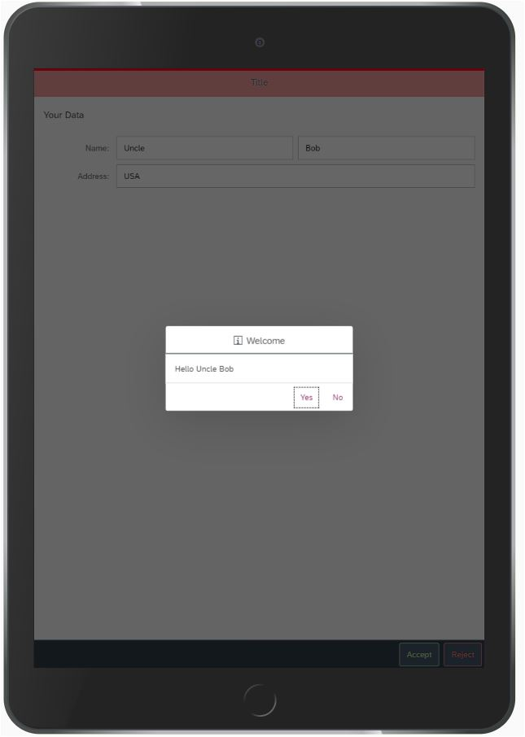
App#7: Event handlers
Add buttons
Add event handler
Access elements by ID
Clean the values onReject
Show Hello message onAccept
Accessing other functions
Accessing i18n

Slide 5
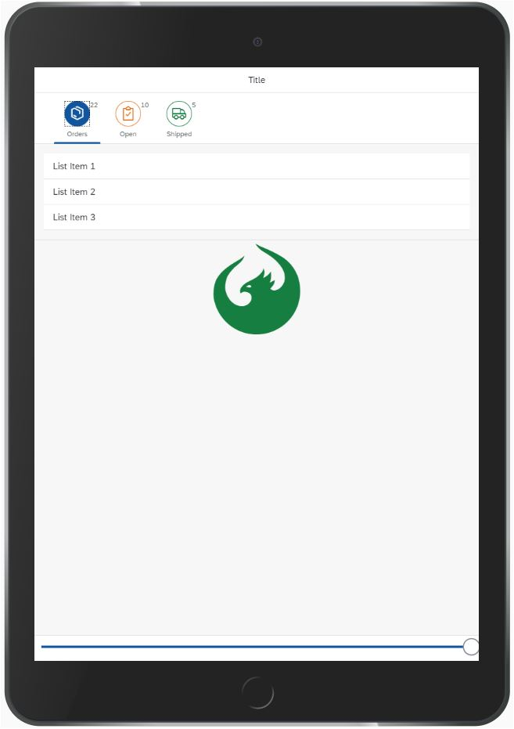
App#8: View Model
IconTabBar
IconTabFilter
Slider
Icon
OnLiveChange event
JsonModel
ViewModel
Working with APIs

