Slide 1

Learn OpenUI5 step by step
Lesson #3
Presented by: Mahdi J.Ansari
www.mjzsoft.com
linkedin.com/in/mjbza/

Slide 2
What do we know now?
Web IDE
API Reference
Sample Applications
XML View
i18n
Auto translation service
RTL support

Slide 3
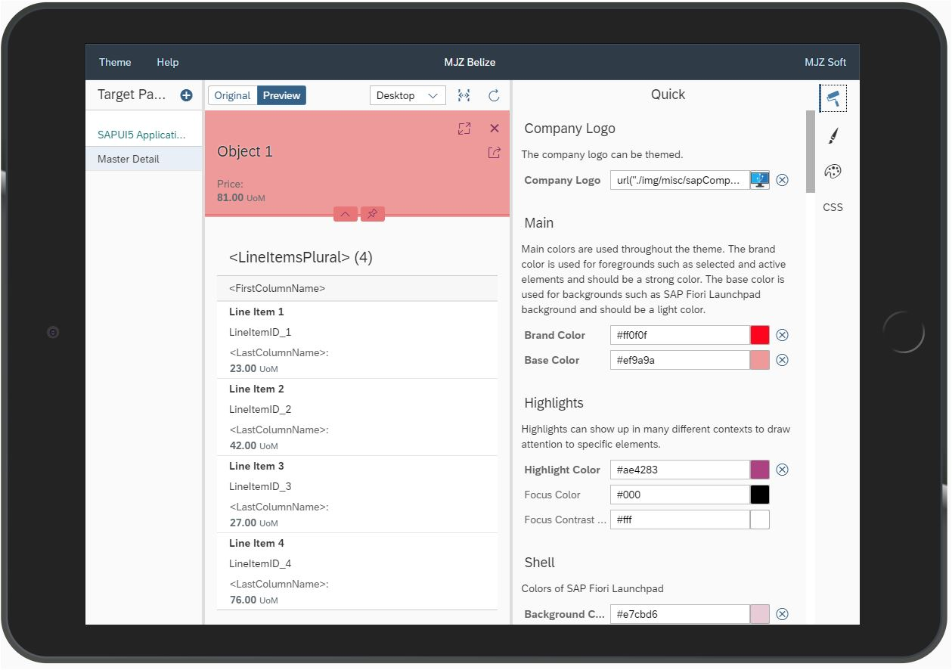
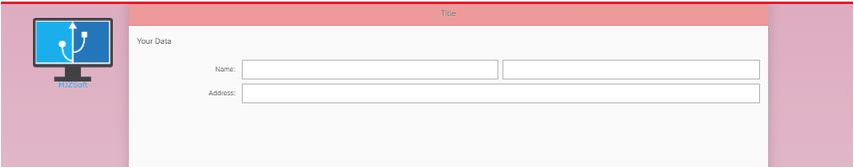
App#7: UI Theme Designer
1- By bootstrap configuration:
<script id="sap-ui-bootstrap"
src="resources/sap-ui-core.js"
data-sap-ui-theme="mjzbelize"
data-sap-ui-theme-roots= '{"mjzbelize":"/resources/UI5"}' ... >
2 -Use the URL parameter sap-ui-theme.
Example:
?sap-ui-theme=my_theme_name@url

Slide 4
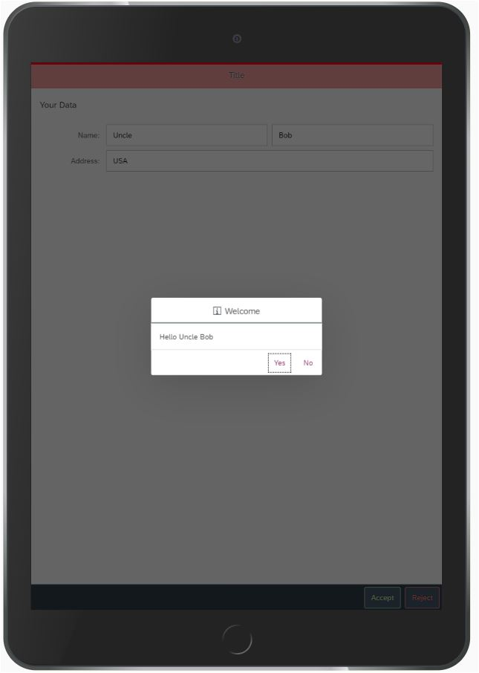
App#7: Event handlers
Add buttons
Add event handler
Access elements by ID
Clean the values onReject
Show Hello message onAccept
Accessing other functions
Accessing i18n

Slide 5
Models in UI5
Client-Browser
JSON
XML
A model in the MVC concept holds the data and provides methods to retrieve the data from the database and to set, delete or update data.
Models can update bound elements of the views directly.
Resource
OData
HTTPS
Server
HTML, CSS, JS, JSON, i18n, XML
OData Gateway
DB

Slide 6
Binding Types in UI5
OData
OData Model
Two-Way
View
One-Way
One-Time
JSON
JSON Model
Two-Way
View
One-Way
One-Time
XML
XML Model
Two-Way
View
One-Way
One-Time
Resources (e.g. i18n)
Resource Model
View
Server
Client
One-Time

Slide 7
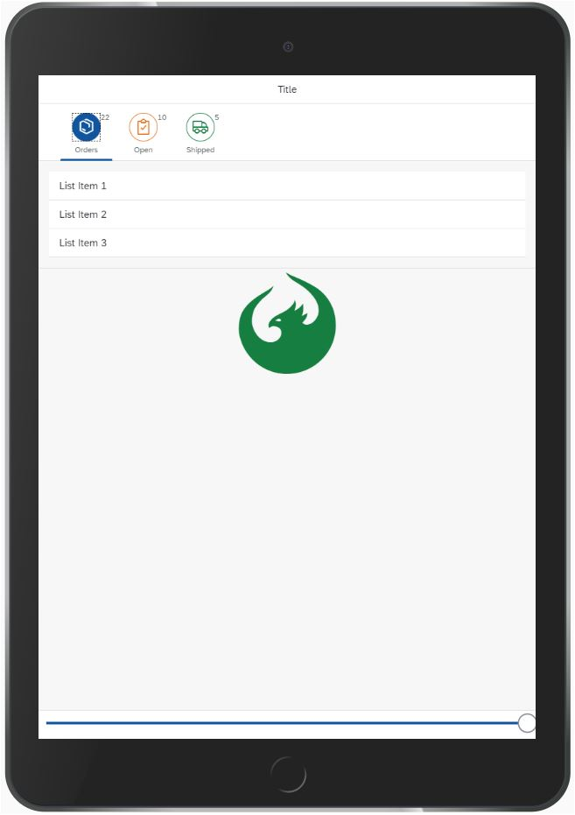
App#8: View Model
IconTabBar
IconTabFilter
Slider
Icon
OnLiveChange event
JSON Model
ViewModel
Working with APIs

Slide 8
App#9: JSON Model
Path in models
Generate JSDoc Comment

