Slide 1

Learn OpenUI5 step by step
Lesson #4
Presented by: Mahdi J.Ansari
www.mjzsoft.com
linkedin.com/in/mjbza/

Slide 2
What do we know now?
UI Theme Designer
Event handlers
Models in UI5 (XML, JSON, OData, Resource)
Bindings (One-time, One-way, two-way)
Model View

Slide 3
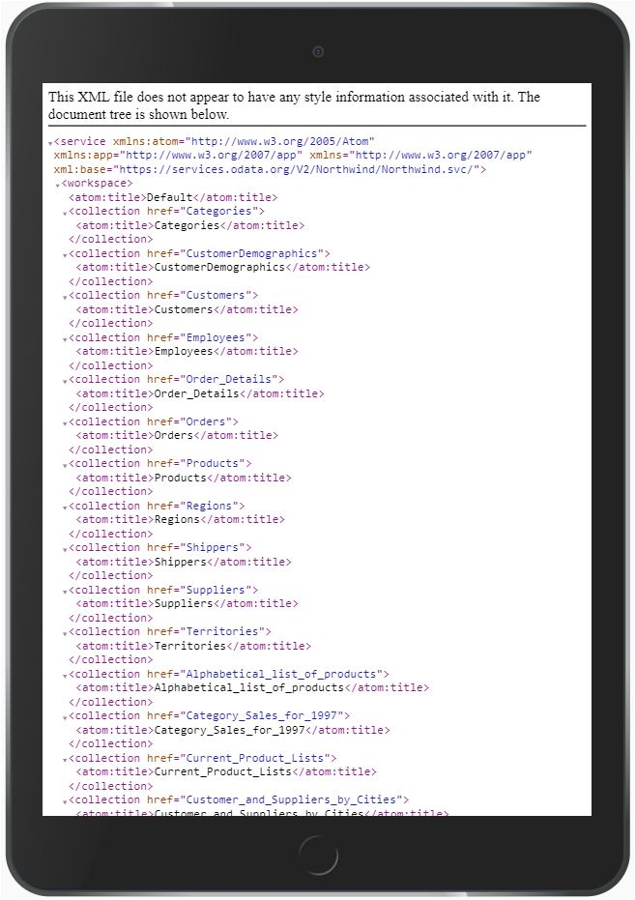
OData
Open Data (OData) is a protocol to allow the creation and consumption of RESTful APIs in a standard way. https://www.odata.org/
UI5 supports OData version 2 and 4.
$metadata
Notes:
Play with Northwind a little bit.

Slide 4
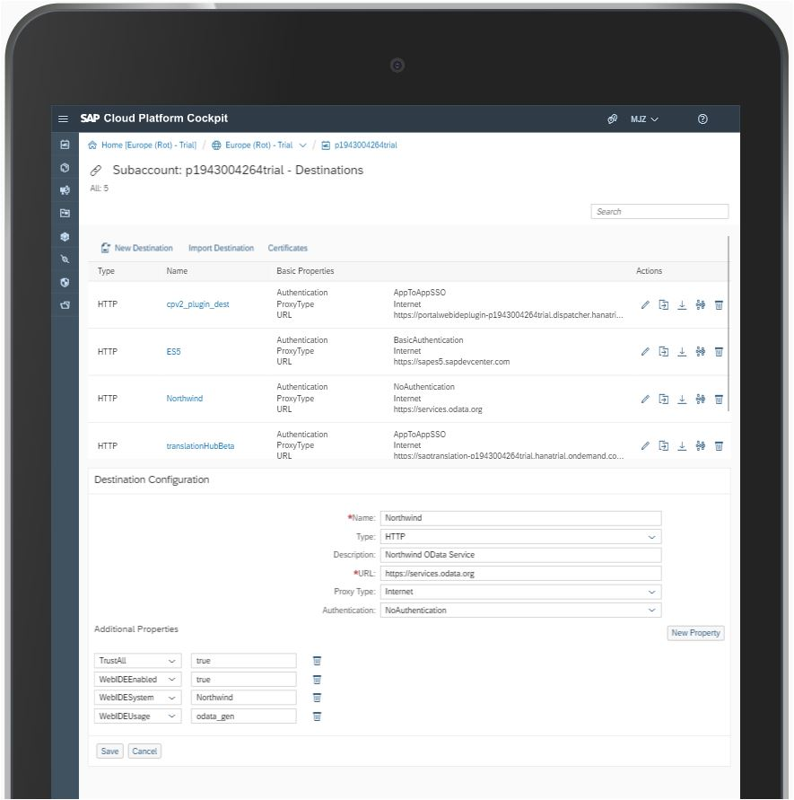
Setting up Northwind Destination
Same Origin Policy
Go to HCP
Create a new Destination
Parameter | Value
Name | Northwind
Type | HTTP
Description | Northwind OData Service
URL | https://services.odata.org
Proxy Type | Internet
Authentication | NoAuthentication
TrustAll | true
WebIDEEnabled | true
WebIDESystem | Northwind
WebIDEUsage | odata_gen

Slide 5
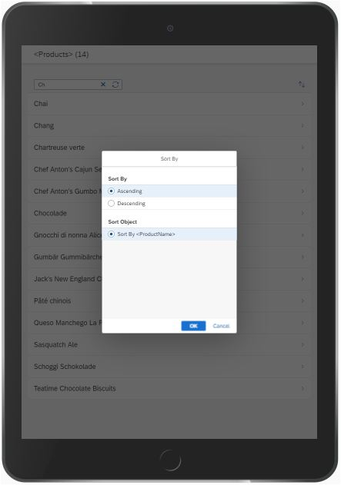
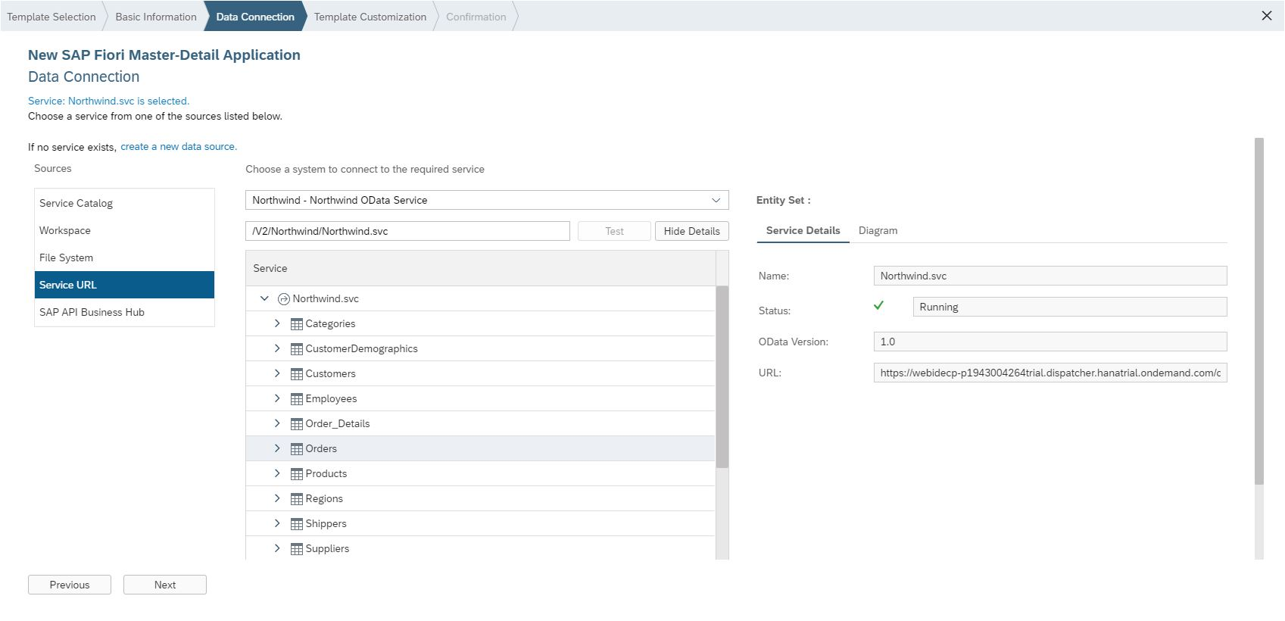
App#10: List of Products
Worklist Template
/V2/Northwind/Northwind.svc/
manifest.json
Story Board
Routing
Notes:
Search: Descriptor for Applications, Components, and Libraries
The cozy factor displays controls with dimensions large enough to enable fingertip interaction. This factor is ideal for devices operated by touch.
The compact factor reduces the dimensions of the controls, allowing more information to be displayed on the UI. This factor is ideal for devices operated by mouse and keyboard.

Slide 6
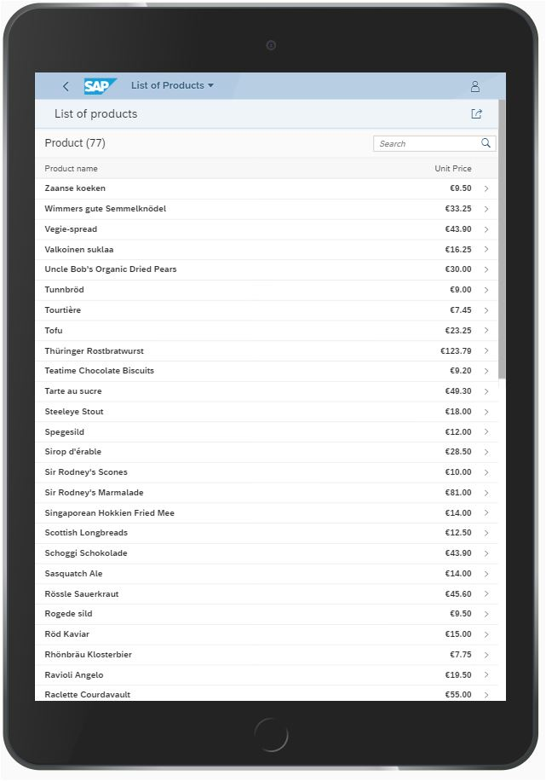
App#11: List of Products
Component.js & Fiori
sapUiTinyMargin (8px)
sapUiTinyMarginTop
sapUiTinyMarginBottom
sapUiTinyMarginBegin
sapUiTinyMarginEnd
sapUiTinyMarginBeginEnd
sapUiTinyMarginTopBottom
Small (16px), Medium (32px), Large (64px)
sapUiNoMargin
sapUiResponsiveMargin
sapUiNoContentPadding
sapUiContentPadding
sapUiResponsiveContentPadding
Notes:
Components are independent and reusable parts used in OpenUI5 applications.
A shell control as container for our app and use it as our new root element. The shell takes care of visual adaptation of the application to the device’s screen size by introducing a so-called letterbox on desktop screens.

Slide 7
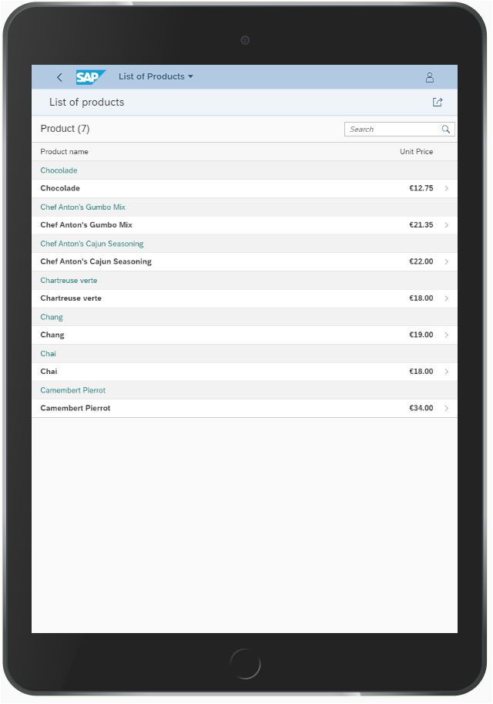
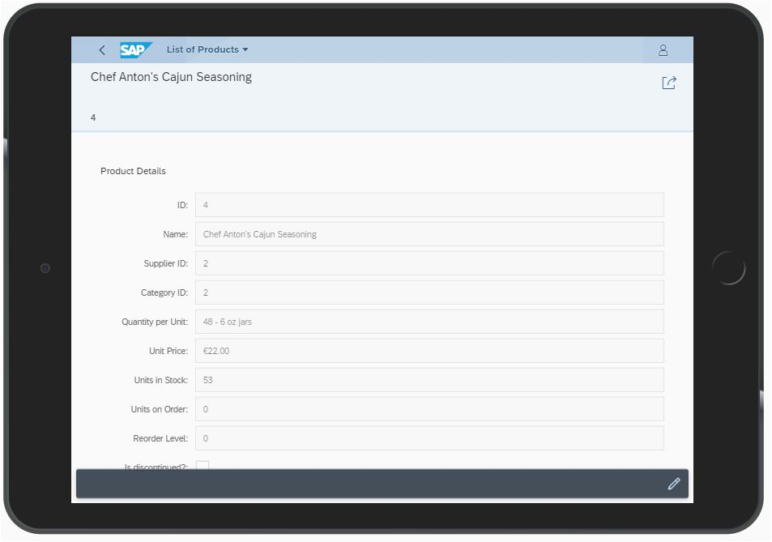
App#11: List of Products
Sort & Group
Filter
Variables in i18n strings
SemanticPage
footerCustomActions
sap.ui.layout
Notes:
new Filter({ filters: aTableSearchState, and: false })
https://sapui5.hana.ondemand.com/#/api/sap.ui.model.ListBinding
https://sapui5.hana.ondemand.com/#/api/sap.ui.model.FilterType

