Slide 1

Learn OpenUI5 step by step
Lesson #5
Presented by: Mahdi J.Ansari
www.mjzsoft.com
linkedin.com/in/mjbza/

Slide 2
What do we know now?
Margins and Paddings
OData ($metadata, $filter, $orderby)
Same Origin Policy in Browsers
Config a Destination for Northwind
Worklist Application Template
Story Board
Routing & Navigation
Margins and Paddings
SemanticPage
Form
Binding

Slide 3
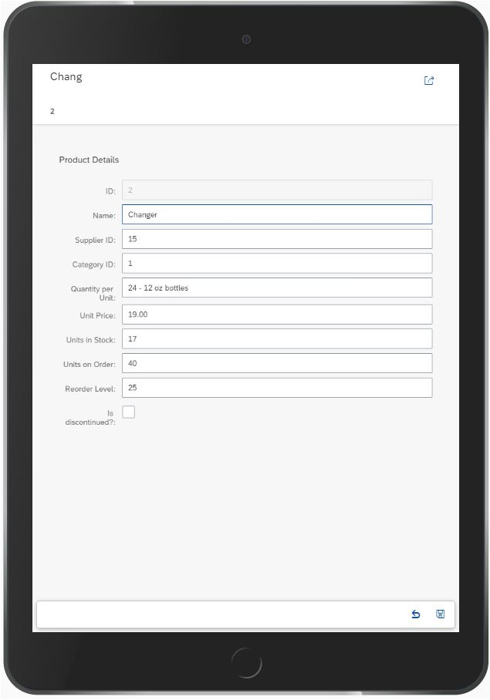
App#12: Mock server
Create or download mock data
Initialize mock server
Create, Update, Delete
Deeper look at ODataModel
Extract data from metadata

