Slide 1

Learn OpenUI5 step by step
Lesson #2
 Presented by: Mahdi J.Ansari
 www.mjzsoft.com
 linkedin.com/in/mjbza/

Slide 2
What we know until now?
UI5 as a JS library
front-end MVC architecture
IDEs for development
Bootstrapping UI5
Running UI5 apps in a server
UI5 Tooling
OpenUI5 vs. SAPUI5
Some sample codes

Slide 3
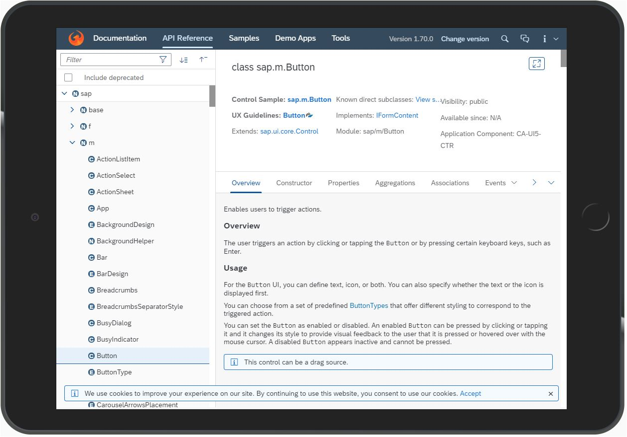
API Reference, Samples
http://openui5.hana.ondemand.com

Slide 4
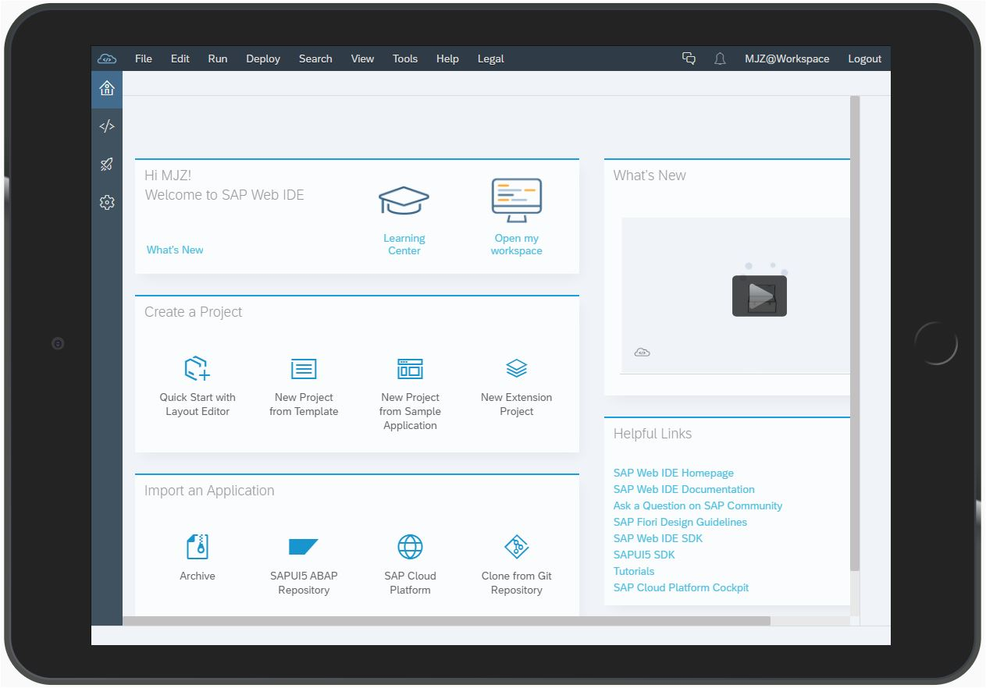
Let’s continue with Web IDE
Take a tour first!
Check the previous applications then!
Why do we need `neo-app.json` file?

Slide 5
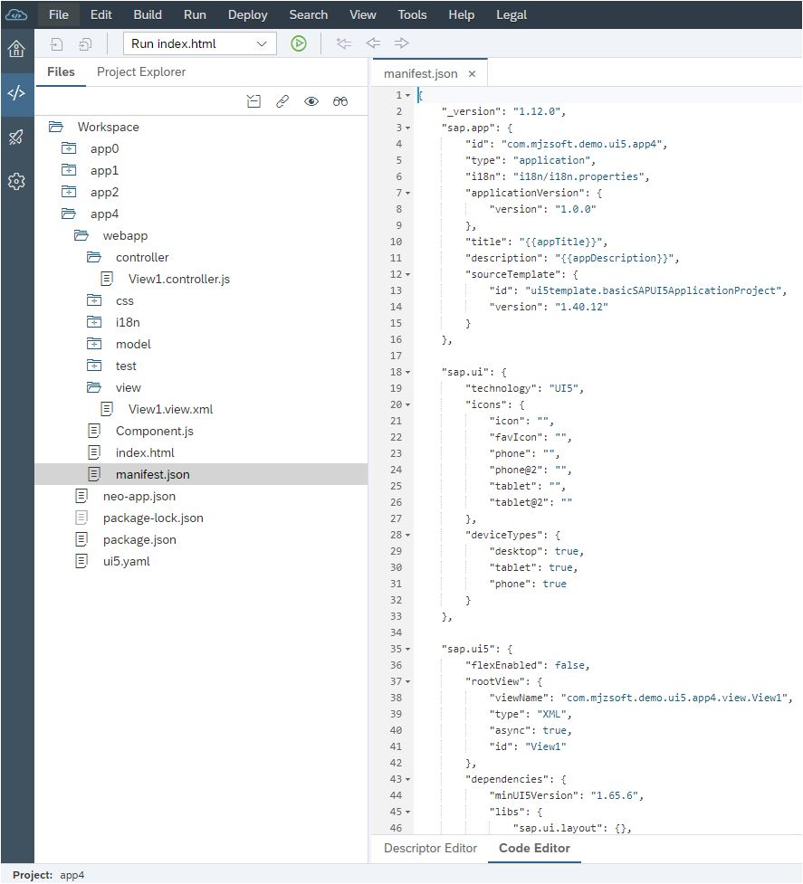
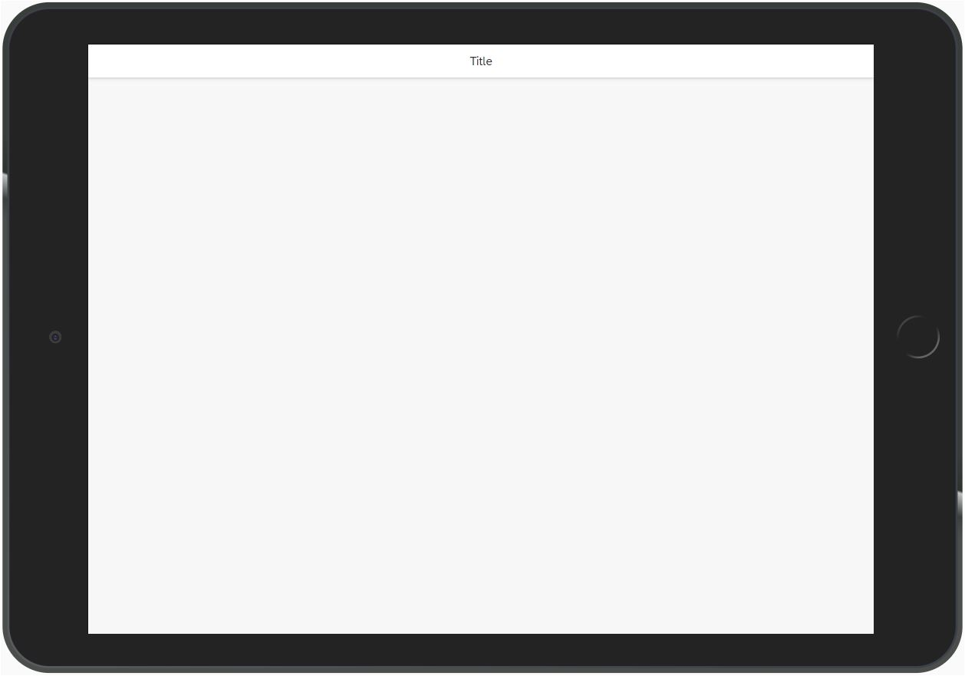
App#4: Start with a blank template!
Create new app from templates
Different color! Why?
What is the Fiori guideline?
What’s the `manifest.json` file?

Slide 6
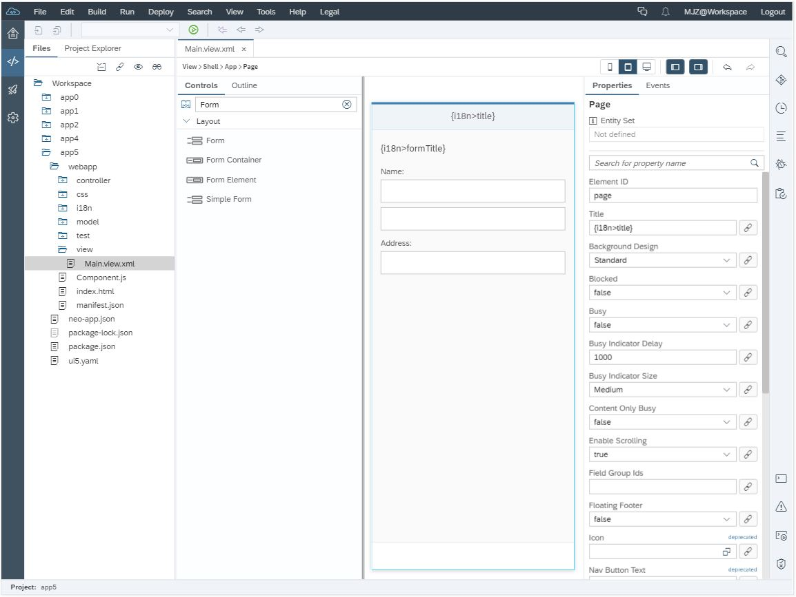
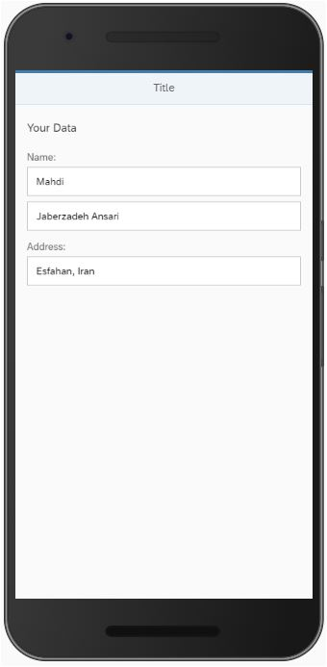
App#5: Start with a blank template!
Layout Editor vs. Code Editor
Controls & UX design
i18n

Slide 7
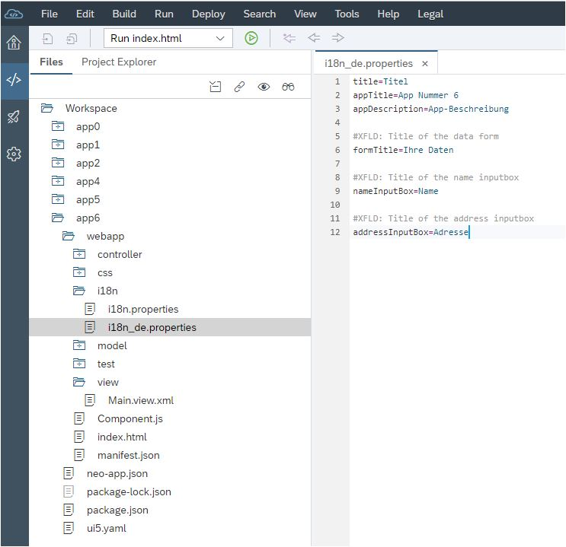
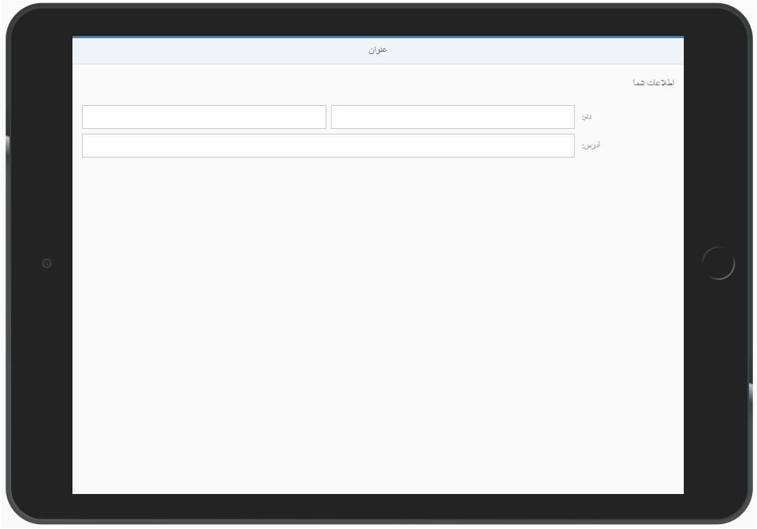
App#6: i18n & RTL support!
Import project
Web IDE Search tool
i18n model
sap-language=de
RTL magic
SAP Translation Hub
Deploy
Git
Auto generate translations
Learn More

