Slide 1

Learn OpenUI5 step by step
Lesson #1
Presented by: Mahdi J.Ansari
www.mjzsoft.com
linkedin.com/in/mjbza/

Slide 2




Prerequisites
HTML, CSS, JS, jQuery, XML
Static and Dynamic web pages
Ajax and RESTful API
MVC design pattern

Slide 3
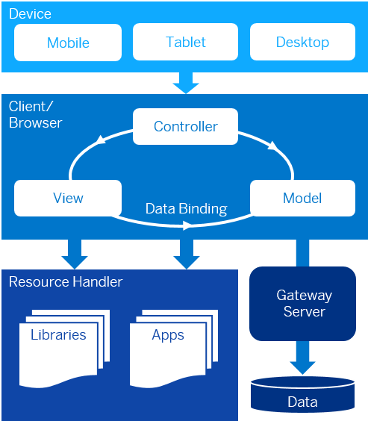
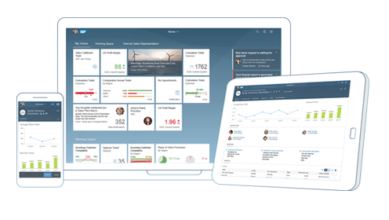
What is OpenUI5?
OpenUI5 is a JavaScript application framework designed to build responsive web applications for enterprise world.
Free and open source version of SAPUI5.
Uses front-end MVC design pattern.
Responsive Across Browsers and Devices
http://openui5.hana.ondemand.com

Slide 4
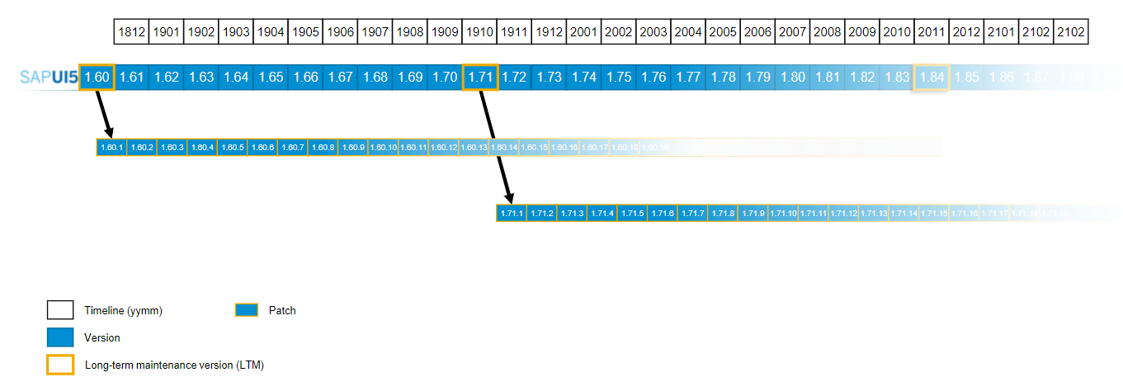
SAPUI5 release and maintenance strategy
Monthly cloud delivery via SAP Cloud Platform
Planned release dates and future version numbers reflect the current planning and can be changed by SAP any time

Slide 5
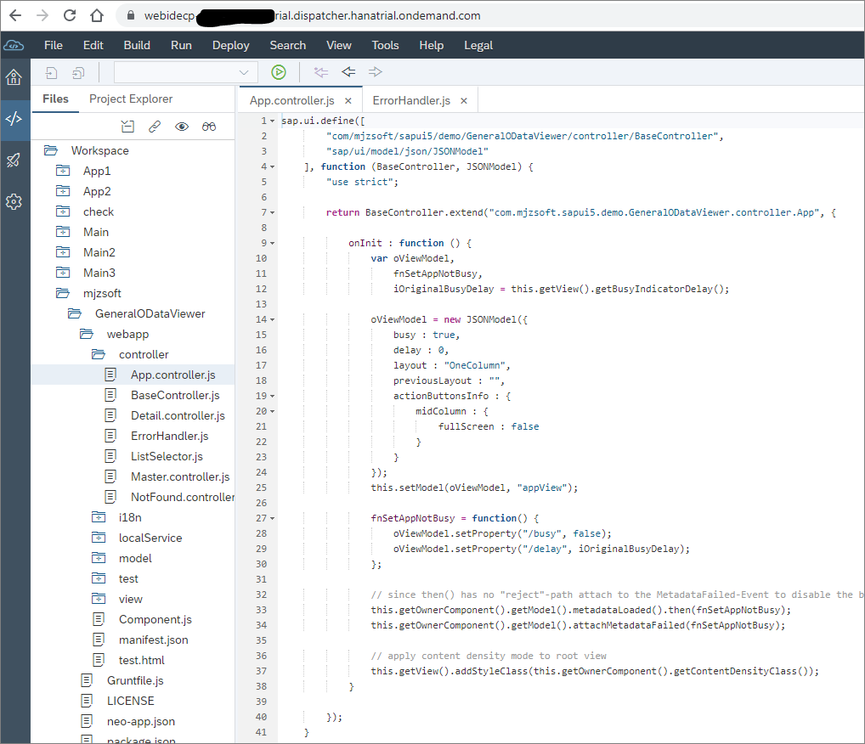
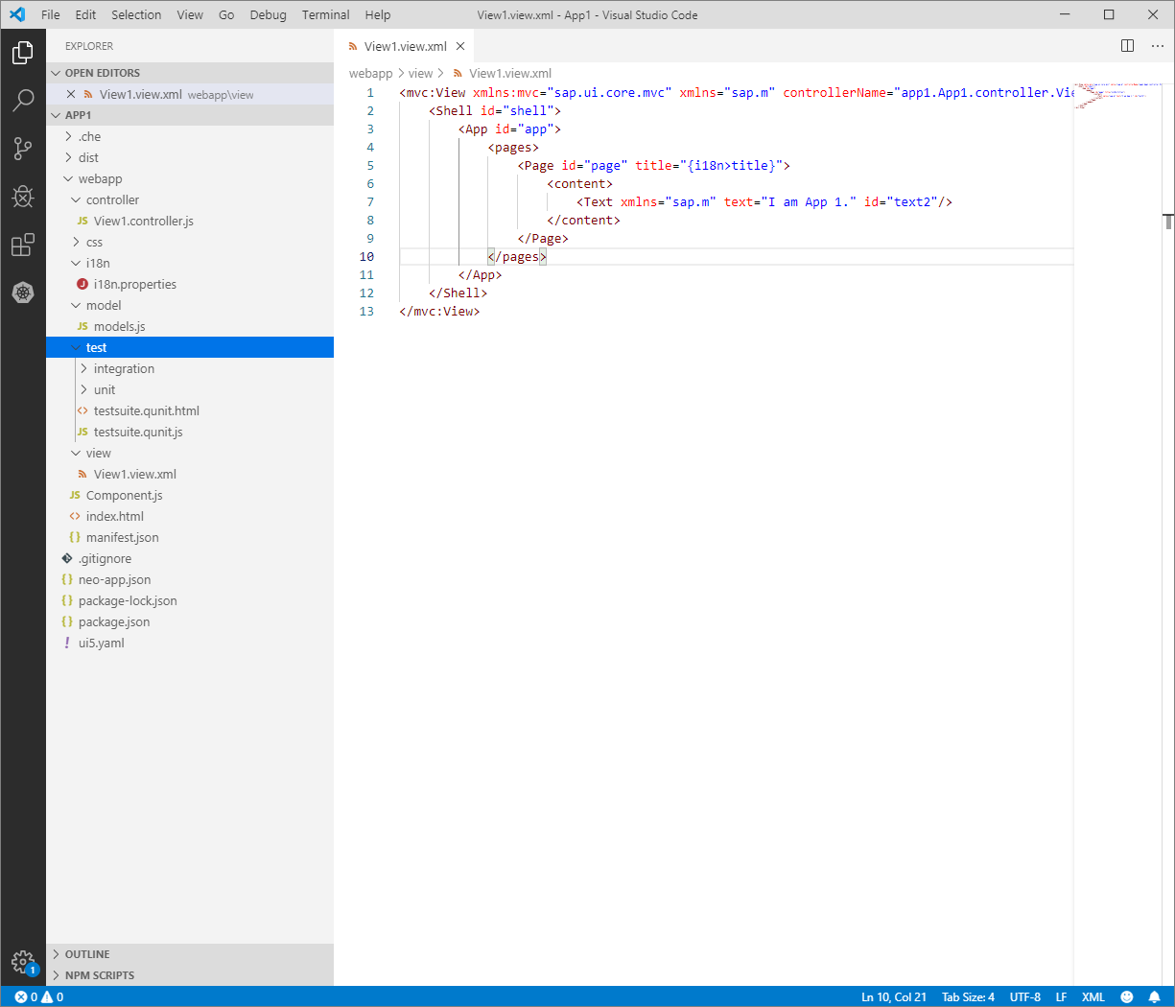
IDEs for UI5 development
1. SAP Web IDE
2. Eclipse or any IDE of your choice
https://help.sap.com/viewer/p/SAP_Web_IDE

Slide 6
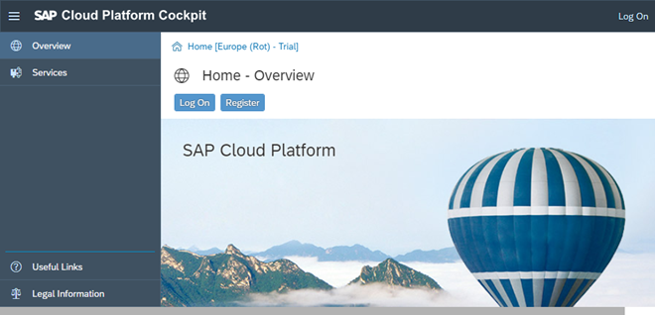
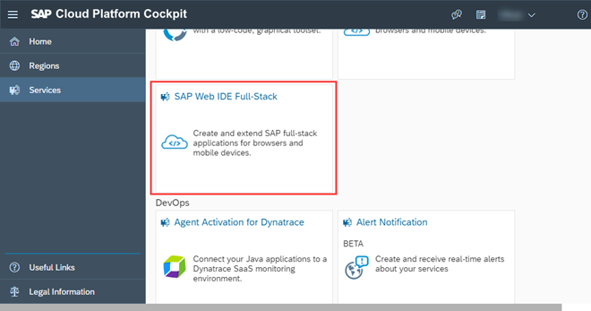
Start with Web IDE Cloud version
Create an SAP Cloud Platform trial account: https://account.hanatrial.ondemand.com/
Then navigate to `Neo Trial` account.
Choose Services in the navigation bar of the SAP Cloud Platform cockpit.
Open the detailed information on your SAP Web IDE by choosing the SAP Web IDE Full-Stack tile.
Activate the service if it is disabled.
Selecting Go to Service leads you to your personal SAP Web IDE.
Bookmark the URL of the Web IDE for the next time.
https://account.hanatrial.ondemand.com/cockpit/#/acc/p0123456789trial/accountdashboard
Notes:
A trial version of SAP Web IDE can be accessed through the SAP Cloud Platform.

Slide 7
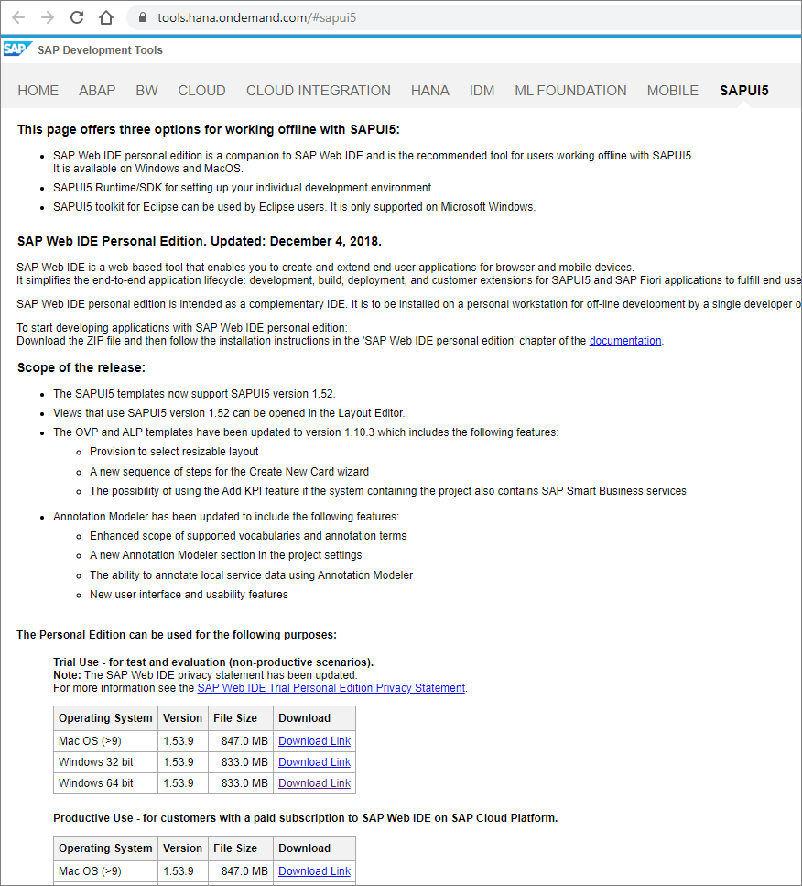
Web IDE on Local Machine (offline)
Google the term `SAP Web IDE Personal Edition`
Normally in the following URL you can find the download link for a local version of Web IDE: https://tools.hana.ondemand.com/#sapui5
In this page you can find the link for downloading the SAPUI5 SDK and Runtime library also.
The Personal Edition can be used for the following purposes:
Trial Use - for test and evaluation (non-productive scenarios).
Productive Use - for customers with a paid subscription to SAP Web IDE on SAP Cloud Platform.

Slide 8
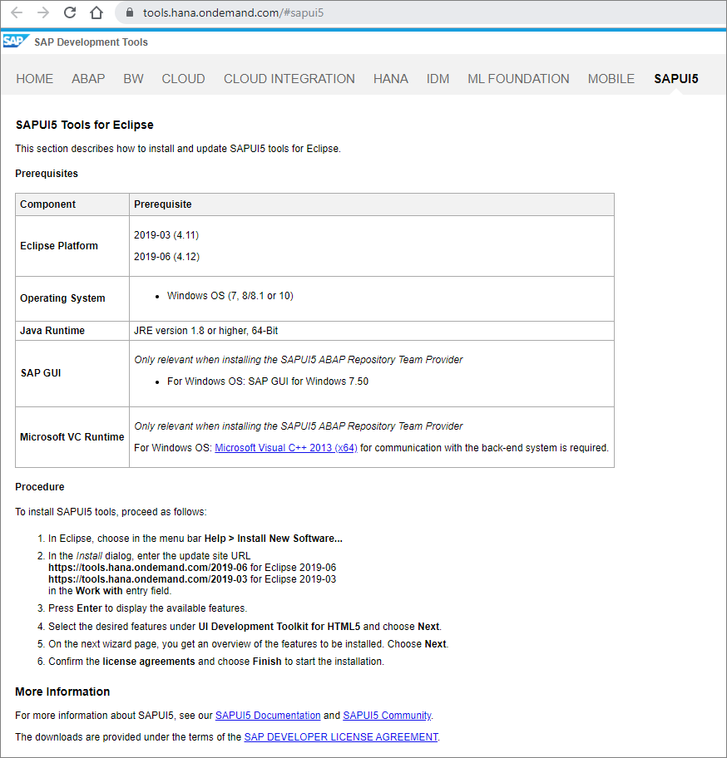
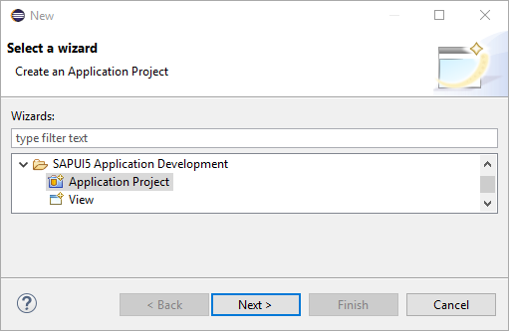
Using Eclipse with SAPUI5 Tools extension
Normally on the same page you can find the instruction for installing SAPUI5 Tools inside the Eclipse https://tools.hana.ondemand.com/#sapui5
This extension provides an application project wizard, and some more.

Slide 9
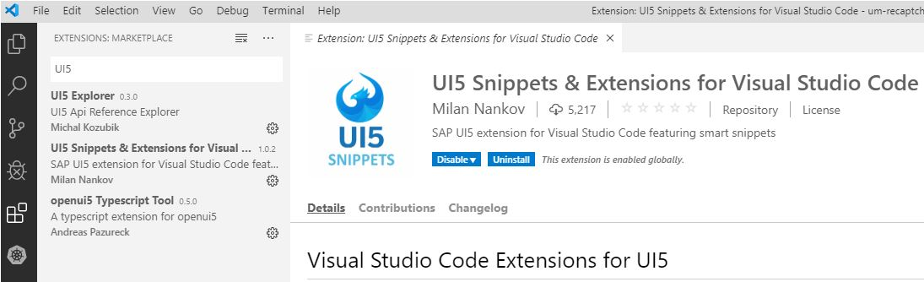
Using Microsoft Visual Studio Code
UI5 Tooling: is an open source Node.js based development environment to support application developers.
> npm install -g @ui5/cli
> ui5 --help
> git clone https://github.com/SAP/openui5-basic-template-app.git
> cd openui5-basic-template-app
> npm install
> npm run
> ui5 serve -o /index.html
> npm run lint
> npm test
UI5 related plugins and ESLint are recommended to be used inside the VSC.

Slide 10
Let’s continue with some coding …

Slide 11
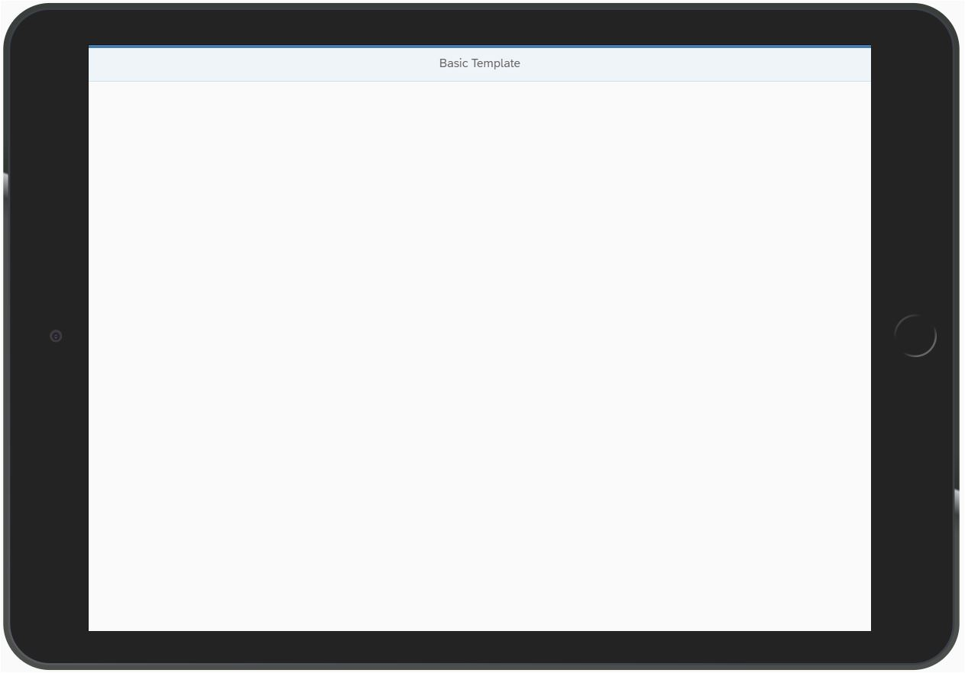
App#0: Node.js and Sample App!
> npm install -g @ui5/cli
> ui5 --help
> git clone https://github.com/SAP/openui5-basic-template-app.git
> cd openui5-basic-template-app
> npm install
> npm run
> ui5 serve -o /index.html
> npm run lint
> npm test

Slide 12
App#1: Bootstrapping
<!DOCTYPE html>
<html>
<head>
<meta charset="utf-8">
<title>More Bootstrapping</title>
// refference to the latest stable version of OpenUI5, is not recommended for productive.
<script
id="sap-ui-bootstrap"
src="https://openui5.hana.ondemand.com/resources/sap-ui-core.js"
data-sap-ui-theme="sap_belize"
data-sap-ui-libs="sap.m"
data-sap-ui-compatVersion="edge"
data-sap-ui-async="true"
data-sap-ui-resourceroots='{
"com.mjzsoft.demo.ui5": "./"
}'
data-sap-ui-oninit="module:com/mjzsoft/demo/ui5/index">
</script>
</head>
<body>
<div>Hello UI5 World</div>
<div id='alert'>Please wait!</div>
</body>
</html>
Notes:
The process of loading and initializing UI5 library is called bootstrapping.
The src attribute of the <script> tag tells the browser where to find the OpenUI5 core library – it initializes the OpenUI5 runtime and loads additional resources, such as the libraries specified in the data-sap-ui-libs attribute.
The OpenUI5 controls support different themes, we choose sap_belize as our default theme.
We specify the required UI library sap.m containing the UI controls we need for this tutorial.
To make use of the most recent functionality of OpenUI5 we define the compatibility version as edge.
We configure the process of “bootstrapping” to run asynchronously.
This means that the OpenUI5 resources can be loaded simultaneously in the background for performance reasons.
We define the module to be loaded initially in a declarative way. With this, we avoid directly executable JavaScript code in the HTML file. This makes your app more secure. We will create the script that this references to further down in this step.

Slide 13
App#2: Xampp, MVC, Bootstrapping
<!DOCTYPE html>
<html>
<head>
<meta charset="utf-8">
<title>I Love UI5</title>
<script id="sap-ui-bootstrap"
src="https://openui5.hana.ondemand.com/resources/sap-ui-core.js"
data-sap-ui-theme="sap_belize"
data-sap-ui-libs="sap.m"
data-sap-ui-resourceroots='{"com.mjzsoft": "./"}'
data-sap-ui-async="true">
</script>
<script>
sap.ui.getCore().attachInit(function () {
sap.ui.require([
"sap/ui/core/mvc/XMLView"
], function (XMLView) {
XMLView.create({viewName: "com.mjzsoft.App"}).then(function (oView) {
oView.placeAt("content");
});
});
});
</script>
</head>
<body class="sapUiBody" id="content"></body>
</html>

Slide 14
App#3: Bootstrapping from local
<!DOCTYPE html>
<html>
<head>
<meta charset="utf-8">
<title>I Love UI5</title>
<script id="sap-ui-bootstrap"
src="../openui5/openui5-runtime-1.70.0/resources/sap-ui-core.js"
data-sap-ui-theme="sap_belize"
data-sap-ui-libs="sap.m"
data-sap-ui-resourceroots='{"com.mjzsoft": "./"}'
data-sap-ui-async="true">
</script>
<script>
sap.ui.getCore().attachInit(function () {
sap.ui.require([
"sap/ui/core/mvc/XMLView"
], function (XMLView) {
XMLView.create({viewName: "com.mjzsoft.App"}).then(function(oView) {
oView.placeAt("content");
});
});
});
</script>
</head>
<body class="sapUiBody" id="content"></body>
</html>

