Slide 1
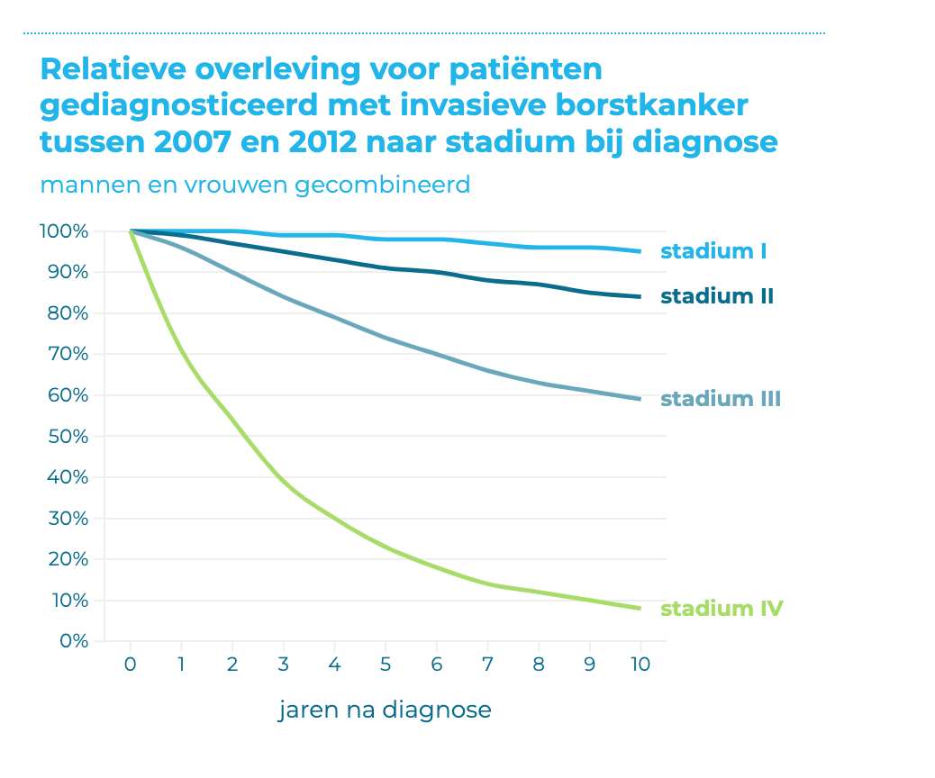
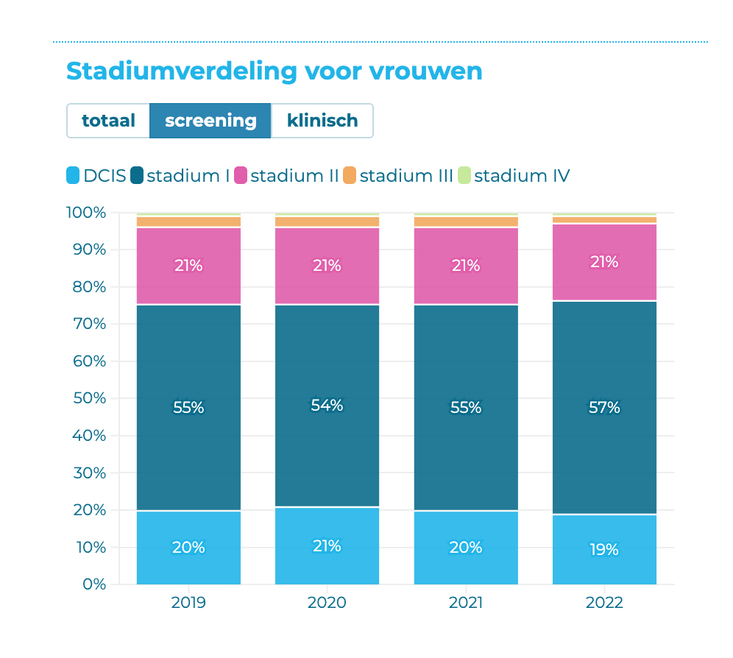
Breast cancer
Figure 1
Source: https://iknl.nl/borstkankercijfers
Figure 2

Slide 2
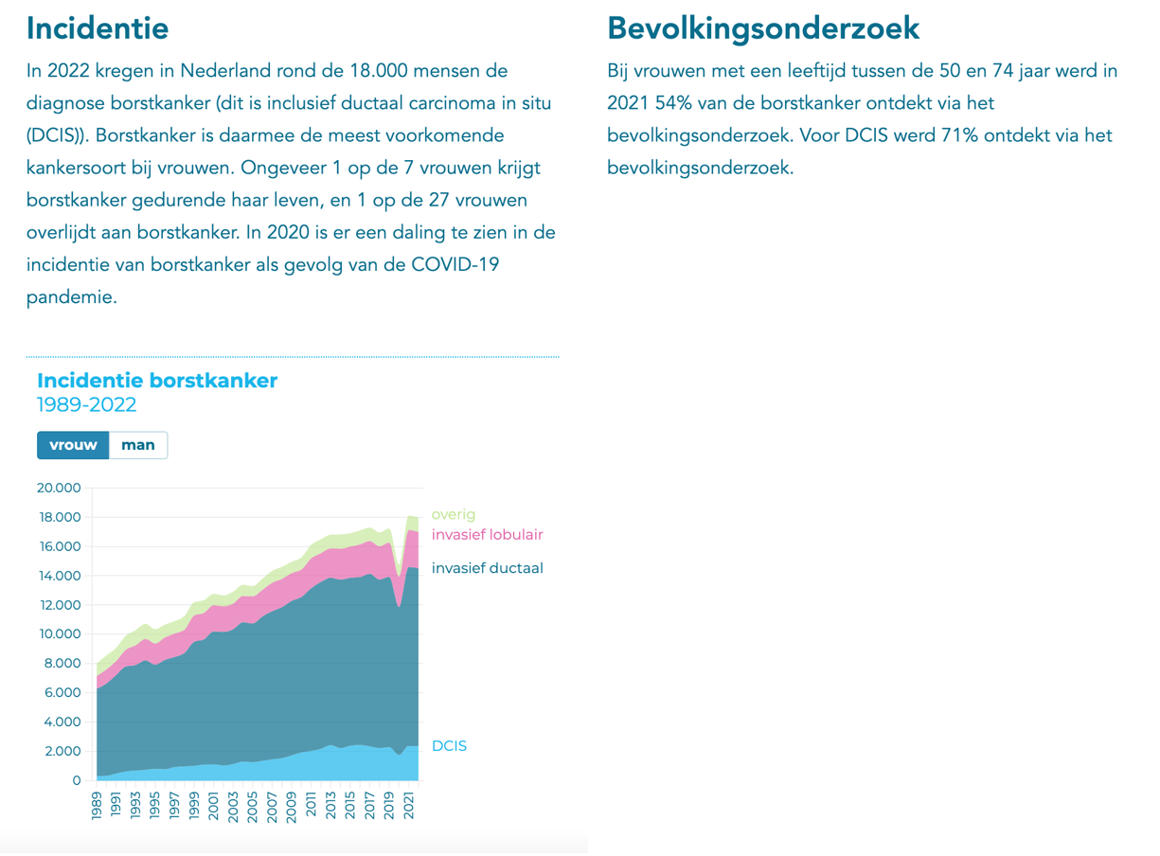
Interpretation of figure 1, 2 and 3:
In 2021 the incidence of breast cancer in the Netherlands is 18,000 (figure 3), of which 54% is discovered through screening (9720 patients, rounded 10.000). Out of which 1 percent (n= 100) is diagnosed in stage 4 (see figure 2). Regarding figure 1, 50% (n = 50) of woman in stage 4 is expected to die after 2 years. Figure 2 shows that 3% of patients diagnosed through screening is in stage 3 (n= 10.000*0,03 = 300). Of these 300, 10% (n = 30) is expected to die after 2 years (see figure 1). Thus the total mortality of patients diagnosed by screening in stage 3 and 4 is expected to be 80 patients in 2 years. If you also include stage 1 and 2 (see figure 1 and 2) and suppose that 1% dies after 2 years (n = 75), a total number of 155 patients diagnosed by screening is expected to die after 2 years.
These are figures from 1 year of screening. Since the screening stopped for 3 months during Covid , the number of patients expected to die after 2 years should by devided by 4.
→ Assuming screening was stopped for 3 months, approximately 40 extra women could die in 2 years (155/4 ) time.
Figure 3

Slide 3
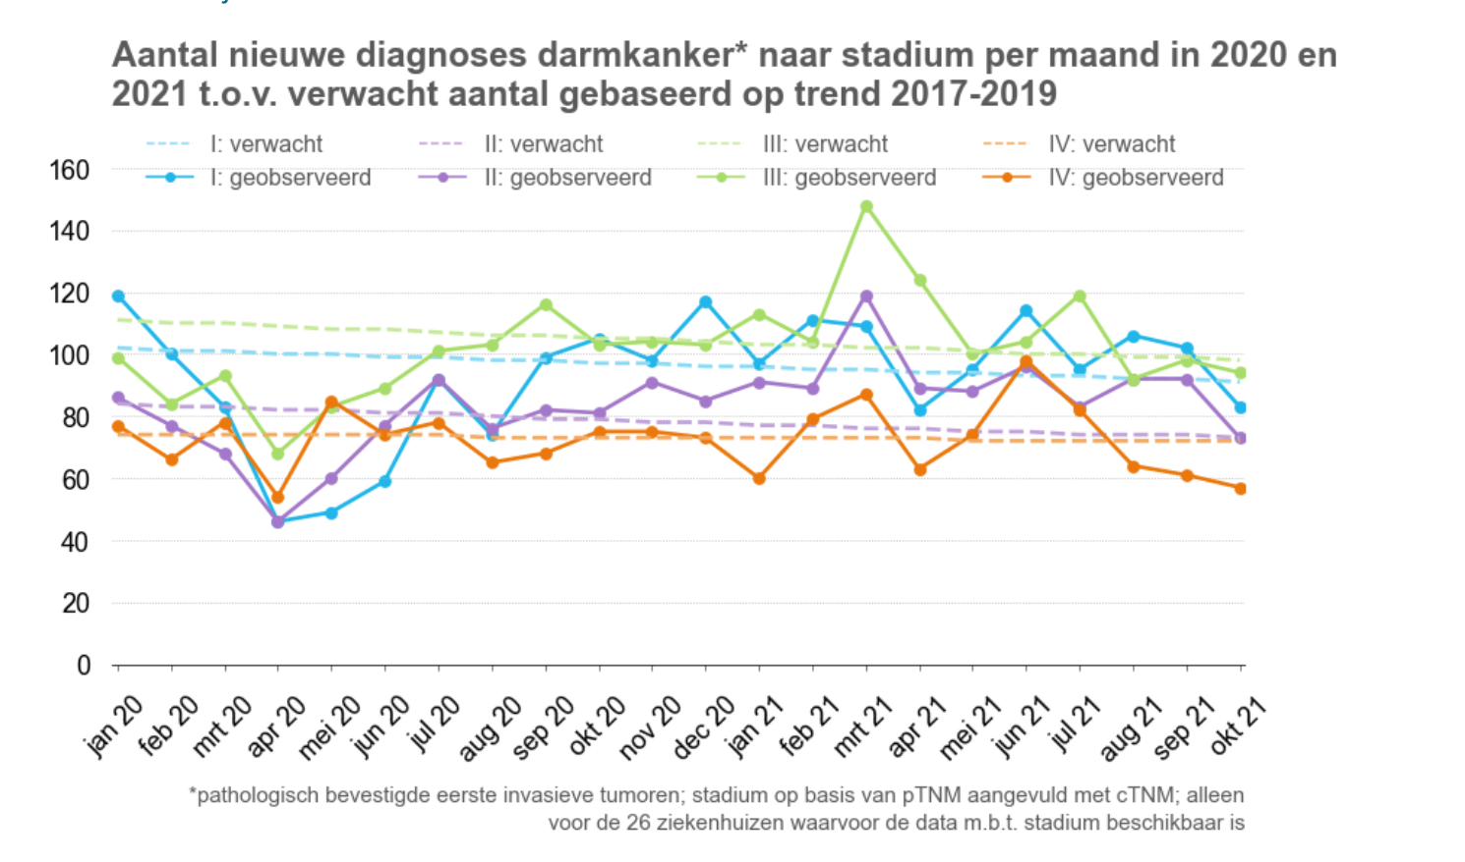
coloncancer
Figure 4

Slide 4
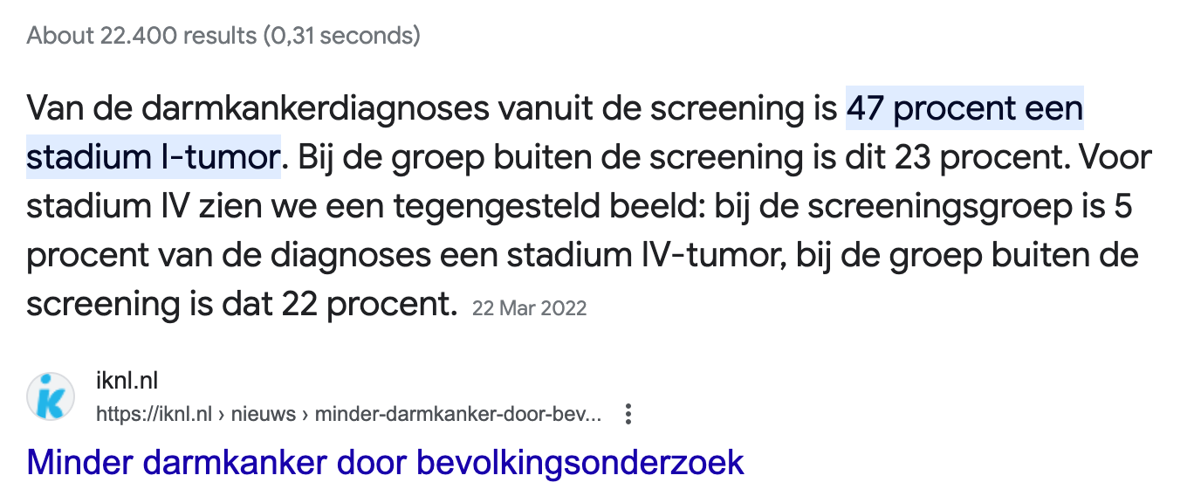
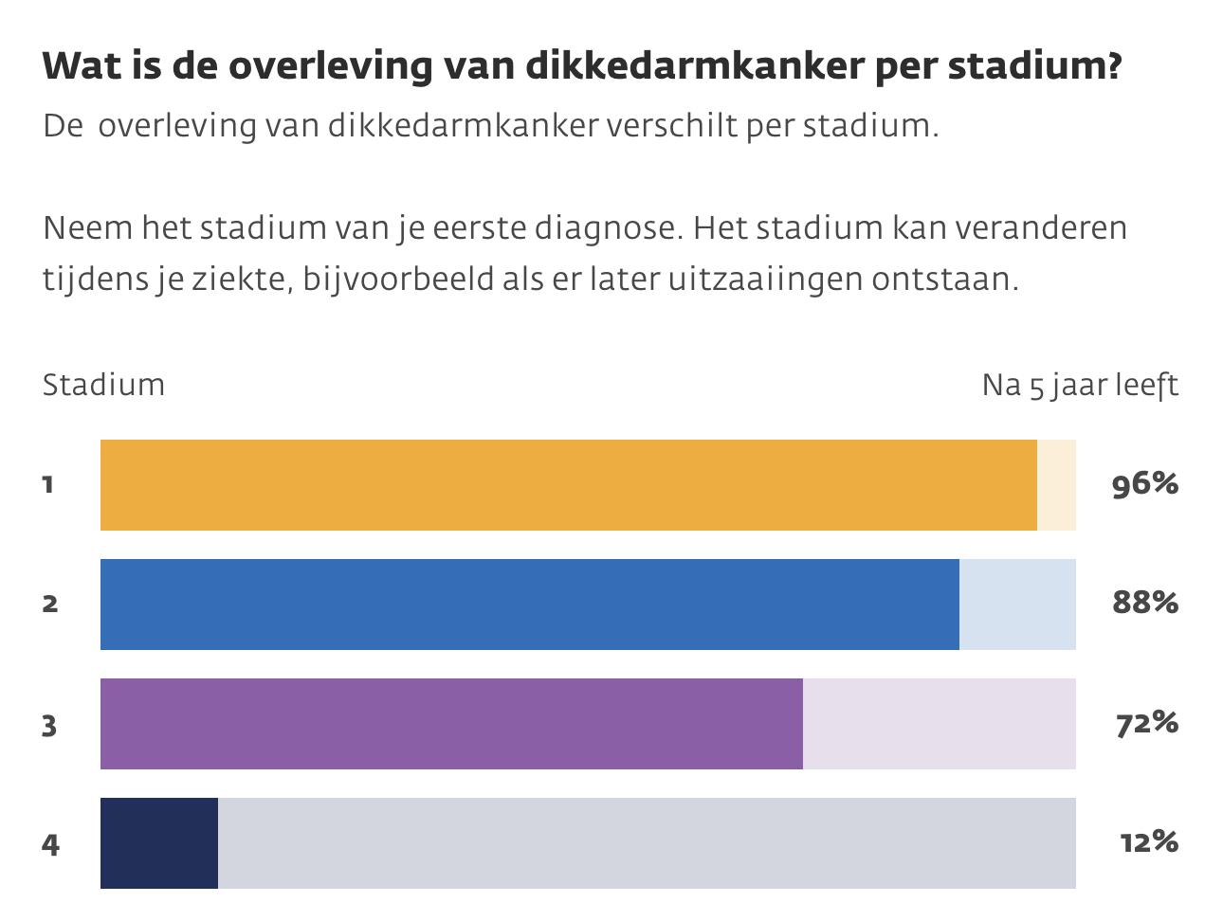
Similar analysis as in breast cancer:
The incidence of colon cancer in screening is 2790 in 2021 (= 0.17% (2790) of the 1.632.493 screened clients).
5% of the screened individuals is diagnosed with stage 4 colon cancer (n = 140). Survival of patients with stage 4 is 12% after 5 years. Suppose half of the patients died after 2 years (n = 70).
Survival of patients with stage 3 is approx. 10% (n = 279). Survival of patients with stage 3 is 70% percent after 5 years. Suppose 15% died after 2 years (n = 40).
The chance of death within 2 years with stages 1 and 2 is very small. Suppose that's 50 individuals.
IN total 160 people will die from colon cancer in 2 years if you do not perform screening for a year.
→ Assuming screening stopped for 3 months, this means that 160/4 = approximately 40 extra people could die in 2 years.
Figure 5
Source: https://www.kanker.nl/kankersoorten/darmkanker-dikkedarmkanker/algemeen/overlevingscijfers-van-darmkanker and
https://www.bevolkingsonderzoeknederland.nl/bewezen-effectief/#baarmoederhalskanker

Slide 5
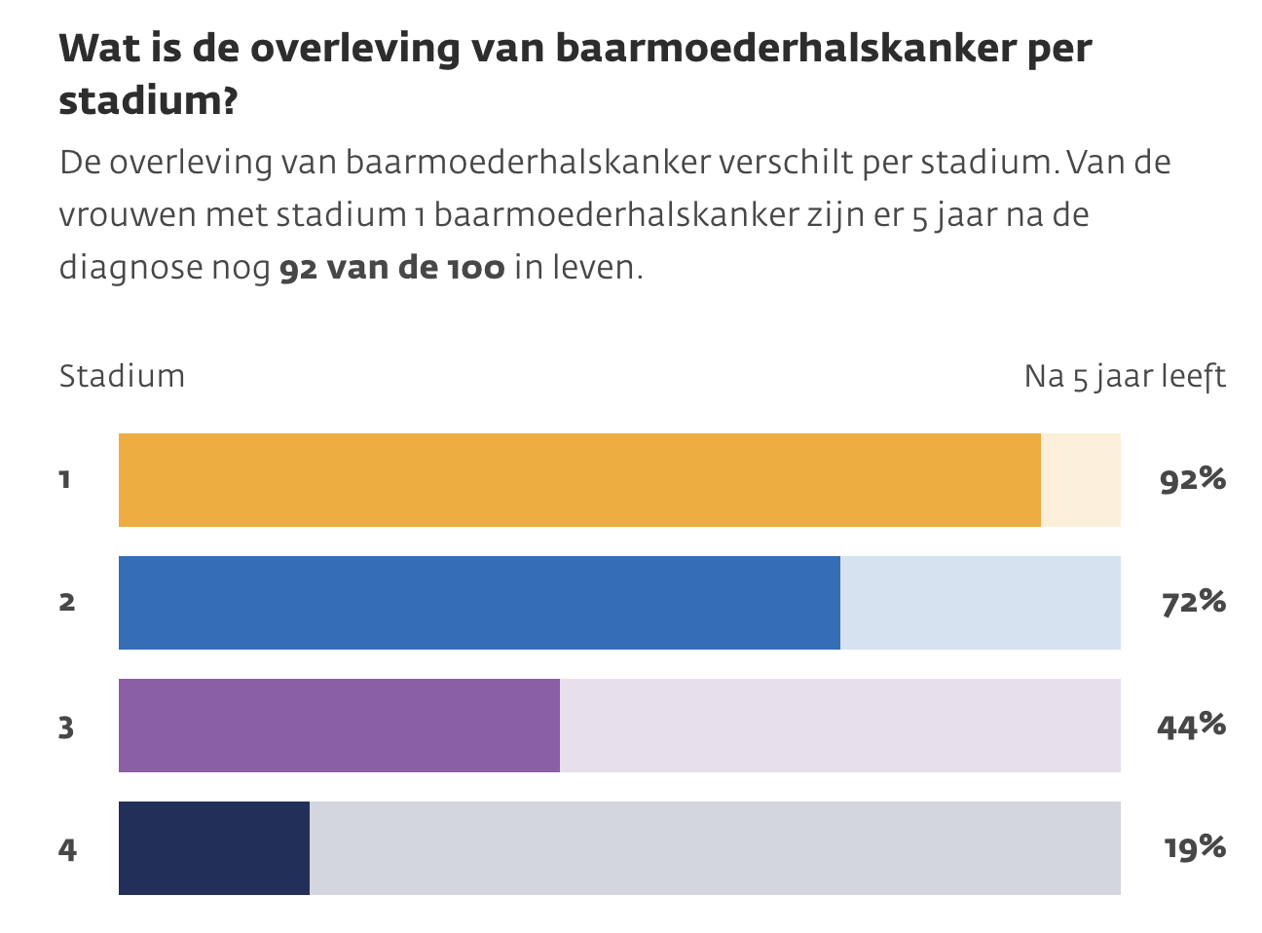
Cervical cancer
The incidence of cervical cancer is 830 (RIVM web-site).
If we assume that 100 percent is found by screening (= overestimation) and we assume that 100% of the women screened are diagnosed with stage 3 (50%) and stage 4 cancer (50%), which is a huge overestimation, then we can conclude that after 5 years 44 % (n= 232) of women with stage 3 would have died and and 19% ((n = 336) of women with stage 4 cancer (total n = 568) (see figure 6).
Regarding a period of 2 year follow-up, in total 227 women would be expected to die if no screening was performed for 1 year.
Due to Covid screening stopped between March 16 and May 10 2020, which is 1/6 of a year. So 227/6 = 38 women could die in 2 years because the of lack of screening in this period.
Important note: it is a huge overestimation that 38 women could die in 2 years time as a result of absence of screening for 2 months regarding the assumptions that we have made, i.e. 100 % of women with cervical cancer is diagnosed by screening and 100 % of them is diagnosed in stage 3 or stage 4.
Figure 6
Source: https://www.bevolkingsonderzoeknederland.nl/bewezen-effectief/#baarmoederhalskanker - https://www.kanker.nl/kankersoorten/baarmoederhalskanker/algemeen/overlevingscijfers-van-baarmoederhalskanker
-https://www.rivm.nl/baarmoederhalskanker

Slide 6
In total (colon, breast and cervical cancer)
Regarding the calculations in the previous slides, in total 120 people could die due to unrecognized colon -, breast - and cervical cancer in 2 years as a result of lack of screening for a period of 3 months. This is an overestimation, partly because:
- In the previous assumptions none of the individuals are screened in the following 2 years after the period of screening pause. In practice, however, it is to be expected that a fair number of people will be discovered when screening resumes.
- For cervical cancer the figures are overestimated in purpose to prevent underestimation in absence of detailed information.
Conclusion:
Assuming an excess mortality of 120 people, due to a 3 month lack of screening during Covid, it is clear that the total excess mortality (= 30K people) in 2020 and 2021 can not be explained by the stop in screening.

Slide 7
Conclusions regarding the 4 hypotheses
1) Looking at the graphs we can conclude that this hypothesis is not true
2) To answer this hypothesis it is relevant to have some additional information, i.e.:
What is the definition of ‘caused by covid’? Is it caused by the disease itself or also due to for example: - the possible interaction of Covid with other diseases, - the lockdowns (and suicides) as result of the Covid-pandemic, - undertreatment as result of misinterpretation of, for example, cardiac diseases because certain complaints are interpreted as complaints due to Covid,
- vaccination for Covid due to the Covid-pandemic,
-undertreatment because people were afraid to go to the hospital as they were scared to get Covid there
What was the procedure for concluding that a patient died of COVID?
Interestingly enough: in dec 2022-jan 2023 there is a peak in excess mortality, however there is no peak in Covid19 diagnoses. This is different as compared to the previous 2 years. As compared to 2020, at least 3 aspects were different in dec 2022-jan 2023; there was less testing for Covid in 2023, there was a booster campaign just before this period and there was no lockdown.
3) As explained in the presentation this hypothesis is not true. If there would be a measurable effect on excess mortality, the effect would be very small as compared to the excess mortality shown in the graphs.
4) This hypothesis is highly unlikely as the number of patient dying from cancer is not increased in 2020-2021 (see figure 11)

