Slide 1
Emerging Technologies and Sustainable Development
Mobile Learning for English Tutoring
- Proposed project in Digital Education
For the UNITAR project on Digital Skills program
TEAM ProTech

Slide 2
Looking ahead to promoting digital tools in underserved areas
Simple App for tutoring English
Helping English Second/Third Language speakers in Primary Schools

Slide 3
Thankful for Government of Japan funding UNITAR skills learning project
Government of Japan can go further by investing in affordable digital devices for children in underserved areas
Participants in UNITAR’s skills development project can further develop software and applications that school children can use, especially speech to text,in indigenous languages. But with the intention to teach English language.

Slide 4
Education as a tool for sustainable development
This is not a new path. It is even one of UN’s sustainable development goals
“Education is the key that will allow many other Sustainable Development Goals (SDGs) to be achieved. When people are able to get quality education they can break from the cycle of poverty.”¹
A project being promoted as part of the UNITAR Skills development plan.

Slide 5
Narrowing the digital divide
Promoting the use of digital devices among school children and using AI to advance the interaction between the child and the device in a language he or she readily understands before moving on to English language which is what will be used in the next 12-14 years of schooling can greatly enhance learning.
Developing digital learning tools can build up the educational system and thereby provide learning capabilities that lead to skill development that lead to economic sustainability. Learners are better equipped. Skills are better retained. And educators are better rewarded.

Slide 6
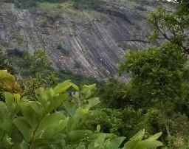
References
Thank you!
1.. The Sustainable Development Goals Report-2023 https://www.un.org/sustainabledevelopment/education/ accessed Feb3, 2024
Modupe Owolabi
Team Protech

