Slide 1

Continued Fractions
$$a0+\frac{1}{a_{1}+\frac{1}{a_{2}+\frac{1}{a_{3}+\frac{1}{a_{4}+⋯}}}}$$
Mobin Jalilifard
10.Dey.1403

Slide 2

Notation
$$a0+\frac{1}{a_{1}+\frac{1}{a_{2}+\frac{1}{a_{3}+\frac{1}{a_{4}+⋯}}}}=$$
[$a0 ;a1$, $a2$, $a3$, $a4$] $=$ [$a0$, $a1$, $a2$, $a3$, $a4$]
Interesting fact
Any number can be written in form of a continued fraction.
The continued fractions of golden ratio is: [1,1,1,1,...]
Finite
Infinite
Simple form
General form

Slide 3


Example: $\frac{348}{72}≈4.8333$
$$\frac{348}{72}=4+\frac{60}{72}$$ | [4] | 4 | $$\frac{348}{72}≈4$$ | First Convergent
$$\frac{72}{60}=1+\frac{12}{60}$$ | [4,1] | $$4+\frac{1}{1}$$ | $$\frac{348}{72}≈5$$ | Second Convergent
$$\frac{60}{12}=5$$ | [4,1,5] | $$4+\frac{1}{1+\frac{1}{5}}$$ | $$\frac{348}{72}≈4.8333$$ | Third Convergent
It is like Approximating a number!

Slide 4
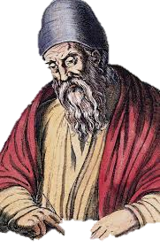



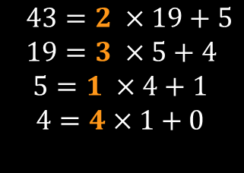
Origins
Euclid’s GCD algorithm
If $a<b$, swap $a$ and $b$
Divide $a$ by $b$ and find the reminder $r$. if $r=0$, then GCD is b
If $r≠0$, then set$a=b , b=r$ and go back to 1
300 B.C.
Example:
$a=43, b=19$
$43=2 ×19+5$
$19=3 ×5+4$
$$5=1 ×4+1$$
$$4=4×1+0$$
$$\frac{43}{19}=2+\frac{1}{3+\frac{1}{1+\frac{1}{4}}}$$

Slide 5



Some Properties
Rational Numbers
Inverting a fraction
Rational numbers can be expressed as a finite Continued fraction and vice versa.
If $P=\text{[}a0 \text{, }a1 \text{, }a2 \text{, }a3 \text{, }a4 \text{]}$ then $\frac{1}{P}=\text{[0,}a0 \text{, }a1 \text{, }a2 \text{, }a3 \text{, }a4 \text{]}$
If $P=\text{[0,}a0 \text{, }a1 \text{, }a2 \text{, }a3 \text{, }a4$then $\frac{1}{P}=\text{[}a0 \text{, }a1 \text{, }a2 \text{, }a3 \text{, }a4 \text{]}$
Multiple CF
Uniqueness of CF
$A=\text{[}a0 \text{, }a1 \text{, }a2 \text{, }a3 ,…,an \text{]}$ = $\text{[}a0 \text{, }a1 \text{, }a2 \text{, }a3 \text{,}…, an−1 \text{,1}\text{]}$
Because $\frac{1}{an}= \frac{1}{an−1+\frac{1}{1}}$
If the last term is 1 we will add it to the previous term.
$x=\text{[}a0 \text{, }a1 \text{, }a2 \text{, }a3 \text{,}…, an \text{]}$ $x=\text{[}b0 \text{, }b1 \text{, }b2 \text{, }b3 \text{,}…, bN \text{]}$
and $an$>1 and $bN$>1 then n=N
the fractions are same

Slide 6
Some Applications
Number Theory
Physics
Analysis
Cryptography
Algebra

Slide 7



Quadratic equations
The usual method yield, in general, irrational answers; therefore, we refer to CF method to get approximate roots in a rational form.
$$ax^{2}+bx+c=0$$
Examples
Simple form
General form
$$x^{2}−2=0 \\ x^{2}−1=1 \\ \left(x−1\right)\left(x+1\right)=1 \\ x−1=\frac{1}{1+x} \\ x=1+\frac{1}{1+x} \\ x=1+\frac{1}{1+(1+\frac{1}{1+x}} \\ x=1+\frac{1}{2+\frac{1}{x}} \\ x=[1, 2, 2, 2, …]$$
$$x^{2}−5x−6=0 \\ x−5− \frac{6}{x}=0 \\ x=5+\frac{6}{x} \\ x=5+\frac{6}{5+\frac{6}{x}}$$
And so on…

Slide 8





Hermite differential equation
$$\ddot{y}−2x\dot{y}+2αy=0$$
$$\frac{ⅆ\ln{y}}{ⅆx}=\frac{\dot{y}}{y}=\frac{2α}{2x−\frac{2\left(α−1\right)}{2x−\frac{2\left(α−2\right)}{2x−\frac{y^{iv}}{\overset{⃛}{y}}}}}$$
$$\frac{ⅆ\ln{y}}{ⅆx}=\frac{\dot{y}}{y}=\frac{2α}{2x−\frac{\ddot{y}}{\dot{y}}}$$
Differentiating the first equation and few simple steps
Now α can be α = 0, 1, 2, 3, …
$$α=0 →y=c \\ α=1 →y=c\text{x} \\ α=2 →y=c\text{(2}x^{2}−1)$$
$$\frac{ⅆ\ln{y}}{ⅆx}=\frac{\dot{y}}{y}=\frac{2α}{2x−\frac{2(α−1)}{2x−\frac{\overset{⃛}{y}}{\ddot{y}}}}$$
These polynomials are first few Hermite polynomials with a appropriate c
Again differentiating the equation twice we get

Slide 9




Finding roots of real numbers
Method 1
To get the square root of a certain number A and if a is the largest number such that its square is less than A; then we can compute the square root of A as shown in the example below
Example
$$Here A=\sqrt{2} and a=1$$
$$\sqrt{2}=1+\frac{1}{1+\sqrt{2}} \\ \sqrt{2}=1+\frac{1}{1+1+\frac{1}{1+\sqrt{2}}} \\ \sqrt{2}=1+\frac{1}{2+\frac{1}{1+\sqrt{2}}}$$
$$\sqrt{2}=1+\sqrt{2}−1 \\ \sqrt{2}=1+\frac{1}{\frac{1}{\sqrt{2}−1}} \\ \sqrt{2}=1+\frac{1}{\frac{1}{\sqrt{2}−1}×\frac{\sqrt{2}+1}{\sqrt{2}+1}}$$
$$\sqrt{2}=[1, 2, 2, 2, …]$$
Because of limited time, I skipped the two other methods and the method of finding n^{th} root.

Slide 10

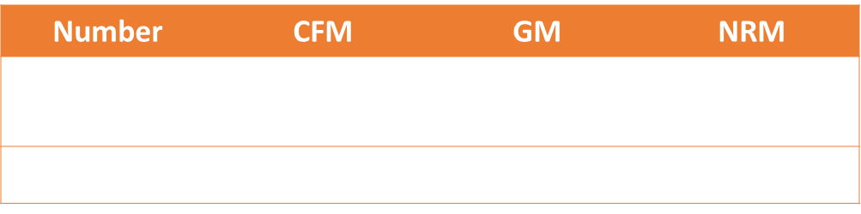
Comparison between the Use of CF and
Some Other Numerical Methods in Computing Roots
Number | CFM | GM | NRM
$$\sqrt{2}$$ | $$1.4142136248$$ | 1.41421356237 | 1.41421356
$$\sqrt[3]{56423456}$$ | 383.54815 | 383.54815 | 383.54815
General Method (GM) is slow but exact
CF 10 steps for$\sqrt{2}$ and 5 steps for $\sqrt[3]{56423456}$
NRM 5 steps for both
NRM > CFM > GM

Slide 11
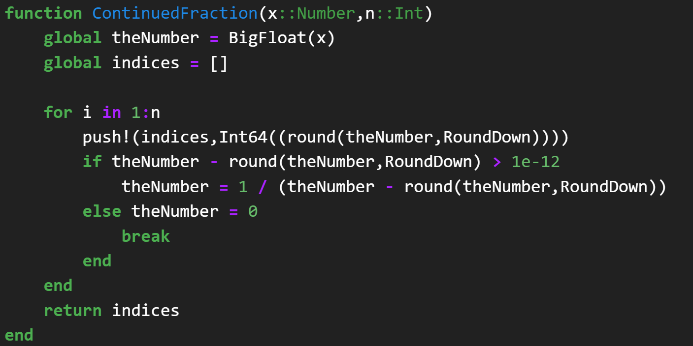
Computation

Slide 12
Thank you for your attention
Reference
Ibran, Z.M., Aljatlawi, E.A. and Awin, A.M. (2022) On Continued Fractions and Their Applications.
Journal of Applied Mathematics and Physics, 10, 142-159.

