Slide 1

Logging at Scale
using Graylog
billion+ messages, 100k+ msg/sec
Rohit Gupta
Production Engineer @ .
@rohit01 / www.rohit.io

Slide 2
What is Graylog?
Open source log management that actually works
Search, analysis, alerting and a lot more

Slide 3
Ola Logging Requirements
Volume: Billion+ logs per day
Velocity: 100k+ messages per sec
Variety: Hundreds of micro-services

Slide 4
Why Graylog?

Slide 5
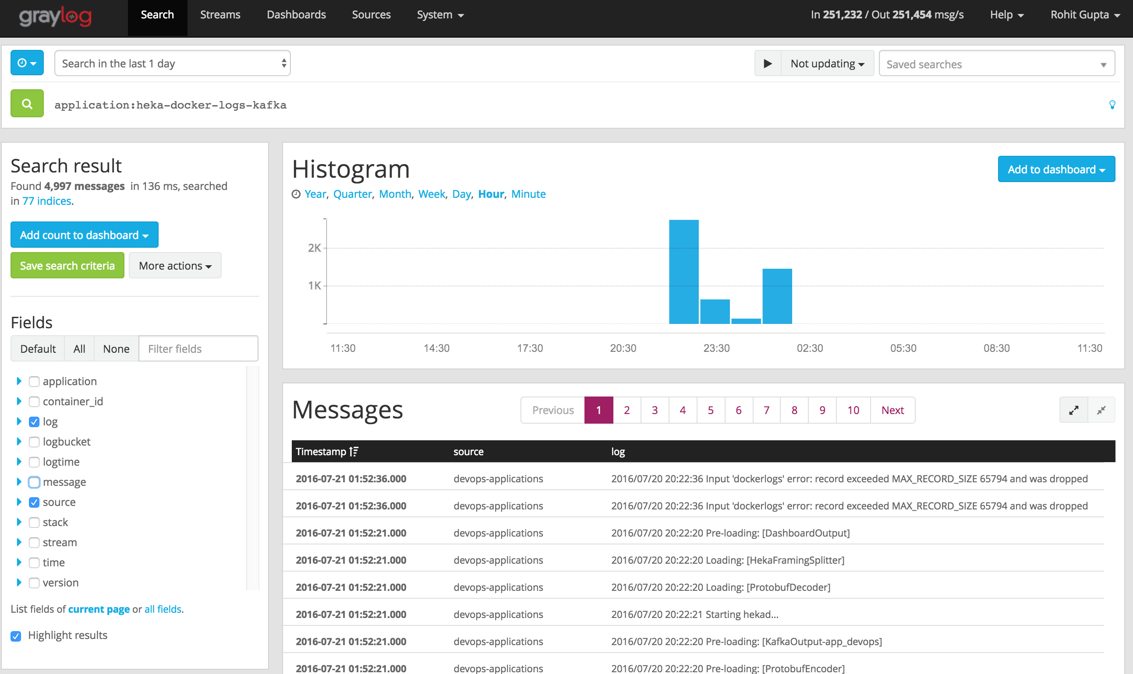
Great UI, best for viewing logs

Slide 6
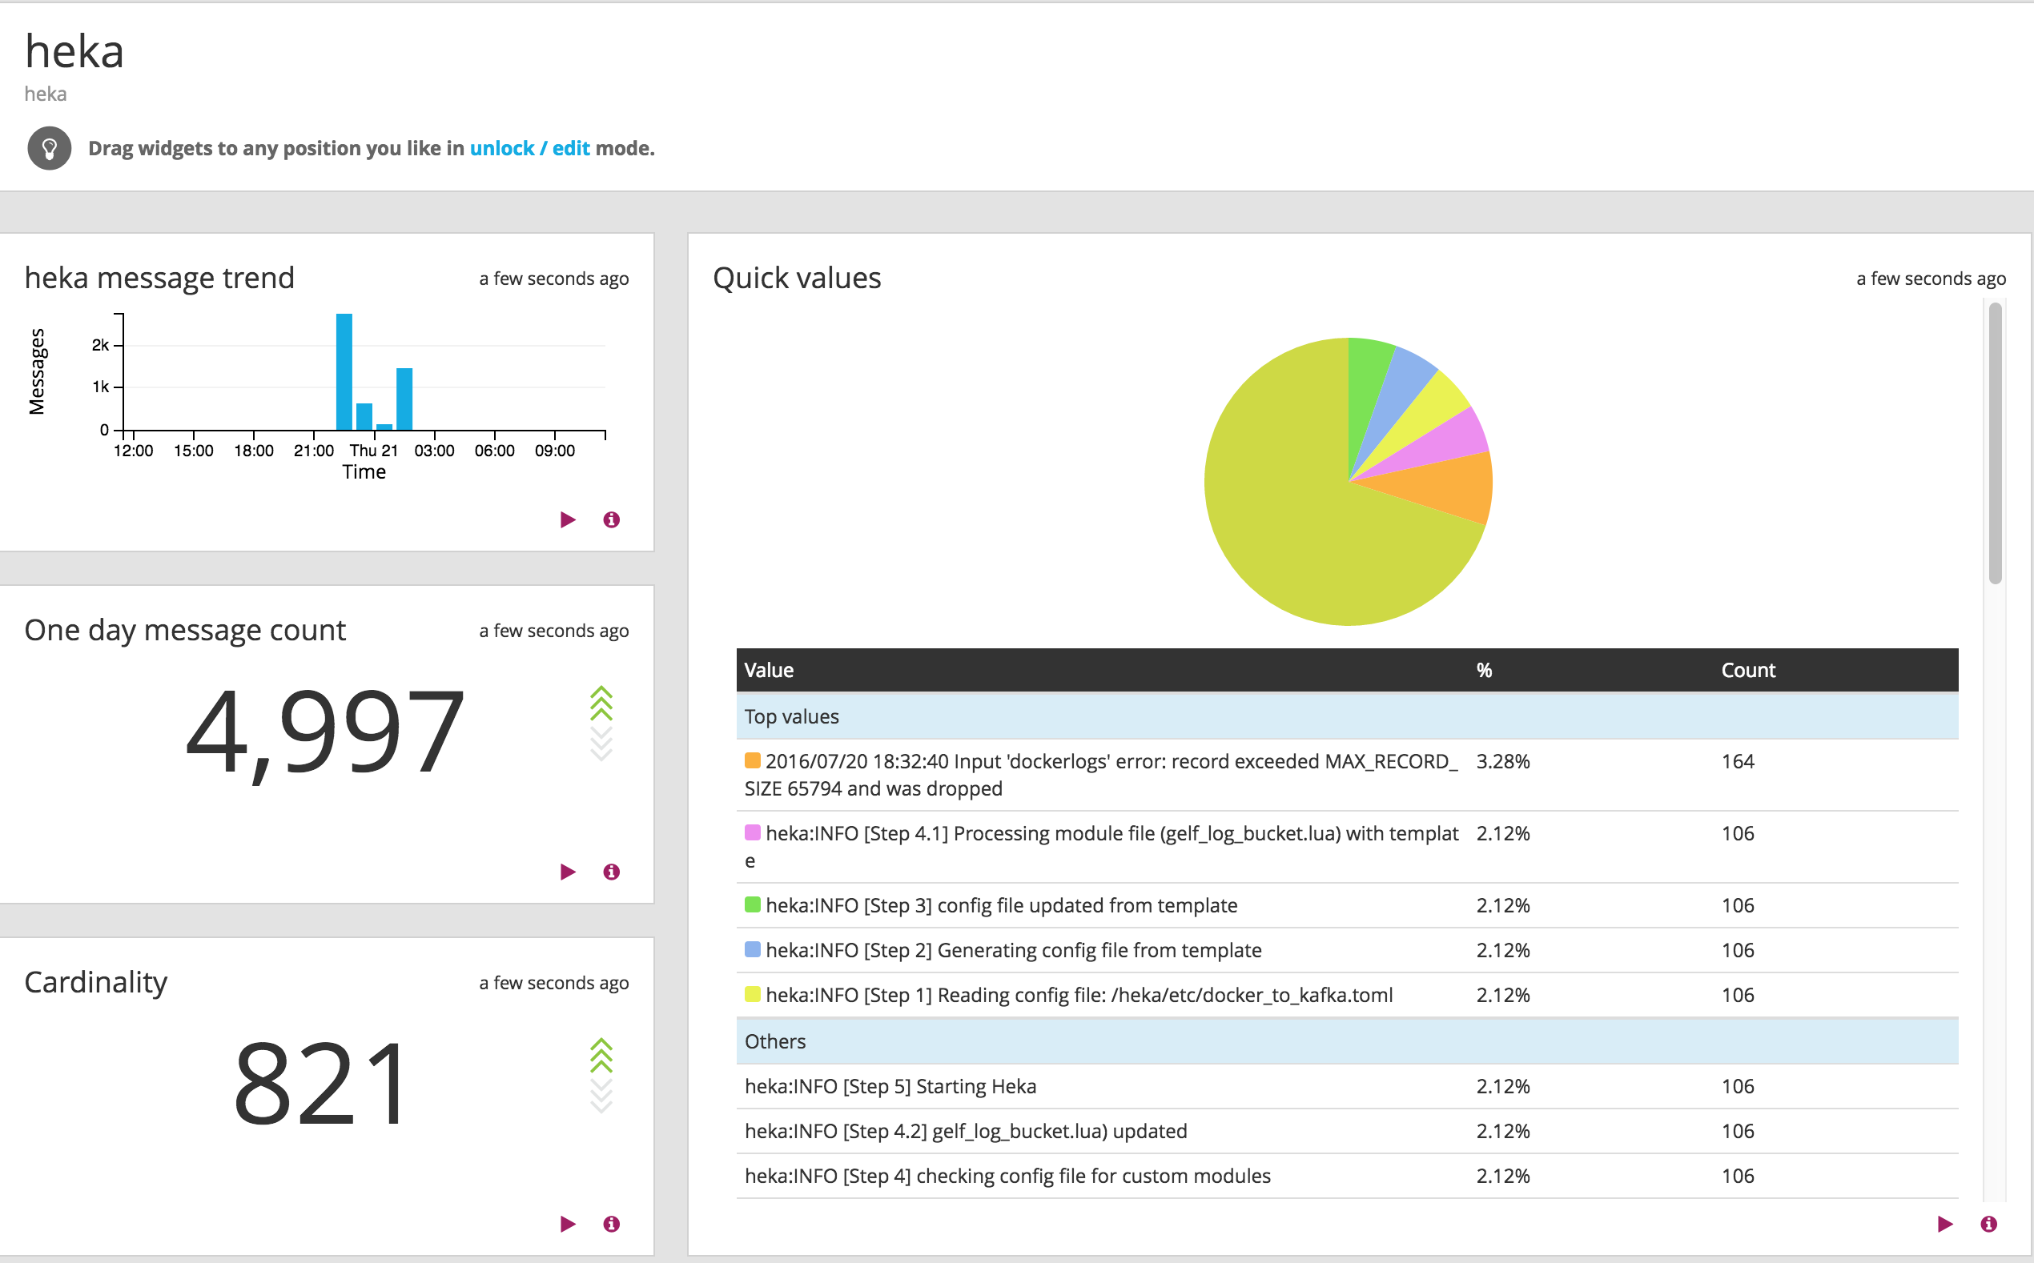
Dashboard

Slide 7
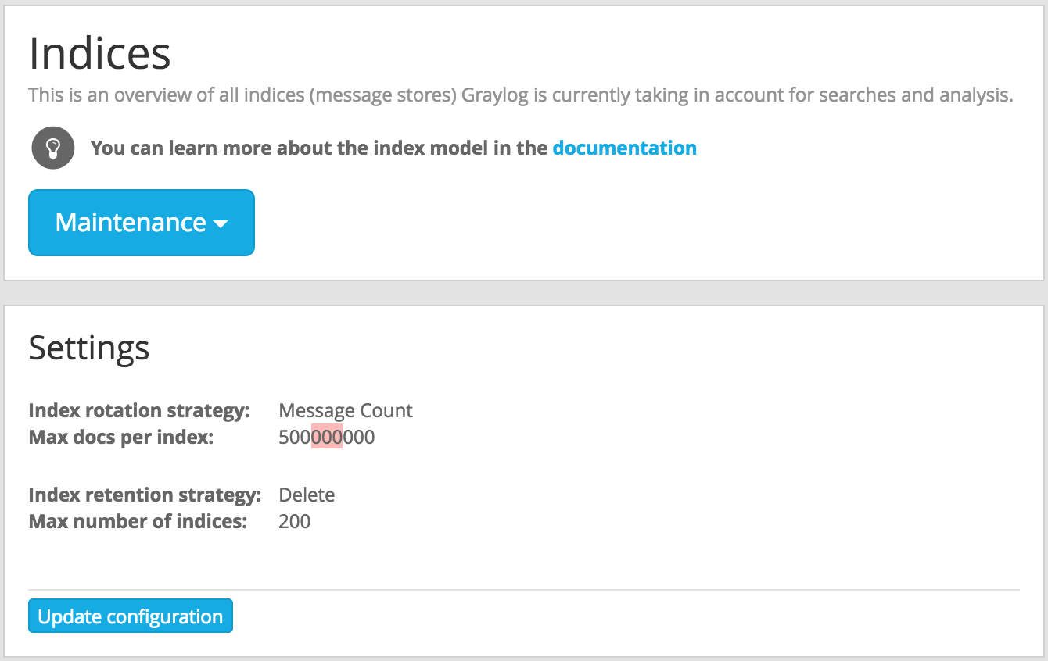
Easy manageability of Elasticsearch indexes

Slide 8
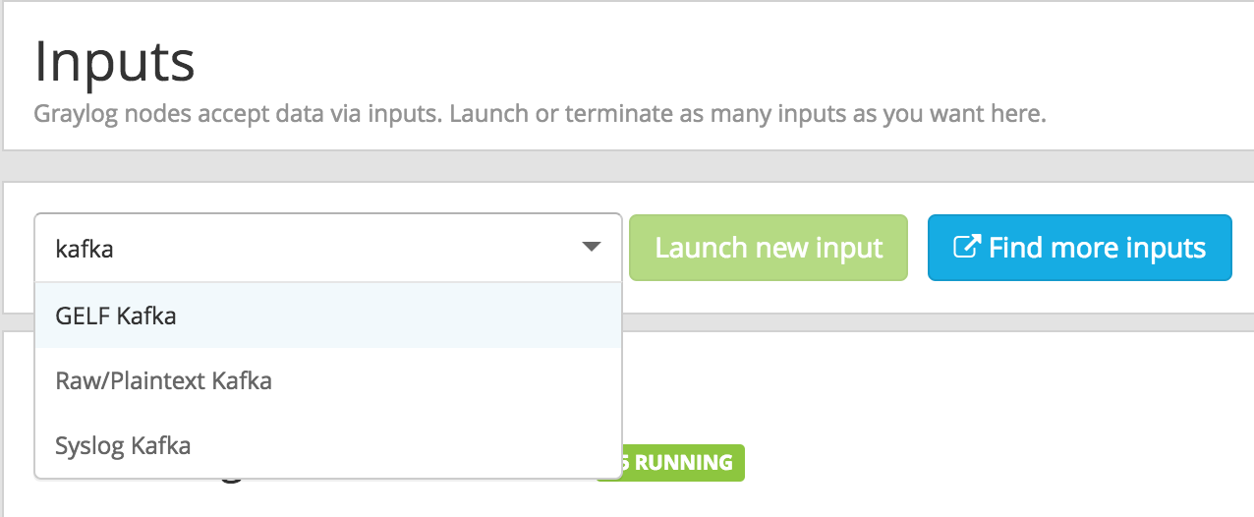
Several input & output options
Stream IN logs from anywhere
Stream OUT logs to anywhere

Slide 9

Real-time log analysis & alerts
Define criteria for streams
Analyze and configure alerts
Create pipelines & dashboards

Slide 10
Problems & learning’s
the Ola story!

Slide 11
Initial Pipeline
v 1.9
v 0.8
Docker
->fluentd log driver<-
Fluentd Producer
->TCP Input<- ->kafka producer<-
Kafka ->pub-sub system<-
v 1.7
v 1.3
Elasticsearch
->Index, Store, Query<-
Graylog Server
->Gelf UDP input<-
->REST API<-
Fluentd Consumer ->kafka consumer<-
v 1.3
Graylog Webserver
User ->

Slide 12
#1: Huge lag for app logs in Graylog
v 1.9
v 0.8
Docker
->fluentd log driver<-
Fluentd Producer
->TCP Input<- ->kafka producer<-
Kafka ->pub-sub system<-
v 1.7
v 1.3
Elasticsearch
->Index, Store, Query<-
Graylog Server
->Gelf UDP input<-
->REST API<-
Fluentd Consumer ->kafka consumer<-
Dead Slow ->huge buffers<-
v 1.3
Graylog Webserver
User ->

Slide 13
#1: Huge lag for app logs in Graylog
v 1.9
v 0.9
Docker
->fluentd log driver<-
Fluentd Producer
->TCP Input<- ->kafka producer<-
Kafka ->pub-sub system<-
v 2.3.1
v 2.0 beta
Elasticsearch
->Index, Store, Query<-
Graylog Server
->Gelf UDP input<-
->REST API & UI<-
Fluentd Consumer ->kafka consumer<-
Dead Slow ->huge buffers<-
User ->

Slide 14
#1: Huge lag for app logs in Graylog
v 1.9
v 0.9
Docker
->fluentd log driver<-
Fluentd Producer
->TCP Input<- ->kafka producer<-
Kafka ->pub-sub system<-
v 2.3.1
v 2.0 beta
Elasticsearch
->Index, Store, Query<-
Graylog Server
->Gelf UDP input<-
->REST API & UI<-
Fluentd Consumer ->kafka consumer<-
Dead Slow ->huge buffers<-
fluent-plugin-gelf
->Slow Plugin<-
User ->

Slide 15
#1: Huge lag for app logs in Graylog
CASE SOLVED
v 1.9
Format to Gelf JSON
v 0.9
Docker
->fluentd log driver<-
Fluentd
->TCP Input<- ->kafka producer<-
Kafka ->pub-sub system<-
v 2.3.1
v 2.0 beta
Elasticsearch
->Index, Store, Query<-
Graylog Server
->Gelf Kafka input<-
->REST API & UI<-
User ->
Zero Message Lag

Slide 16
#2: Docker Service Crash
v 1.9
Format to Gelf JSON
v 0.9
Docker
->fluentd log driver<-
Fluentd
->TCP Input<- ->kafka producer<-
Kafka ->pub-sub system<-
v 2.3.1
v 2.0 beta
Elasticsearch
->Index, Store, Query<-
Graylog Server
->Gelf Kafka input<-
->REST API & UI<-
User ->

Slide 17
#2: Docker Service Crash
v 1.9
Format to Gelf JSON
v 0.9
Docker
->fluentd log driver<-
Fluentd
->TCP Input<- ->kafka producer<-
Kafka ->pub-sub system<-
Buffer Full
v 2.3.1
v 2.0 beta
Elasticsearch
->Index, Store, Query<-
Graylog Server
->Gelf Kafka input<-
->REST API & UI<-
User ->

Slide 18
#2: Docker Service Crash
* v 1.11 kernel 4.2.0
Format to Gelf JSON
v 0.9
Docker
->fluentd log driver<-
Fluentd
->TCP Input<- ->kafka producer<-
Kafka ->pub-sub system<-
Buffer Full
v 2.3.1
v 2.0 beta
Elasticsearch
->Index, Store, Query<-
Graylog Server
->Gelf Kafka input<-
->REST API & UI<-
User ->
* Docker should not crash due to log-driver

Slide 19
#2: Docker Service Crash
* v 1.11 kernel 4.2.0
Format to Gelf JSON
v 0.9
Docker
->json-file log driver<-
Fluentd
->tail Input<- . ->kafka producer<-
Kafka ->pub-sub system<-
tail –f app.log
v 2.3.1
v 2.0 beta
Elasticsearch
->Index, Store, Query<-
Graylog Server
->Gelf Kafka input<-
->REST API & UI<-
User ->
* Docker should not crash due to log-driver
Use default docker logging driver: json-driver

Slide 20
#2: Docker Service Crash
CASE SOLVED
->Streaming logs<- tail –f app.log
v 0.9
Fluentd
->tail Input<- ->kafka producer<-
Kafka ->pub-sub system<-
v 2.3.1
v 2.0 beta
Elasticsearch
->Index, Store, Query<-
Graylog Server
->Gelf Kafka input<-
->REST API & UI<-
User ->
* Docker should not crash due to log-driver
Use default docker logging driver: json-driver

Slide 21
#3: Huge lag due to 3 MB log messages
->Streaming logs<- tail –f app.log
Fluentd
->tail Input<- ->kafka producer<-
Kafka ->pub-sub system<-
Elasticsearch
->Index, Store, Query<-
Graylog Server
->Gelf Kafka input<-
->REST API & UI<-
User ->

Slide 22
#3: Huge lag due to 3 MB log messages
->Streaming logs<- tail –f app.log
Fluentd
->tail Input<- ->kafka producer<-
Kafka ->pub-sub system<-
Elasticsearch
->Index, Store, Query<-
Graylog Server
->Gelf Kafka input<-
->REST API & UI<-
Retries msg 5 times with 30 second wait
& finally it is discarded
Lucene Index Exceptions ->max message size: 32kb<-
User ->
Unable to index huge log messages!

Slide 23
#3: Huge lag due to 3 MB log messages
CASE SOLVED
Truncate msg fields > 8kb
->Streaming logs<- tail –f app.log
Fluentd
->tail Input<- ->kafka producer<-
Kafka ->pub-sub system<-
Elasticsearch
->Index, Store, Query<-
Graylog Server
->Gelf Kafka input<-
->REST API & UI<-
Retries msg 5 times with 30 second wait
& finally it is discarded
Lucene Index Exceptions ->max message size: 32kb<-
User ->
Unable to index huge log messages!
Able to index small log messages!

Slide 24
#4: Inconsistent schema problem
Fluentd
->tail docker logs<-
Happy User ->
Kafka ->pub-sub system<-
Fluentd
->tail APP logs<-
Graylog Server
->Gelf Kafka input<-
->REST API & UI<-
New apps on-boarded
Elasticsearch
->Index, Store, Query<-

Slide 25
#4: Inconsistent schema problem
Fluentd
->tail docker logs<-
Unhappy User ->
Kafka ->pub-sub system<-
Fluentd
->tail APP logs<-
Graylog Server
->Gelf Kafka input<-
->REST API & UI<-
New apps on-boarded
Elasticsearch
->Index, Store, Query<-
Retries msg 5 times with 30 second wait
& finally it is discarded
App1: {“status”: true}
App2: {“status”: "success"}
App3: {“status”: 1}
Schema Exceptions ->data-type mismatch<-
Elasticsearch maps field data-type for every key!

Slide 26
#4: Inconsistent schema problem
CASE SOLVED
Fluentd
->tail docker logs<-
Happy User ->
Kafka ->pub-sub system<-
Fluentd
->tail APP logs<-
Graylog Server
->Gelf Kafka input<-
->REST API & UI<-
New apps on-boarded
Elasticsearch
->Index, Store, Query<-
Retries msg 5 times with 30 second wait
& finally it is discarded
App1: {“status”: “true”}
App2: {“status”: "success"}
App3: {“status”: “1”}
Schema Exceptions ->data-type mismatch<-
Elasticsearch maps field data-type for every key!

Slide 27
#5: Journal/Buffer utilization too high
Fluentd
->tail docker logs<-
Huge buffer
Unhappy User ->
Two days retention
Kafka ->pub-sub system<-
Fluentd
->tail APP logs<-
Graylog Server
->Gelf Kafka input<-
->REST API & UI<-
Huge buffer
Elasticsearch
->Index, Store, Query<-
Journal directory: /var/lib/graylog-server/journal/
Q. Are buffers at each level necessary?

Slide 28
#5: Journal/Buffer utilization too high
CASE SOLVED
Fluentd
->tail docker logs<-
Buffer disabled
Happy User ->
Two days retention
Kafka ->pub-sub system<-
Buffer disabled
Graylog Server
->Gelf Kafka input<-
->REST API & UI<-
Fluentd
->tail APP logs<-
Elasticsearch
->Index, Store, Query<-
Journal disabled
Q. Are buffers at each level necessary?
Ans. No. Log files & Kafka retention is enough.

Slide 29
#6: Missing/delayed docker logs
Happy User ->
Fluentd
->tail log files<-
Kafka ->pub-sub system<-
Graylog Server
->Gelf Kafka input<-
->REST API & UI<-
Elasticsearch
->Index, Store, Query<-

Slide 30
#6: Missing/delayed docker logs
Slow kafka plugin
->fluent-plugin-kafka<-
Unhappy User ->
Fluentd
->tail log files<-
Kafka ->pub-sub system<-
Graylog Server
->Gelf Kafka input<-
->REST API & UI<-
Elasticsearch
->Index, Store, Query<-
Slow plugin, adding CPU/RAM did not help!

Slide 31
#6: Missing/delayed docker logs
CASE SOLVED
KafkaOutput
->Superfast, written in Go<-
Happy User ->
Heka
->tail log files<-
Kafka ->pub-sub system<-
Graylog Server
->Gelf Kafka input<-
->REST API & UI<-
Elasticsearch
->Index, Store, Query<-
Fluentd vs. Heka
Written in Ruby
Easy & very good plugin ecosystem
Simple configuration
Written in Go (10x CPU, 5x mem friendly)
Learning curve, few community plugins
Feature rich configuration

Slide 32
#7: Centralized solution, Centralized problems
Happy User ->
Heka
->tail log files<-
Kafka ->pub-sub system<-
Graylog Server
->Gelf Kafka input<-
->REST API & UI<-
Elasticsearch
->Index, Store, Query<-

Slide 33
#7: Centralized solution, Centralized problems
KafkaOutput
->Superfast, written in Go<-
Unhappy User ->
Heka
->tail log files<-
Contention
->Kafka Lag<-
Kafka ->pub-sub system<-
Graylog Server
->Gelf Kafka input<-
->REST API & UI<-
Elasticsearch
->Index, Store, Query<-
Contention
->CPU & RAM<-
Contention
->JVM & GC Problems<-

Slide 34
#7: Centralized solution, Decentralized problems
CASE SOLVED
KafkaOutput
->Superfast, written in Go<-
Happy User ->
Heka
->tail log files<-
Topic sub-clusters
->rebalance partitions<-
Kafka ->pub-sub system<-
Log-bucket support More CPU cores
Graylog Server
->Gelf Kafka input<-
->REST API & UI<-
Elasticsearch
->Index, Store, Query<-
Dockerized
->Elastic Scalability<-
Separate as required ->graylog es_prefix config<-
Logs are sent to different kafka topics based on log-bucket
Mesos + docker provides elastic scaling for Graylog

Slide 35
Who likes it?
Developers: Quick RCAs
Devops: More time to sleep
Management: Lovely dashboards

Slide 36
Questions?
Happy User ->
v 0.10
Heka
->tail log files<-
v 0.10.2
Kafka ->pub-sub system<-
Graylog Server
->Gelf Kafka input<-
->REST API & UI<-
v 2.2
v 2.4.4
Elasticsearch
->Index, Store, Query<-
Thank You!

