Slide 1
Investigation of Excited State Absorption of Squaraine1 Molecules in the Ultraviolet Regime at Femtosecond Resolution
Koch group, Institute of Experimental Physics, https://iep.tugraz.at, robert.schwarzl@tugraz.at

Slide 2
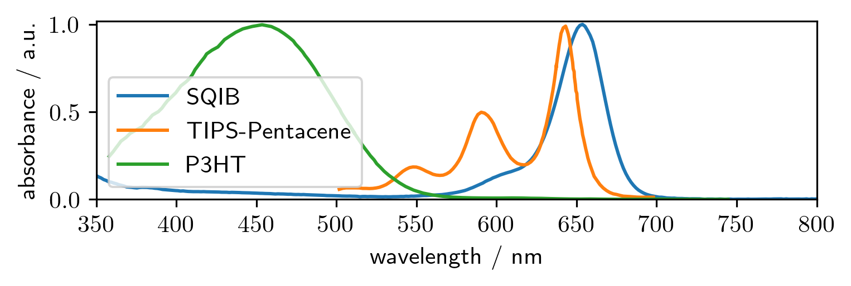
Introduction to squaraines
Monomerbsorbing in the red
Spincasting possible
Crystal structure influenced by sidechains
Notes:
Excitation peaks are red-near infrared, good range of possible applications

Slide 3
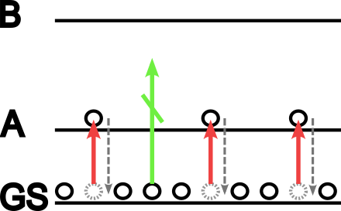
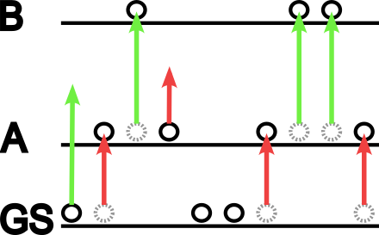
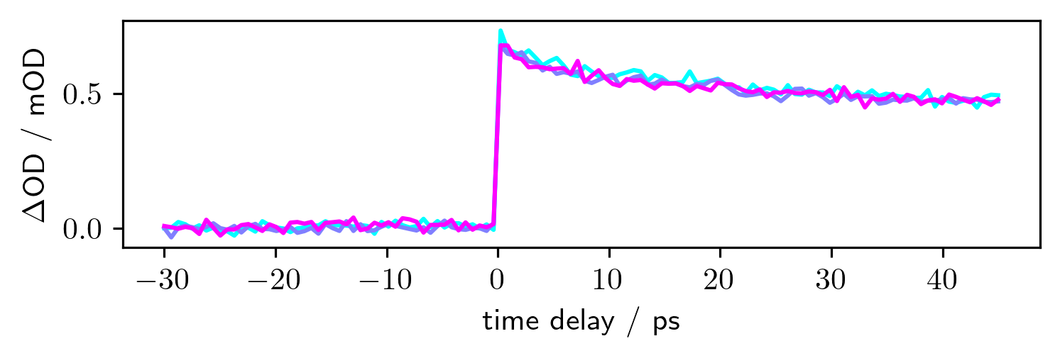
Pump-Probe transient absorption
Shot to shot comparison of probe intensities
Every second shot is probe only
$$ΔA=−\log_{10}\frac{I_{pump−probe}}{I_{probeonly}}$$

Slide 4
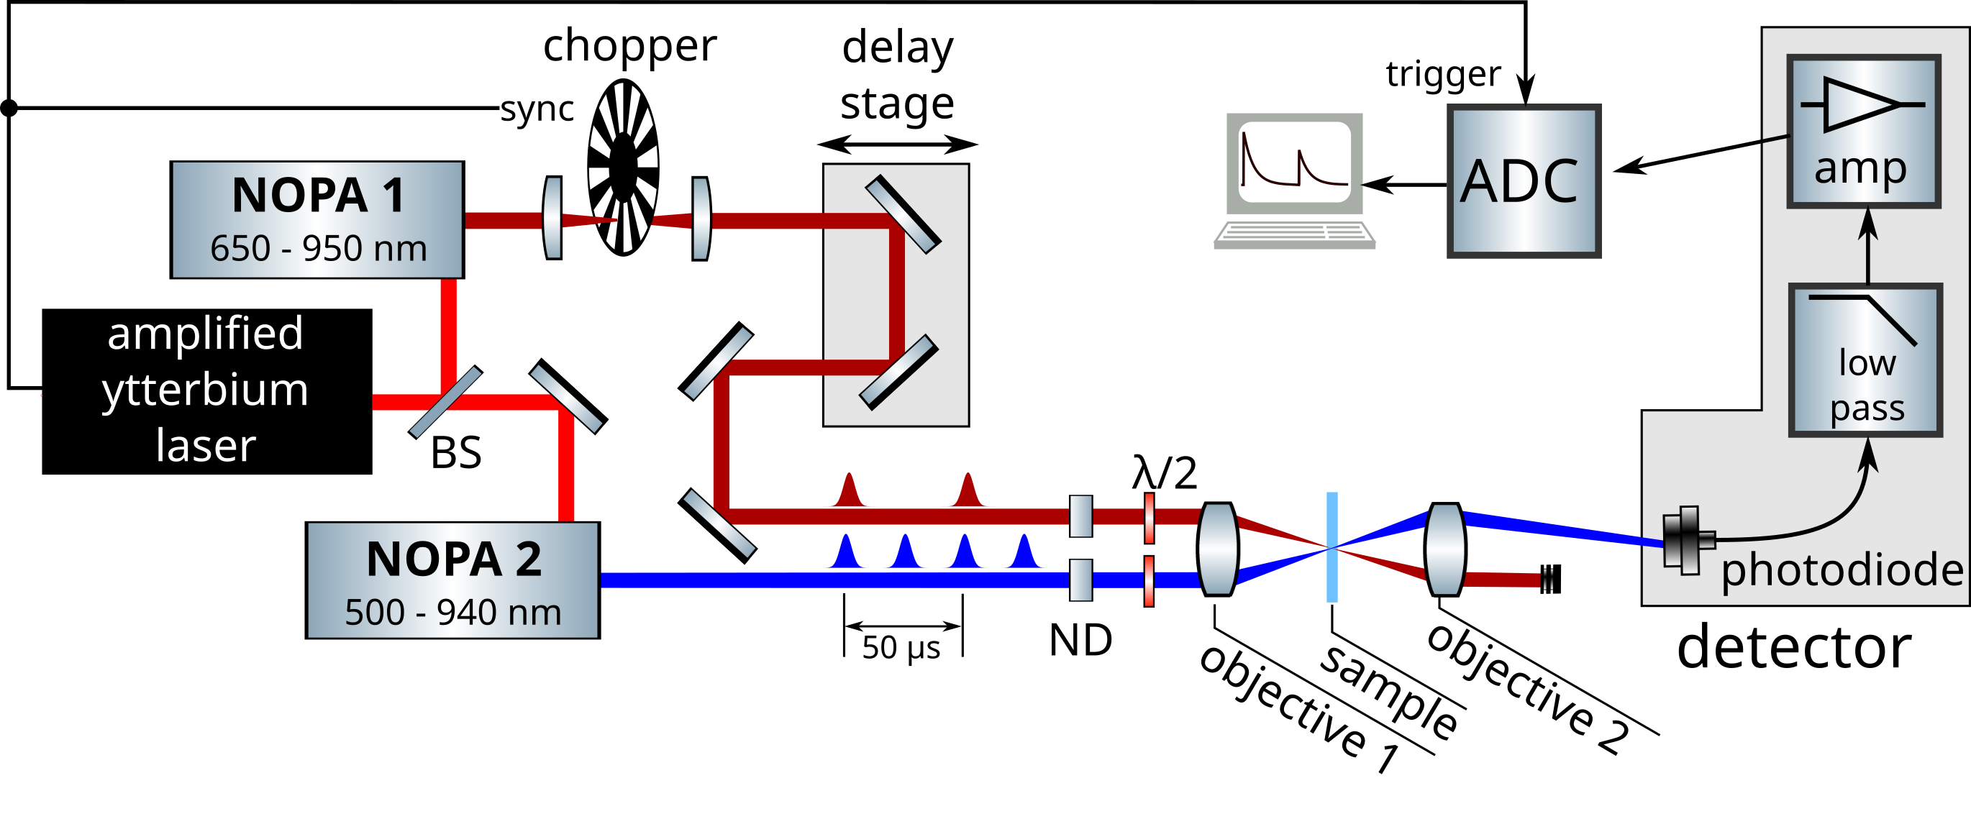
General transient absorption microscope

Slide 5
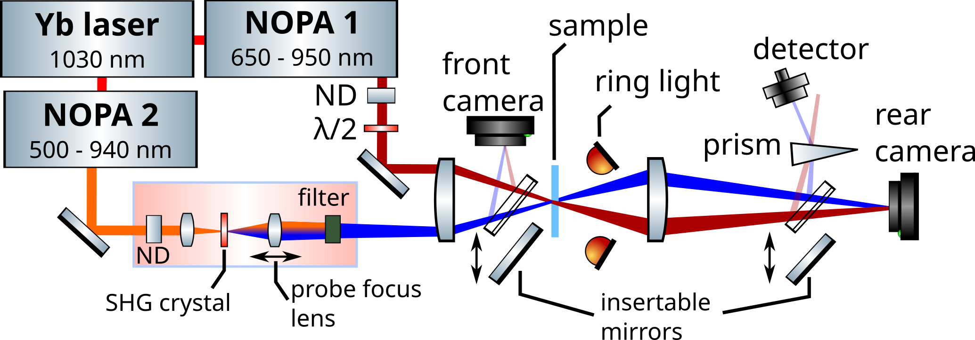
UV extended TAM

Slide 6
UV extended TAM

Slide 7
UV extended TAM

Slide 8
Focusing (animation)
Show focusing action by simple animation?
1st: ring light on rear focus on sample
2nd: minimize pump with frontal lens (alternative for future is design drop in so it is spatially symmetric and use ringlight again to focus on artray, nope does not work, lens is in front of the mirror)
3rd: optimize artray position with TA feedback
Is there a point in showing this?

Slide 9
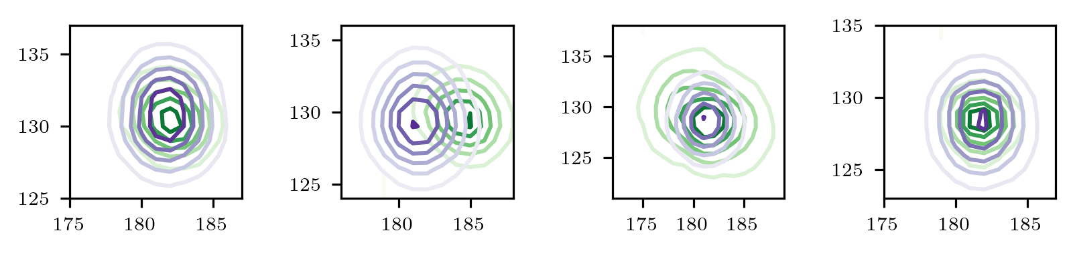
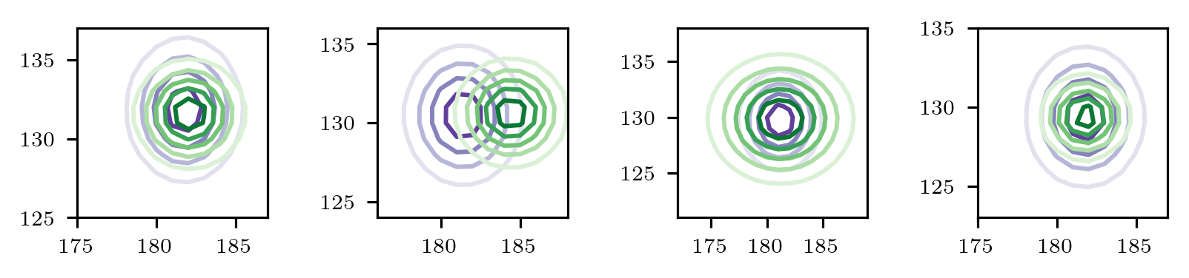
Considerations for overlap
True beam shapes
$$∆A\sim d∙I_{pump}∙(σ_{ES}−σ_{GS})$$
$$I_{pump}=I_{pump}\left(x,y\right)$$
$$I_{probe}=I_{probe}(x,y)$$
$$∆A\sim$$
$$I_{pump}(x,y)∙{norm(I}_{probe}(x,y))$$
Fitted beam shapes
Animate lateral and size aspect ratio
Show contour plot vs fit of beam

Slide 10
Considerations for overlap
Animate lateral and size aspect ratio
Show contour plot vs fit of beam
$$∆A\sim$$
$$I_{pump}(x,y)∙{norm(I}_{probe}(x,y))$$
$$C= \frac{\int{I_{ideal−pump}^{}}(x)∙I_{probe}\left(x\right)dx}{\int{I_{real−pump}^{}}(x)∙I_{probe}\left(x\right)dx}$$

Slide 11
Considerations for overlap
Animate lateral and size aspect ratio
Show contour plot vs fit of beam
$$∆A\sim$$
$$I_{pump}(x,y)∙{norm(I}_{probe}(x,y))$$
$$C= \frac{\int{I_{ideal−pump}^{}}(x)∙I_{probe}\left(x\right)dx}{\int{I_{real−pump}^{}}(x)∙I_{probe}\left(x\right)dx}$$

Slide 12
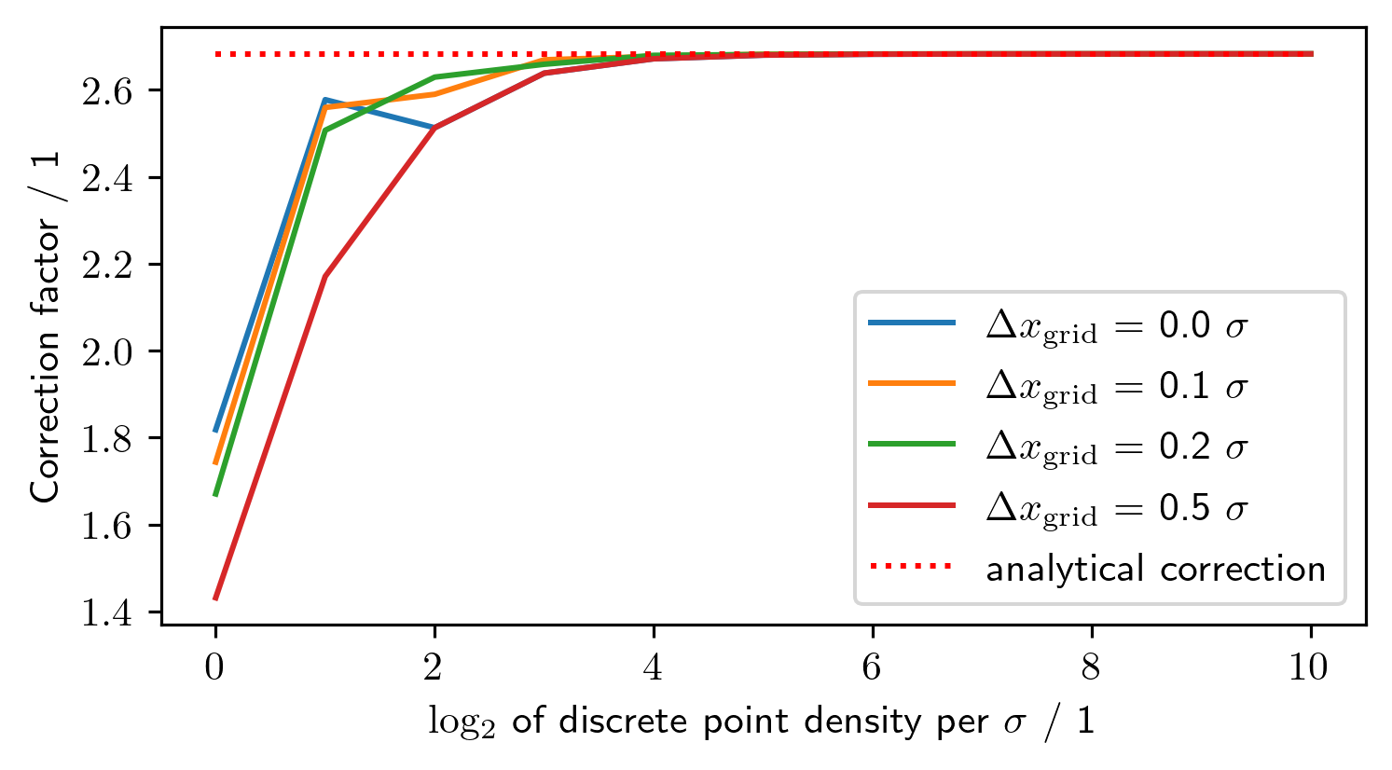
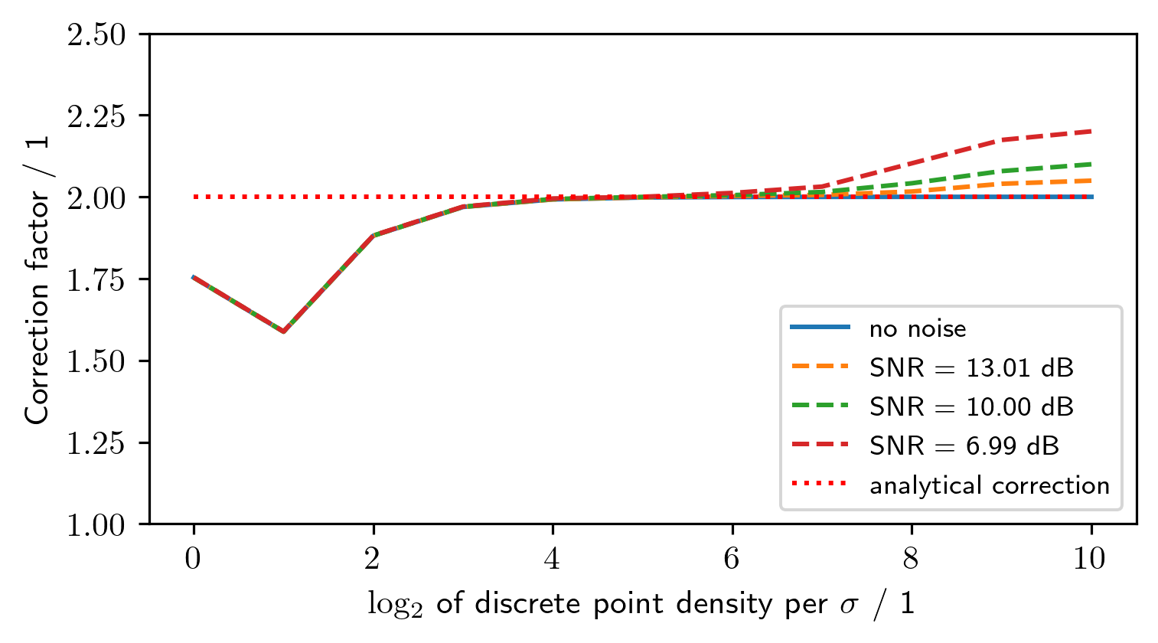
Why not numerical?

Slide 13
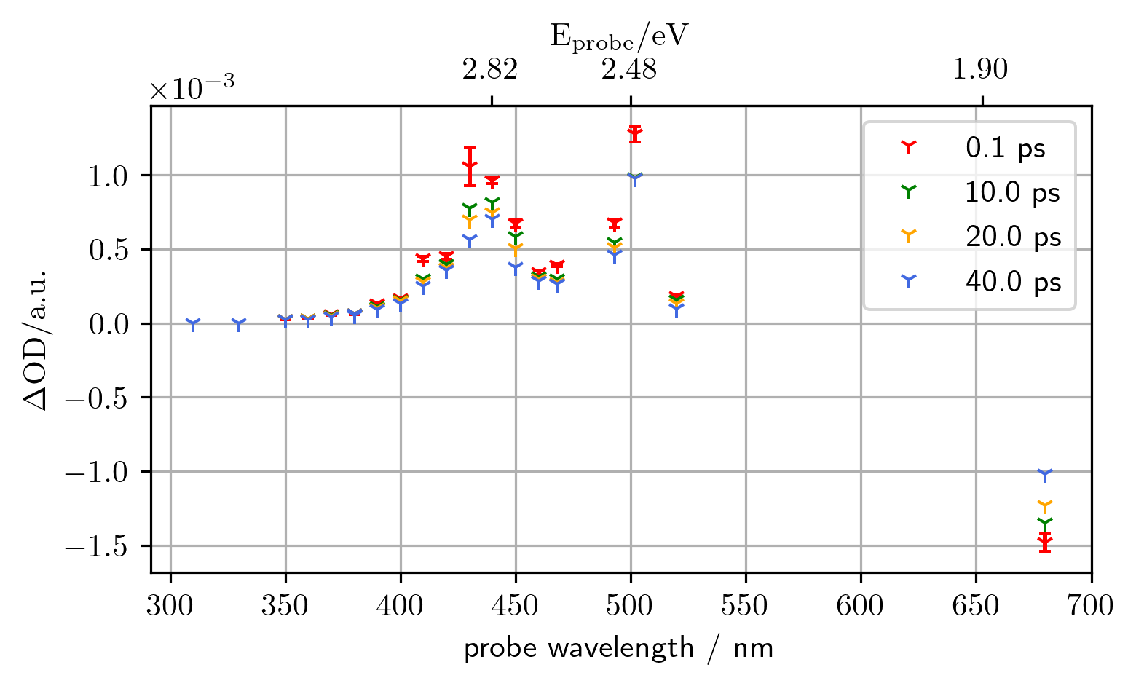
Not sure if to put the results now or last?

Slide 14
What else had to be accounted for?
Are the measurements comparable?
Are there unwanted influences?

Slide 15
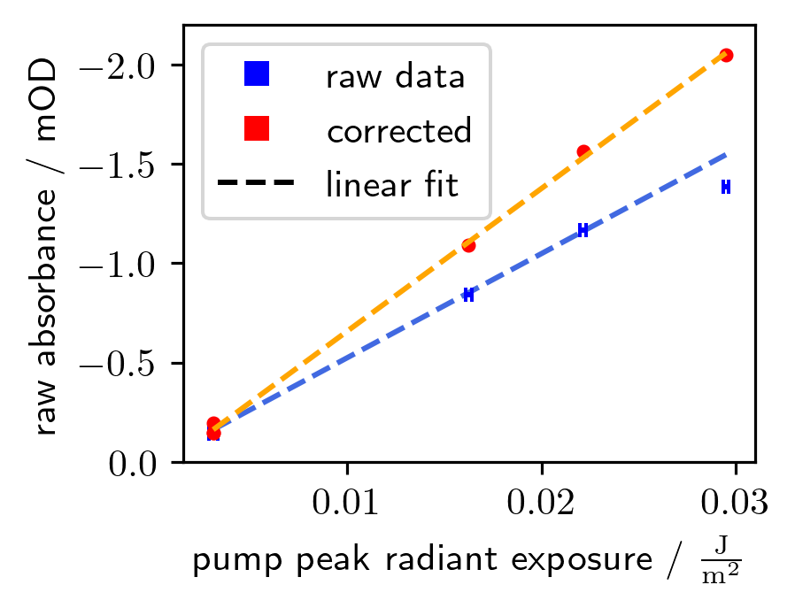
Linearity of pump irradiance
Are the measurements comparable?
Are there unwanted influences?

Slide 16
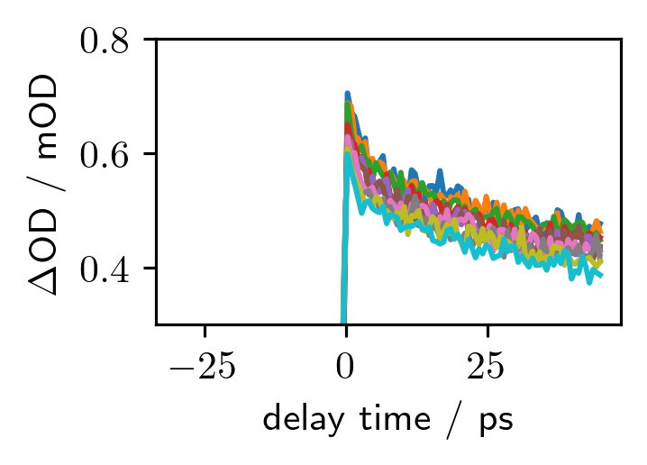
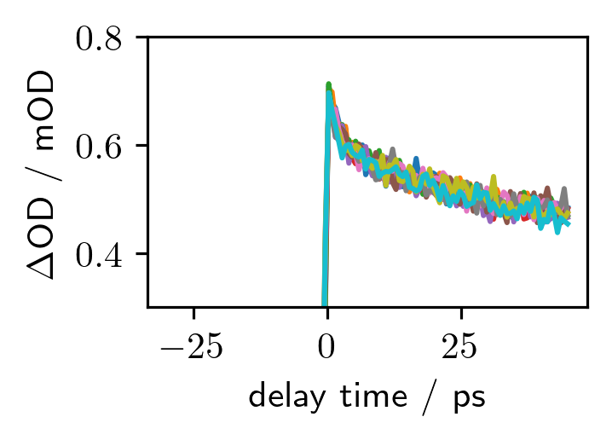
Sample degradation
raw
Sample response declines over time
Single exponential fit sufficient
$$∆A\left(t\right)=∆A\left(t=0\right)exp\left(\frac{t⋅I_{x_{0},y_{0}}}{τ}\right)$$
corrected

Slide 17
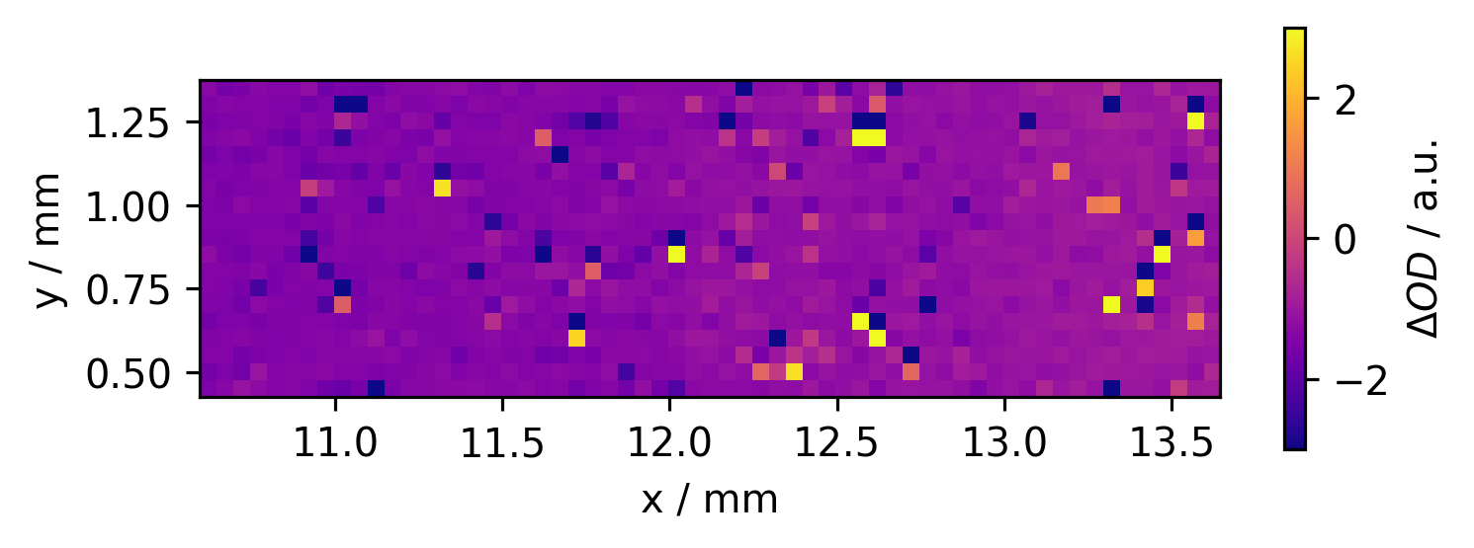
Sample irregularities
Sample

Slide 18
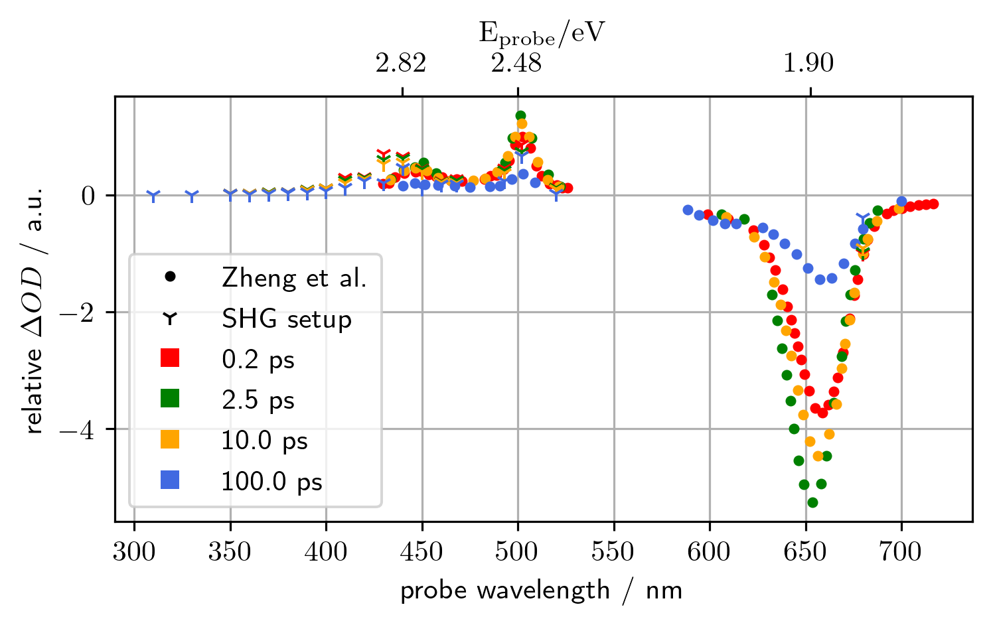
Results

Slide 19
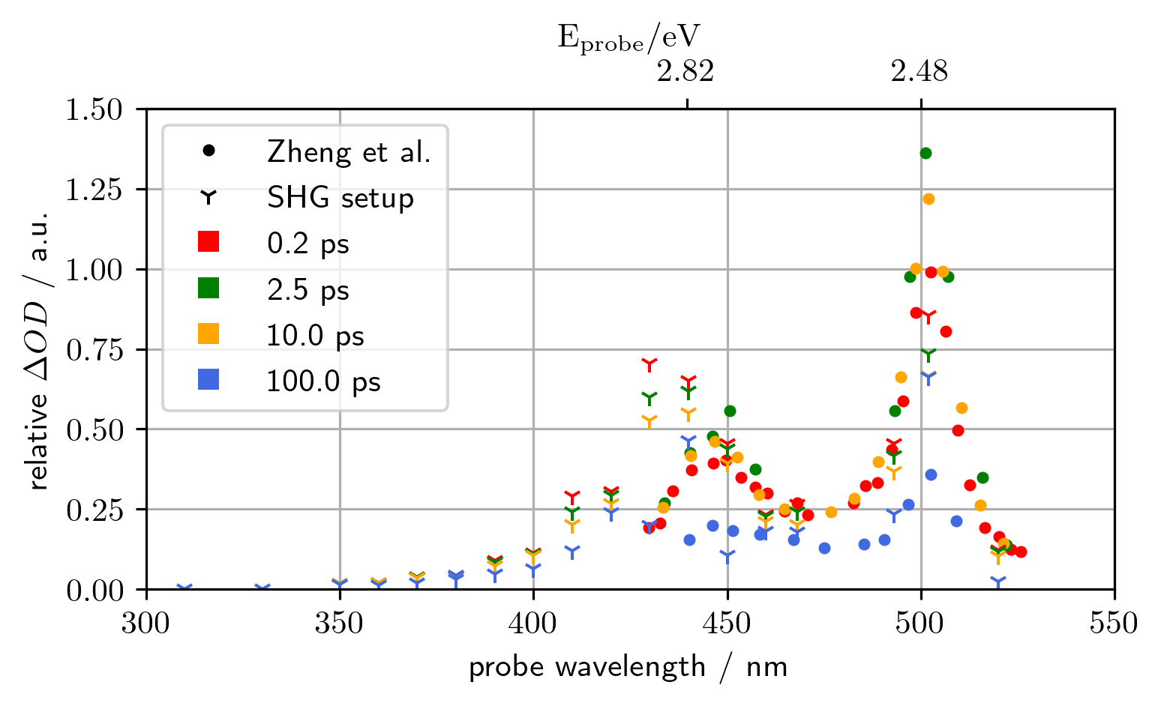
Results

Slide 20
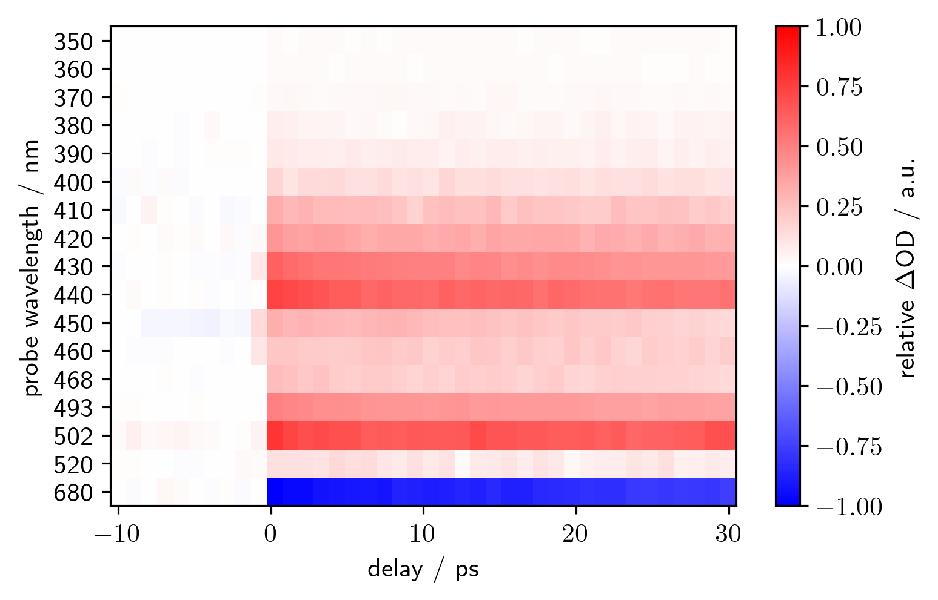
Results

