Slide 1
Investigation of Excited State Absorption of Squaraine Molecules in the Ultraviolet Regime at Femtosecond Resolution
Koch group, Institute of Experimental Physics, https://iep.tugraz.at, robert.schwarzl@tugraz.at

Slide 2
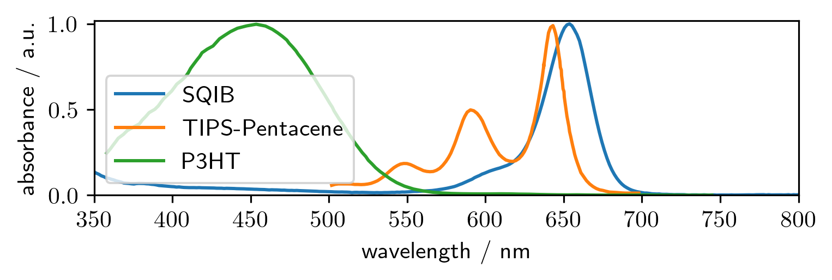
Introduction to squaraines
Monomerbsorbing in the red
Spincasting possible
Crystal structure influenced by sidechains
Notes:
Excitation peaks are red-near infrared, good range of possible applications

Slide 3
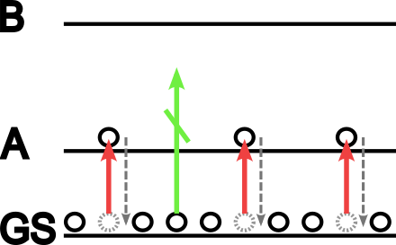
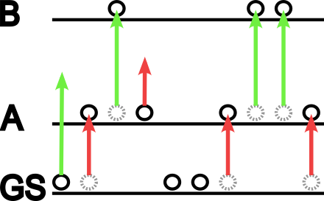
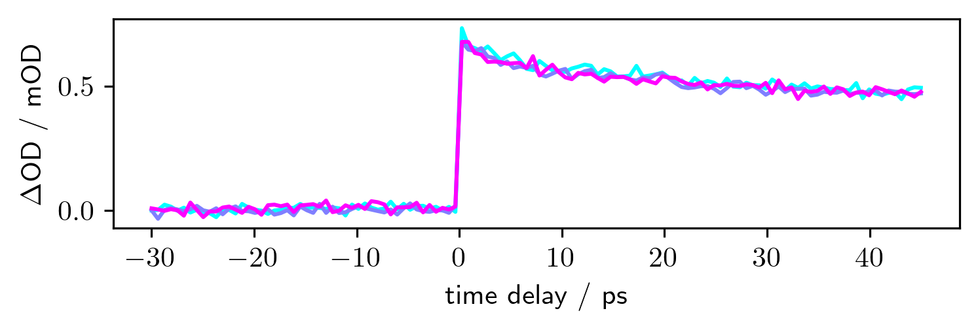
Pump-Probe transient absorption
Shot to shot comparison of probe intensities
Every second shot is probe only
$ΔA=−\log_{10}\frac{I_{pump−probe}}{I_{probeonly}}$

Slide 4
General transient absorption microscope
Show old setup in large
Have a frame over things that had to change

Slide 5
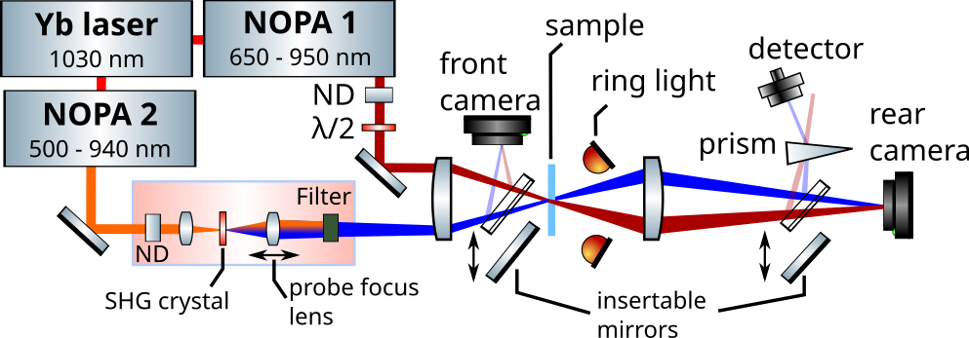
UV extended TAM

Slide 6
Focusing (animation)
Show focusing action by simple animation?
1st: ring light on rear focus on sample
2nd: minimize pump with frontal lens (alternative for future is design drop in so it is spatially symmetric and use ringlight again to focus on artray, nope does not work, lens is in front of the mirror)
3rd: optimize artray position with TA feedback

Slide 7
Considerations for overlap
Animate lateral and size aspect ratio
Show contour plot vs fit of beam

Slide 8
Considerations for overlap
Animate lateral and size aspect ratio
Show contour plot vs fit of beam

Slide 9
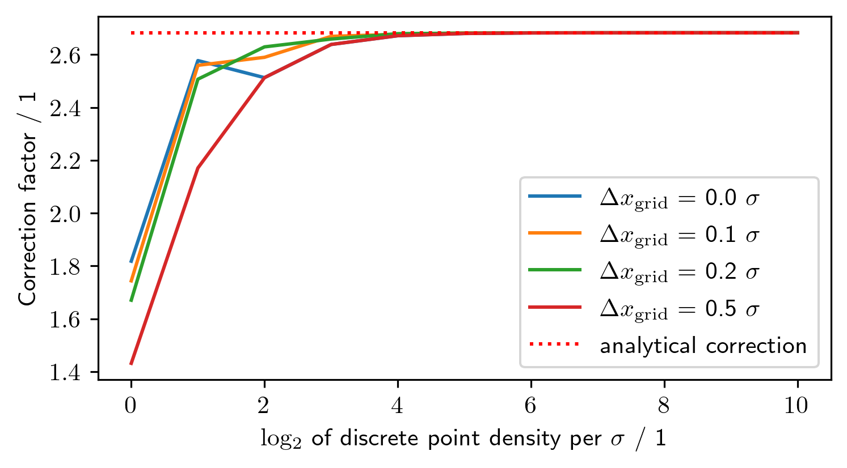
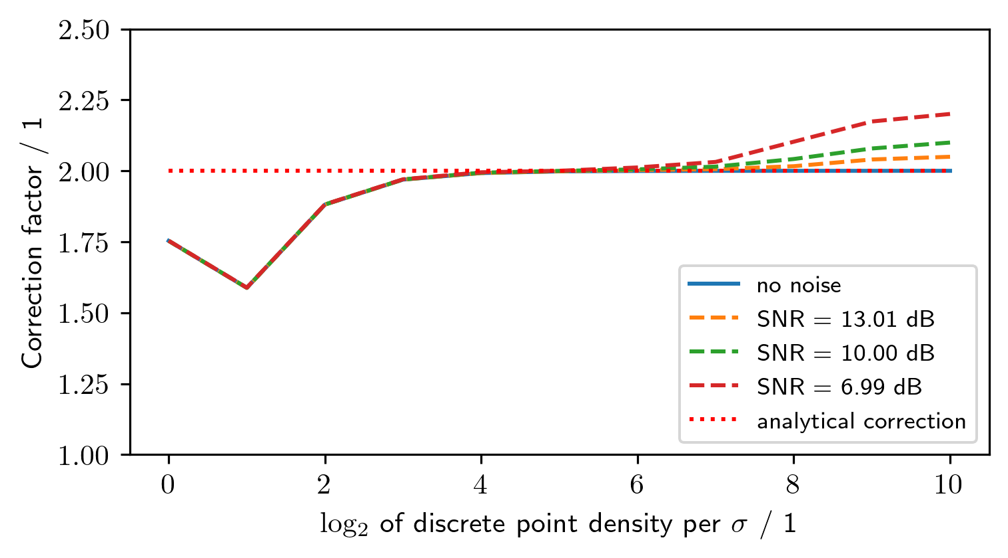
Why not numerical?

Slide 10
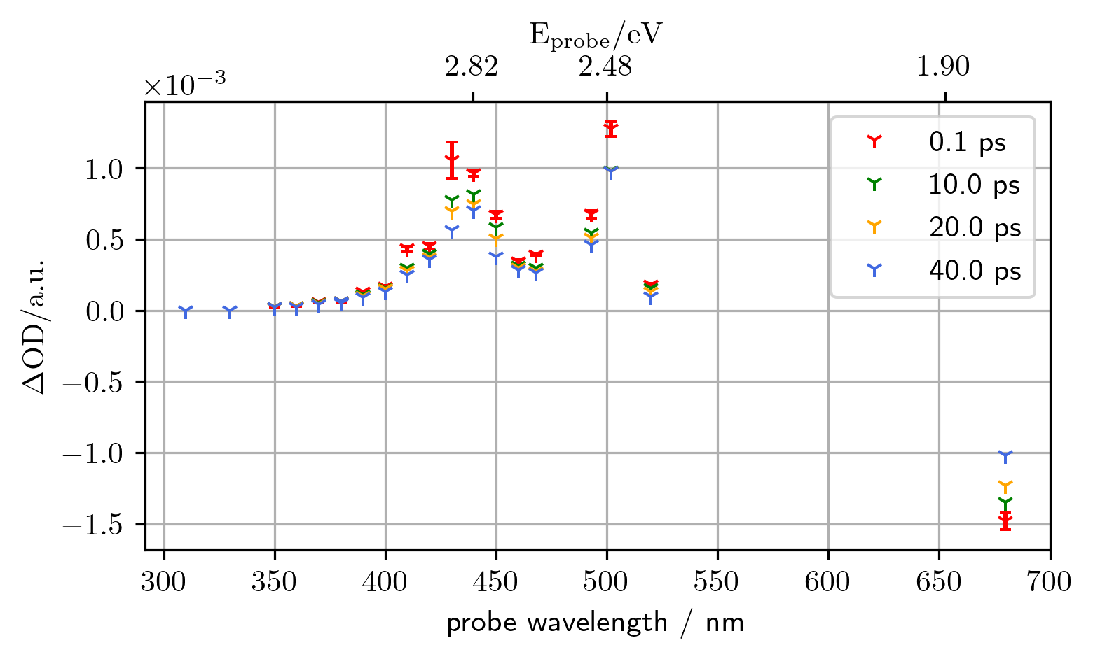
Not sure if to put the results now or last?

Slide 11
What else had to be accounted for?
Are the measurements comparable?
Are there unwanted influences?

Slide 12
What else had to be accounted for?
Are the measurements comparable?
Are there unwanted influences?

Slide 13
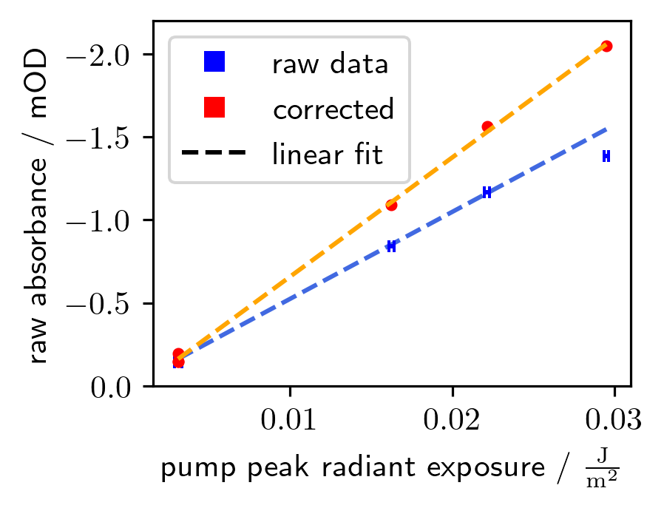
Linearity of pump irradiance
Are the measurements comparable?
Are there unwanted influences?

Slide 14
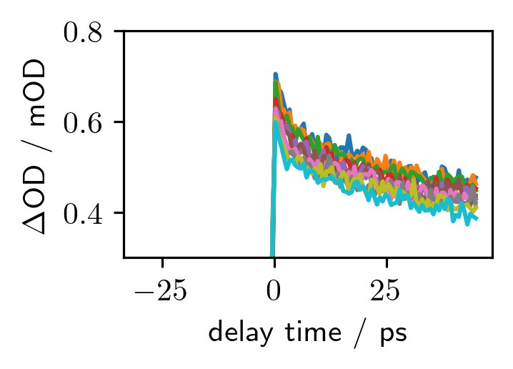
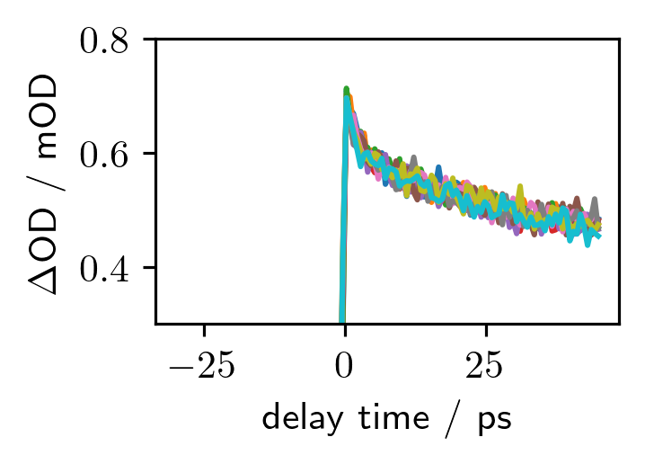
Sample degradation
$A\left(t\right)=A\left(t=0\right)⋅exp$
Sample response declines over time
Single exponential fit sufficient
$A\left(t\right)=A\left(t=0\right)exp\left(\frac{t⋅I_{x_{0},y_{0}}}{τ}\right)$

Slide 15
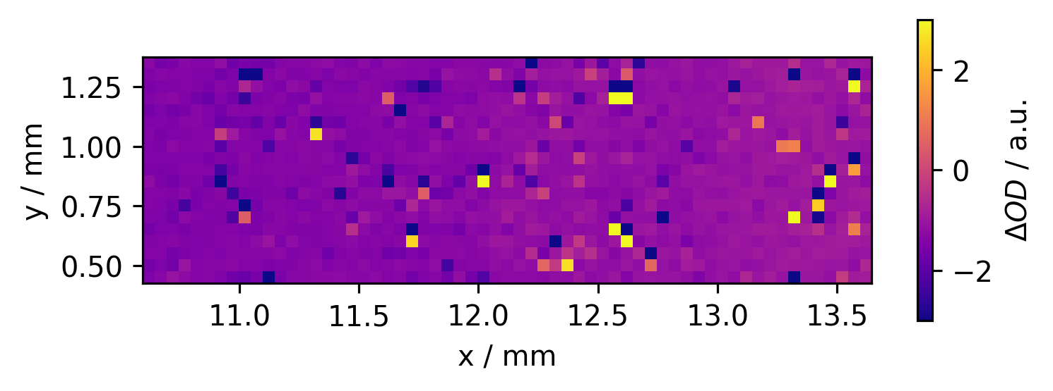
Sample irregularities
$A\left(t\right)=A\left(t=0\right)⋅exp$
Sample

Slide 16
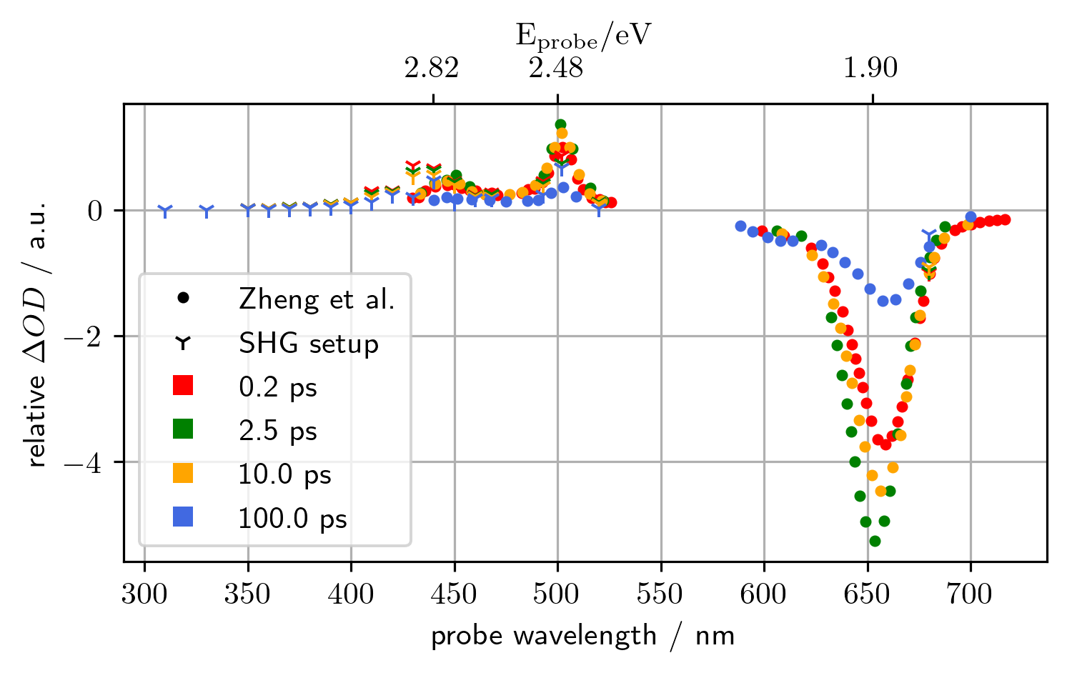
Results
$A\left(t\right)=A\left(t=0\right)⋅exp$

Slide 17
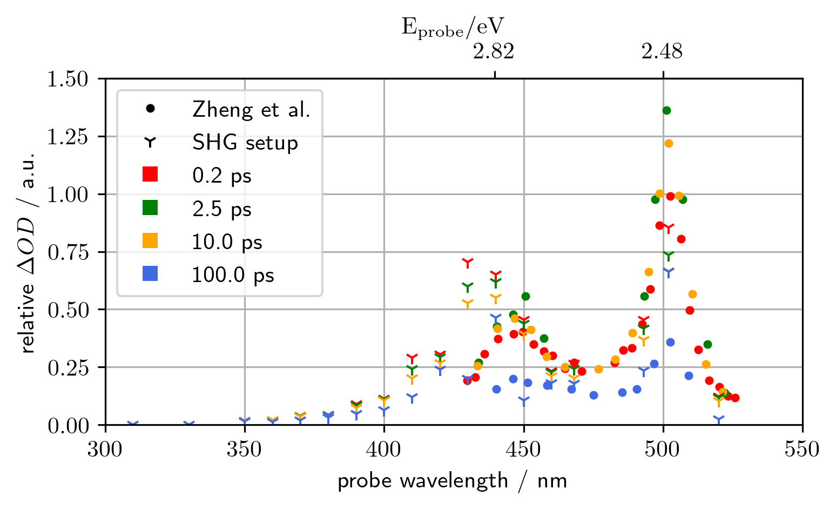
Results
$A\left(t\right)=A\left(t=0\right)⋅exp$

Slide 18
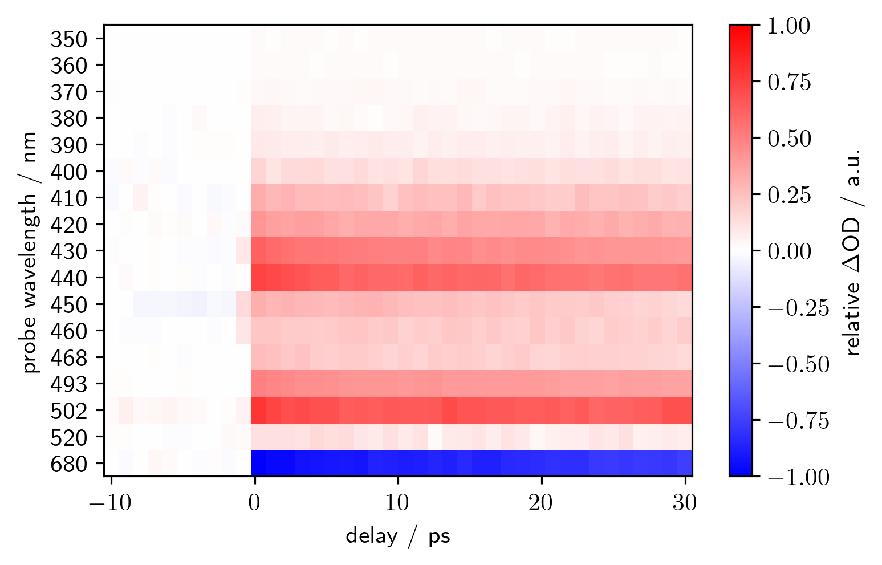
Results
$A\left(t\right)=A\left(t=0\right)⋅exp$

