Slide 1

THE AI BILLING DELEGATION STANDARD
ABDS: OAuth-based delegation for user-authorized AI resource consumption
Proposed open standard
Bounded, revocable, provider-enforced delegation of AI resource usage from a user-authorized account.
Marc Johnston | NeuroSync AI Dynamics Pty Ltd Cape Town, South Africa
AI Billing Delegation Standard
01

Slide 2
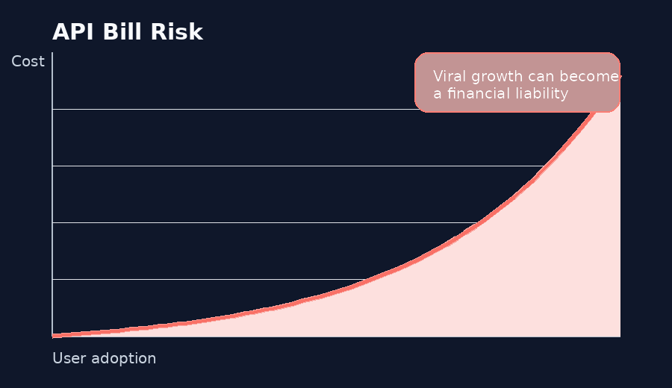
MARKET FAILURE
The consumer AI app economy has a billing problem
Inference-cost exposure, not model capability, blocks many useful consumer AI products.
Developer risk
BYOK friction
Credit systems
A successful launch can become an immediate API bill liability.
Ordinary users do not understand API keys, token pricing, or provider dashboards.
Custom app credits add engineering overhead, support burden, and payment friction.
The ecosystem needs a standardized way to route bounded AI resource usage to the user’s existing provider relationship.
AI Billing Delegation Standard
02

Slide 3
THE MISSING LAYER
AI lacks a consumer-grade delegation pattern
Ecosystem
Delegation pattern
What the user authorizes
Music
Provider account OAuth
Third-party app playback or playlist access
Cloud storage
Scoped app authorization
Access to selected files, folders, or account scopes
Payments
Bounded account-linked actions
Explicit permission for a financial workflow
AI APIs
Developer usually pays inference cost
No standard user-authorized resource delegation
ABDS proposes the missing delegation layer between consumer AI subscriptions and third-party AI applications.
AI Billing Delegation Standard
03

Slide 4
DEFINITION
ABDS in one sentence
ABDS lets users authorize bounded third-party consumption of provider-defined AI resource units, enforced through provider-side grants, short-lived execution tokens, usage ledgers, revocation controls, and explicit economic consent.
Consent
Grant
Token
Ledger
Revoke
01
02
03
04
05
User sees economic consequence before approval
Provider creates bounded delegated grant
Short-lived credential references the grant
Provider records authoritative usage
User can withdraw access at any time
AI Billing Delegation Standard
04

Slide 5
CORE ARCHITECTURE
The four-object architecture
User Subscription Entitlement
The user’s underlying provider account or plan. Root economic relationship.
Critical design rule
The token identifies the grant. It does not carry quota state. Quota truth lives in the provider grant and usage ledger, exposed through the Usage Introspection Endpoint.
Delegated AI Grant
Server-side provider record defining app, user, cap, model scope, period, status.
Short-lived Execution Token
OAuth access token carrying identity, audience, scope, jti, and delegation_id.
Provider-side Usage Ledger
This separation is what makes ABDS credible as a standards proposal.
Authoritative record of usage, reservations, settlement, audit, and enforcement.
AI Billing Delegation Standard
05

Slide 6
STANDARDS ALIGNMENT
ABDS should be an OAuth 2.0 profile
It should reuse proven OAuth patterns rather than introduce a new authentication protocol.
ABDS Delegation Profile
ABDS function
Standards-aligned pattern
OAuth Token Exchange
User authorization
Authorization Code Flow with PKCE
Execution-token issuance
OAuth Token Exchange
Resource Indicators
Target API binding
Resource Indicators
Authorization Code + PKCE
User withdrawal
Token revocation + connected-app dashboard
Revocation + Connected Apps
App trust
Developer registration / verification
Strategic objective: interoperability. Reuse identity infrastructure and define only the AI-specific delegation layer.
AI Billing Delegation Standard
06

Slide 7
TECHNICAL CREDIBILITY
Mutable quota state does not belong in JWT claims
Execution Token
Provider Usage Ledger
Identity, audience, expiry, scope, jti, delegation_id, model_scope.
Authoritative accounting and enforcement state.
{ "iss": "https://auth.provider.com", "aud": "https://api.provider.com", "sub": "user_id", "jti": "tok_xyz789", "delegation_id": "del_abc123" }
✓ delegation_id
✓ quota_cap
✓ quota_used
✓ quota_remaining
✓ quota_period
✓ quota_reset
× quota_used
✓ grant_status
× quota_remaining
✓ usage_receipts
× quota_cap
× quota_reset
Token references grant. Ledger determines truth.
AI Billing Delegation Standard
07

Slide 8
EXECUTION PATH
Provider-enforced execution flow
Authorization Server
Delegated Grant Service
Token Service
3
4
User
Client App
2
1
5
AI API Gateway
Usage Ledger
Inference Engine
6
7
Gateway enforcement
The API gateway resolves delegation_id, validates token audience and scope, checks grant status, records usage against the ledger, and only then forwards permitted requests to the inference engine.
AI Billing Delegation Standard
08

Slide 9
USER TRUST
Economic consent must be explicit
Authorize AI Resource Access
Consent requirements
Translation Studio by example.com wants permission to use a bounded portion of your AI account allowance.
Verified app and developer identity Concrete quota cap and reset period Model class and renewal behaviour Plain-language account impact Clear revocation path and warnings for unverified apps
Verified app
Translation Studio
Developer
example.com
Quota cap
500,000 standard text units / month
Model tier
Standard text models only
Renewal
Monthly until revoked
Allow bounded access
Cancel
AI Billing Delegation Standard
09

Slide 10
CLIENT SECURITY
Sensitive AI execution tokens should not live in the browser
Browser / mobile client
App backend / BFF
AI provider gateway
Opaque secure session only. No ABDS refresh tokens or execution tokens.
Stores provider credentials server-side and performs token exchange.
Receives short-lived execution token and enforces grant/ledger constraints.
Encrypted server-side token store
Recommended pattern: browsers receive only an opaque HttpOnly Secure session cookie. Refresh tokens and execution tokens remain on the application server and are never exposed to JavaScript-accessible storage.
AI Billing Delegation Standard
10

Slide 11
RESOURCE ACCOUNTING
Streaming and agentic workloads need reservation semantics
Estimate
Reserve
Execute
Settle
Release
Predict maximum resource envelope
Place temporary hold
Run or stream within bounds
Record actual usage
Return unused hold
Error semantics
Standards posture
Insufficient delegated quota should return HTTP 429, not HTTP 402.
Reservation/settlement should be a v0.3 profile for streaming, batch, multimodal and agentic workloads.
AI Billing Delegation Standard
11

Slide 12
PROVIDER STRATEGY
Ecosystem expansion, not free compute
ABDS gives providers controlled delegation while reducing developer-side launch risk.
Provider control levers
Lower developer risk
CFO objection
Delegated allowance separate from full subscription Model-tier restrictions Monthly caps and review thresholds Paid delegated add-ons Enterprise API lanes remain separate
“This cannibalizes developer API revenue.” Counterargument: many consumer apps are not launching at all under the current billing model.
Stronger provider ecosystem
More consumer AI apps
ABDS first-mover advantage
Higher retention
More subscription utility
Provider economics improve when bounded delegation expands the consumer app ecosystem without exposing enterprise API lanes.
AI Billing Delegation Standard
12

Slide 13
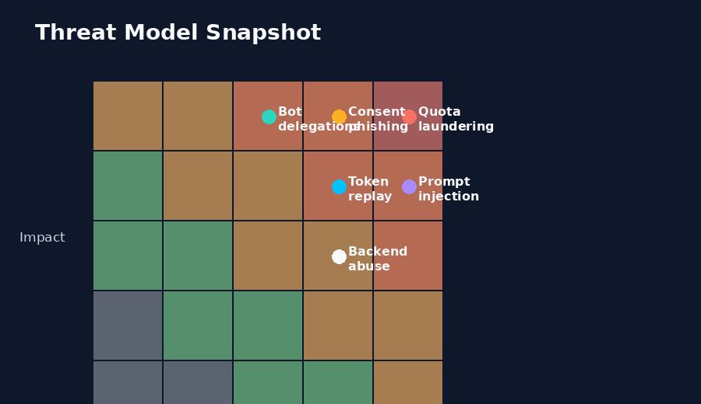
SECURITY
ABDS must be abuse-resistant by design
Priority threats
Quota laundering and resale Consent phishing and spoofing Token replay and backend leaks Prompt-injection quota drain Bot-created delegations Model laundering through consumer subscriptions
Core mitigations: app verification, provider-side caps, risk scoring, rate limits, audit receipts, revocation dashboards, and proof-of-possession for higher-risk cases.
AI Billing Delegation Standard
13

Slide 14
STANDARDS PATH
From open proposal to standards candidate
v0.2 Draft
Threat Model
Consent UX Profile
Reservation Profile
Reference Implementation
Provider Review
IETF/OIDF Discussion
1
2
3
4
5
6
7
Core object model and token constraints
Abuse, fraud, and provider-risk analysis
Economic consent and connected-app controls
Streaming, multimodal, batch, agentic accounting
Provider/app proof of feasibility
AI platform, identity, and API gateway feedback
Candidate future standards path
Positioning discipline
Say “candidate future IETF/OIDF discussion,” not “approved IETF draft.” ABDS should earn standards credibility through review, threat modelling, and reference implementation.
AI Billing Delegation Standard
14

Slide 15

Review the ABDS proposal
Open technical review invited: OAuth, security, provider economics, resource accounting, and implementation constraints.
github.com/MJohnstonAI/ ai-billing-delegation
Closing thesis
ABDS is a proposed delegation layer between consumer AI subscriptions and third-party AI applications.
Marc Johnston | NeuroSync AI Dynamics Pty Ltd | Cape Town, South Africa
AI Billing Delegation Standard
15

Slide 16
APPENDIX
Technical appendix
Reference material for reviewers, engineers, and standards contributors.
AI Billing Delegation Standard | Appendix
16

Slide 17
APPENDIX A
Token and usage-introspection examples
Execution token claims
Usage introspection response
Short-lived OAuth access token. References delegation_id only.
Provider-authoritative quota state from /v1/quota.
{ "iss": "https://auth.provider.com", "aud": "https://api.provider.com", "sub": "user_id", "exp": 1702592000, "jti": "tok_xyz789", "client_id": "app_123", "delegation_id": "del_abc123", "scope": "ai.inference.generate", "model_scope": ["standard-text-only"], "abds_version": "0.2" }
{ "delegation_id": "del_abc123", "status": "active", "quota_cap": 500000, "quota_used": 125000, "quota_remaining": 375000, "quota_period": "monthly", "quota_reset": "2026-07-01T00:00:00Z" }
Design rule: quota fields belong in grant/ledger/introspection, not in bearer-token claims.
AI Billing Delegation Standard | Appendix
17

Slide 18
APPENDIX B
Threat model and mitigations
Threat
Consequence
Mitigation
Token replay
Delegated quota consumed by attacker
Short token lifetime, audience restriction, jti, optional DPoP
Quota laundering
Consumer subscriptions used as wholesale API supply
Velocity limits, app verification, aggregation detection
Consent phishing
Users authorize malicious consumption
Verified developers, warnings, step-up consent
Backend proxy abuse
Legitimate app drains quota under attack
Backend rate limits, bot detection, per-delegation throttles
Prompt-injection drain
Agentic loops consume unexpected quota
Budget caps, tool limits, stepwise settlement
Bot-created delegations
Automated abuse at provider scale
Account trust scoring, verification, fraud detection
AI Billing Delegation Standard | Appendix
18

Slide 19
APPENDIX C
Open design questions for reviewers
Quota units
Reservation
Should ABDS standardize provider-defined units, or only the interface semantics?
Should reservation/settlement be required for streaming or optional profile?
Enterprise ABDS
App verification
Should organizational delegation be a separate extension profile?
What quota thresholds require sensitive-scope style review?
Abuse reporting
Standards venue
Should providers expose usage receipts to users, apps, or both?
IETF OAuth WG, OpenID Foundation, W3C community group, or provider consortium?
ABDS should invite technical challenge early. These open questions make the proposal stronger, not weaker.
AI Billing Delegation Standard | Appendix
19

