Slide 1
Cannabis Market
The first Data entry in history
The first documented case of cannabis use dates back to 2800 BC, when it was listed in the Emperor Shen Nung's (regarded as the father of Chinese medicine) pharmacopoeia.

Slide 2
Table of contents
01
03
02
04
Background and data collection
Prediction
You can describe the topic of the section here
Strategy
Market_Analysed
You can describe the topic of the section here
You can describe the topic of the section here

Slide 3
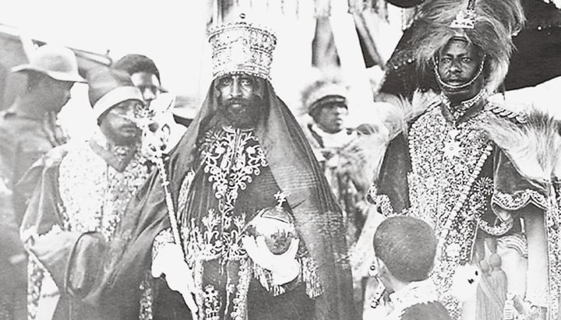
Cannabis American History
. The history of cannabis cultivation in America dates back to the early colonists, who grew hemp for textiles and rope. Political and racial factors in the 20th century led to the criminalization of marijuana in the United States, though its legal status is changing in many places now.
.

Slide 4
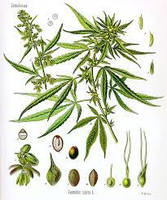
The plant
Cannabis as .
Three species sativa, indica, and ruderalis.
The flower, or bud, is the smokable, trichome-covered part of a female plant.
Flower is the most popular form of cannabis since it can be consumed in a variety of ways, smoked in a joint, vaporized in a vaporizer, or incorporated into edibles.
THC is the substance that's primarily responsible for the effects of marijuana on a person's mental state.

Slide 5

The law
A century after becoming the first U.S. state to criminalize recreational cannabis in 1911, Massachusetts voters elected to legalize it in 2016.
Legality
Recreational marijuana is regulated and taxed but legal in Massachusetts, with retail sales from licensed dealers becoming legal on November 2018.

Slide 6

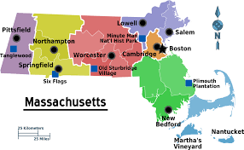
Data resources
So I gather Data from cannabis control commission of massachusetts why them ?
Because the only available source information is the gouvernement, I have never see in my entire life an Illegal business, with receipt and declaring taxes to the government knowing that.
This is real Data about our actual Weed market in USA,

Slide 7
Hypothesis
Is it still worth it to open a Marijuana business in 2023 ?

