Slide 1

bioinformatics.ca
bioinformaticsdotca.github.io

Slide 2
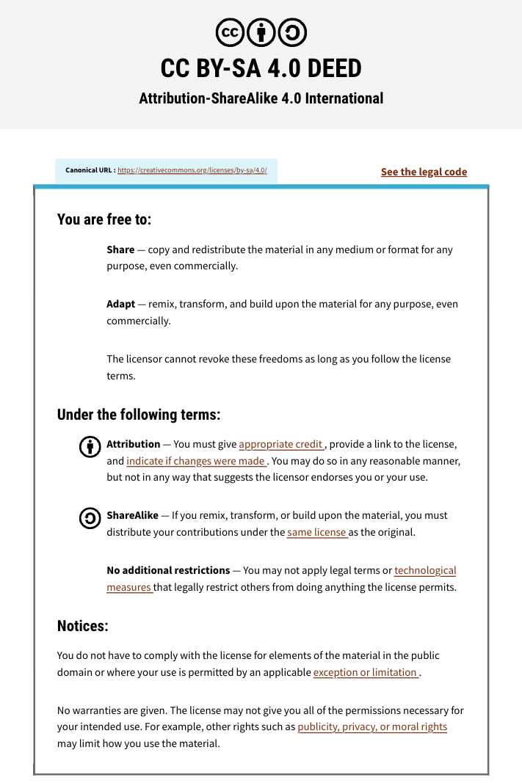

Slide 3
Introduction to R
1
Getting Started
Help
Packages
RStudio
2
Data
types
Atomic classes
Data structures
Operators
3
Control
Structures
Functions
If statement
for loop
4
Basic data manipulation
Read & Write
Basic data frame operations
5
Advanced data
Manipulation
dplyr
tidyr
stringr
6
Generating
Outputs
Graphics
ggplot2
RMarkdown
Templates

Slide 4


But first…. Introductions
Notes:
Who am I
What I do
Depending on size of the crowd go around and get people to introduce themselves. Ask people experience with coding.

Slide 5



Module 1: Getting Started
Maximiliane Jousse
INTRODUCTION TO R
October 1st-2nd, 2025

Slide 6
Learning Objectives
Downloading workshop materials
Why R?
Downloading R, R Studio
R Basics
Installing and loading packages

Slide 7

Downloading Workshop Materials
1. Go to workshop page
https://github.com/bioinformaticsdotca/IntroToR
2. Click on
3. Choose

Slide 8
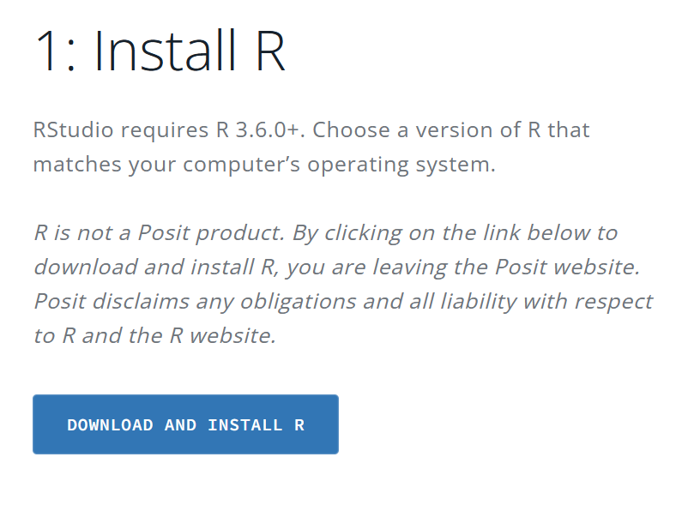
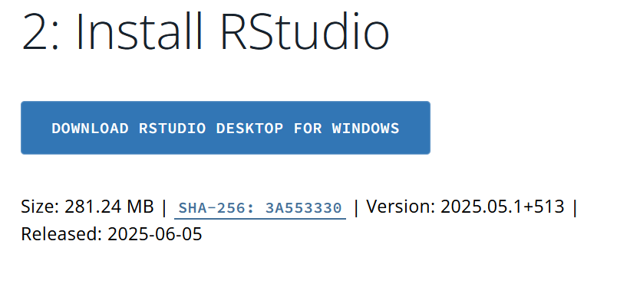
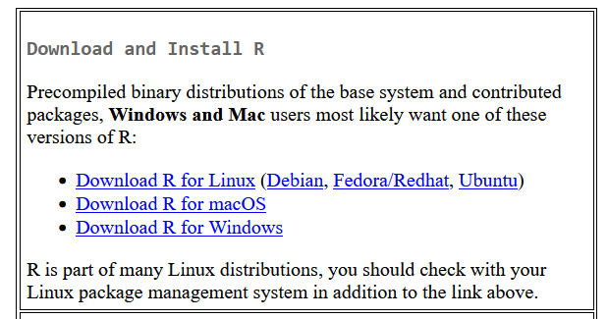
Downloading R, R studio
https://posit.co/download/rstudio-desktop/
Note we want R version ≥ 4
https://cran.rstudio.com/

Slide 9

Why R?
Statistical programming language
Allows for repeatable, reproducible, and automated coding
Open source
Integrated suite for data manipulation, analysis, and graphical visualization
Functionality easily extended with packages
Notes:
Ask people what motivated them to join the workshop ☺
Why I use R

Slide 10

R and R studio
R is the programming language (Developed at the University of Auckland)
RStudio is an Integrated Development Environment (IDE) (developed by Posit) i.e. A Graphical User Interface software to develop and execute R code

Slide 11
R Basics
Possible files
No spaces allowed in variable names
Case sensitive
1 based indexing
.R ‘Script’
.Rmd ‘R Notebook’
.Rproj ‘R Project’
.qmd ‘Quarto Notebook’
.ipynb ‘Jupyter Notebook’
Notes:
Scripts v notebooks

Slide 12
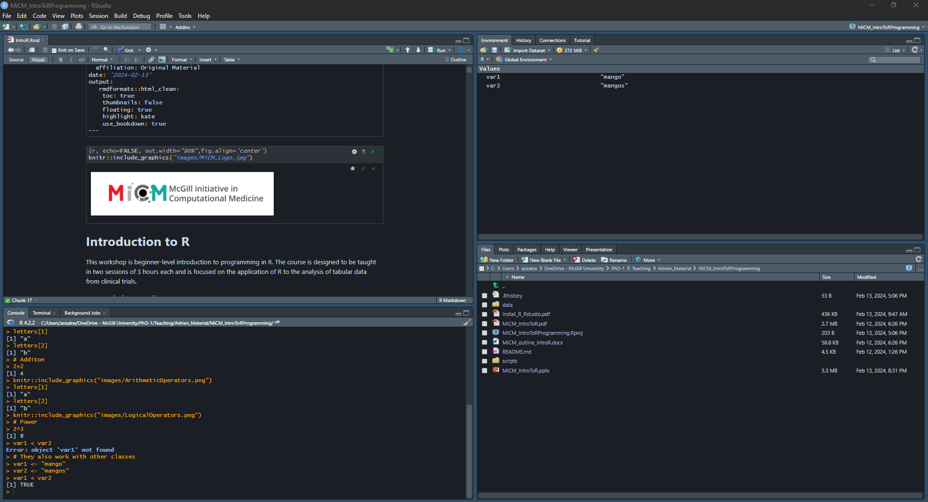
Source Pane
Environment Pane
Console Pane
Files/Plot/Help Pane

Slide 13

Practice
Notes:
Opening R

Slide 14
Module 2: Data Types & Structures
Maximiliane Jousse
INTRODUCTION TO R
October 1st-2nd, 2025

Slide 15
Learning Objectives
Understand the differences between classes, objects and data types in R
Create objects of different types
Subset and index objects
Learn and use vectorized operations

Slide 16
Atomic Classes Also called data types
Character | A,b,c,d,e,..
Numeric (real numbers) | 1.00,2.00,… Inf, NaN
Integer | 1L,2L,3L,4L,….
Complex | 2i
Logical (True/False) | TRUE,FALSE
Missing Value | NA

Slide 17
Arithmetic operators
Addition | +
Subtraction | -
Division | /
Power | ^
Scalar multiplication | *
Matrix multiplication | %*%

Slide 18
Syntax operators
Comment line | #
Assignation | <-
Access content | $
Equal | =

Slide 19
Logical operators
Equal | ==
Not equal | !=
Greater than | >
Greater than or equal to | >=
Less than | <
Less than or equal to | <=
contains | %in%
x AND y | x & y
x OR y | x | y
NOT x | !x

Slide 20
Objects Also called data structures
Vector | Only elements of the same class | 1D
List | Elements of any class | 1D
Factor | Categorical data | 1D
Matrix | Elements of the same class | 2D
Data frame | Elements of multiple classes | 2D
NULL | Empty object | -

Slide 21
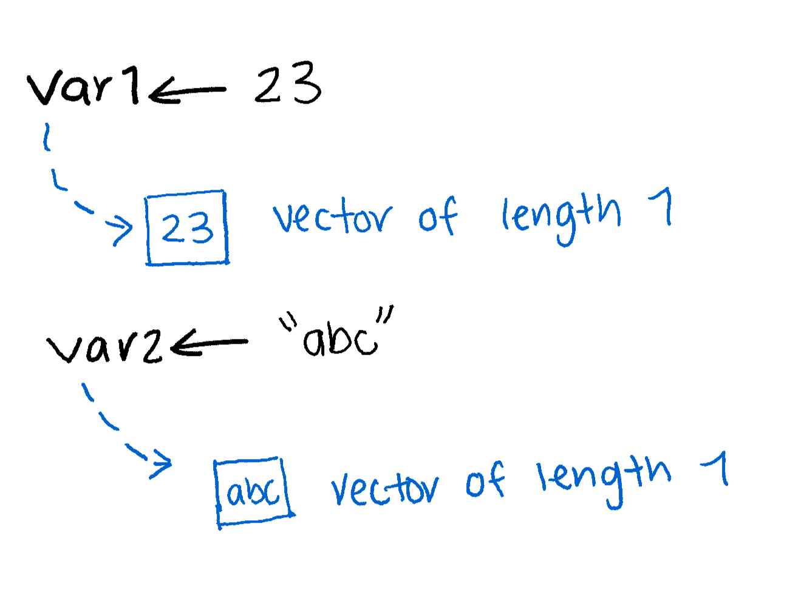
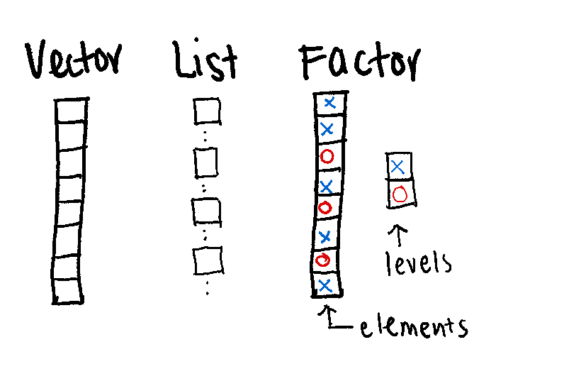
Vectors
Can only contain objects of the same class
Most basic type of R object
Variables are vectors
length 8
element
Notes:
Recap: what are the data types inside of var1, var2

Slide 22
Factors
Implicit order
Each element has a label or level
They are important in statistical modelling and plotting with ggplot
Order
Notes:
Recap: what are the data types inside of var1, var2

Slide 23
Lists
Can contain objects of multiple classes
Very important data type in R
Can easily combine with built in functions
Note elements of a list are vectors, and can have a length ≥ 1.

Slide 24
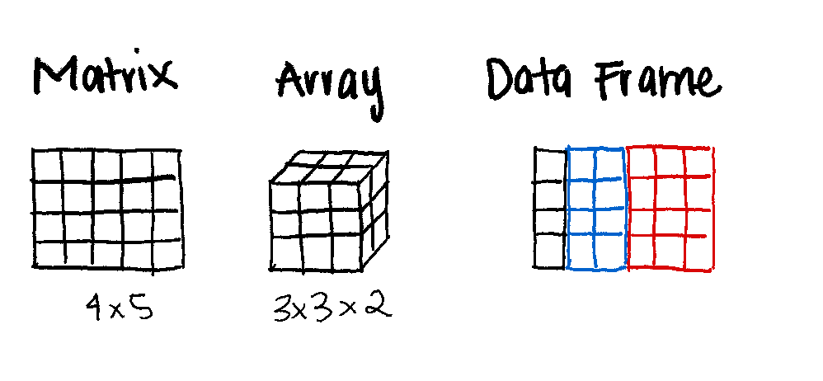
Multiple dimensions
One data type
Multiple data types

Slide 25
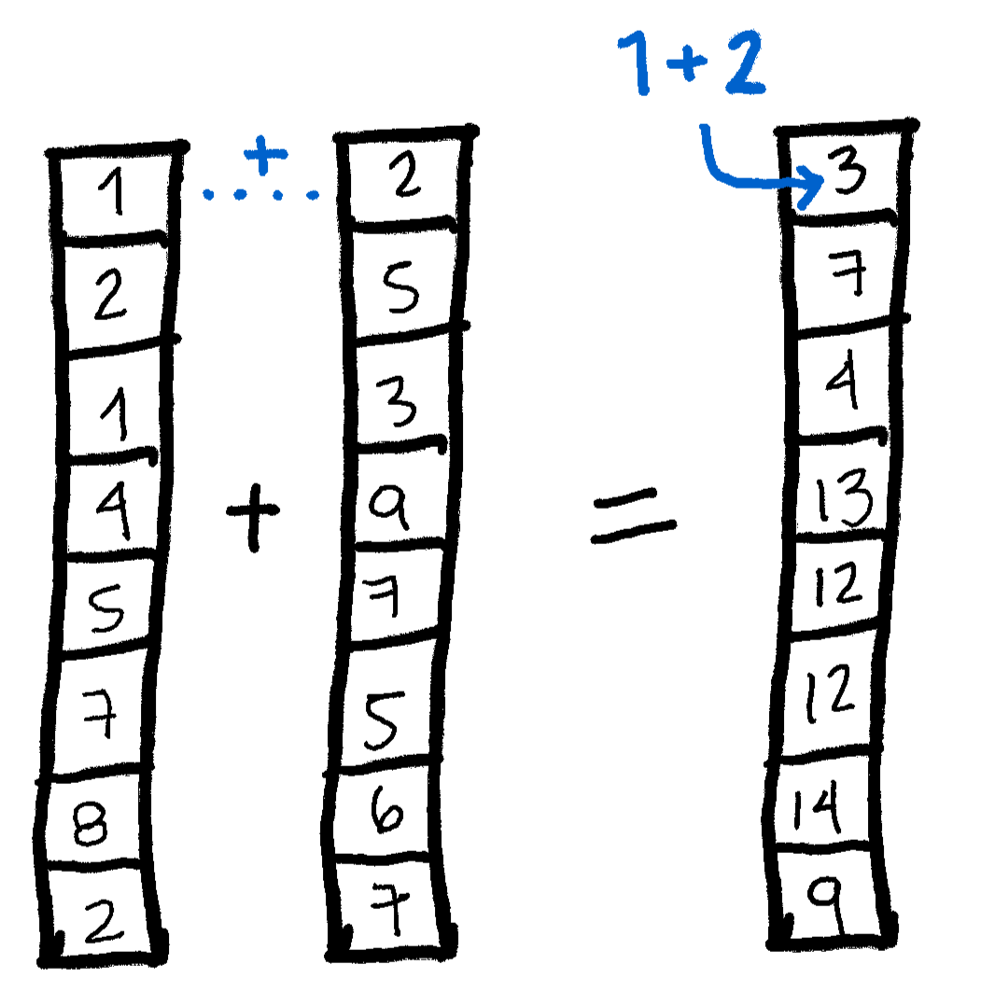
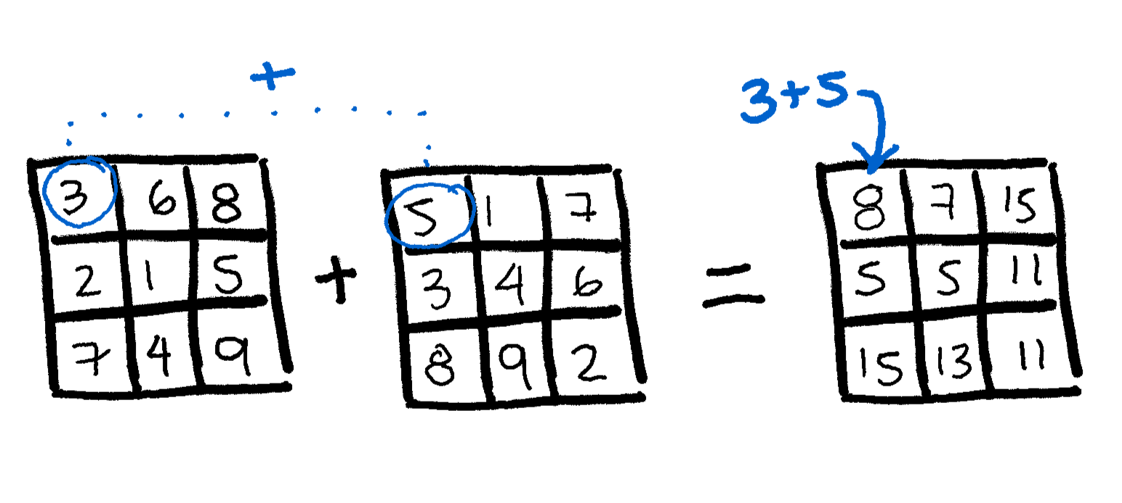
Vectorized operations
… as opposed to matrix operations, also possible!
Notes:
Recap: what are the data types inside of var1, var2

Slide 26
Practice

Slide 27
Module 3: Control structures and functions
Maximiliane Jousse
INTRODUCTION TO R
October 1st-2nd, 2025

Slide 28
Learning Objectives
Functions
If….Else
For loop
While loop
Creating new functions
Packages

Slide 29
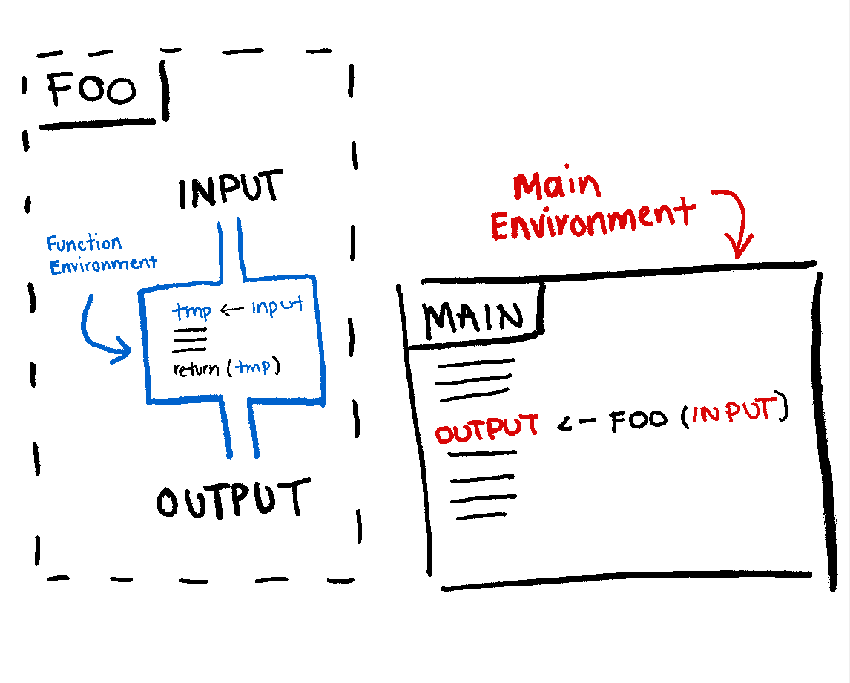
Functions

Slide 30
Pass by value and scope
When we pass an object to a function, a copy of it is created internally
The changes made inside the function won’t modify the original object we passed to it
Any variables created inside the function will only exist during the function’s execution time

Slide 31
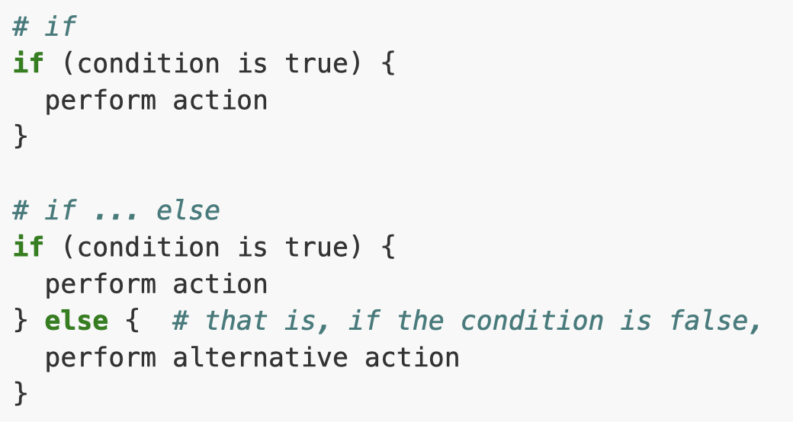
Conditional statements
When we want a set of actions to be executed only if certain conditions are met
https://swcarpentry.github.io/r-novice-gapminder/07-control-flow

Slide 32
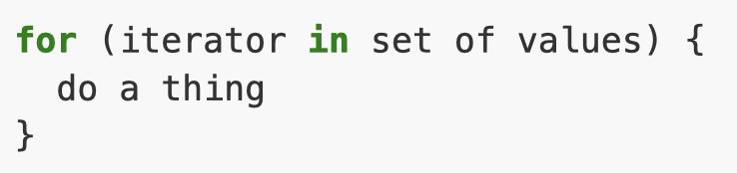
For loop
Repeat a set of operations a certain number of times
https://swcarpentry.github.io/r-novice-gapminder/07-control-flow

Slide 33

While loop
Repeat a set of operations until a condition is no longer met
https://swcarpentry.github.io/r-novice-gapminder/07-control-flow

Slide 34
Going beyond Base R:
Create new functions
Use Packages, which provide a way to incorporate methods and functions from
Notes:
Create new functions -> we will see in the practical!

Slide 35
Packages
Packages are a way for users to share methods they have developed
Incorporate novel methods, datasets, or visualization tools
Downloaded from many places:
Comprehensive R Archive Network (CRAN)
Bioconductor
GitHub, Bitbucket etc.
Notes:
- How reliable are they

Slide 36
Practice

Slide 37
Module 4: Basic Data Manipulation
Maximiliane Jousse
INTRODUCTION TO R
October 1st-2nd, 2025

Slide 38
Learning Objectives
Learn how to read/write data to/from files with different formats (.tsv, .csv)
Familiarize with basic operations of data frames
Index and subset data frames using base R functions
Manipulate specific data frame columns
Adding columns and rows

Slide 39
Practice

Slide 40
Module 5: Advanced Data Manipulation
Maximiliane Jousse
INTRODUCTION TO R
October 1st-2nd, 2025

Slide 41
Learning Objectives
Become familiar with the dplyr syntax
Create pipes with the operator %>%
Perform operations on data frames using dplyr and tidyr functions
Use joins
Implement functions from other external packages

Slide 42
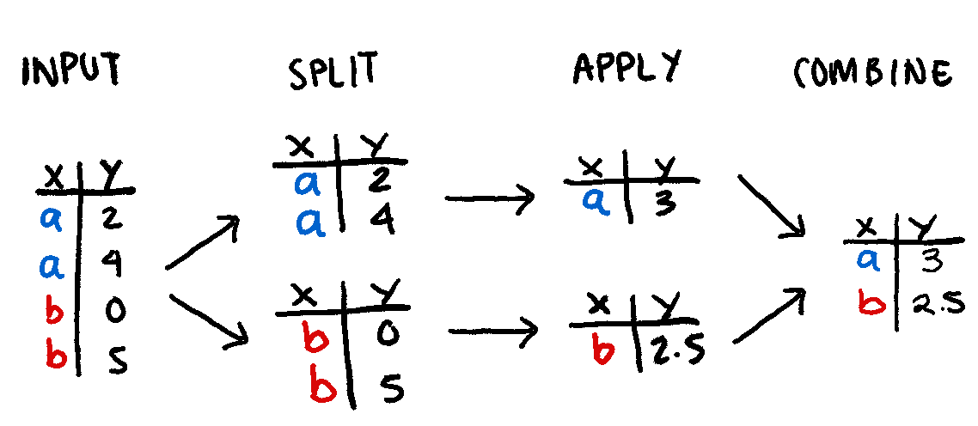
Split-Apply-Combine problem

Slide 43
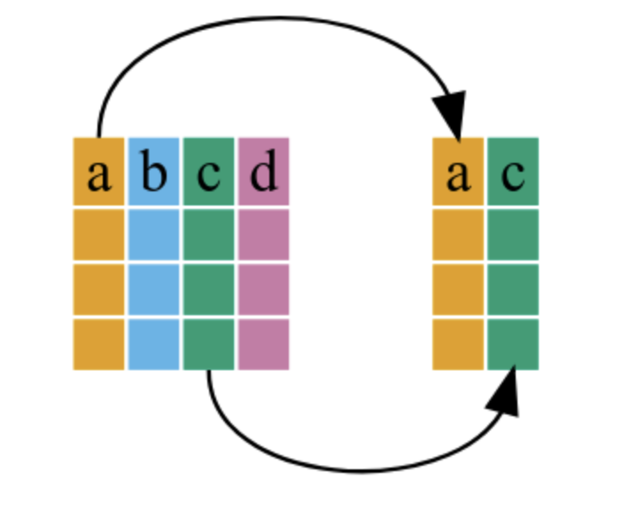
Select
https://swcarpentry.github.io/r-novice-gapminder/13-dplyr/index.html

Slide 44
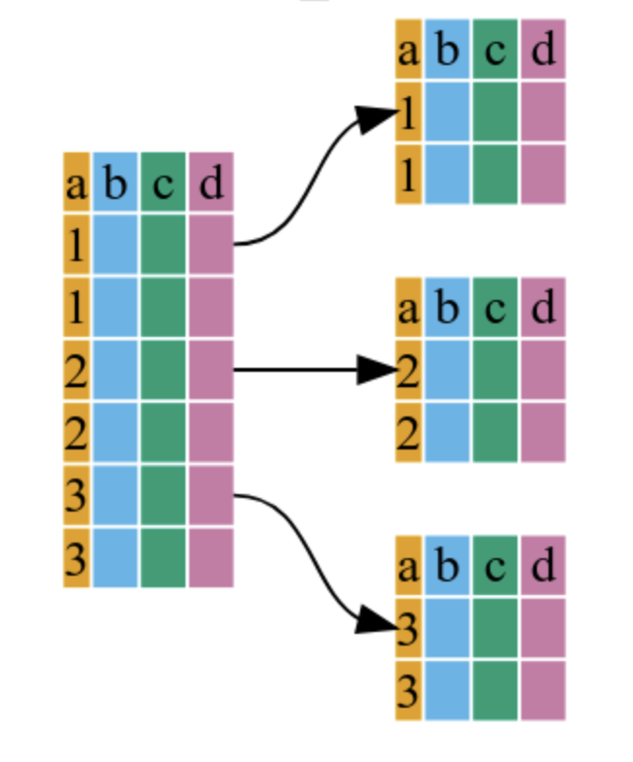
Group by
https://swcarpentry.github.io/r-novice-gapminder/13-dplyr/index.html

Slide 45
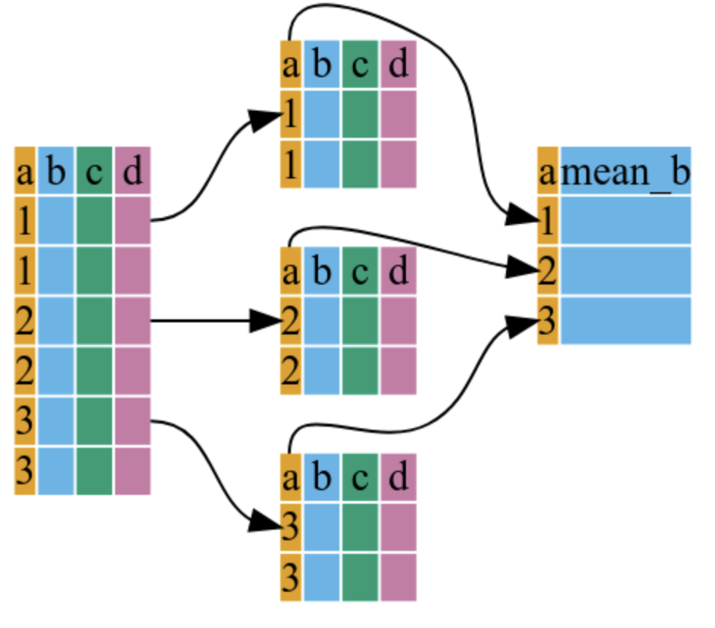
Summarize
https://swcarpentry.github.io/r-novice-gapminder/13-dplyr/index.html

Slide 46
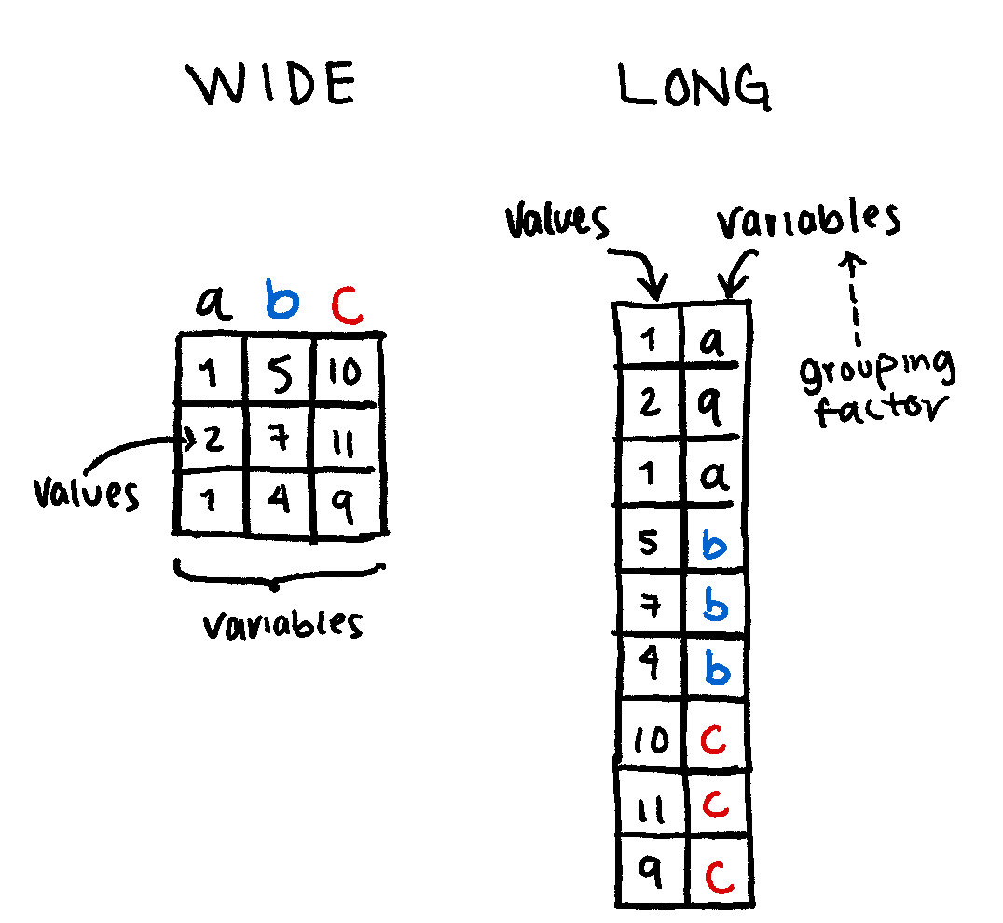
Formatting data with Tidyr

Slide 47
Practice

Slide 48
Module 6: Generating Outputs
Maximiliane Jousse
INTRODUCTION TO R
October 1st-2nd, 2025

Slide 49
Learning Objectives
Create basic plots using base R functions
Understand the connection between data frames and ggplot2
Create basic graphs with ggplot2

Slide 50
Practice

Slide 51








Coffee Break & Networking Session
Workshop Sponsors

