Slide 1
Notic
I will speak Korean
So, No Question please

Slide 2

Fuzzer With SQLite3
MinJung Jo (2023002484)
Kyungpook National University (KNU), Daegu, Republic of Korea
2023.06.20

Slide 3
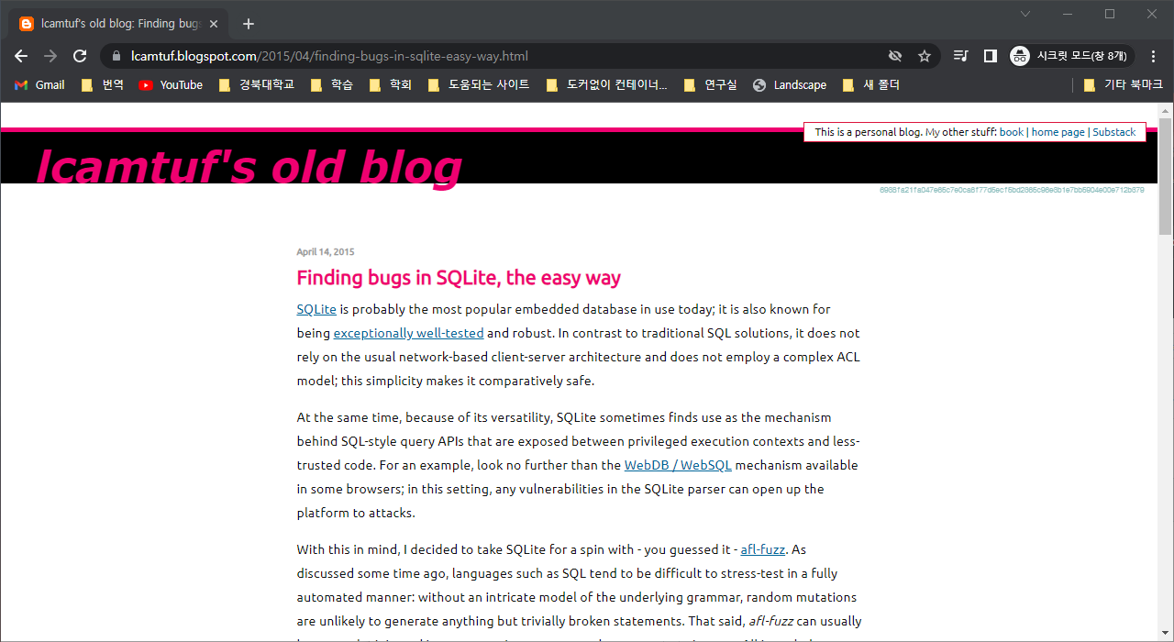
Motivation
I am parsing the SQL syntax and fuzzing the syntax errors, and Coverage
Reference

Slide 4

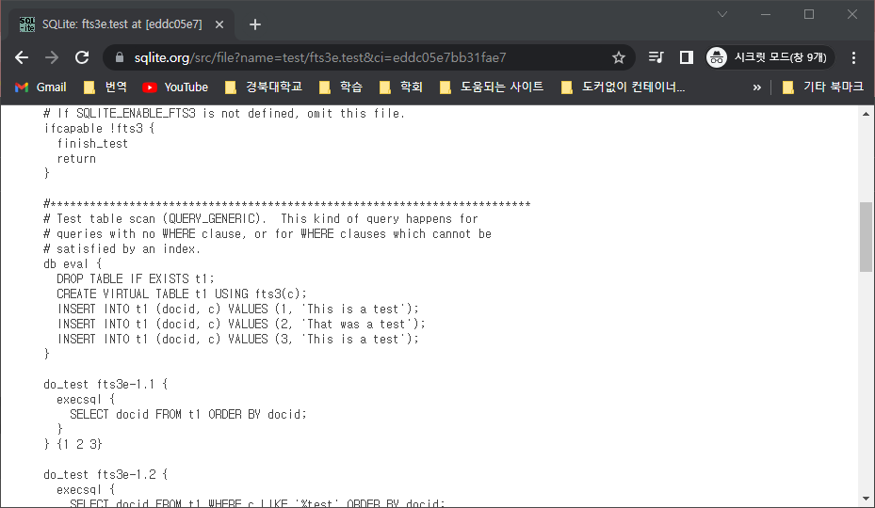
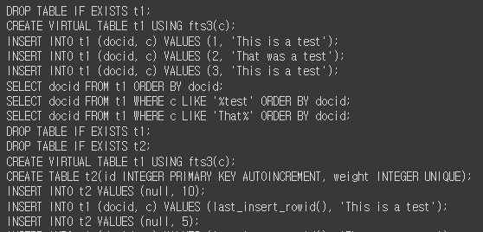
Target system
SQLite3 Syntax
Base SQLite Test Code

Slide 5
Target system
SQLite3 Syntax
I will use "sqlparse" to parsing SQL Syntax
"sqlparse“ is a non-validating SQL parser for Python. It provides support for parsing, splitting and formatting SQL statements.
Base SQLite Test Code

Slide 6
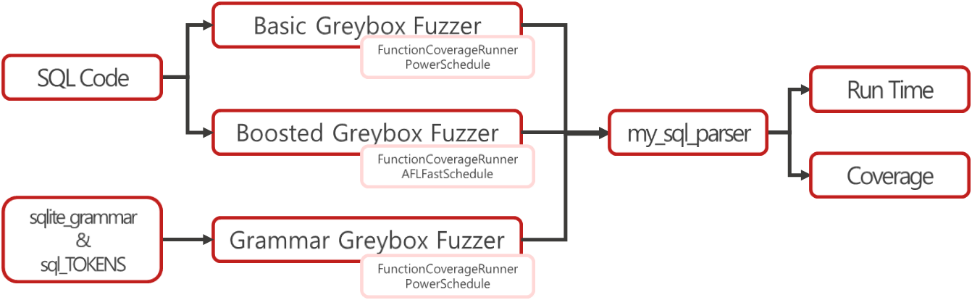
Architecture

Slide 7
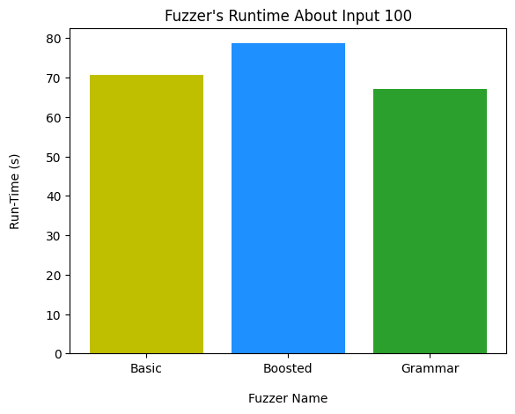
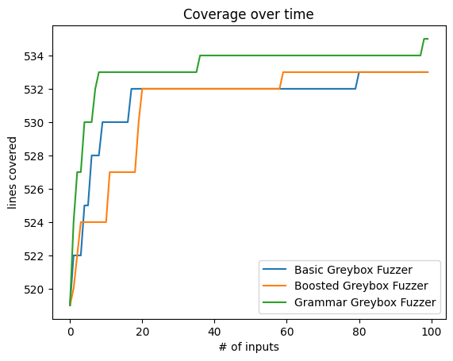
Result
Runtime
Coverage

Slide 8
Source
https://github.com/MJung-Jo/Learning-Fuzzing/tree/main

Slide 9
The End
MinJung Jo (2023002484)
Kyungpook National University (KNU), Daegu, Republic of Korea
2023.06.20

