Slide 1
Creating user persona
SDLC – Requirements Gathering

Slide 2
Why Use a persona?
Definition: A persona is an example of fictitious users that represent groups of potential users of your system
Helps in understand point of view of users and those interacting with your system including:
Needs and Expectations
Experiences
Behaviours
Goals
Summarised on one page

Slide 3
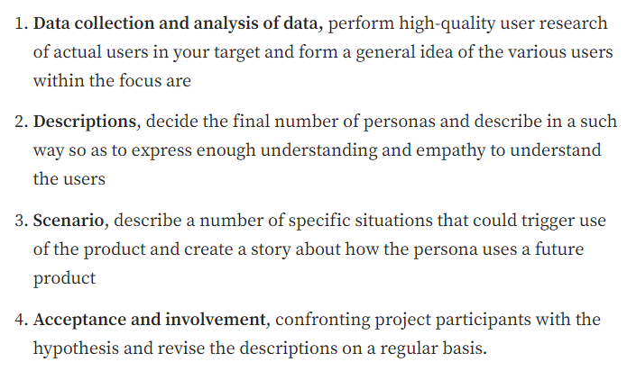
Defining a persona

Slide 4
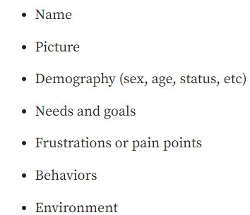
7 parts of a persona

Slide 5
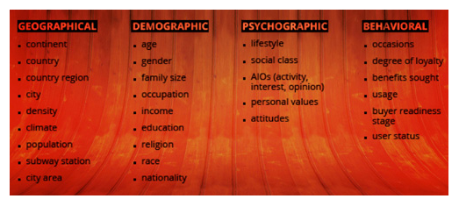
Identifying your users
Segmentation

