Slide 1
Functional and Non Functional Requirements

Slide 2
Functional Requirements

Slide 3
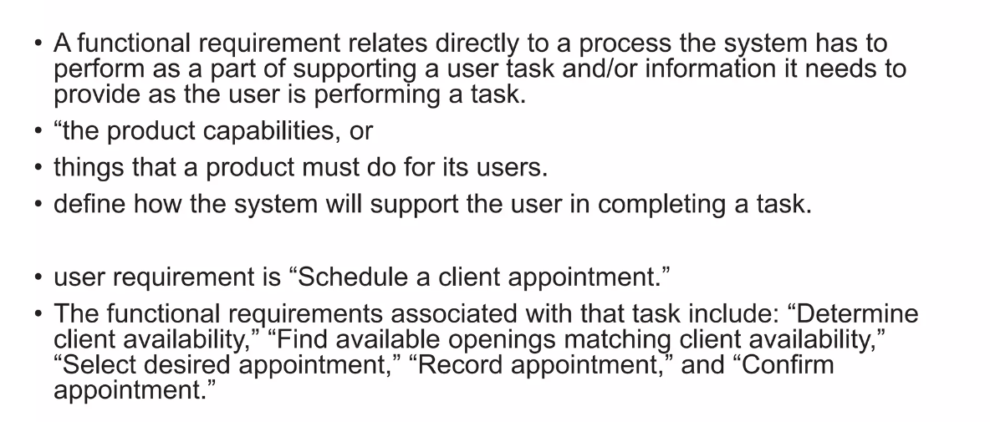
Functional Requirements

Slide 4
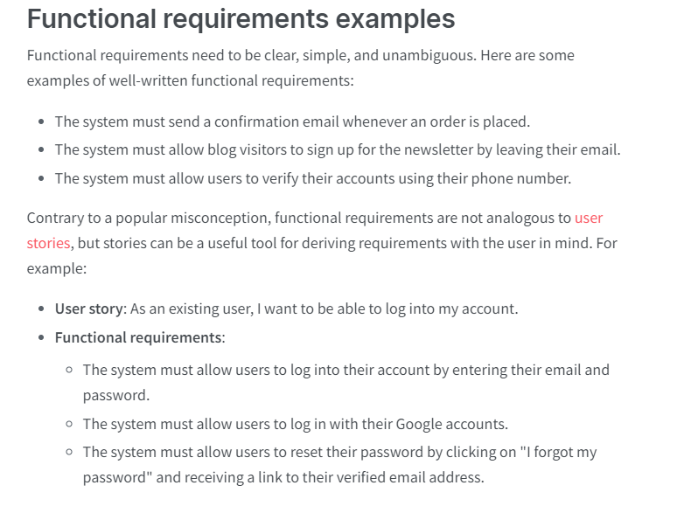

Slide 5
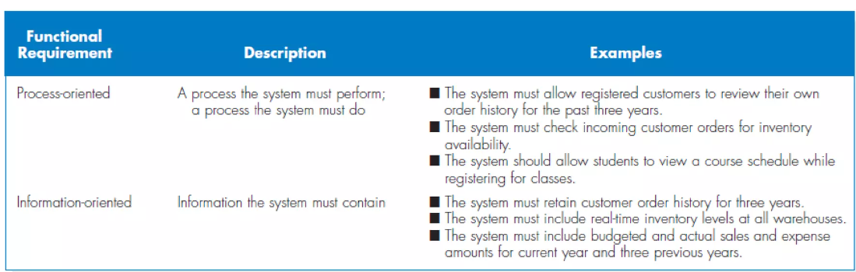
Functional Requirements Examples 2

Slide 6
Non-Functional Requirements (NFR)

Slide 7
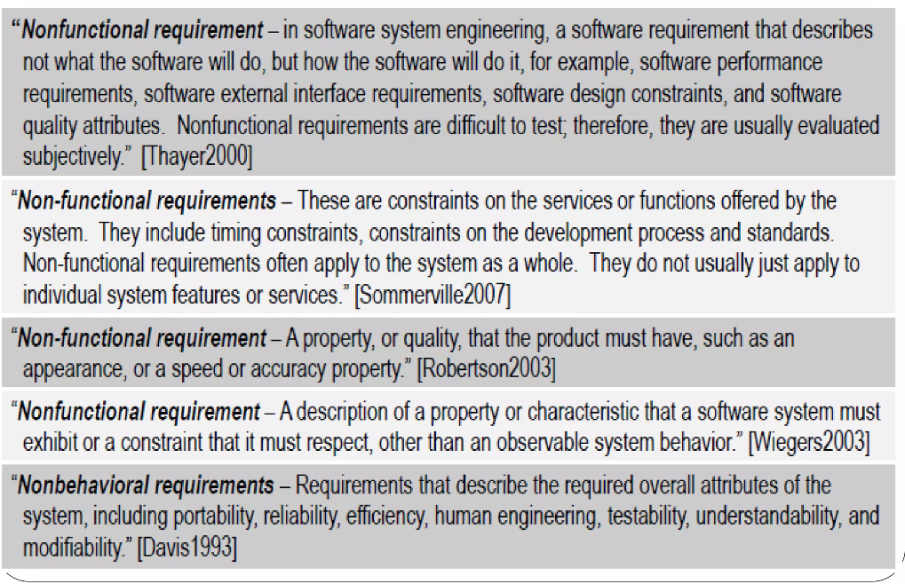
Definitions

Slide 8
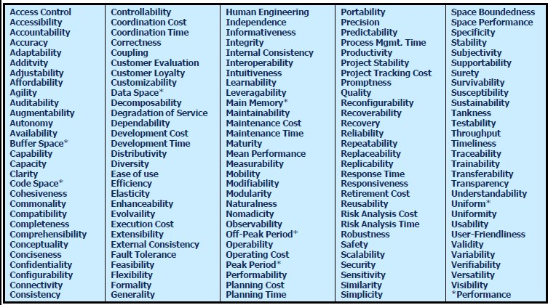
Classification of NFRS

Slide 9
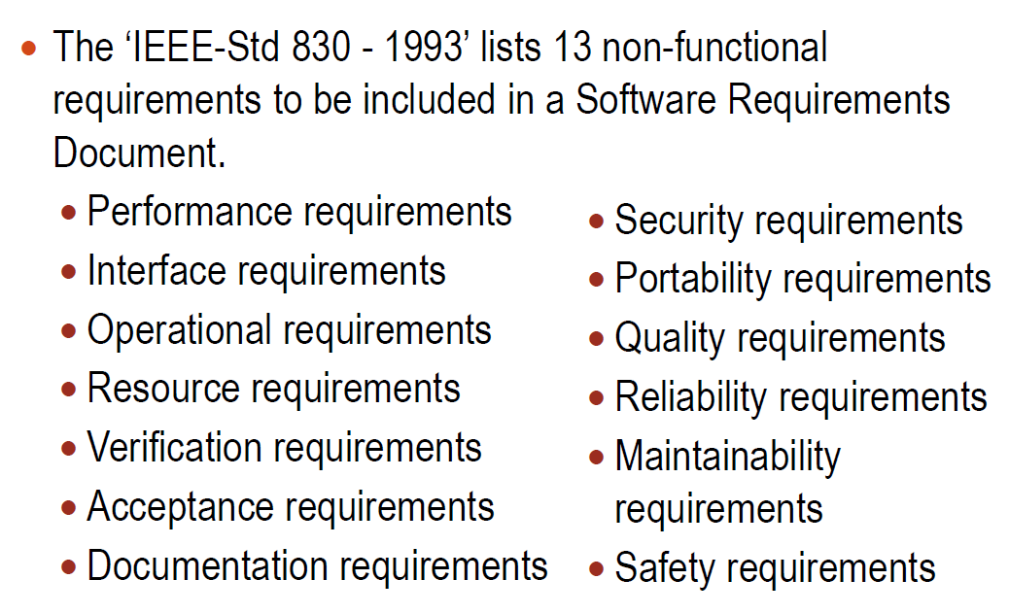
Classification of NFRS

Slide 10
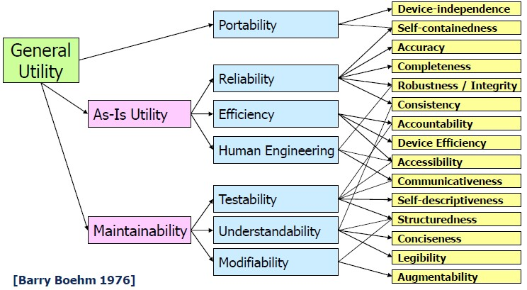
Classification of NFRs…
Different ways classifying NFRs have been proposed
NFRs may be classified in terms of qualities that a software must exhibit (Boehm)

Slide 11
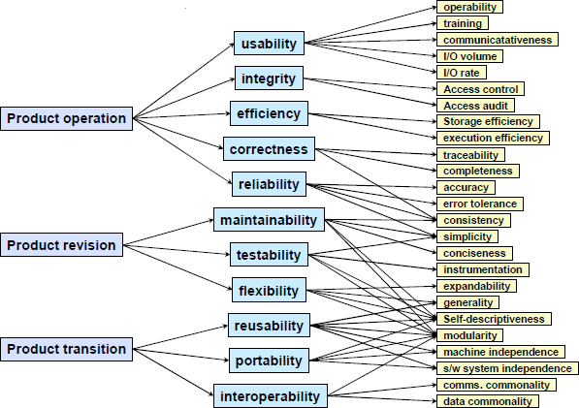
Classification of NFRs…
McCall [1977]
McCall factor model is user centred classification
McCall [1977]

Slide 12
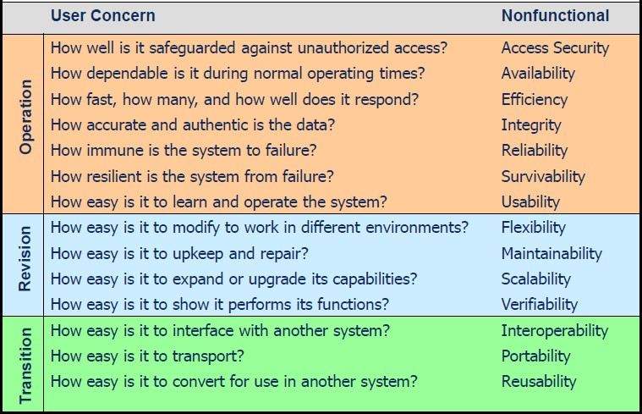
Classification of NFRs…
McCall factor model is derived from user concerns

