Slide 1
OSP Task 1: Analysing the problem and designing a solution

Slide 2
Task 1A Research
1a. Research In preparation for developing a solution, you should carry out research to explore existing or potential solutions. You should consider the functionality of these existing solutions and whether or not they would meet the needs of the project brief. Your research should also allow you to investigate the legal and regulatory considerations that are applicable to the context and environment of the project brief. Any notes produced in this research should be submitted as an appendix. You will then use this research to create a detailed proposal.

Slide 3
Task 1B Proposal
You should produce a proposal which:
1. Introduces the business context
2. Identifies and clearly defines the problem
3. Defines the functional and non-functional requirements of the solution
4. Defines the key performance indicators (KPIs) of the solution
5. Justifies how the recommended solution meets the needs of the clients and users
6. Justifies the potential risks and how these will be mitigated
7. Describes in detail the proposed solution
8. Describes how relevant regulatory guidelines and legal requirements in relation to software development will be addressed

Slide 4
Task 1C Design Documentation
1c. Design documentation Your design documentation should clearly explain and illustrate the proposed solution. The design documentation should include: ● Interface designs ● Algorithm designs ● Test strategy
Your design documentation should allow the client to have a strong understanding of the proposed solution and be able to make informed decisions about the future development of the solution. Your design documentation should also communicate the proposed solution in a way that is suitable for both technical and non-technical audiences. Your design documentation should be clear enough that it could be passed on to a thirdparty developer or design team in order to implement the solution. Your test strategy should include plans for functional and non-functional testing and identify a range of appropriate test data.

Slide 5
Task Summary
In summary, there are three subtasks in Task 1:
1a. Research to explore existing and possible solutions (in an appendix for the proposal)
1b. Proposal (presented as a document that has clear headings for each area)
1c. A set of design documents that includes a test strategy

Slide 6
Task 1A Research
Project Scenario Research Ideas:
Understanding the Context of the Problem:
Research the specific industry or domain described in the scenario (e.g., education, healthcare, or retail).
Investigate typical challenges faced by users in the identified context and common digital solutions implemented to address them.
Digital Product Design and Development:
Study user-centered design (UCD) principles to ensure the solution aligns with user needs.
Explore methodologies like agile or waterfall for managing project development cycles.
Relevant Technologies and Tools:
Research software tools and platforms relevant to the project requirements (e.g., web development frameworks, mobile app tools).
Investigate APIs, libraries, or integrations that can enhance the digital solution (e.g., third-party payment systems or data visualization tools).
Data Handling and Privacy:
Explore best practices for data collection, storage, and processing to comply with regulations like GDPR.
Study methods for securing user data in digital applications.

Slide 7
Task 1A Research
Business Need Research Ideas
Client/User Requirements:
Research strategies for conducting stakeholder analysis to understand business objectives and constraints.
Study examples of successful digital solutions created for similar business needs and their impact.
Market Research:
Investigate trends and innovations in the target market or industry.
Explore competitive analysis methods to position the digital product effectively.
Cost-Benefit Analysis:
Research methods for assessing the cost-effectiveness of different technological solutions.
Explore ways to demonstrate return on investment (ROI) for a proposed digital solution.
Sustainability in Digital Products:
Investigate sustainable development practices in digital production (e.g., energy-efficient coding, server optimization).
Study examples of businesses adopting sustainability in their technology solutions.
User Accessibility and Inclusivity:
Explore standards for making digital solutions accessible to diverse user groups, including those with disabilities.
Research tools and methods for testing the accessibility of digital products.

Slide 8
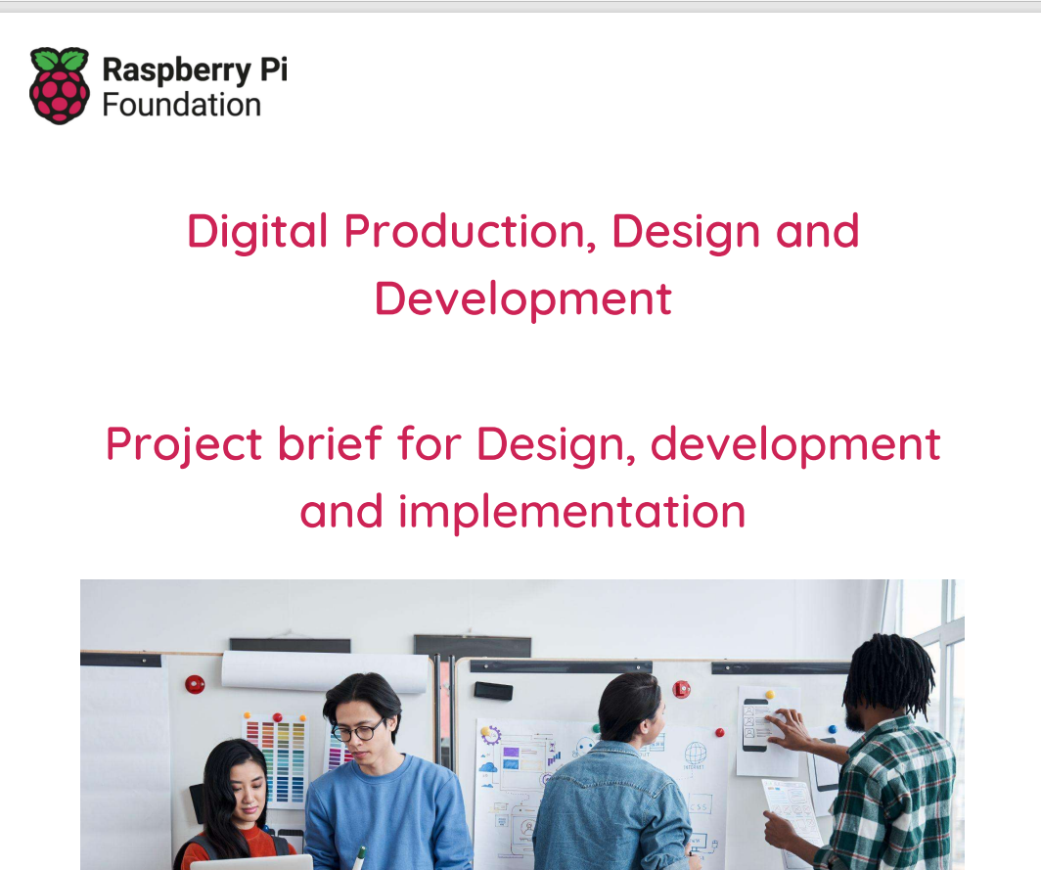
Task 1A Research
Read the project brief and start task 1A: Research
Activity A (i):
In preparation for developing a proposal for the digital solution, you have been asked to carry out research. Your research should consider how digital solutions are used to meet the needs of different users within the education sector, including:
• how hardware and software are used within the context of the industry
• newly emerging technologies
• how digital solutions could be used to meet different user needs
• the industry-specific guidelines and regulations you will need to follow.
Any notes you produce should be kept and submitted as an appendix.

