Slide 1
OSP Task 1: Analysing the problem and designing a solution

Slide 2
Task Summary
In summary, there are three subtasks in Task 1:
1a. Research to explore existing and possible solutions (in an appendix for the proposal)
1b. Proposal (presented as a document that has clear headings for each area)
1c. A set of design documents that includes a test strategy

Slide 3
Task 1B Proposal
You should produce a proposal which:
1. Introduces the business context
2. Identifies and clearly defines the problem
3. Defines the functional and non-functional requirements of the solution
4. Defines the key performance indicators (KPIs) of the solution
5. Justifies how the recommended solution meets the needs of the clients and users
6. Justifies the potential risks and how these will be mitigated
7. Describes in detail the proposed solution
8. Describes how relevant regulatory guidelines and legal requirements in relation to software development will be addressed

Slide 4
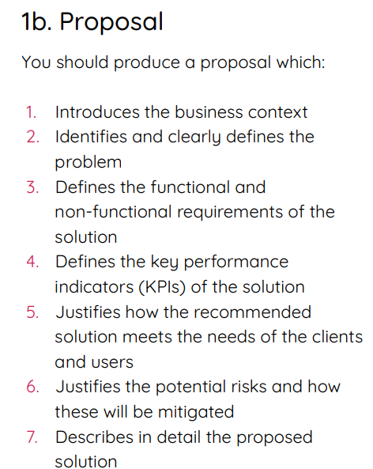
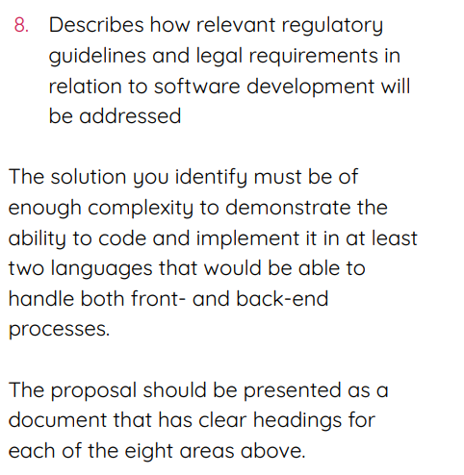
Task 1B Proposal
Read the project brief again and start task 1B: Proposal

Slide 5
Task 1b Proposal: Code Dojo Scenario
1. Introducing the Business Context
Activities:
Research the purpose of Code Dojo and its role in the community.
Identify the target audience (e.g., beginners, advanced coders).
Investigate competitors and similar coding platforms.
Ideas:
Define how the platform aims to improve coding skills.
Highlight the demand for interactive learning solutions.

Slide 6
2. Identifying and Defining the Problem
Activities:
Conduct stakeholder interviews to gather pain points.
Perform a SWOT analysis on current systems.
Ideas:
Define specific issues, such as limited engagement or lack of progress tracking.
Frame the problem as an opportunity for innovation.

Slide 7
3. Defining Functional and Non-Functional Requirements
Activities:
Create a feature list based on user needs.
Use MoSCoW prioritization to categorize requirements.
Ideas:
Functional: Progress tracking, live coding challenges.
Non-Functional: System uptime, quick response times.

Slide 8
5. Justifying the Recommended Solution
Activities:
Map features to client needs and user goals.
Conduct usability testing to validate proposed designs.
Ideas:
Emphasize how the solution aligns with stakeholder requirements.
Highlight the potential for scalability and future enhancements.

Slide 9
6. Identifying Risks and Mitigation Strategies
Activities:
Perform a risk assessment to identify potential challenges.
Develop a mitigation plan for each identified risk.
Ideas:
Risks: Technical failures, low user adoption.
Mitigation: Regular testing, targeted marketing campaigns.

Slide 10
7. Describing the Proposed Solution
Activities:
Create detailed system architecture diagrams.
Outline core features and their implementation roadmap.
Ideas:
Include visuals to describe workflows and user interfaces.
Highlight innovative features, such as adaptive learning.

Slide 11
8. Addressing Regulatory and Legal Requirements
Activities:
Research GDPR and other data protection regulations.
Ensure compliance with accessibility standards (e.g., WCAG).
Ideas:
Plan for regular audits to maintain legal compliance.
Incorporate user consent mechanisms for data collection.

